Slide 1

WEEK 03
Instructor: Yanan Wu
TA: Khadija Nisar
Spring 2025

Slide 2
2.1.1 Data visualization

Slide 3
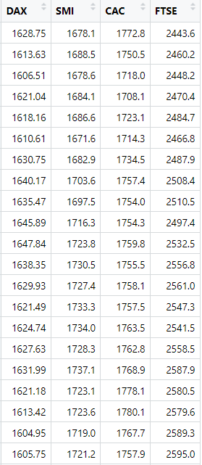
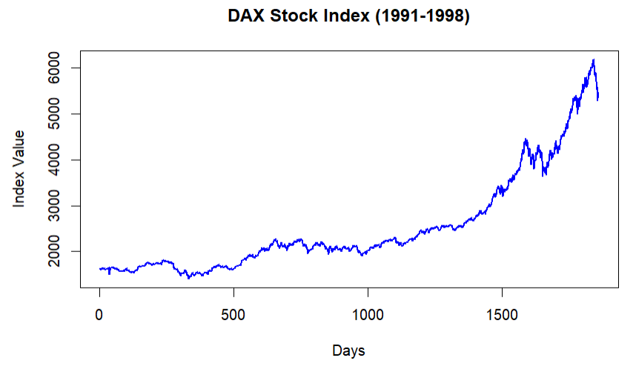
Line graph
At its core, data visualization is about turning numbers into stories — stories that people can understand, remember, and act upon. It's the bridge between raw data and human perception.

Slide 4
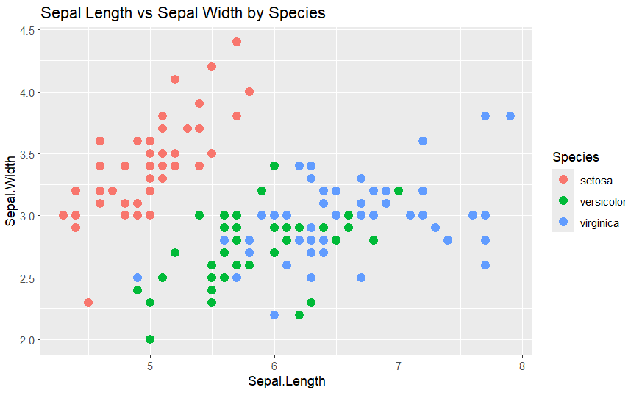



scatterplot
Scatterplots are useful for visualizing the relationship between two numerical variables. They can also incorporate a third variable through additional visual elements, such as color, size, or shape of points

Slide 5
histogram
A histogram displays data by grouping values into bins (ranges) and shows the frequency of values falling within each bin
Why Use a Histogram?
Quickly understand the overall distribution of a dataset.
Identify important characteristics, such as:
Whether the data is normally distributed.
If the data is skewed (left or right).
Gaps or clusters in the data.
The presence of outliers.

Slide 6
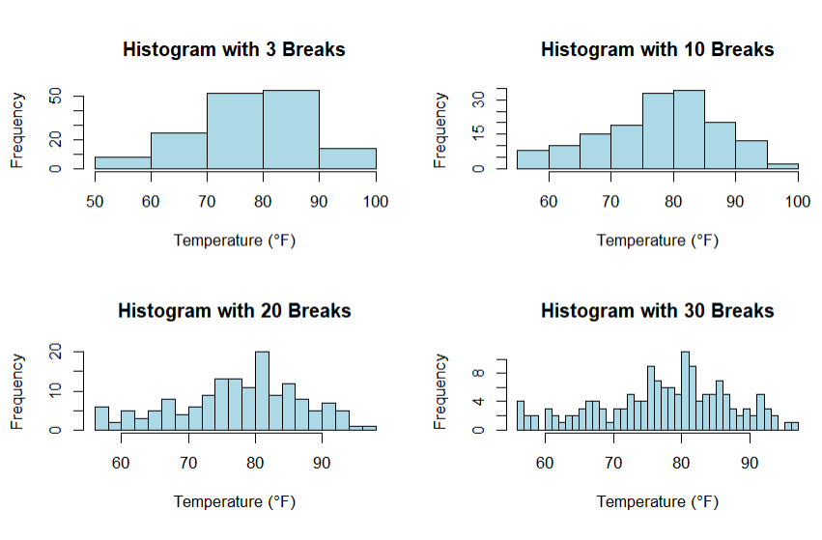
What does the distribution of variable tell us?
Identify the reasonable range of values?
Highlights the most frequency occurring values?
Which one(s) of these histograms are informative? 🤔

Slide 7
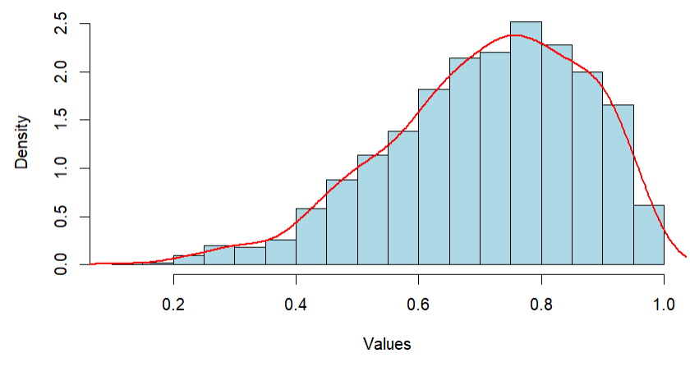
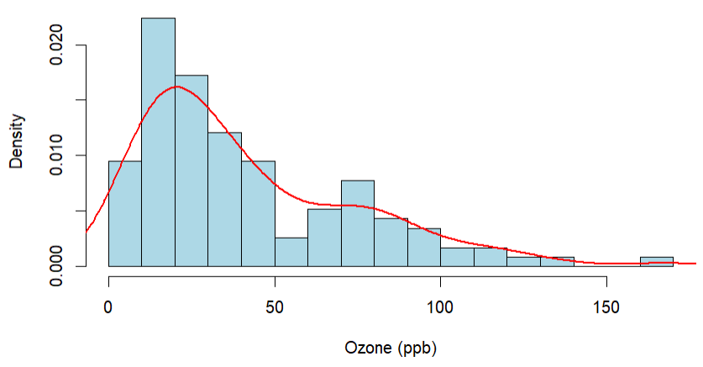
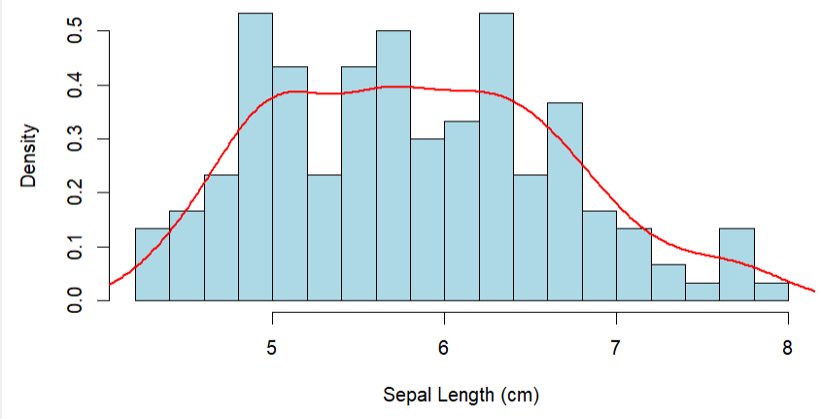
Shape of distribution: skewness
What does the distribution of variable tell us?
The spread and central tendency of the distribution
Is the histogram right skewed, left skewed, or symmetric?

Slide 8
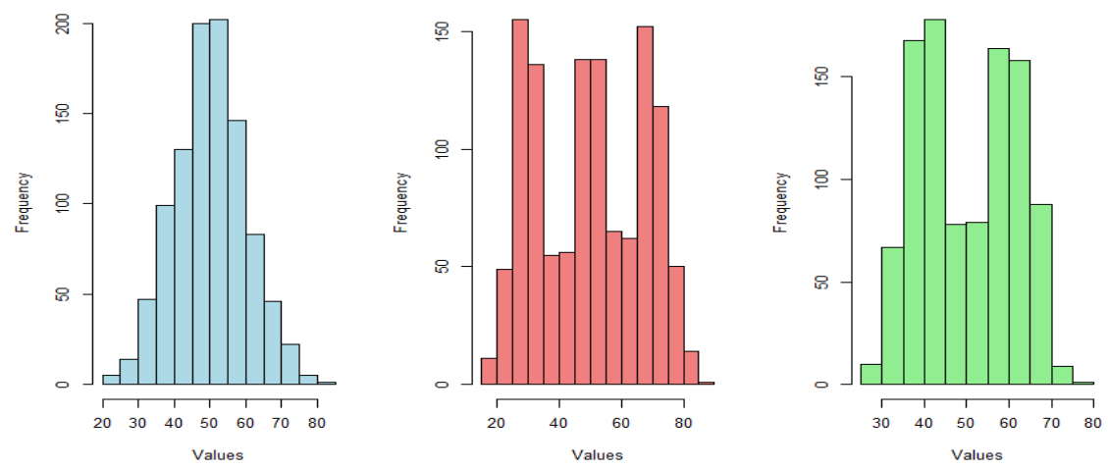
Shape of distribution: modality
Modality describe the number of meaningful cluster of observation

Slide 9
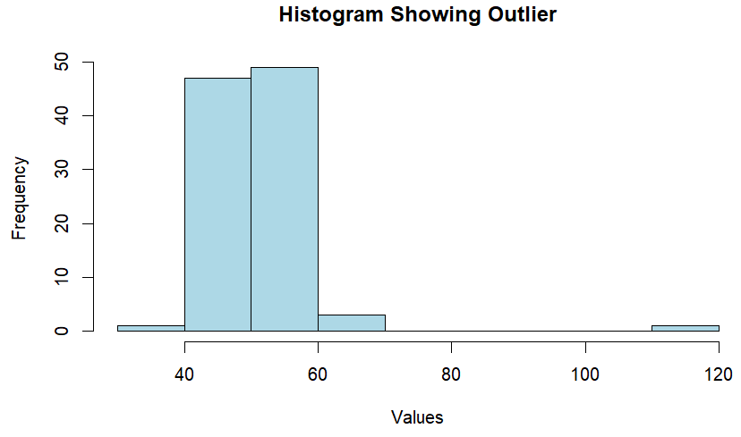
Shape of distribution: outlier
What does the distribution of variable tell us?
Detect outliers or unusual observations compared to the rest of the sample

Slide 10
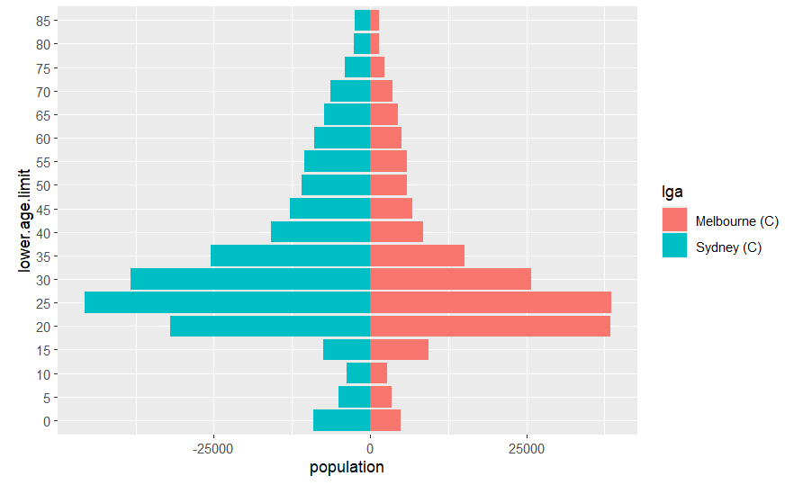
SIDE-BY-SIDE HISTOGRAM
A side-by-side graph is a comparative visualization technique used to display two related data sets next to each other, making it easier to compare values across different categories or groups

Slide 11
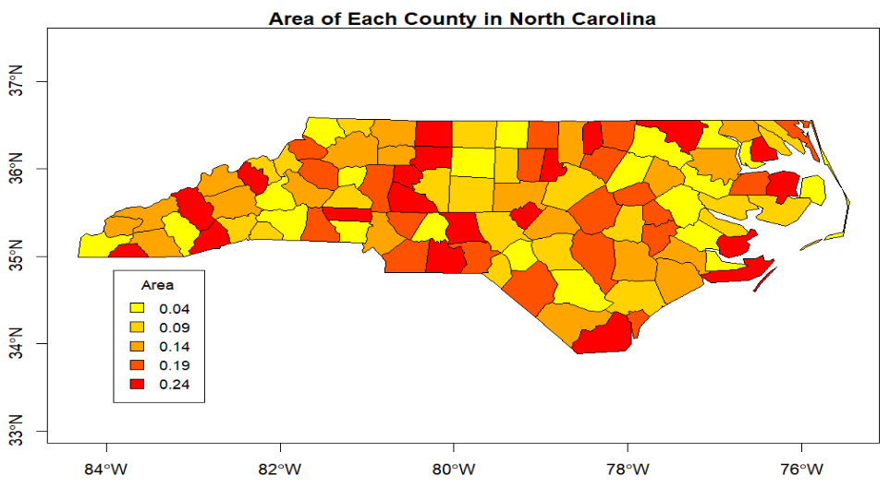
Spatial data
Gradient continuous map theme

Slide 12
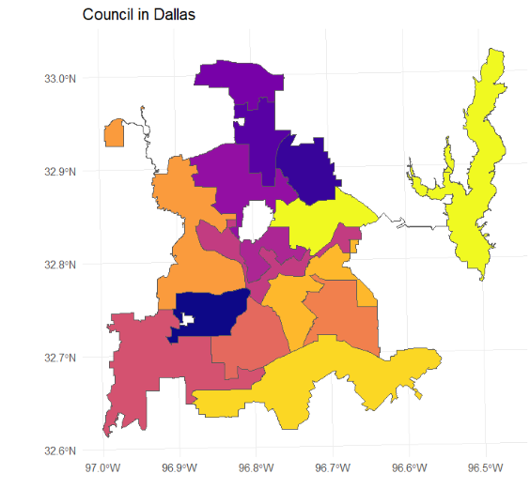
Spatial data
Categorical map theme

Slide 13
2.1.2 univariate variable distributions

Slide 14
Data description
Describing the distributions of a variable is a very import steps of any data analysis.
The distribution or shape of a univariate distribution can have substantial impact on the outcome of statistical analysis.
For example, skewness data may influence the outcome of statistical analysis and parameter estimations.
Most methods assume the variables are symmetric and normally distributed.
Why do normal distribution matter?
Parameter estimation: Most parametric models estimate parameters (mean, variance) based on the assumption that the data follows a normal distribution.
Hypothesis testing: Tests like t-tests and ANOVA require normal distribution to calculate valid p-values.
Inference: For methods like linear regression, normally distributed residuals are important for making accurate predictions.

Slide 15
normality
The normal distribution is a bell-shaped curve that represents a continuous probability distribution with the highest density of observations clustered around the mean.
As you move farther from the mean in either direction, the frequency of observations gradually decreases, resulting in symmetry about the center.
The distribution is fully characterized by two parameters: the mean (μ), which determines the central location of the curve, and the standard deviation (σ), which controls the spread or dispersion of the data.

Slide 16
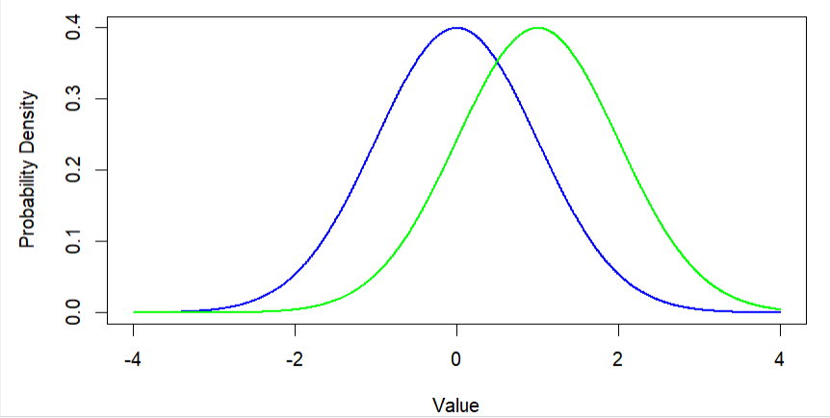
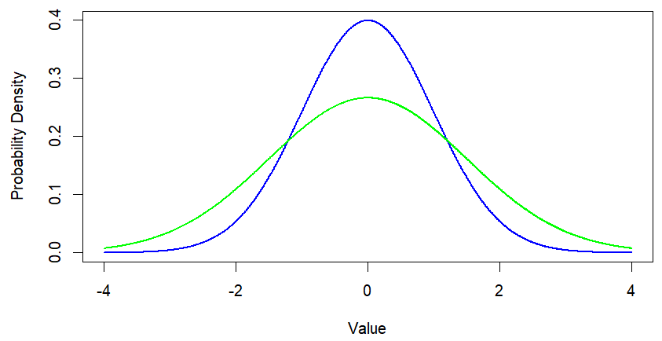
Which graph shows curves with the same mean but different standard deviations?
Which graph shows curves with the same standard deviation but different means? 🤔

Slide 17
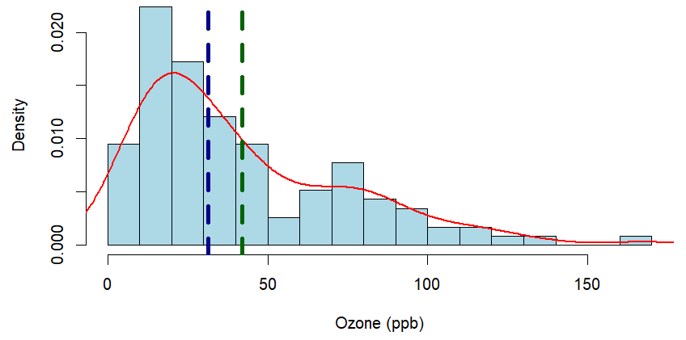
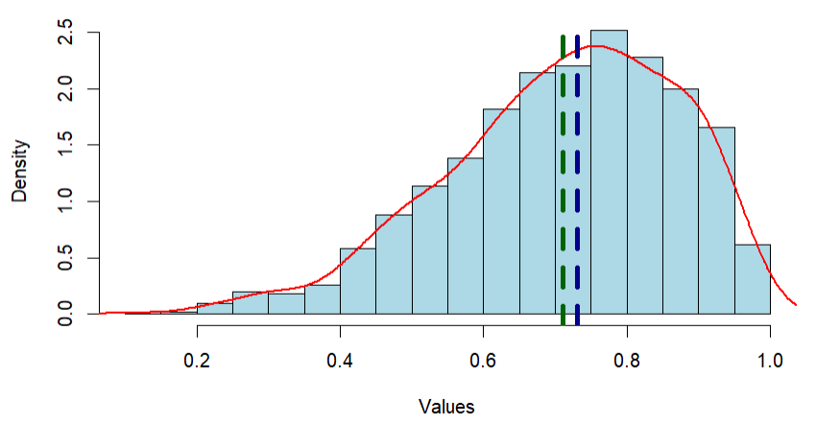
Non-normality
The concept of the mean as a measure of central tendency becomes less reliable due to the disproportionate influence of extreme values (outliers)d distribution
Consequently, the median, being less sensitive to extreme values, often provides a more robust and meaningful representation of the center of the distribution
mean
median

Slide 18
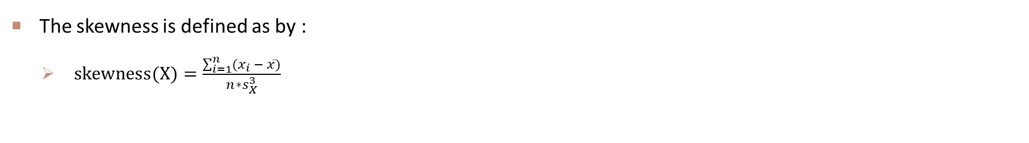
skewness
The skewness is defined as by :
$skewness(X)=\frac{\sum_{i=1}^{n}{(x_{i} − \overline{x})}}{n∗s_{X}^{3}}$
Skewness = 1.2
Skewness = -0.596
What is the skewness for a normal distribution? 🤔

Slide 19
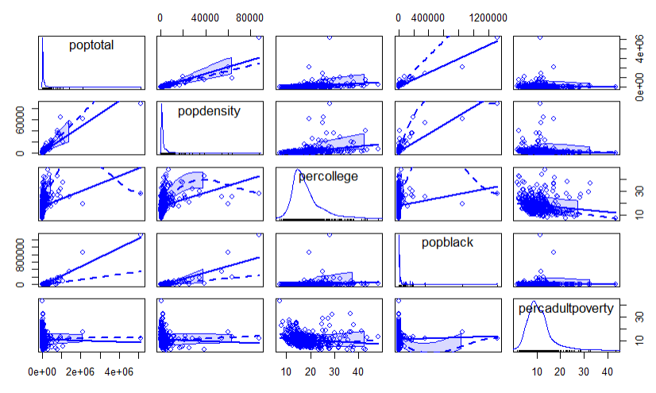
Scatterplot matrix
A scatterplot matrix is a matrix of scatterplots that lets you understand the pairwise relationship between different variables in a dataset

Slide 20
2.1.3 data transformation

Slide 21
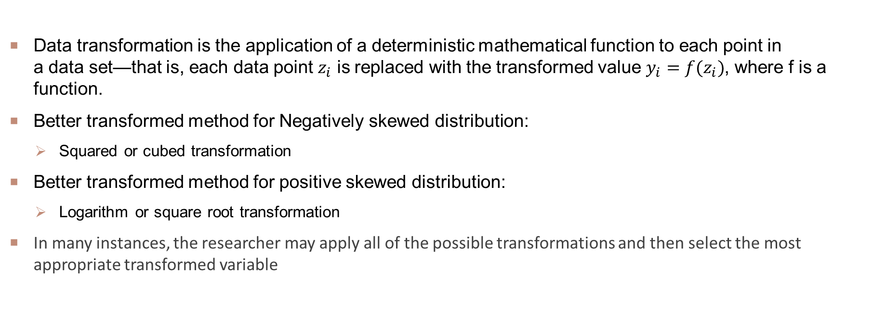
DATA TRANSFORMATION
Data transformation is the application of a deterministic mathematical function to each point in a data set—that is, each data point $z_{i}$ is replaced with the transformed value $y_{i}=f(z_{i})$, where f is a function.
Better transformed method for Negatively skewed distribution:
Squared or cubed transformation
Better transformed method for positive skewed distribution:
Logarithm or square root transformation
In many instances, the researcher may apply all of the possible transformations and then select the most appropriate transformed variable

Slide 22
WEEK 03 Lab session
Instructor: Yanan Wu
TA: Khadija Nisar
Spring 2025

Slide 23
2.2.1 task 1

Slide 24
Confidence interval

