Slide 1

WEEK 04 PART 02
Instructor: Yanan Wu
TA: Khadija Nisar
Spring 2025

Slide 2
4.1 KEY ASSUMPTION

Slide 3
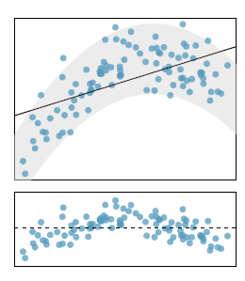
Linearity: The relationship between the independent variable and dependent variable is linear, if there is a nonlinear trend, an advanced regression method should be applied
Non-linearity of the Data
Liner regression line
Residual plot is a useful graphical tool for identifying non-linearity.

Slide 4
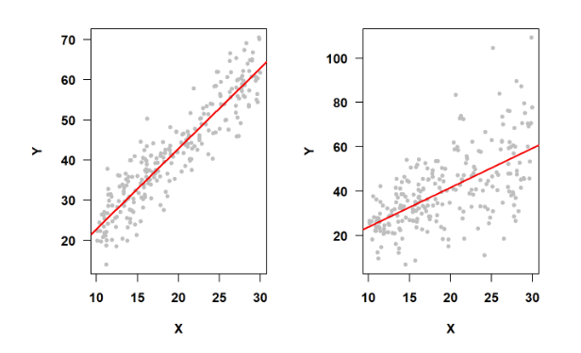
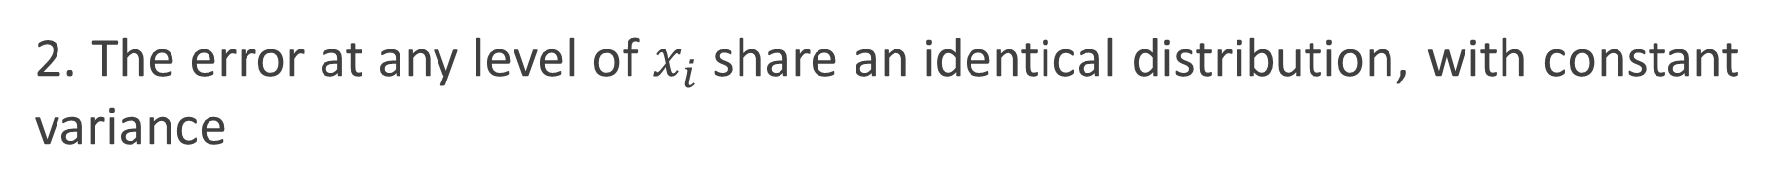
2. The error at any level of $x_{i}$ share an identical distribution, with constant variance
constant variance of Error Terms
non-constant variance of Error Terms

Slide 5
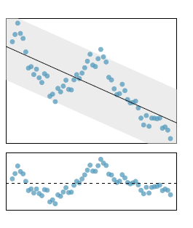
3. Error are assumed to be independent (uncorrelated) among each other
Example of correlated Error

Slide 6
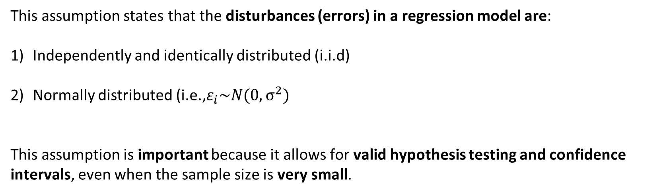
4. i.i.d Normality of Error
This assumption states that the disturbances (errors) in a regression model are:
Independently and identically distributed (i.i.d)
Normally distributed (i.e.,$ε_{i}\sim N(0,σ^{2})$
This assumption is important because it allows for valid hypothesis testing and confidence intervals, even when the sample size is very small.

Slide 7
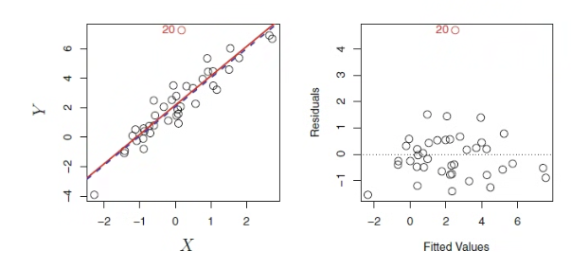
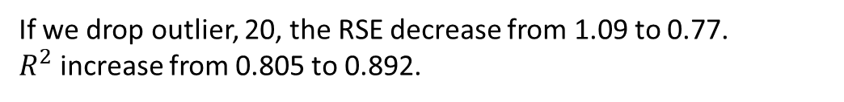
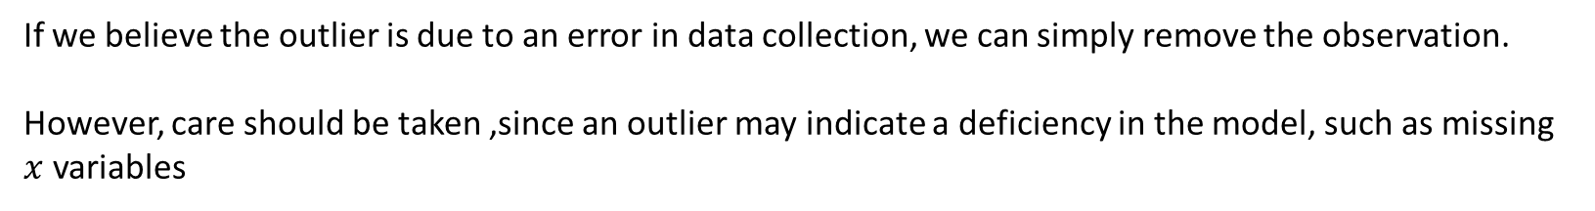
4. Outlier
If we drop outlier, 20, the RSE decrease from 1.09 to 0.77.
$R^{2}$ increase from 0.805 to 0.892.
If we believe the outlier is due to an error in data collection, we can simply remove the observation.
However, care should be taken ,since an outlier may indicate a deficiency in the model, such as missing $x$ variables

Slide 8
Transformation of dependent and independent variable
The transformation is needed for the dependent and independent variable is able to:
Fix a curvilinear relationship and making relationship linear
Make the distribution of error to a normal distribution or close to the normal distribution
To stabilize the variability of the regression residuals by a transformation of the dependent variable

Slide 9
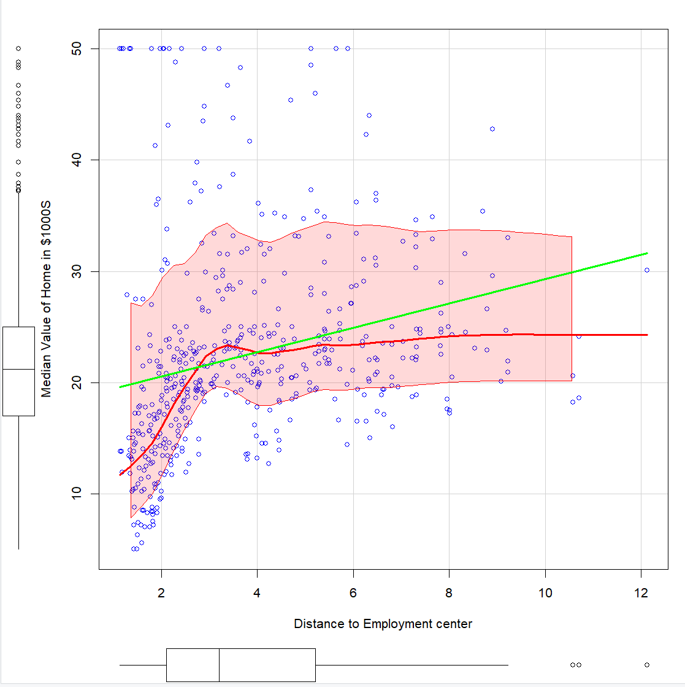
Assess the univariate distribution in $x_{i}$ and $y_{i}$ variables: scatterplot

Slide 10
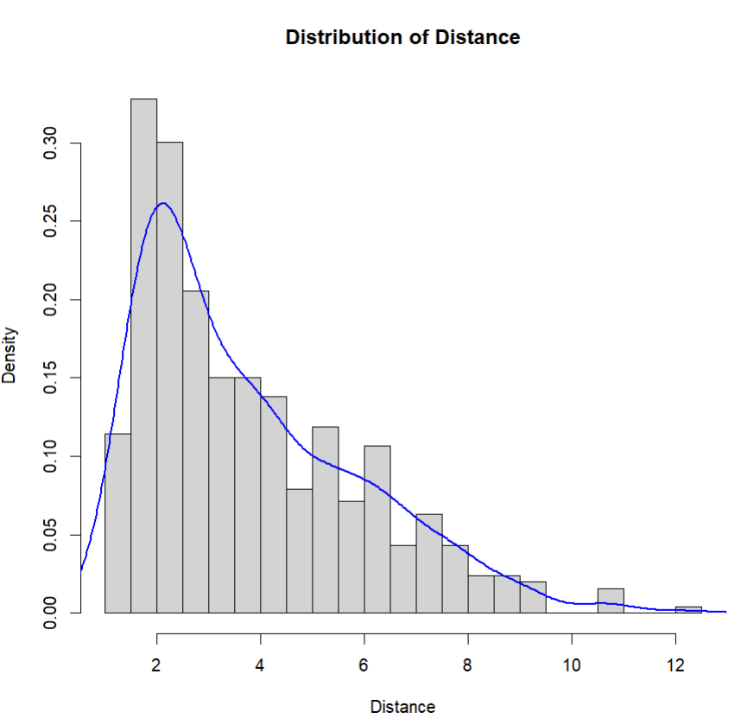
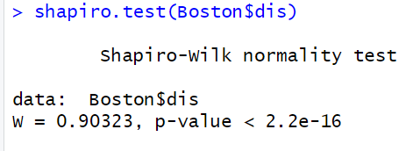
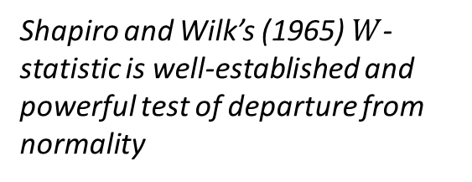
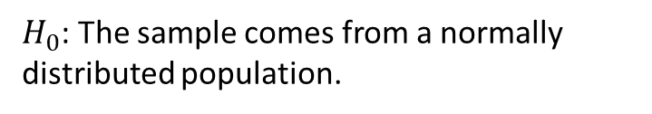
Shapiro Test: Assess the normality in univariate distribution
Shapiro and Wilk’s (1965) $W$-statistic is well-established and powerful test of departure from normality
Skewness: 1.00579
$H_{0}$: The sample comes from a normally distributed population.

Slide 11
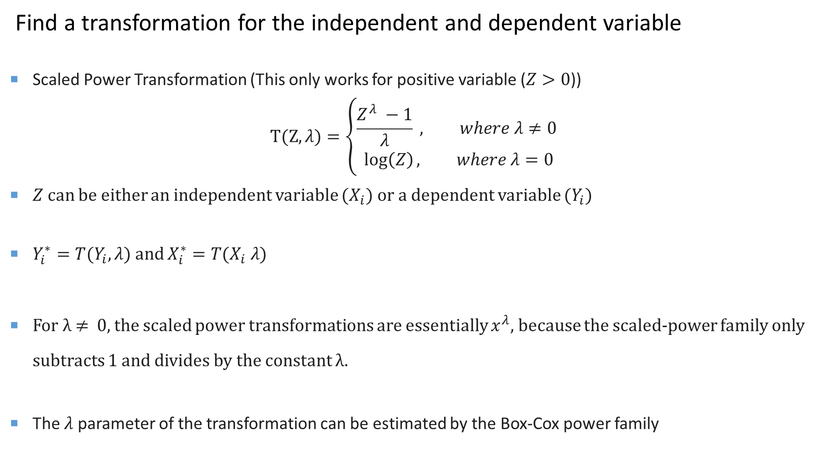
Find a transformation for the independent and dependent variable
Scaled Power Transformation (This only works for positive variable ($Z>0$))
$$T(Z,λ)=\left\{\begin{aligned}\frac{Z^{λ} −1}{λ} , where λ≠0 \\ \log\left(Z\right), where λ=0\end{aligned}\right.$$
$Z$ can be either an independent variable ($X_{i}$) or a dependent variable ($Y_{i}$)
$Y_{i}^{∗}=T(Y_{i},λ)$ and $X_{i}^{∗}=T(X_{i} λ)$
For λ ≠ 0, the scaled power transformations are essentially $x^{λ}$, because the scaled-power family only subtracts 1 and divides by the constant λ.
The $λ$ parameter of the transformation can be estimated by the Box-Cox power family

Slide 12
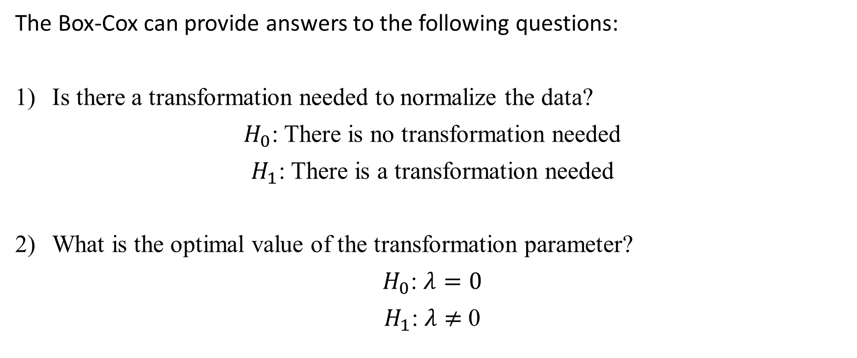
Box-Cox Transformation
The Box-Cox can provide answers to the following questions:
Is there a transformation needed to normalize the data?
$H_{0}$: There is no transformation needed
$H_{1}$: There is a transformation needed
What is the optimal value of the transformation parameter?
$H_{0}$: $λ=0$
$H_{1}$: $λ$ $≠$ 0

Slide 13
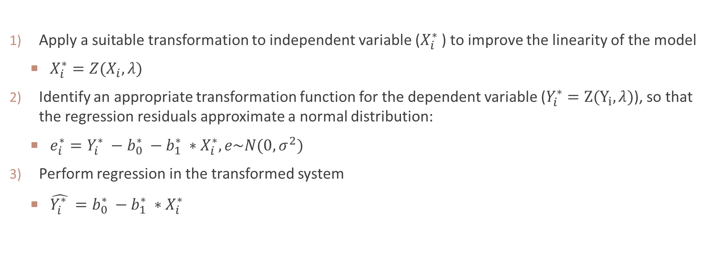
4. Procedure for Data Transformation in Regression Analysis
Apply a suitable transformation to independent variable ($X_{i}^{∗}$ ) to improve the linearity of the model
$X_{i}^{∗}=Z(X_{i},λ)$
Identify an appropriate transformation function for the dependent variable ($Y_{i}^{∗}=Z(Y_{i},λ)$), so that the regression residuals approximate a normal distribution:
$e_{i}^{∗}=Y_{i}^{∗} −b_{0}^{∗} −b_{1}^{∗} ∗X_{i}^{∗}, e\sim N(0, σ^{2})$
Perform regression in the transformed system
$\hat{Y_{i}^{∗} }=b_{0}^{∗} −b_{1}^{∗} ∗X_{i}^{∗}$

Slide 14
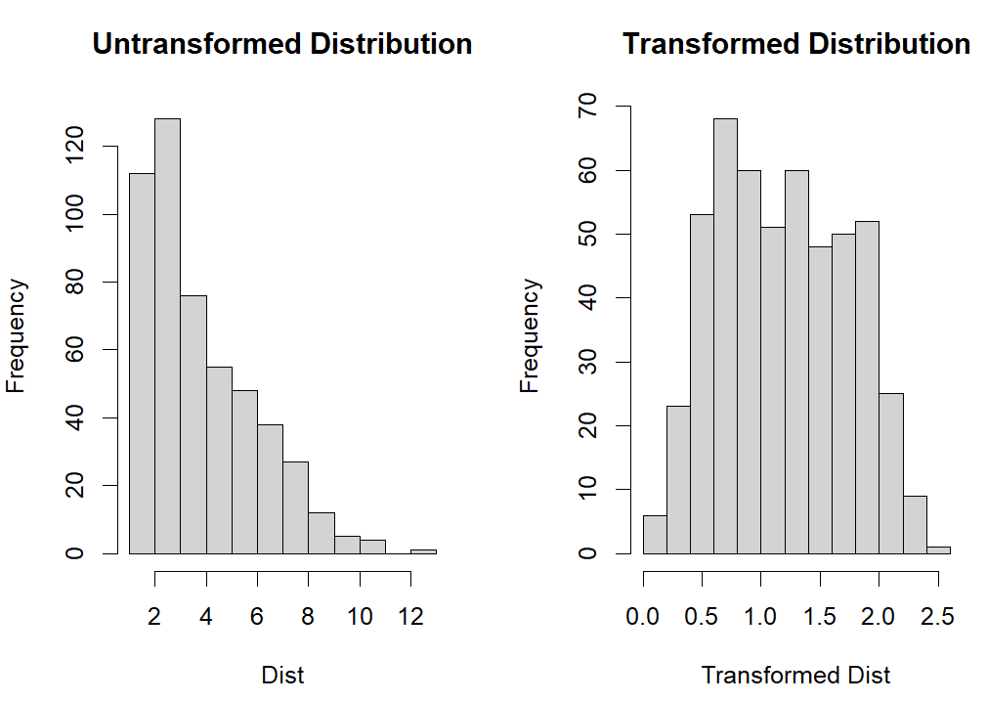


Impact of $λ$ on Transformation
$λ=$0
$$λ=1$$

Slide 15
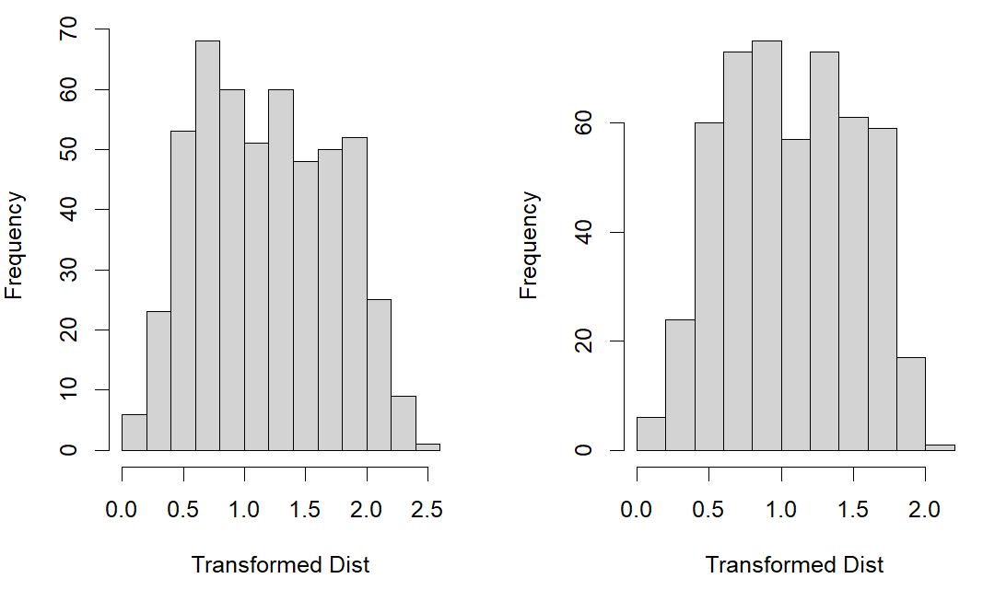





Impact of $λ$ on Transformation
Transformed Distribution in $log⁡(X_{i})$
Transformed Distribution in $\frac{X_{i}^{λ} −1}{λ}$
$$λ=0$$
$λ=$-0.1556

Slide 16
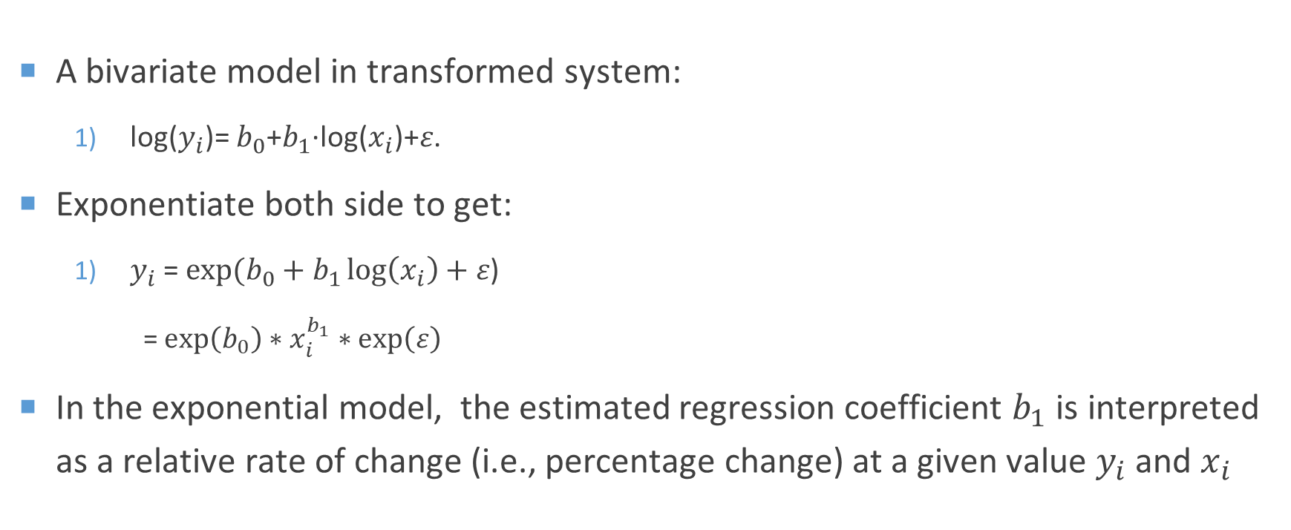
Elasticity
A bivariate model in transformed system:
log($y_{i}$)= $b_{0}$+$b_{1}$∙log($x_{i}$)+𝜀.
Exponentiate both side to get:
$y_{i}$= $exp(b_{0}+b_{1}\log\left(x_{i}\right)+\text{ε}\text{)}$
= $\exp\left(b_{0}\right)∗x_{i}^{b_{1}}∗exp\left(\text{ε}\right)$
In the exponential model, the estimated regression coefficient $b_{1}$ is interpreted as a relative rate of change (i.e., percentage change) at a given value $y_{i}$ and $x_{i}$

Slide 17
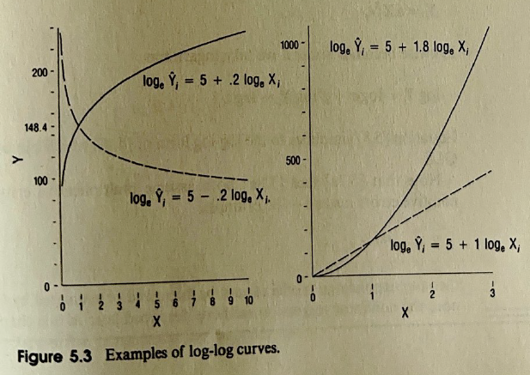
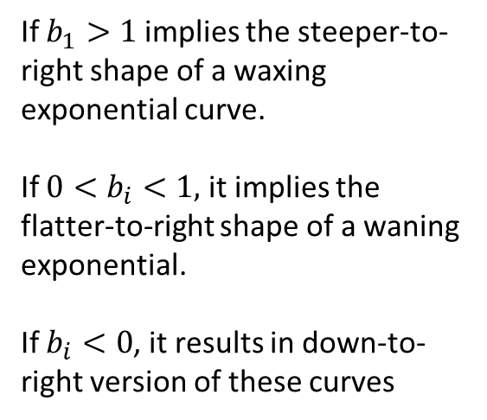
Log-log curve
If $b_{1}>1$ implies the steeper-to-right shape of a waxing exponential curve.
If $0<b_{i}<1,$ it implies the flatter-to-right shape of a waning exponential.
If $b_{i}<0$, it results in down-to-right version of these curves

