Slide 1

WEEK 04
Instructor: Yanan Wu
TA: Khadija Nisar
Spring 2025

Slide 2
2.1.1 regression

Slide 3
CAUSALITY & REGRESSION
Causality
The change in
Co-variation

Slide 4
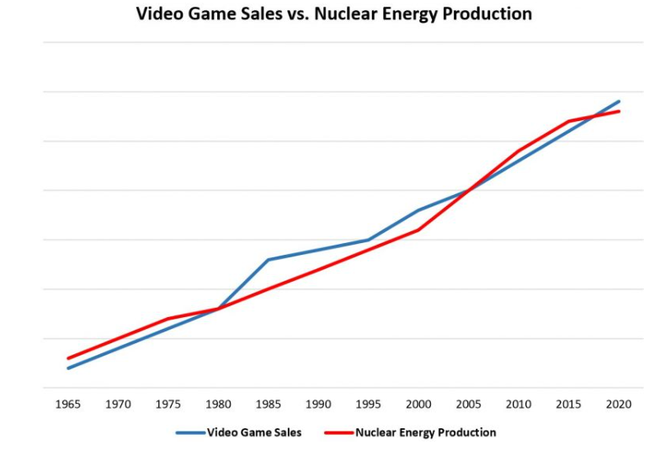
Spurious relationship
The covariation between $X$ and $Y$ can be influenced by their joint relationship to another variable $Z$ (or a set of variables)

Slide 5
2.1.2 bivariate regression

Slide 6
Population model
$$y_{i}=β_{0}+β_{1}∗x_{i1}+ε_{i}$$
$β_{0}:intercept$: The mean value of $y$ when all $x$ are zero
$β_{1}:slope$: How much the $y$ changes for every one unit change in $x$
$$_{i}:error$$

Slide 7
Estimated model based on sample
$\hat{y_{i}}=b_{0}+b_{1}∗x_{i1}+e_{i}$ with the residual $e_{i}=y_{i} − \hat{y_{i}}$

Slide 8
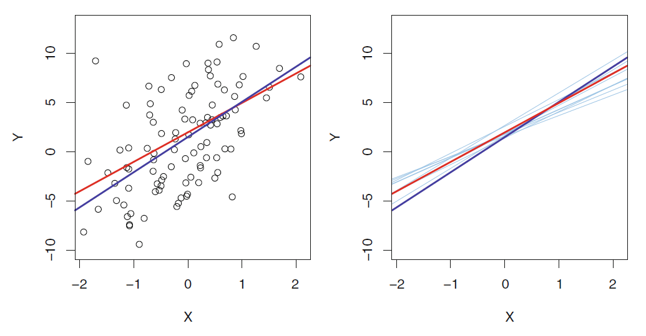
POPULATION REGRESSION LINE VS SAMPLE REGRESSION LINE
Red line: population regression line
Dark blue: sample regression line
Light blue: sample regression line based on different samples

Slide 9
2.1.3 key assumption

Slide 10
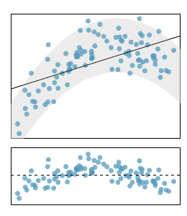
Linearity: The relationship between the independent variable and dependent variable is linear, if there is a nonlinear trend, an advanced regression method should be applied
Liner regression line
Residual plot is a useful graphical tool for identifying non-linearity.

Slide 11
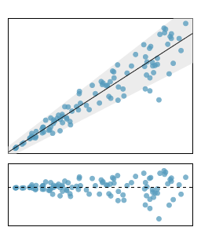
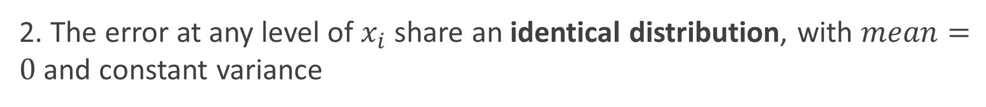
2. The error at any level of $x_{i}$ share an identical distribution, with $mean=0$ and constant variance

Slide 12
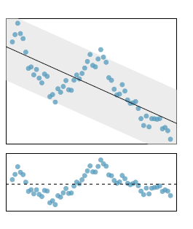
3. Error are assumed to be independent (uncorrelated) among each other

Slide 13
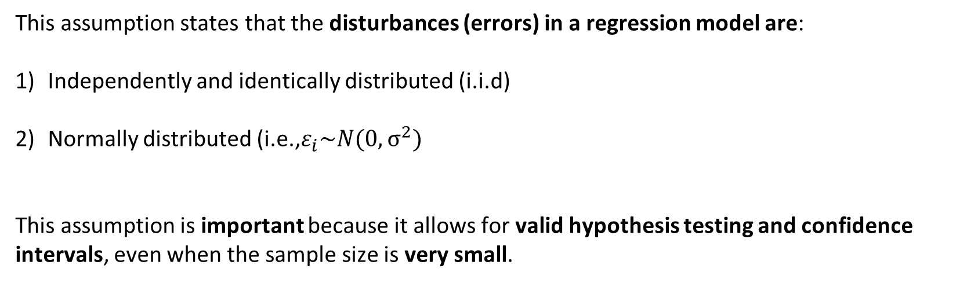
4. i.i.d Normality of Error
This assumption states that the disturbances (errors) in a regression model are:
Independently and identically distributed (i.i.d)
Normally distributed (i.e.,$ε_{i}\sim N(0,σ^{2})$
This assumption is important because it allows for valid hypothesis testing and confidence intervals, even when the sample size is very small.

Slide 14
2.1.3 ordinary least squares estimation

Slide 15
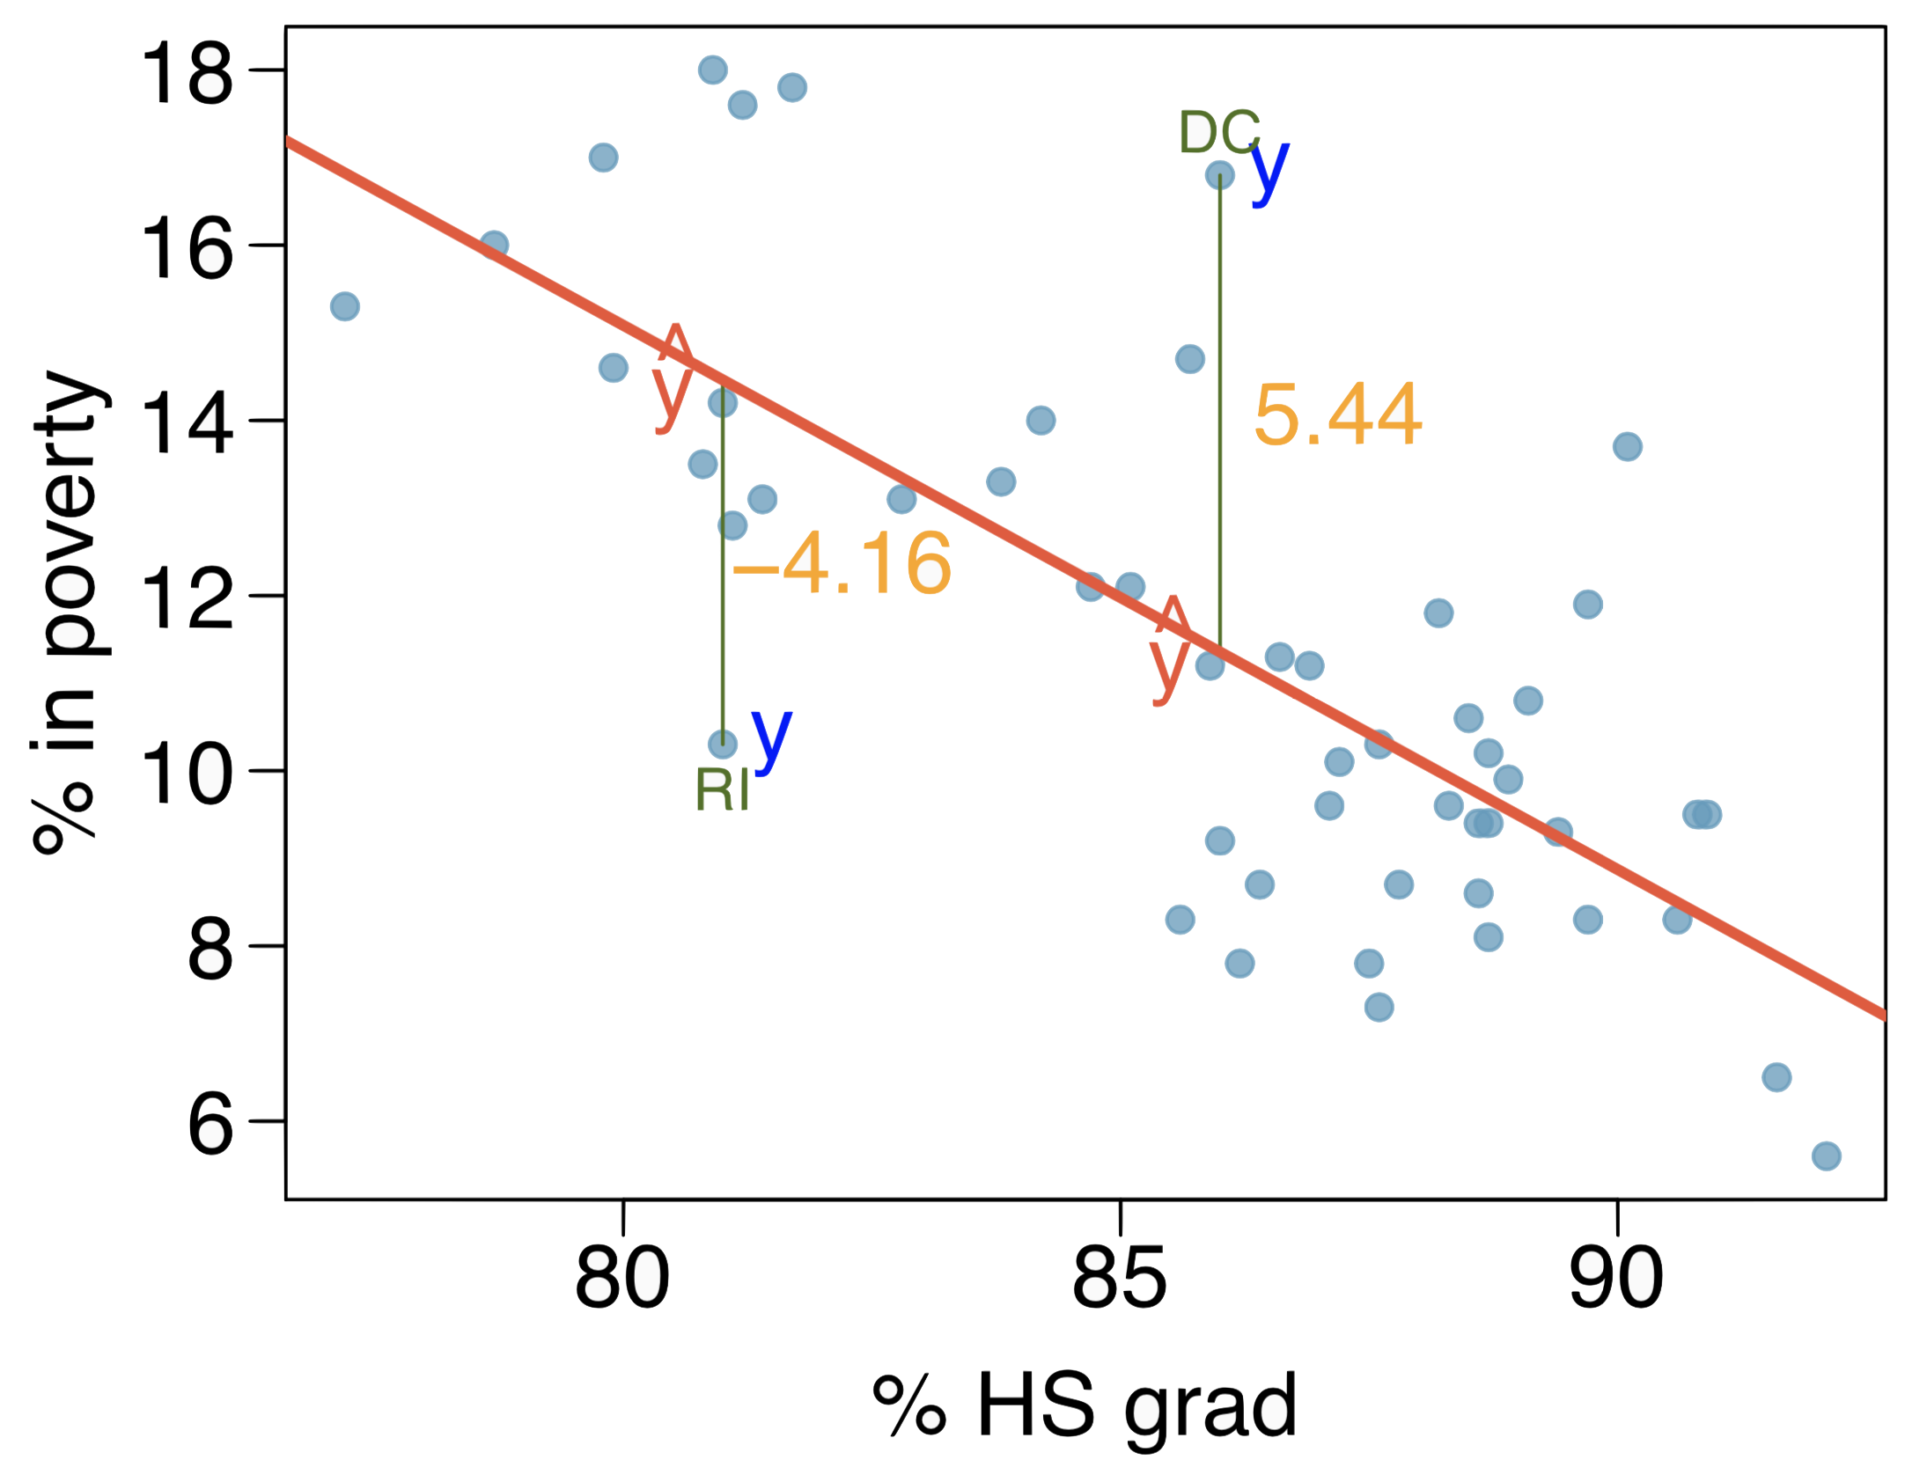

Ordinary Least Squares
1. A straight line can minimize the residual sum of squares (RSS)
$$e_{i}=y_{i} − \hat{y_{i}}$$

Slide 16
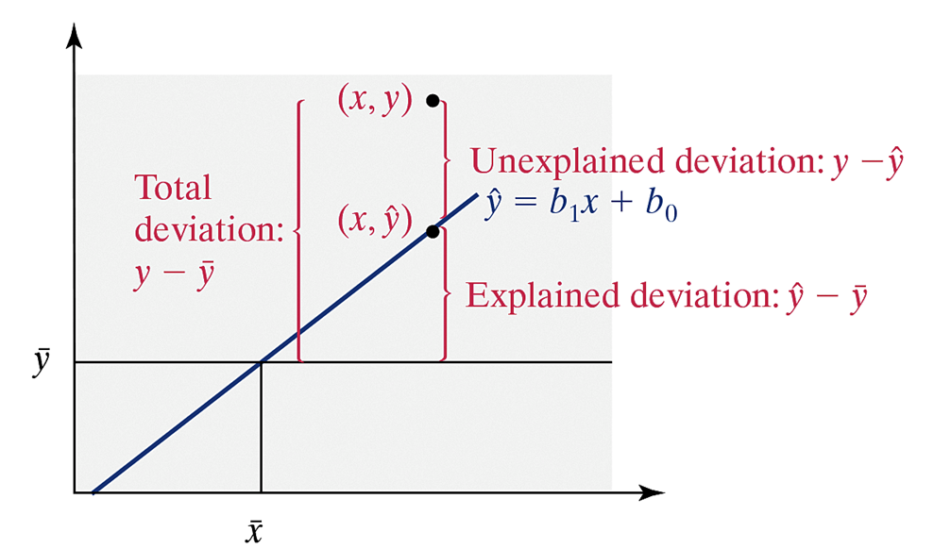
2. Regression line go through $\overline{x} and \overline{y}$
As long as the linear model has an intercept, the regression line always goes through means of 𝑋 and 𝑌, i.e., the point (𝑥̅,𝑦̅) will be on the regression line

Slide 17
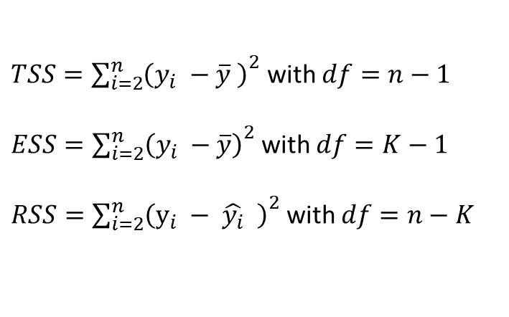
2. TSS, RSS, ESS
$TSS={\sum_{i=2}^{n}{\left(y_{i} −\overline{y} \right)}}^{2}$with $df=n−1$
$ESS={\sum_{i=2}^{n}{\left(y_{i} −\overline{y}\right)}}^{2}$with $df=K−1$
$RSS={\sum_{i=2}^{n}{\left(y_{i} − \hat{y_{i}} \right)}}^{2}$with $df=n−K$

Slide 18
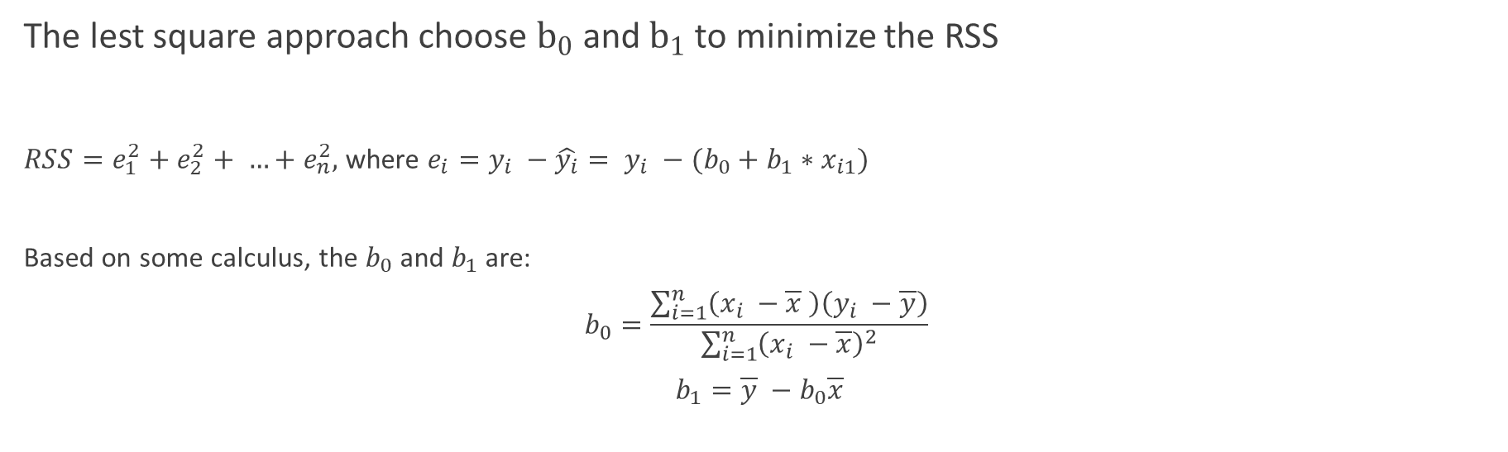
Slope and intercept
The lest square approach choose $b_{0}$ and $b_{1}$ to minimize the RSS
$RSS=e_{1}^{2}+e_{2}^{2}+ …+e_{n}^{2},$ where $e_{i}=y_{i} −\hat{y_{i}}= y_{i} −(b_{0}+b_{1}∗x_{i1})$
Based on some calculus, the $b_{0}$ and $b_{1}$ are:
$$b_{0}=\frac{\sum_{i=1}^{n}{\left(x_{i} −\overline{x} \right)\left(y_{i} −\overline{y}\right)}}{\sum_{i=1}^{n}{{\left(x_{i} −\overline{x}\right)}^{2}}}$$
$$b_{1}=\overline{y} −b_{0}\overline{x}$$

Slide 19
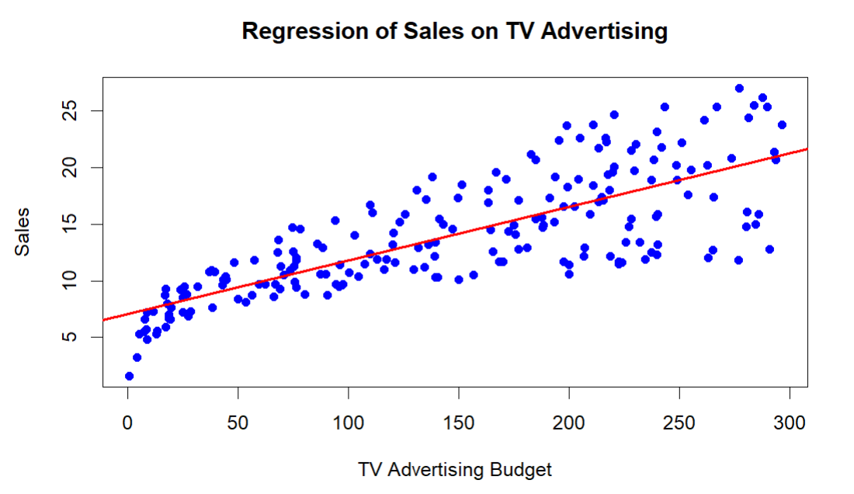

Explanation on $b_{0}$ & $b_{1}$
$$b_{0}=7.03, b_{1}=0.0475$$

Slide 20
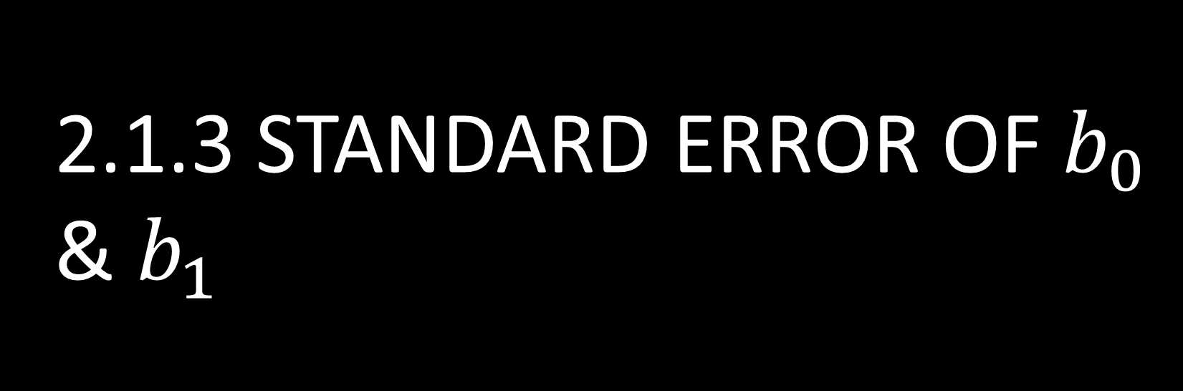
2.1.3 Standard error of $b_{0}$ & $b_{1}$

Slide 21
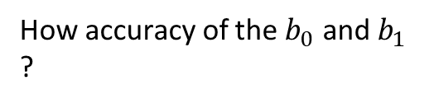
The estimated coefficients ($b_{0}$ and $b_{1}$) differ from sample to sample and therefore will have a distribution
Red line: population regression line
Dark blue: sample regression line
Light blue: sample regression line based on different samples
How accuracy of the $b_{0}$ and $b_{1}$ ?

Slide 22
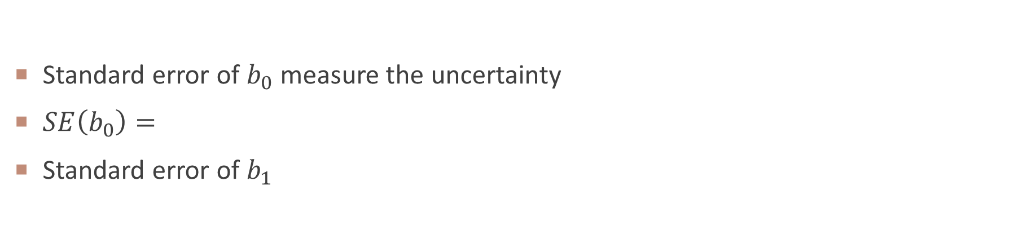
Standard error
Standard error of $b_{0}$ measure the uncertainty
$SE\left(b_{0}\right)=$
Standard error of $b_{1}$

Slide 23
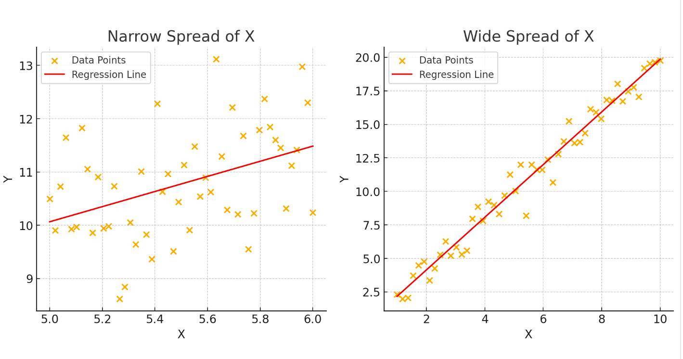
Influence of Dispersion of $x_{i}$ on $SE(b_{0})$ and $SE(b_{1})$

Slide 25
2.1.3confidence interval

Slide 26
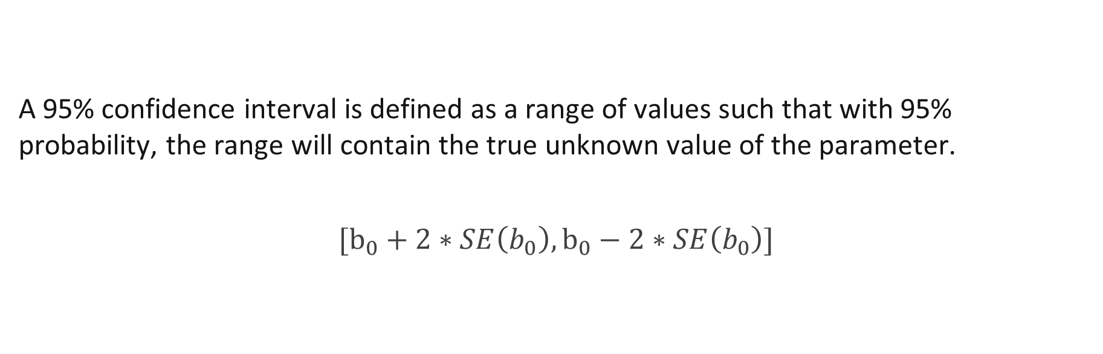
Confidence interval for $b_{0}$
A 95% confidence interval is defined as a range of values such that with 95% probability, the range will contain the true unknown value of the parameter.
$$[b_{0}+2∗SE\left(b_{0}\right),b_{0}−2∗SE\left(b_{0}\right)]$$

Slide 27
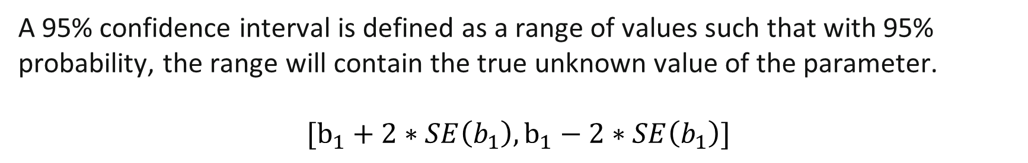
Confidence interval for $b_{1}$
A 95% confidence interval is defined as a range of values such that with 95% probability, the range will contain the true unknown value of the parameter.
$$[b_{1}+2∗SE\left(b_{1}\right),b_{1}−2∗SE\left(b_{1}\right)]$$

Slide 28
Two confidence interval

Slide 29
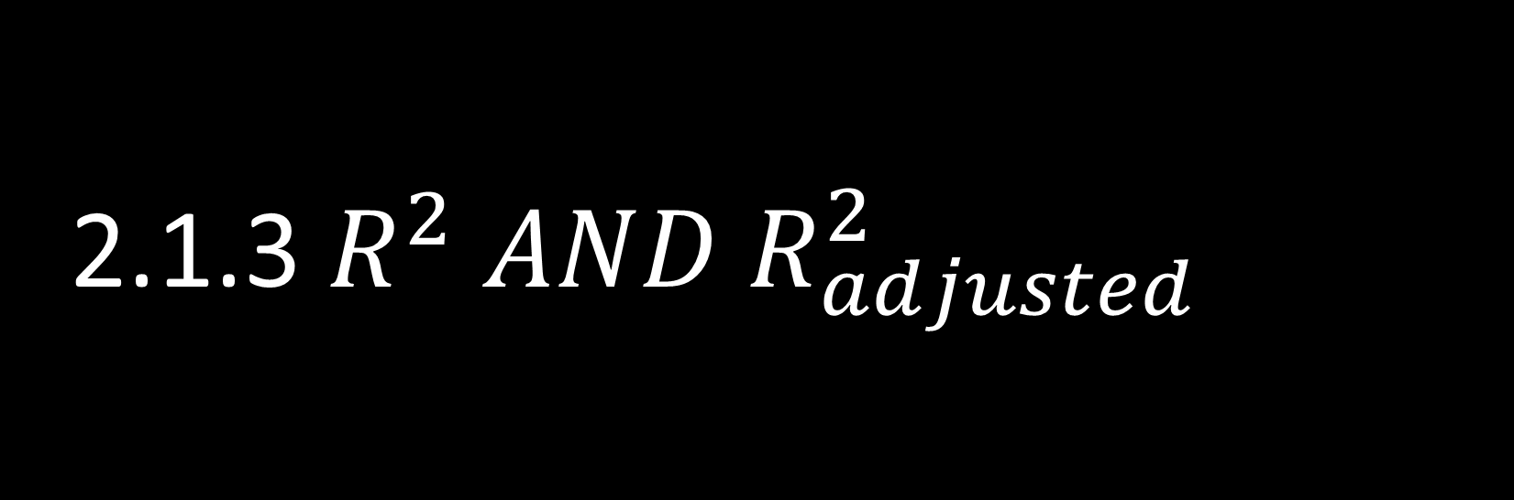
2.1.3 $R^{2} AND R_{adjusted}^{2}$

Slide 30
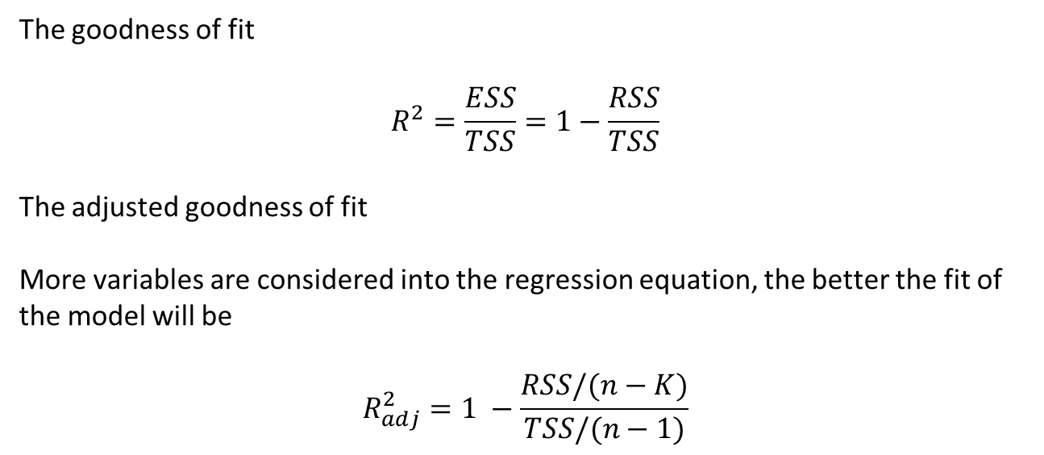
The goodness of fit
$$R^{2}=\frac{ESS}{TSS}=1−\frac{RSS}{TSS}$$
The adjusted goodness of fit
More variables are considered into the regression equation, the better the fit of the model will be
$$R_{adj}^{2}=1 −\frac{RSS/(n−K)}{TSS/(n−1)}$$

Slide 31
WEEK 03 Lab session
Instructor: Yanan Wu
TA: Khadija Nisar
Spring 2025

