Slide 1

WEEK 14
Instructor: Yanan Wu
TA: Khadija Nisar
Spring 2025

Slide 2
Understanding Spatial Patterns An Introduction to Spatial Autocorrelation Analysis

Slide 3
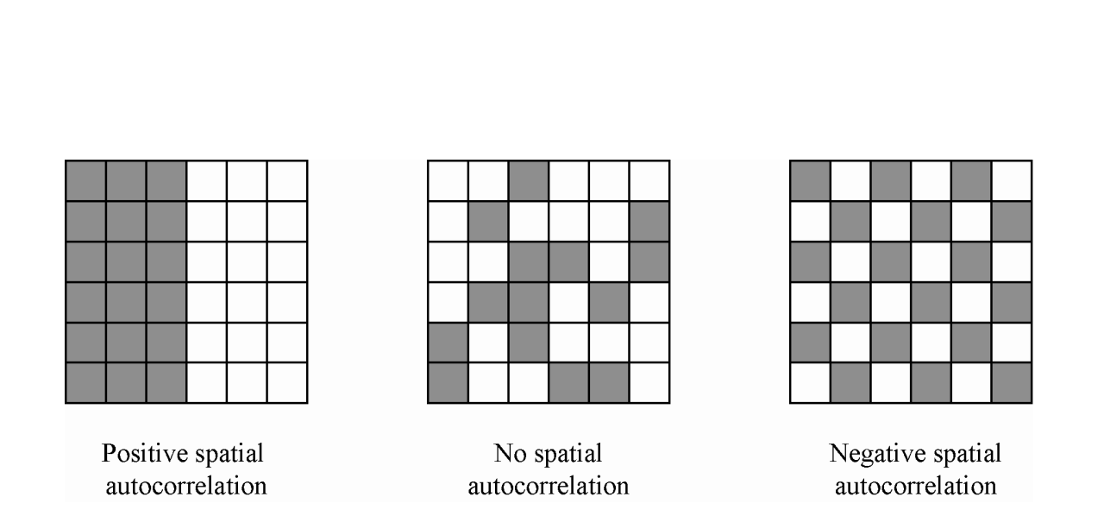
What is Spatial Autocorrelation?
Definition: Measures the degree to which a variable is correlated with itself across space. Are nearby things similar or different?
Tobler's First Law of Geography: "Everything is related to everything else, but near things are more related than distant things." This is the core idea!
Example: Think about house prices or temperatures – places close together often have similar values.
Notes:
So, what exactly is spatial autocorrelation? Simply put, it's a measure of how similar (or dissimilar) things are based on their geographic location. It builds on Tobler's First Law of Geography, a fundamental concept stating that proximity often implies similarity. For instance, you usually find similar house prices in the same neighborhood, or similar temperatures in adjacent areas.

Slide 4
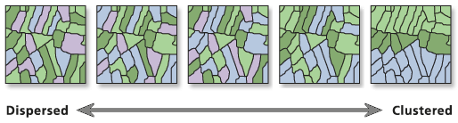
Why is Spatial Autocorrelation Important?
Reveals Spatial Dependence: Tells us if our observations are truly independent or influenced by location.
Uncovers Spatial Processes: Helps understand why patterns exist (e.g., disease spread, diffusion of ideas).
Impacts Statistical Models: Standard statistics often assume independence. Spatial autocorrelation violates this, potentially biasing results.
Identifies Clusters: Allows us to find hotspots (high values clustered), coldspots (low values clustered), or spatial outliers.
Notes:
Why should we care about spatial autocorrelation? Firstly, it signals spatial dependence – meaning the location of an observation influences its value. This can reveal underlying processes driving the patterns we see. Crucially, many standard statistical methods assume data points are independent; if spatial autocorrelation exists, those assumptions are broken, and our results could be misleading. Finally, it's key for identifying significant spatial clusters, like crime hotspots or areas with low vaccination rates.

Slide 5
Types of Spatial Autocorrelation
Positive: Similar values cluster together (High near High, Low near Low).
This is the most common type, aligning with Tobler's Law.
Negative: Dissimilar values cluster together (High near Low, Low near High). Think of a checkerboard pattern.
Zero (Random): No spatial effect. Values are randomly distributed across the study area.
Notes:
Spatial autocorrelation can manifest in three main ways. Positive autocorrelation is when similar values group together – high-income households next to other high-income households, for example. Negative autocorrelation is less common, where dissimilar values are neighbors, like a checkerboard. Zero autocorrelation means there's no discernible spatial pattern; values are randomly scattered.

Slide 6
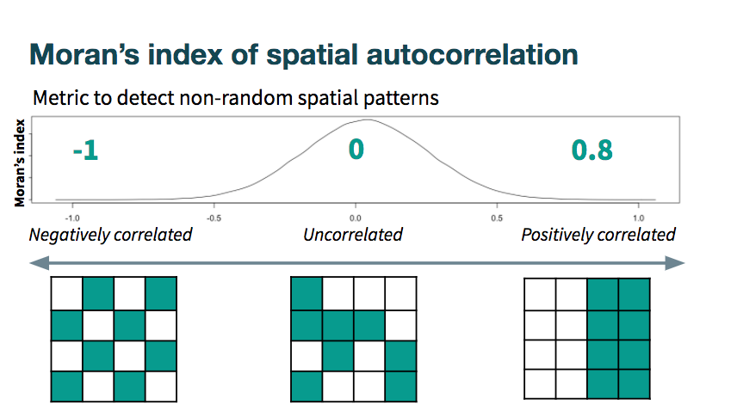
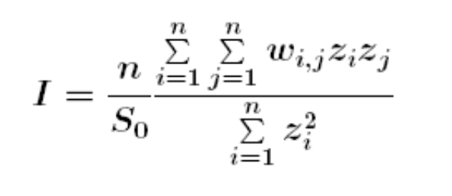
Global Autocorrelation: Moran's I
Purpose: Measures the overall spatial pattern in the entire dataset.
Is there clustering, dispersion, or randomness?
Statistic: Moran's I is the most common measure.
Ranges from -1 (perfect dispersion) to +1 (perfect clustering). 0 means random.
Spatial Weight Matrix
More Details

Slide 7
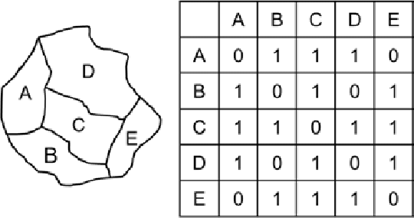
Defining Neighbors: Spatial Weights
Concept: We need to formally define who is a neighbor to whom before testing autocorrelation.
Spatial Weights Matrix: Represents these neighborhood relationships.
Common Types:
Contiguity: Neighbors share a boundary.
Queen: Share border or corner. (Most Common)
Rook: Share border only.
Distance: Neighbors are within a certain distance.
K-Nearest Neighbors (KNN): Each area's k closest neighbors.
Notes:
Before we can calculate autocorrelation, we need to tell R how areas are related spatially – who counts as a neighbor? We do this using a spatial weights matrix. Common ways to define neighbors include contiguity (sharing a boundary, like Queen or Rook chess moves), being within a certain distance, or being one of the 'k' nearest neighbors.

Slide 8
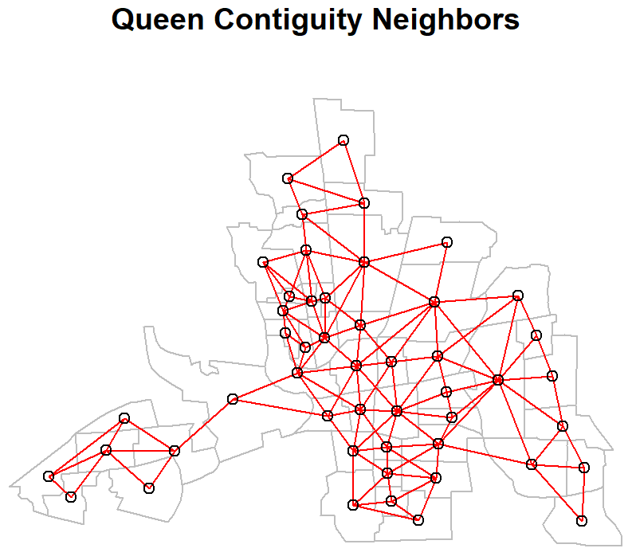
Creating Spatial Weights in R (Queen Example)
Function: poly2nb() from spdep creates a neighbor list based on polygons.
queen_nb <- poly2nb(columbus_poly, queen = TRUE)
Convert to Weights: nb2listw() converts the neighbor list into a weights object R can use for tests.
queen_weights <- nb2listw(queen_nb, style = "W")
Visualize: Plot the network to see the connections.
Notes:
"In R, we use poly2nb from the spdep package to create a list of neighbors. Here, we're creating 'Queen' contiguity neighbors, meaning polygons are neighbors if they touch at corners or borders. Then, nb2listw converts this list into a format needed for the analysis, often standardizing the weights. We can even plot these neighbor connections on the map."

Slide 9
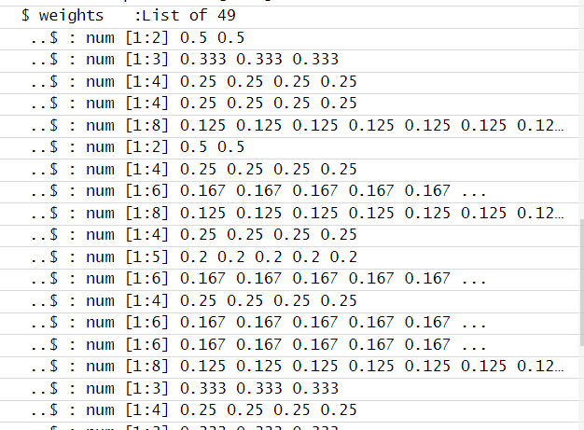
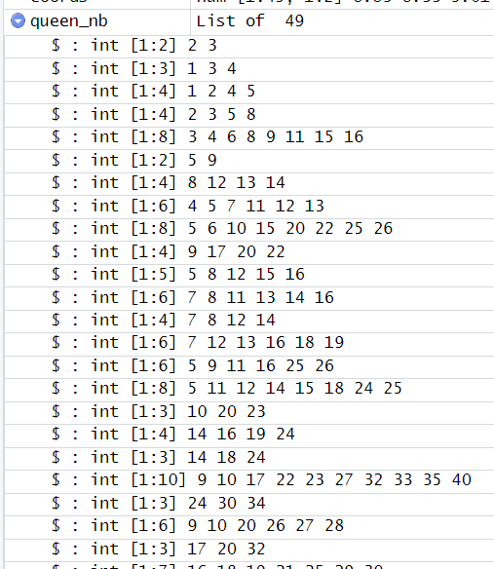
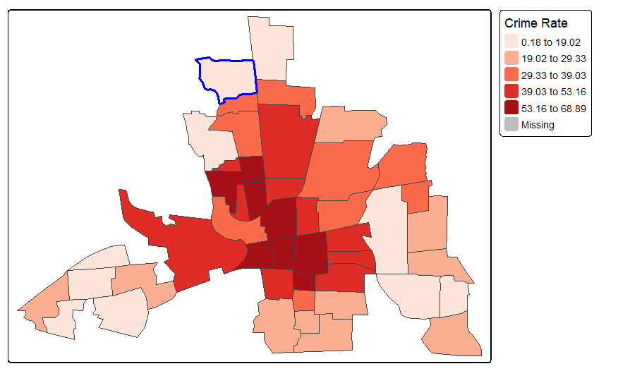
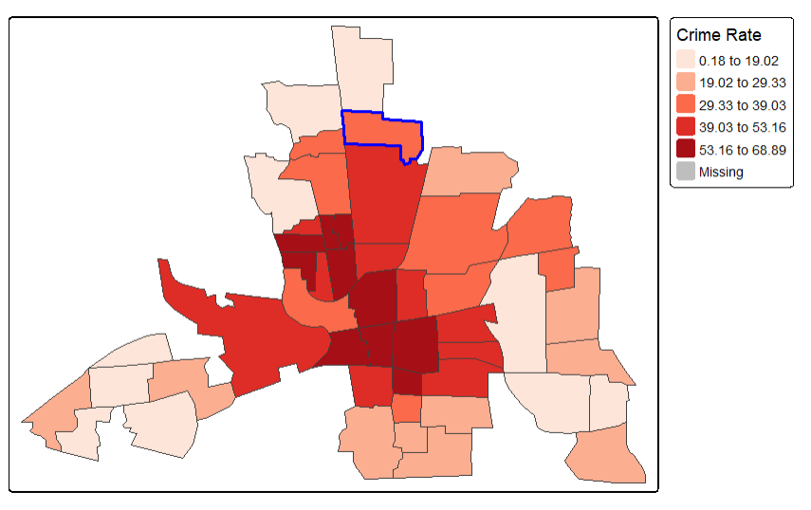
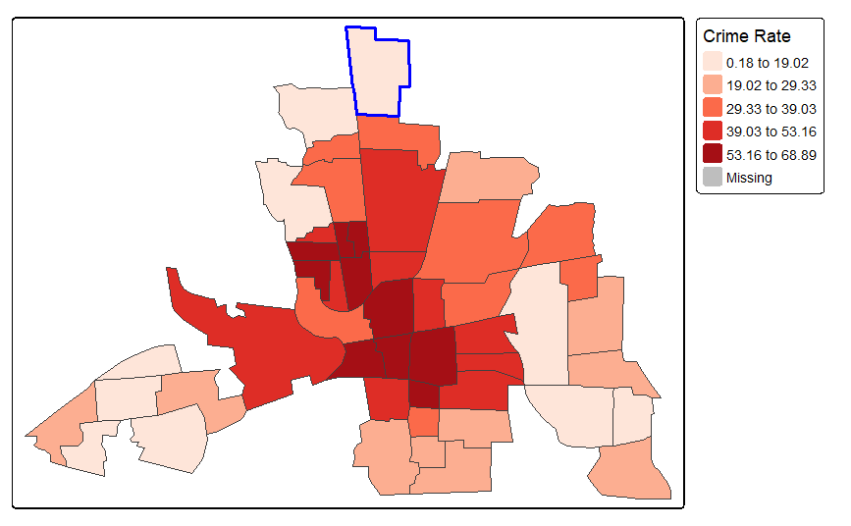
Creating Spatial Weights in R (Queen Example)
Neighborhood List
Weighted Neighborhood List

Slide 10
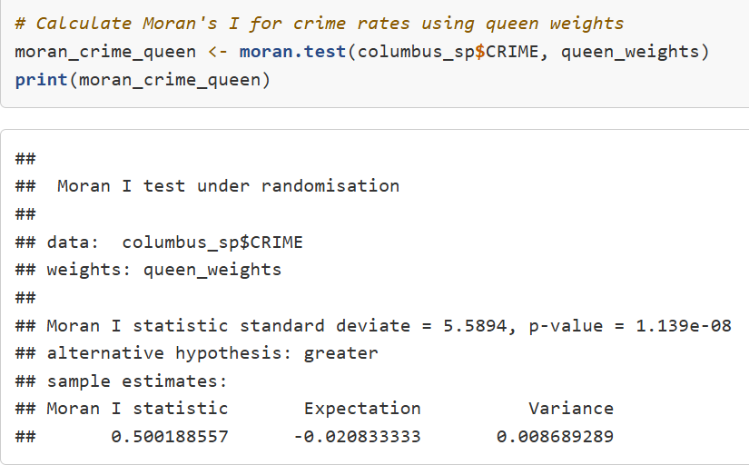
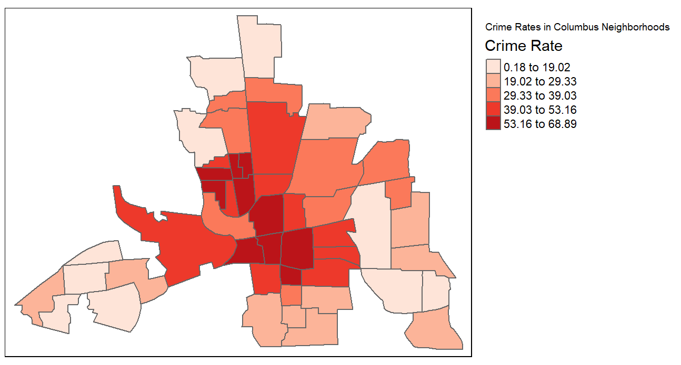
Interpreting Moran's I & Scatterplot in r
Global Moran’s I
R Function: moran.test() from spdep.
moran.test(variable, weights_object)
Moran's I Test Output:
Moran I statistic: The calculated I value.
p-value: Probability of seeing this pattern by chance.
Low p-value (<0.05) suggests significance.
Significant Positive Spatial Autocorrelation
Notes:
When we run moran.test, we look at the Moran I statistic itself and the p-value. A small p-value tells us the observed pattern is unlikely to be random chance.

Slide 11
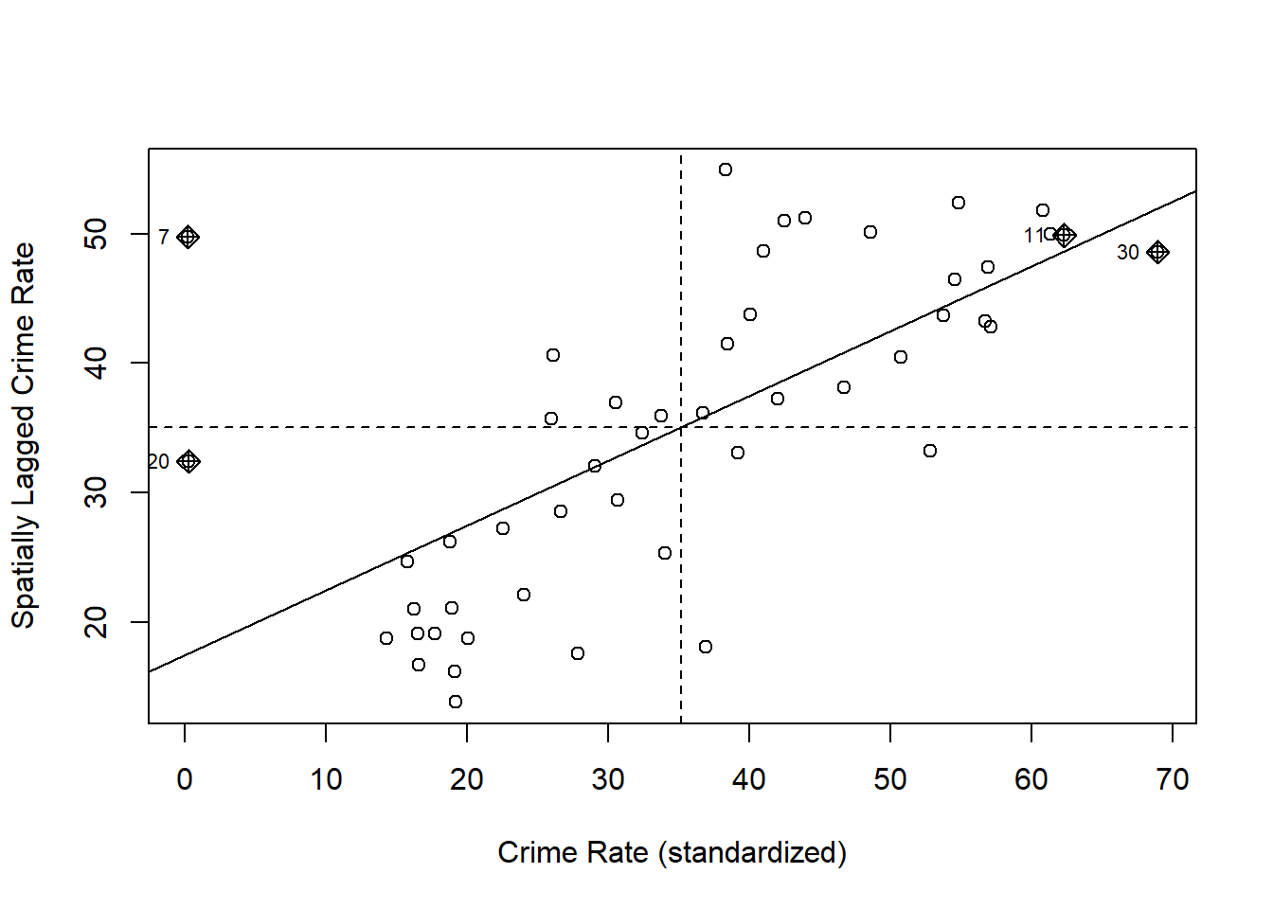
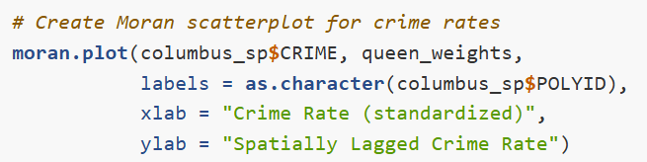
Interpreting Moran's I & Scatterplot in r
Moran Scatterplot: Visualizes the relationship.
moran.plot(variable, weights_object).
X-axis: Value at location i (standardized).
Y-axis: Average value of neighbors of i (standardized).
Slope of the line = Moran's I.
Quadrants show High-High, Low-Low, High-Low, Low-High relationships.
Low-High
High-High
Low-Low
High-Low
Notes:
A useful visualization is the Moran Scatterplot, created with moran.plot. It plots each location's value against the average value of its neighbors. The overall slope represents Moran's I, and the points falling in different quadrants help us see the types of spatial relationships present.

Slide 12
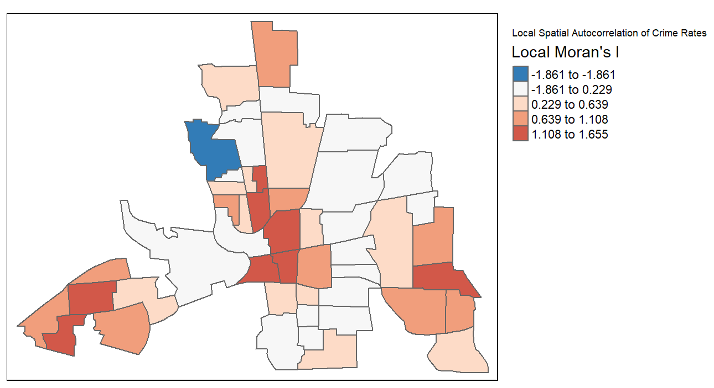
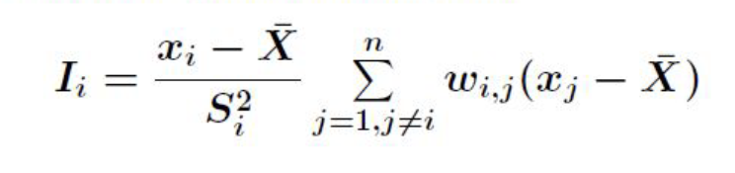
Local Indicators of Spatial Association (LISA)
Purpose: Global Moran's I gives one value for the whole map. Local measures identify where specific clusters or outliers exist.
LISA: Local Indicators of Spatial Association. Decomposes the global Moran's I into location-specific values.
Local Moran’s I (Most Common)
Local version of Global Moran’s I, you can think of it like only focus on one feature and its neighbors
Negative correlated to its neighbors
R Function: localmoran() from spdep.
lisa_crime <- localmoran(variable, weights_object)
Output: Gives a local I statistic and p-value for each location.
More Details
Notes:
Global Moran's I tells us if there's clustering overall, but not where. For that, we need local statistics. Local Indicators of Spatial Association, or LISA, developed by Luc Anselin, break down the global pattern to show each location's contribution. We use the localmoran function in R. This gives us a local Moran's I value and a p-value for every single neighborhood, indicating if its local pattern is significant.

Slide 13
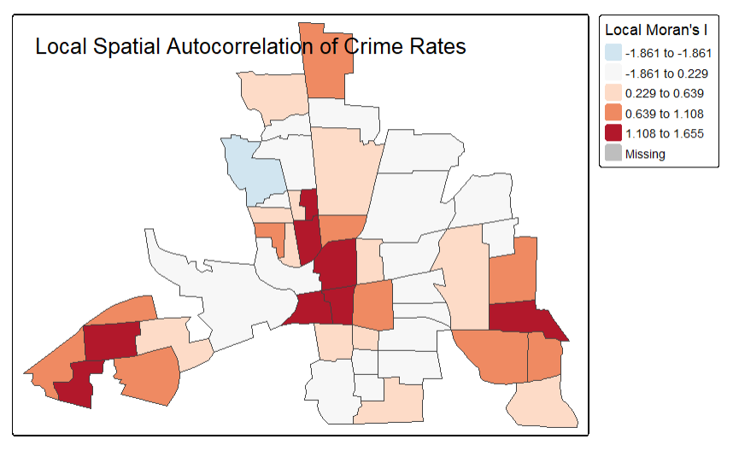
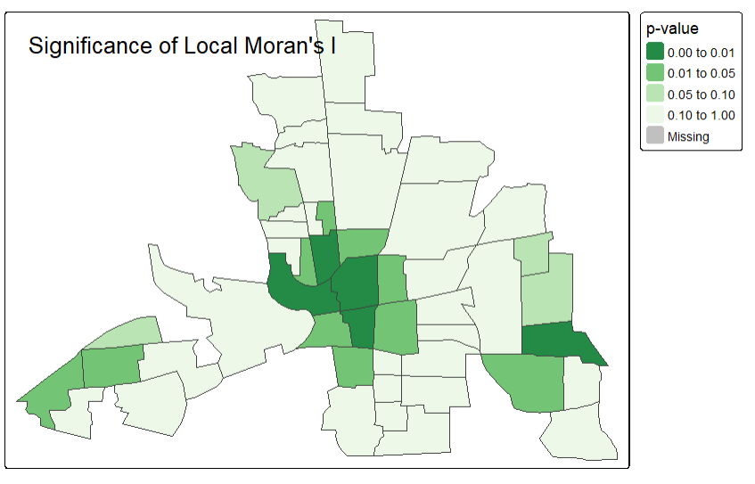
Local Moran's I and significance

Slide 14
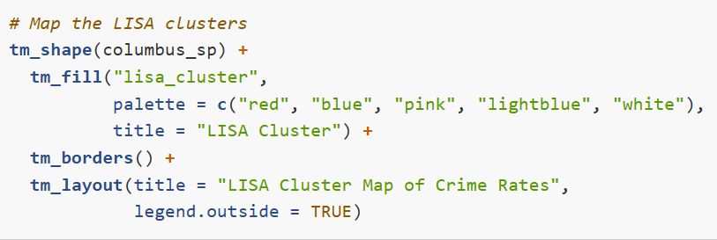
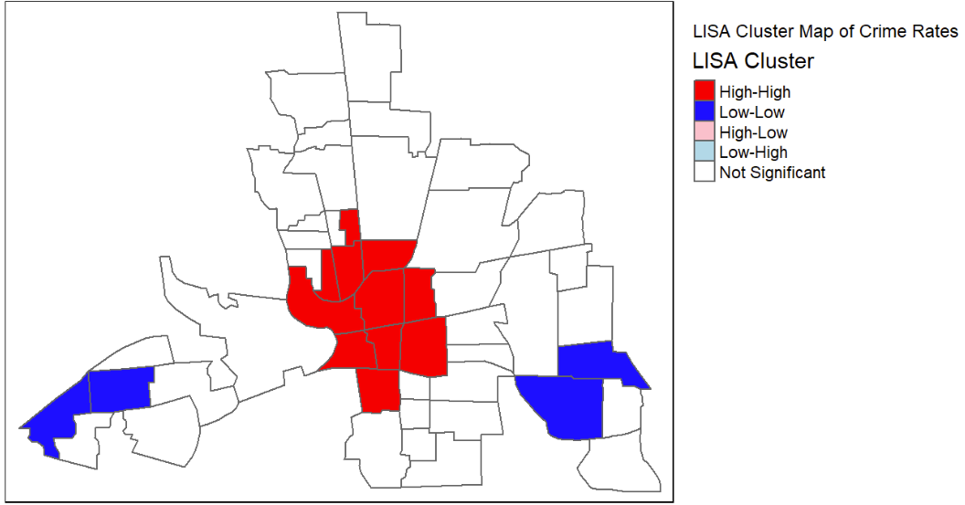
LISA Cluster Map
Purpose: Visualize significant local patterns identified by LISA.
Classification: Combines the local Moran's I value, its p-value, and the location's value relative to the mean to classify areas.
Categories:
High-High (Hotspot): High value surrounded by high values (Significant positive local I).
Low-Low (Coldspot): Low value surrounded by low values (Significant positive local I).
High-Low (Outlier): High value surrounded by low values (Significant negative local I).
Low-High (Outlier): Low value surrounded by high values (Significant negative local I).
Not Significant: Pattern isn't statistically significant.
Mapping: Use tmap to map these categories.
Notes:
The most intuitive way to show LISA results is a cluster map. We classify each neighborhood based on its own value and its neighbors' values, but only if the local Moran's I is statistically significant. This reveals 'High-High' clusters or hotspots (high crime areas next to other high crime areas), 'Low-Low' clusters or coldspots, and spatial outliers ('High-Low' or 'Low-High'). Areas where the pattern isn't significant are also shown. This map is powerful for targeting interventions.

Slide 15
WEEK 12 CODE DEMO session
Instructor: Yanan Wu
TA: Khadija Nisar
Spring 2025

