Slide 1

WEEK 05
Instructor: Yanan Wu
TA: Khadija Nisar
Spring 2025

Slide 2
5.1 regression

Slide 3
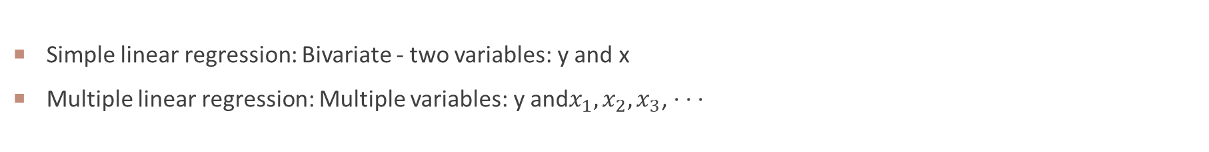
Multiple regression
Simple linear regression: Bivariate - two variables: y and x
Multiple linear regression: Multiple variables: y and$x_{1}, x_{2}, x_{3}$, · · ·

Slide 4
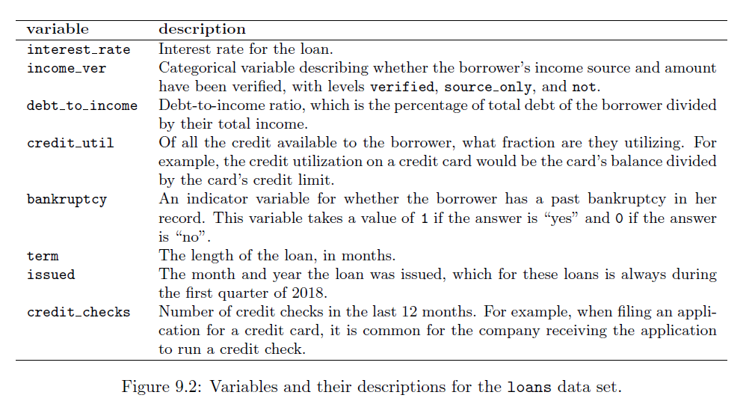
Loans data

Slide 5
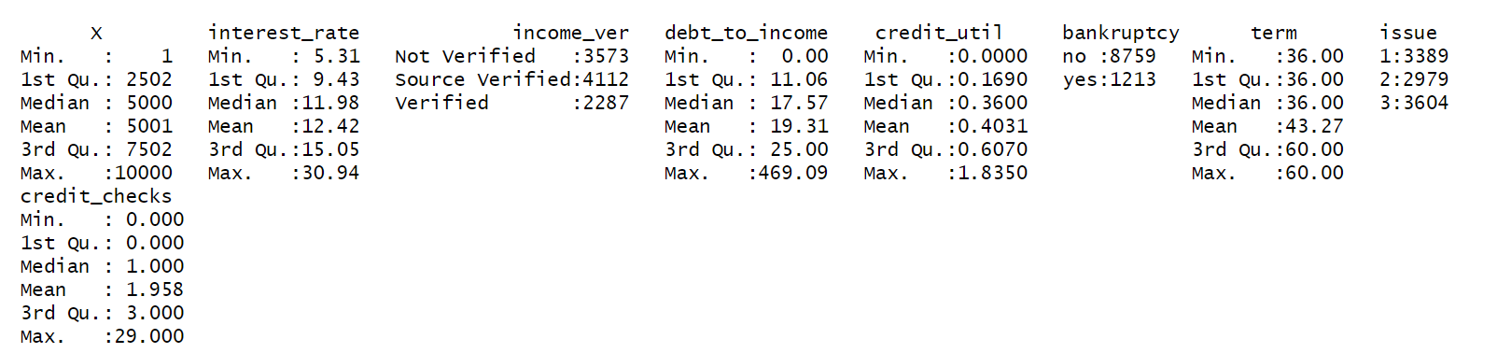
Categorical variable as predictors
Which variables are categorical variable？

Slide 6
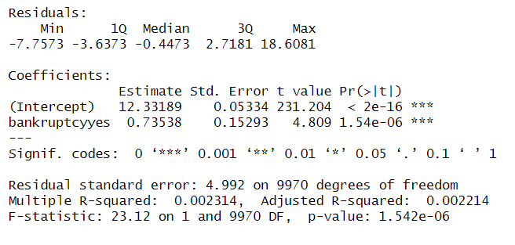
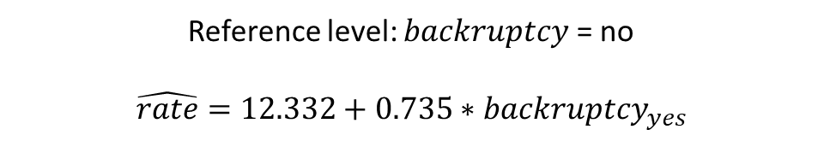
2-level Categorical variable as predictors
Reference level: $backruptcy$ = no
$$\hat{rate}=12.332+0.735∗backruptcy_{yes}$$

Slide 7
2-level Categorical variable as predictors
Intercept: The estimated average interest rate for borrower without a bankruptcy record is 12.332
This is the value we get if we plug in 0 for the explanatory variable
Slope: The estimated average interest rate for borrower with a bankruptcy record is 0.735 higher than borrower without a bankruptcy record
Then, the estimated average interest rate for borrower with a bankruptcy record is 12.332 + 0.735= 13.067
This is the value we get if we plug in 1 for the explanatory variable

Slide 8
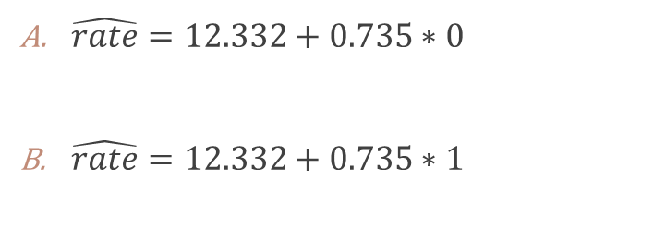
regression model
$$\hat{rate}=12.332+0.735∗backruptcy_{yes}$$
Borrower with bankruptcy record
Borrower without bankruptcy record
$\hat{rate}=12.332+0.735∗0$
$\hat{rate}=12.332+0.735∗1$
Which value (with bankruptcy or without bankruptcy) has the higher interest rate?

Slide 9
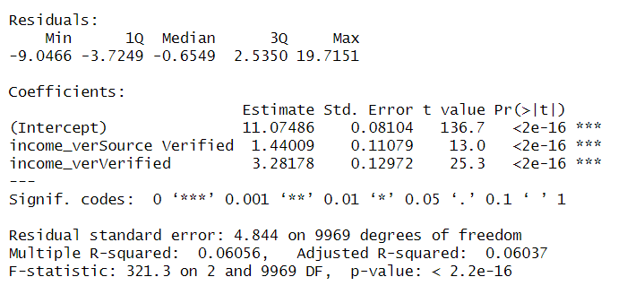
3-level Categorical variable as predictors
Which income verification (Source verified, verified, Non verified) is the reference level?
$$\hat{rate}=11.075+1.44∗income_{sourceVer}+2.282∗income_{verified }$$

Slide 10
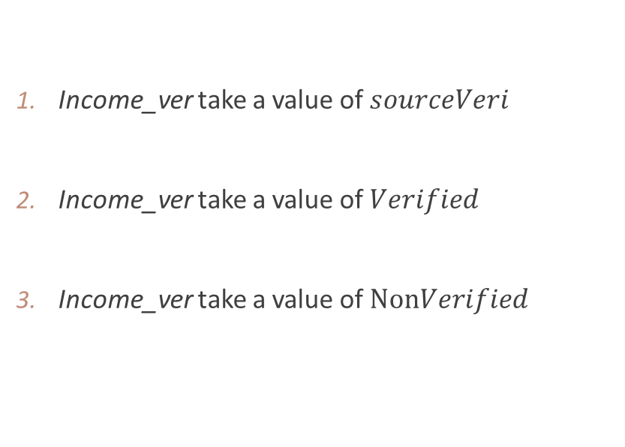
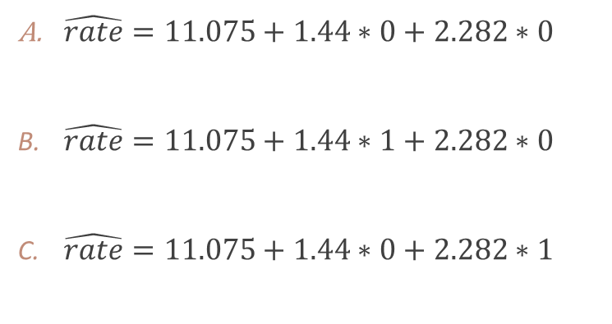
regression model
$$\hat{rate}=11.075+1.44∗income_{sourceVer}+2.282∗income_{verified }$$
Income_ver take a value of $sourceVeri$
Income_ver take a value of $Verified$
Income_ver take a value of $NonVerified$
$\hat{rate}=11.075+1.44∗0+2.282∗0$
$\hat{rate}=11.075+1.44∗1+2.282∗0$
$\hat{rate}=11.075+1.44∗0+2.282∗1$
Which income verification approach has the highest interest rate?
Source verification
Verification
Not verification
Can not tell

Slide 11
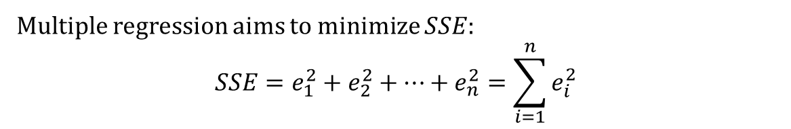
Assessing many $x_{i}$ in a model
lm(formula = interest_rate ~ income_ver + debt_to_income + credit_util + bankruptcy + issue + credit_checks, data = loans)
Multiple regression aims to minimize $SSE$:
$$SSE=e_{1}^{2}+e_{2}^{2}+…+e_{n}^{2}=\sum_{i=1}^{n}{e_{i}^{2}}$$

Slide 12
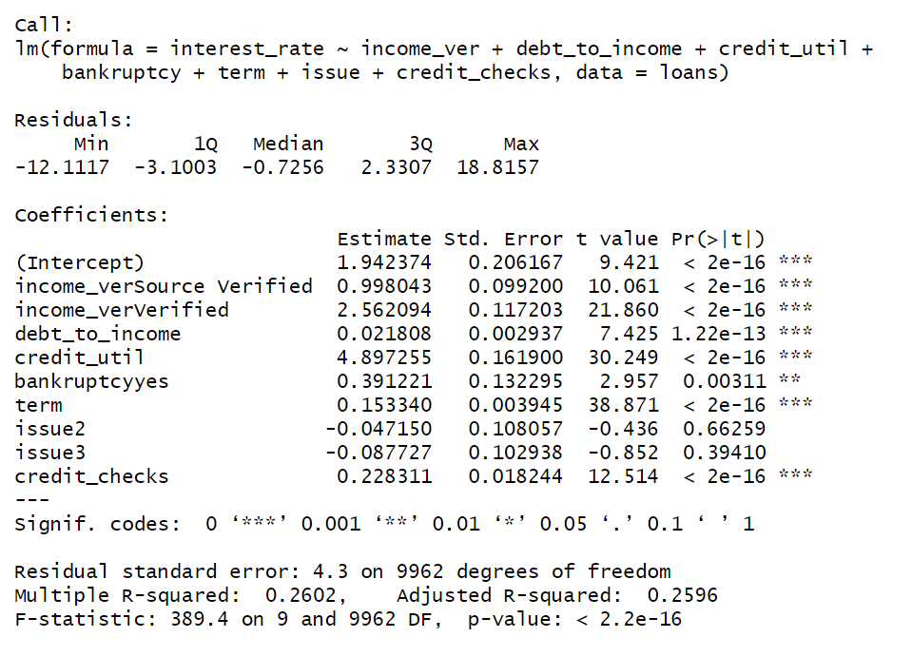
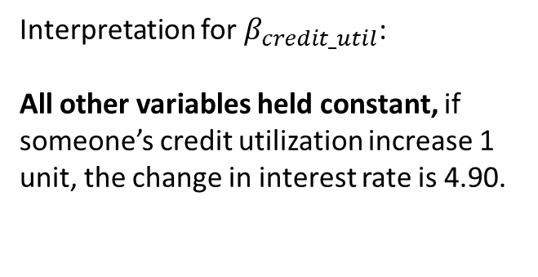
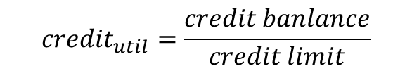
Output for the regression model
Which two variables are not important?
$$credit_{util}=\frac{credit banlance}{credit limit}$$
Interpretation for $β_{credit_util}$:
All other variables held constant, if someone’s credit utilization increase 1 unit, the change in interest rate is 4.90.

Slide 13
Interpretation
All else being equal, borrower with bankruptcy record
are estimated to have interest rate 0.39 lower
are estimated to have interest rate 0.39 higher
than borrower without bankruptcy record

Slide 14
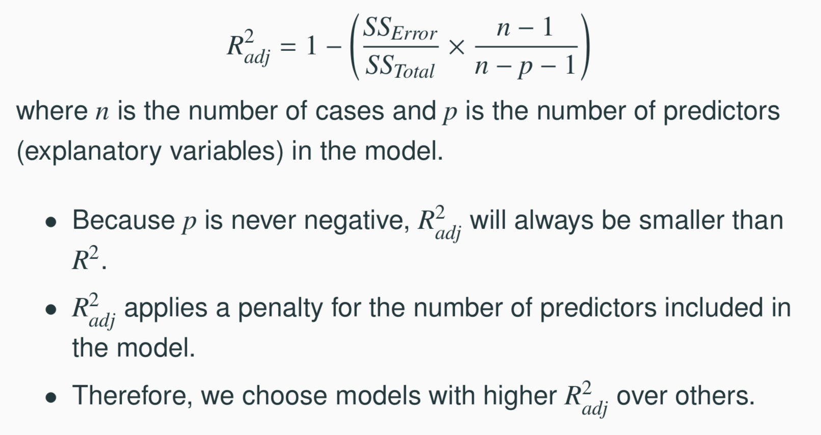
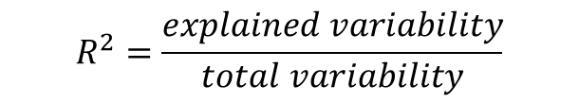
$R^{2}$ VS. adjusted $R^{2}$
$$R^{2}=\frac{explained variability}{total variability}$$

Slide 15
$R^{2}$ VS. adjusted $R^{2}$

Slide 16
COLLINEARITY BETWEEN INDEPENDENT VARIABLES
Two independent variables are said to be collinear when they are correlated, and this collinearity complicates model estimation.
We don’t like adding independent that are associated with each other to the model, because often times the addition of such variable brings nothing to the table. Instead, we prefer the simplest best model, i.e. parsimonious model.
While it’s impossible to avoid collinearity from arising in observational data, experiments are usually designed to prevent correlation among predictors.

Slide 17
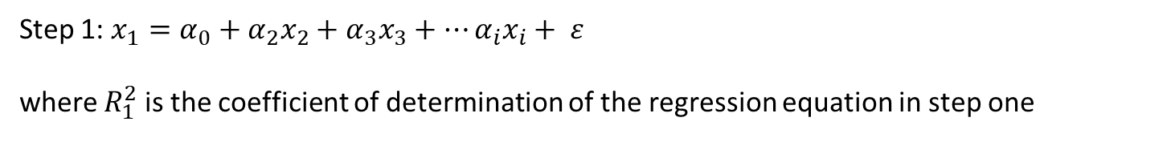
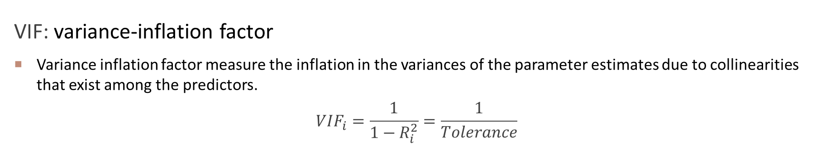
COLLINEARITY DIAGNOSTICS
VIF: variance-inflation factor
Variance inflation factor measure the inflation in the variances of the parameter estimates due to collinearities that exist among the predictors.
$$VIF_{i}=\frac{1}{1−R_{i}^{2}}=\frac{1}{Tolerance}$$
Step 1: $x_{1}=α_{0}+α_{2}x_{2}+α_{3}x_{3}+…α_{i}x_{i}+ ε$
where $R_{1}^{2}$ is the coefficient of determination of the regression equation in step one

Slide 18
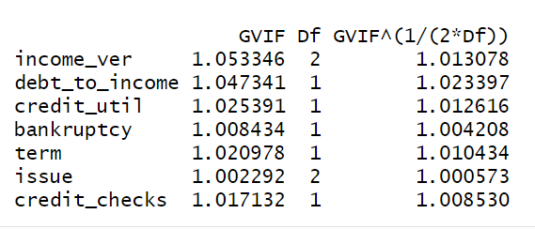
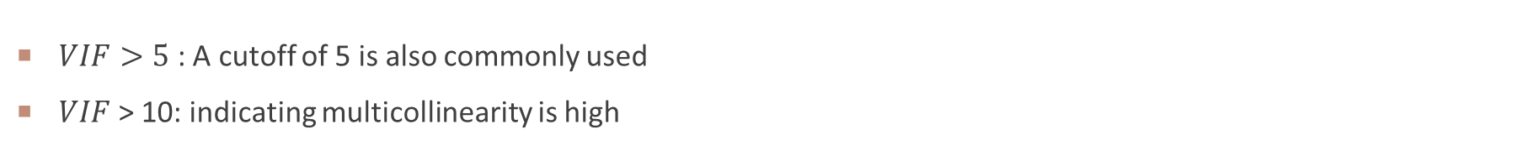
COLLINEARITY DIAGNOSTICS
$VIF>5$ : A cutoff of 5 is also commonly used
$VIF$ > 10: indicating multicollinearity is high

Slide 19
WEEK 03 CODE DEMO session
Instructor: Yanan Wu
TA: Khadija Nisar
Spring 2025

