Slide 1

WEEK 10
Instructor: Yanan Wu
TA: Khadija Nisar
Spring 2025

Slide 2
10.1 PRINCIPAL COMPONENT ANALYSIS

Slide 3
Learning Objectives
Understand how decision trees work.
Distinguish between regression and classification trees.
Learn how to build, interpret, and prune decision trees.
How to use Cross Validation for hyperparameter tuning.
Apply decision trees practically using R

Slide 4
PRINCIPAL COMPONENT ANALYSIS
Unsupervised analysis
Tool for data visualization

Slide 5
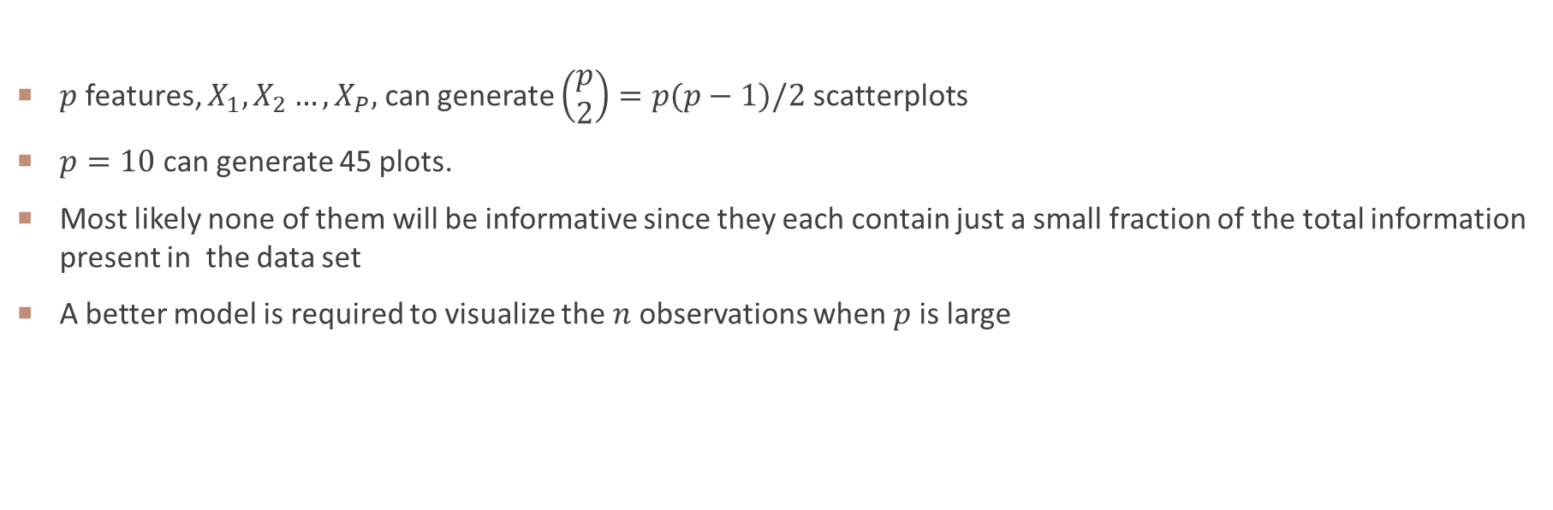
Principal component
$p$ features, $X_{1}, X_{2}…, X_{P},$ can generate $\left(\begin{matrix}p \\ 2\end{matrix}\right)=p(p−1)/2$ scatterplots
$p=10$ can generate 45 plots.
Most likely none of them will be informative since they each contain just a small fraction of the total information present in the data set
A better model is required to visualize the $n$ observations when $p$ is large

Slide 6
RASTER PCA
Create a few uncorrelated bands from a large set of correated bands

Slide 7
Data: landsat 8
USGS Data Introduction: https://www.usgs.gov/landsat-missions/landsat-8

Slide 8
WEEK 10 CODE DEMO session
Instructor: Yanan Wu
TA: Khadija Nisar
Spring 2025

Slide 9
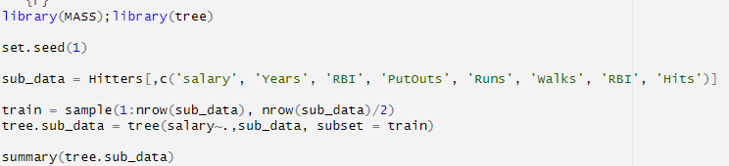
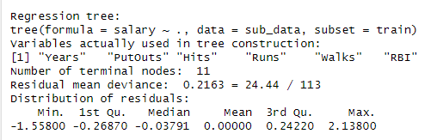
DECISION TREE IN R

Slide 10
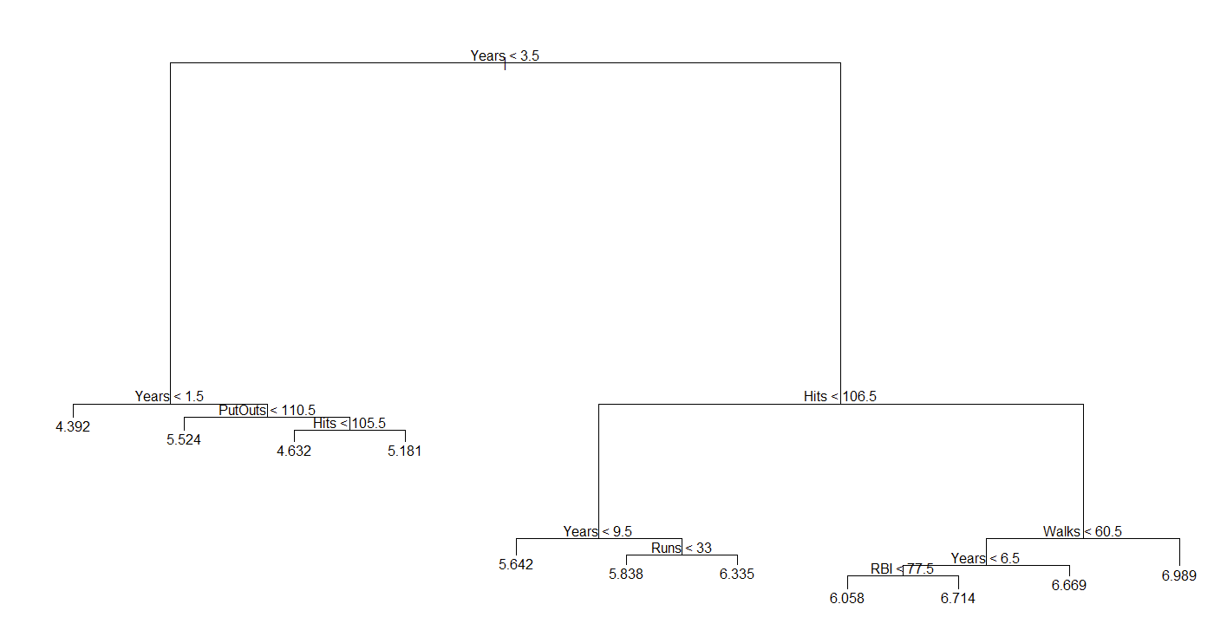
Decision tree structure

Slide 11
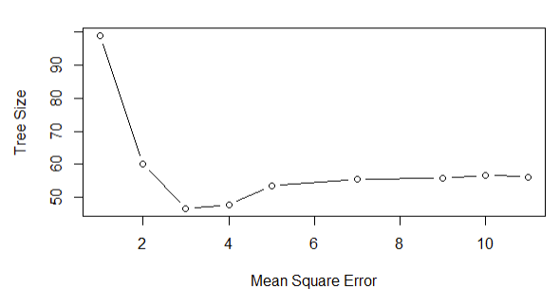
Prune tree

