Slide 1

WEEK 04
Instructor: Yanan Wu
TA: Khadija Nisar
Spring 2025

Slide 2
2.1.1 regression

Slide 3
CAUSALITY & REGRESSION
Causality: Relationship between cause and effect, where one event (the cause) directly influences another event (the effect).
Example: the relationship between rainfall and flooding
Co-variation: Two variables change together. If two variables tend to increase or decrease in a related manner, they are said to covary (not causality)

Slide 4
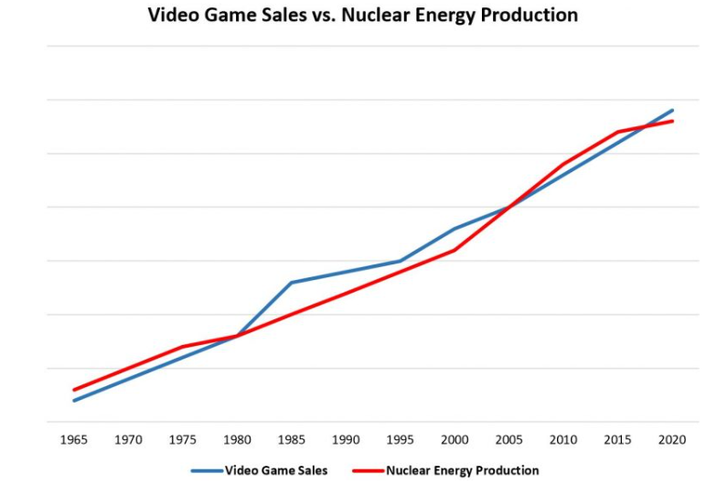
Spurious relationship
The covariation between $X$ and $Y$ can be influenced by their joint relationship to another variable $Z$ (or a set of variables)
Examples of spurious relationship

Slide 5
2.1.2 bivariate regression

Slide 6
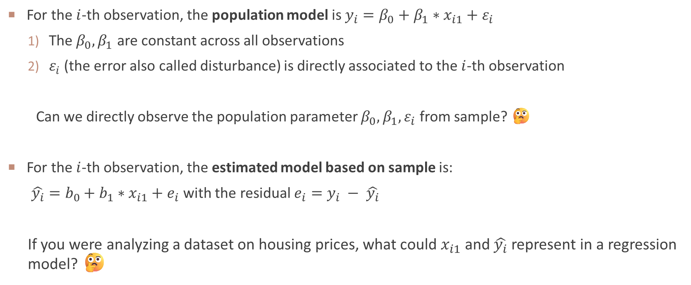
Model based on population and sample
For the $i$-th observation, the population model is $y_{i}=β_{0}+β_{1}∗x_{i1}+ε_{i}$
The $β_{0}, β_{1}$ are constant across all observations
$ε_{i}$ (the error also called disturbance) is directly associated to the $i$-th observation
Can we directly observe the population parameter $β_{0}, β_{1}, ε_{i}$ from sample? 🤔
For the $i$-th observation, the estimated model based on sample is:
$\hat{y_{i}}=b_{0}+b_{1}∗x_{i1}+e_{i}$ with the residual $e_{i}=y_{i} − \hat{y_{i}}$
If you were analyzing a dataset on housing prices, what could $x_{i1}$ and $\hat{y_{i}}$​ represent in a regression model? 🤔

Slide 7
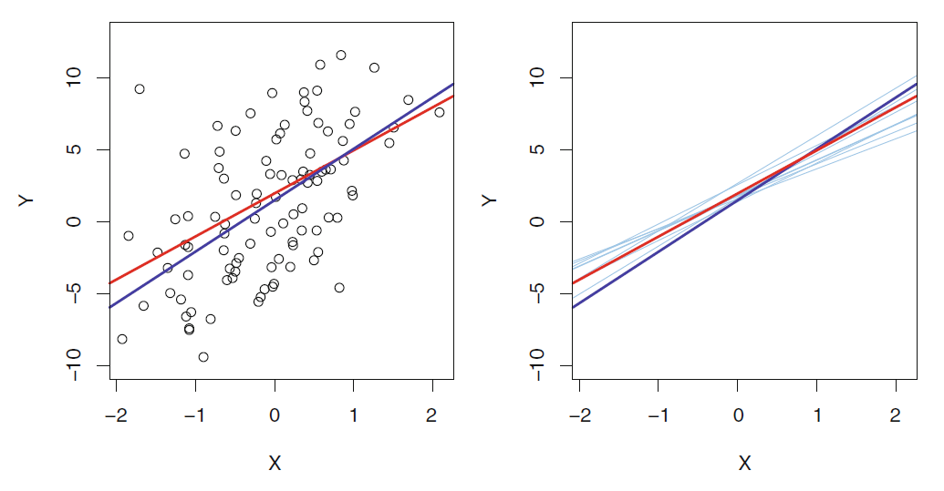
POPULATION REGRESSION LINE VS SAMPLE REGRESSION LINE
Red line: population regression line
Dark blue: sample regression line
Light blue: sample regression line based on different samples

Slide 8
2.1.3 ordinary least squares estimation

Slide 9
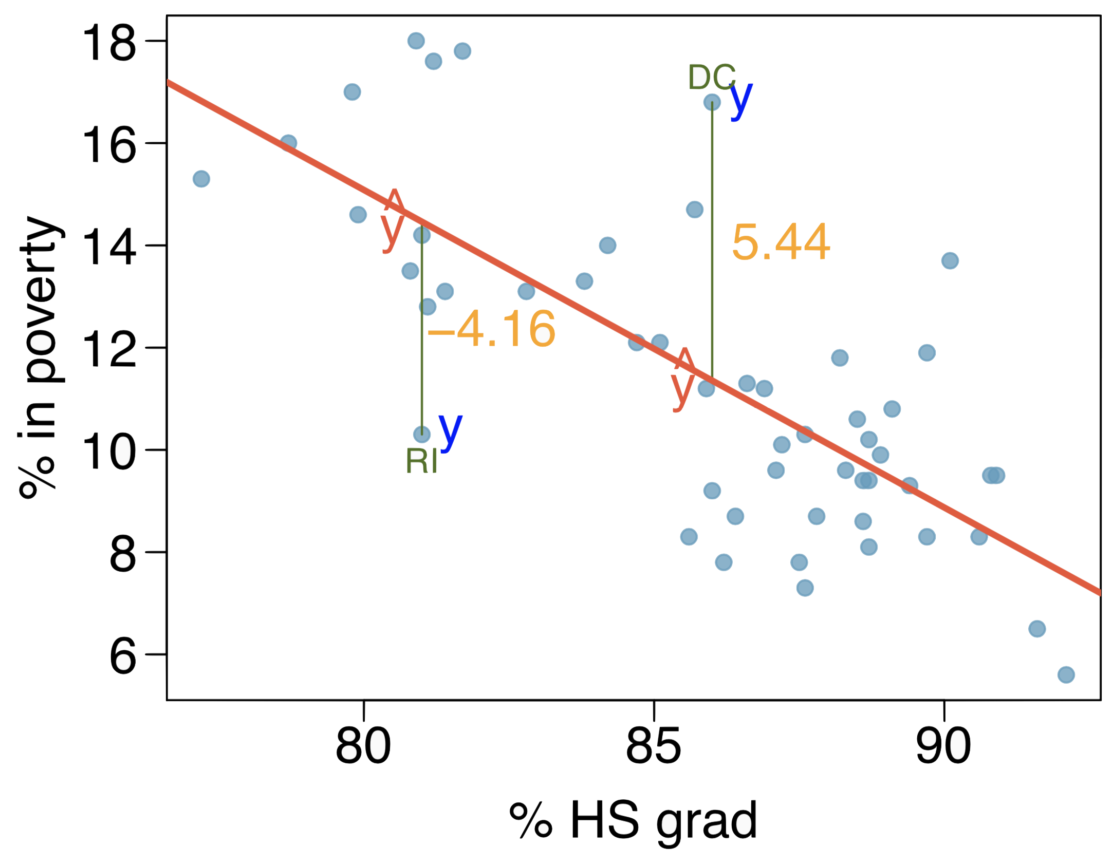
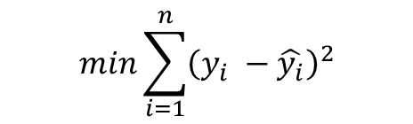

Ordinary Least Squares
1. A straight line can minimize the error (the difference between $y_{i}$ and $\hat{y_{i}}$)
$$e_{i}=y_{i} − \hat{y_{i}}$$
Do you want a smaller error or larger error? 🤔
$$min\sum_{i=1}^{n}{{\left(y_{i} −\hat{y_{i}}\right)}^{2}}$$

Slide 10
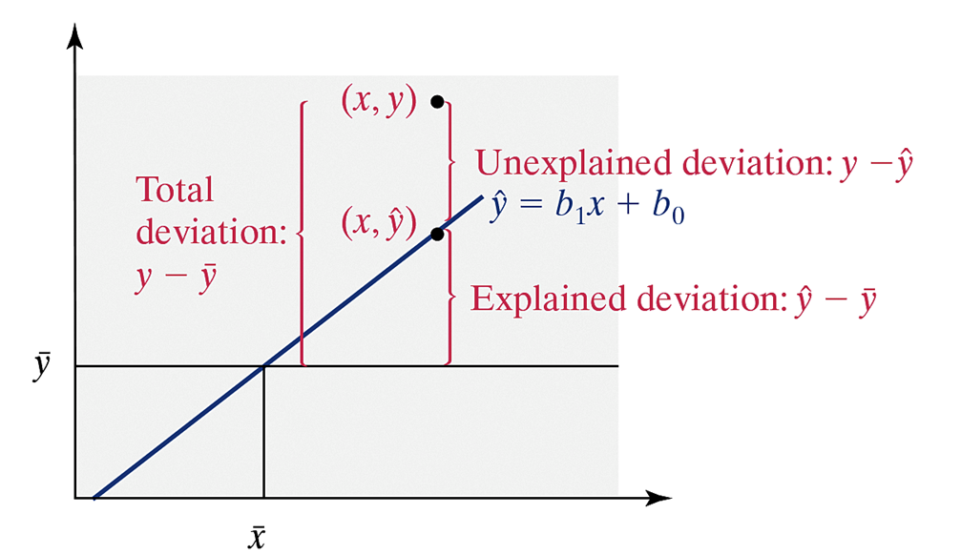
2. Variance Decomposition
As long as the linear model has an intercept, the regression line always goes through means of 𝑋 and 𝑌, i.e., the point (𝑥̅,𝑦̅) will be on the regression line

Slide 11

2. TSS, RSS, ESS
$$TSS={\sum_{i=2}^{n}{\left(y_{i} −\overline{y} \right)}}^{2}$$
$$ESS={\sum_{i=2}^{n}{\left(\hat{y_{i}}−\overline{y}\right)}}^{2}$$
$$RSS={\sum_{i=2}^{n}{\left(y_{i} − \hat{y_{i}} \right)}}^{2}$$
TSS = ESS + RSS

Slide 12
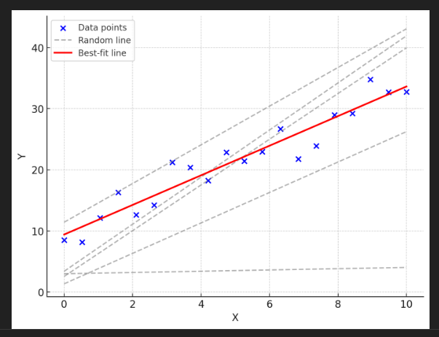
Slope and intercept
The lest square approach use $b_{0}$ and $b_{1}$ to minimize the RSS
$RSS=e_{1}^{2}+e_{2}^{2}+ …+e_{n}^{2},$ where $e_{i}=y_{i} −\hat{y_{i}}= y_{i} −(b_{0}+b_{1}∗x_{i1})$

Slide 13
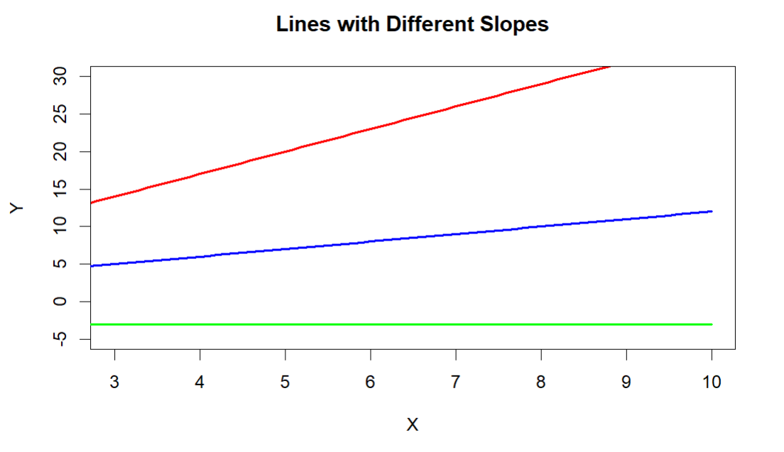
Explanation on $b_{0}$ and $b_{1}$
Which line has the highest slope?
Which line has the lowest intercept?

Slide 14
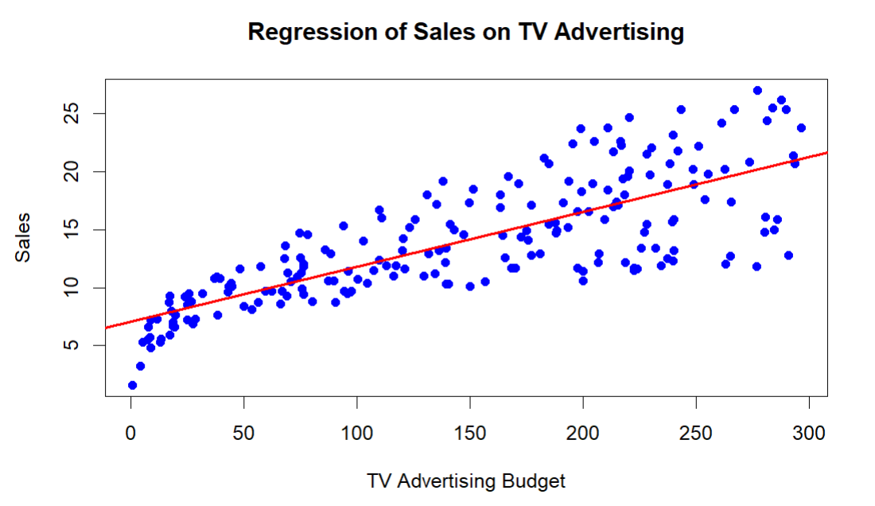
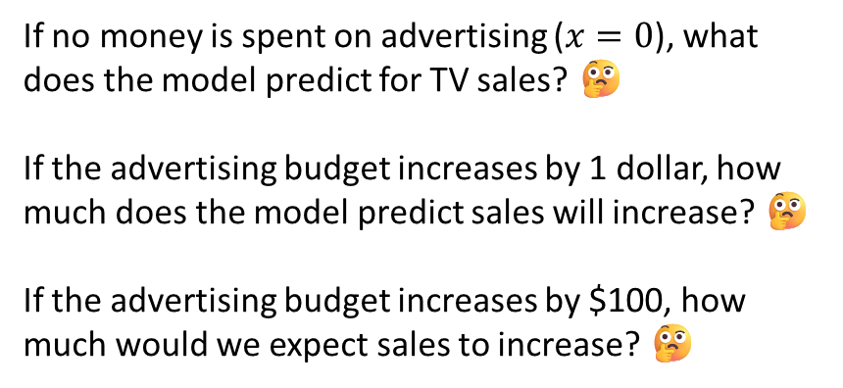
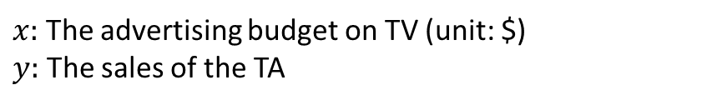

Explanation on $b_{0}$ & $b_{1}$
$$b_{0}=7.03, b_{1}=0.0475$$
If no money is spent on advertising ($x=0$), what does the model predict for TV sales? 🤔
If the advertising budget increases by 1 dollar, how much does the model predict sales will increase? 🤔
If the advertising budget increases by $100, how much would we expect sales to increase? 🤔
$x:$ The advertising budget on TV (unit: $)
$y:$ The sales of the TA

Slide 15
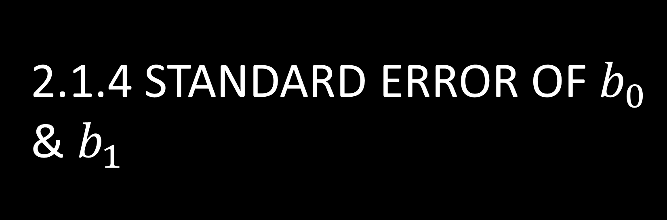
2.1.4 Standard error of $b_{0}$ & $b_{1}$

Slide 16
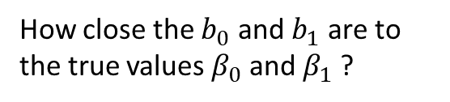
The estimated coefficients ($b_{0}$ and $b_{1}$) differ from sample to sample
Red line: population regression line
Dark blue: sample regression line
Light blue: sample regression line based on different samples
How close the $b_{0}$ and $b_{1}$ are to the true values $β_{0}$ and $β_{1}$ ?

Slide 17
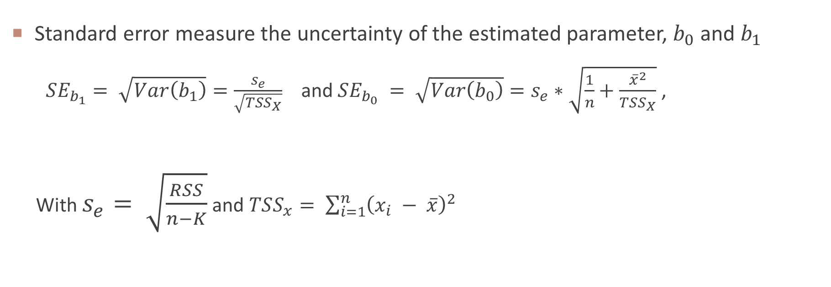
Standard error
Standard error measure the uncertainty of the estimated parameter, $b_{0}$ and $b_{1}$
$SE_{b_{1}}= \sqrt{Var\left(b_{1}\right)}=\frac{s_{e}}{\sqrt{TSS_{X}}}$ and $SE_{b_{0}} = \sqrt{Var\left(b_{0}\right)}=s_{e}∗\sqrt{\frac{1}{n}+\frac{{\overline{x}}^{2}}{TSS_{X}}}$ ,
With $s_{e}= \sqrt{\frac{RSS}{n−K}}$ and $TSS_{x}= \sum_{i=1}^{n}{{\left(x_{i} − \overline{x}\right)}^{2} }$
If the standard error of $b_{1}$​ is large, what does it indicate about the reliability of our estimate? 🤔
What is the effect of a small residual sum of squares (RSS) on the standard error?
How does the total of sum of squares $TSS_{x}$ affect the standard error?
Low uncertainty of any estimates is desirable properties.

Slide 18
2.1.5 confidence interval

Slide 19
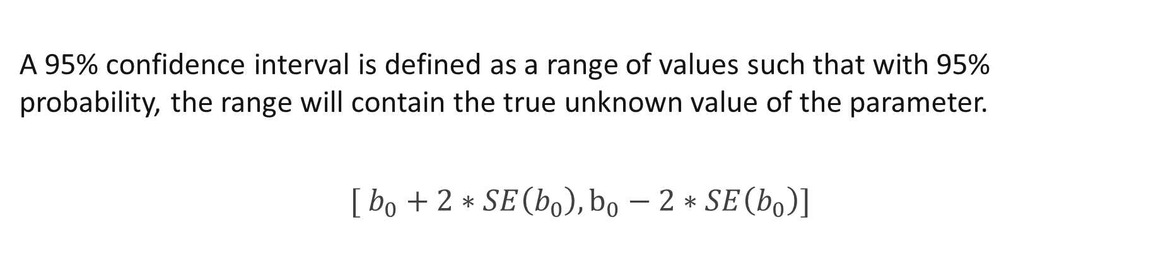
Confidence interval for $b_{0}$
A 95% confidence interval is defined as a range of values such that with 95% probability, the range will contain the true unknown value of the parameter.
$$[ b_{0}+2∗SE\left(b_{0}\right),b_{0}−2∗SE\left(b_{0}\right)]$$

Slide 20
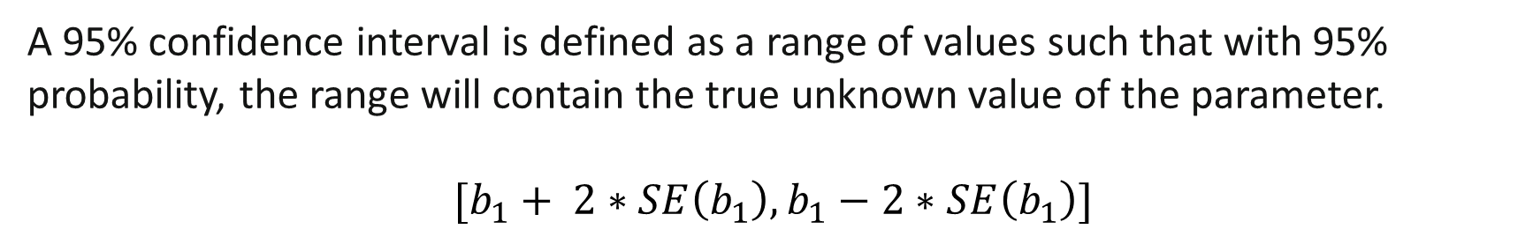
Confidence interval for $b_{1}$
A 95% confidence interval is defined as a range of values such that with 95% probability, the range will contain the true unknown value of the parameter.
$$[b_{1}+ 2∗SE\left(b_{1}\right),b_{1}−2∗SE\left(b_{1}\right)]$$

Slide 21
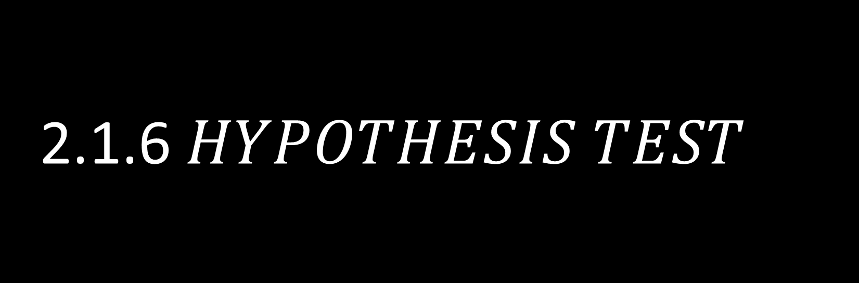
2.1.6 $HYPOTHESIS TEST$

Slide 22
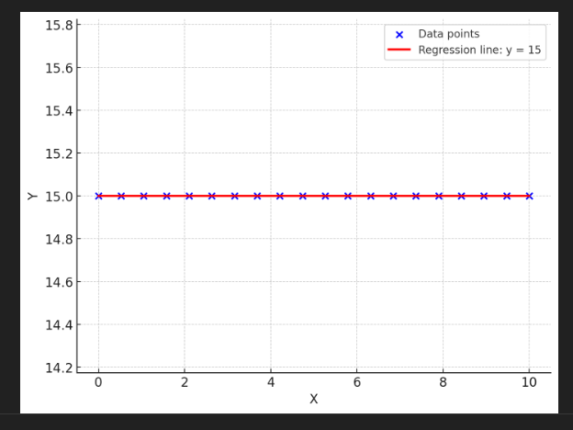
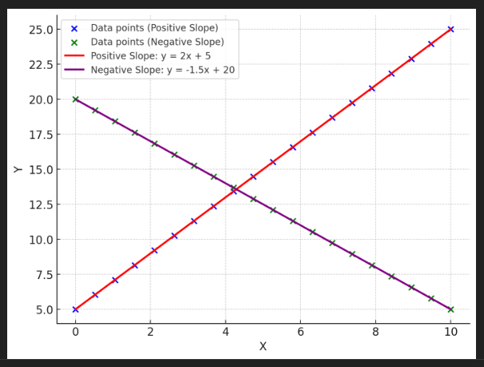
HYPOTHESIS TEST for $b_{1}$
If the $X$ variable does not explain any variation in $Y$, then there is no relationship between $X$ and $Y$
$H_{0}:b_{1}=0$ (There is no relationship between $X$ and $Y$)
$H_{1}:b_{1} ≠0$ (There is some relationship between $X$ and $Y$)

Slide 23
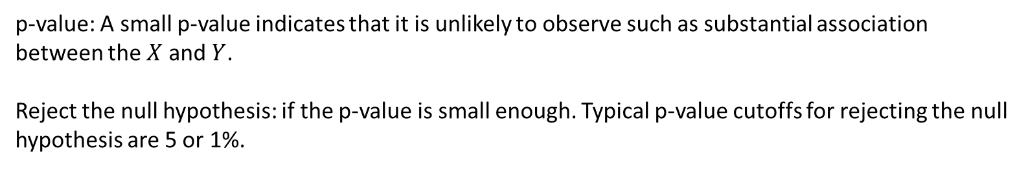
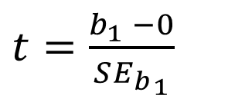
t-statistics
$t=\frac{b_{1} −0}{S{E_{b}}_{1}}$
p-value: A small p-value indicates that it is unlikely to observe such as substantial association between the $X$ and $Y$.
Reject the null hypothesis: if the p-value is small enough. Typical p-value cutoffs for rejecting the null hypothesis are 5 or 1%.

Slide 24
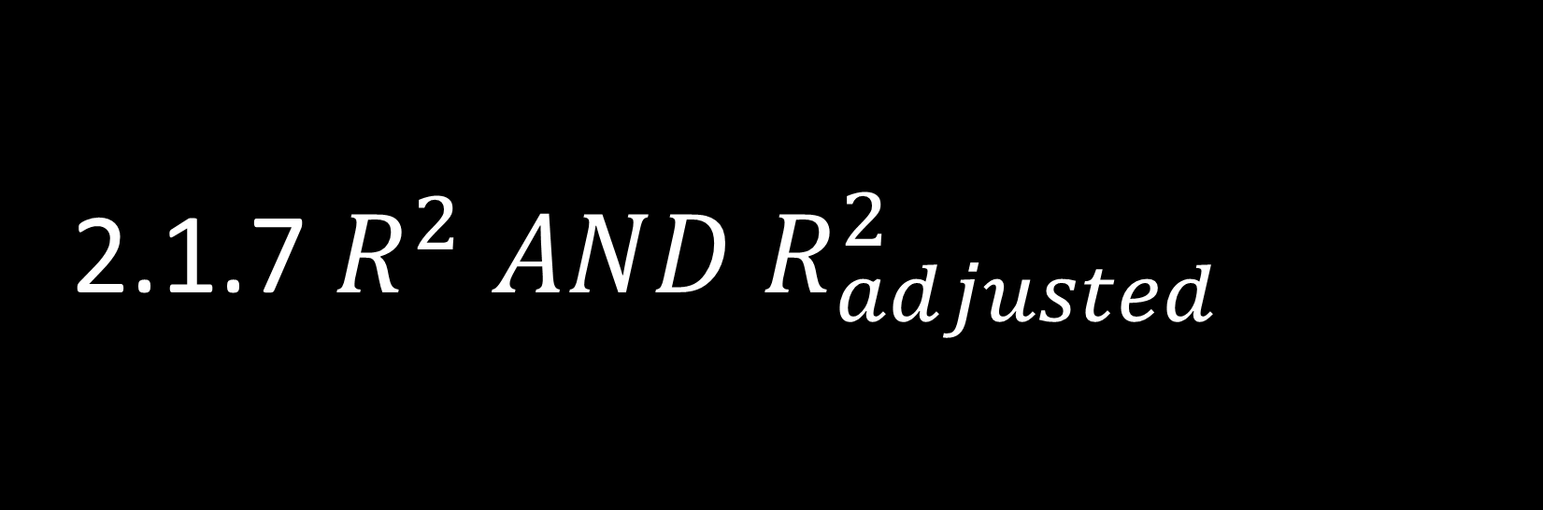
2.1.7 $R^{2} AND R_{adjusted}^{2}$

Slide 25
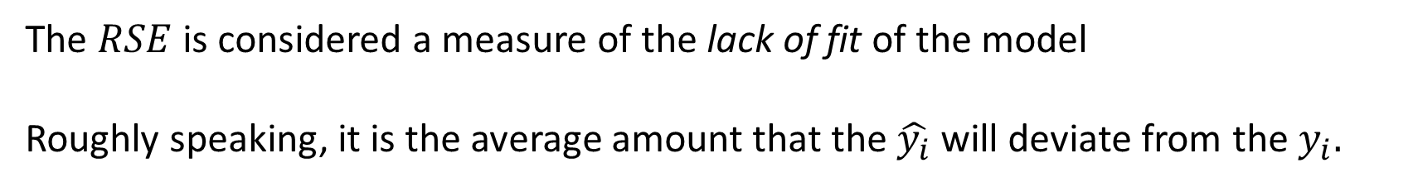
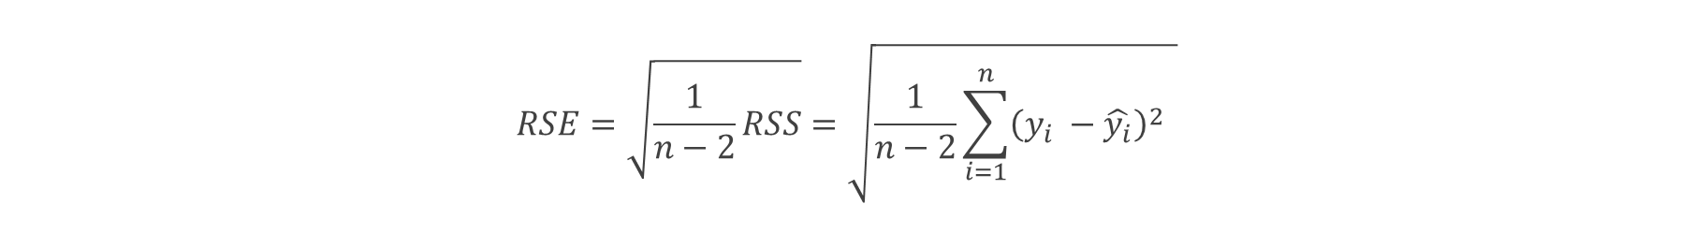
Residual standard error
$$RSE=\sqrt{\frac{1}{n−2}RSS}=\sqrt{\frac{1}{n−2}\sum_{i=1}^{n}{{\left(y_{i} −\hat{y_{i}}\right)}^{2}} }$$
The $RSE$ is considered a measure of the lack of fit of the model
Roughly speaking, it is the average amount that the $\hat{y_{i}}$ will deviate from the $y_{i}.$
For data with the same scale, Does a smaller RSE indicate a better or worse model fit?

Slide 26
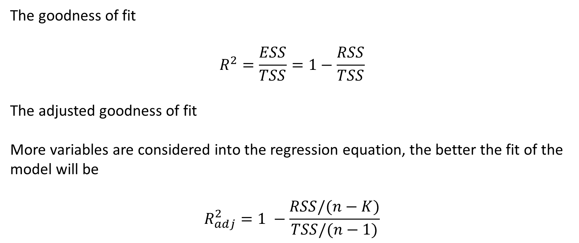
Assessing the Accuracy of the Model
The goodness of fit
$$R^{2}=\frac{ESS}{TSS}=1−\frac{RSS}{TSS}$$
The adjusted goodness of fit
More variables are considered into the regression equation, the better the fit of the model will be
$$R_{adj}^{2}=1 −\frac{RSS/(n−K)}{TSS/(n−1)}$$

Slide 27
2.1.8 key assumption on regression analysis

Slide 28
WEEK 03 CODE DEMO session
Instructor: Yanan Wu
TA: Khadija Nisar
Spring 2025

Slide 29
code
week04_Demo

