Slide 1

WEEK 10
Instructor: Yanan Wu
TA: Khadija Nisar
Spring 2025

Slide 2
10.1 Tree-based classification

Slide 3

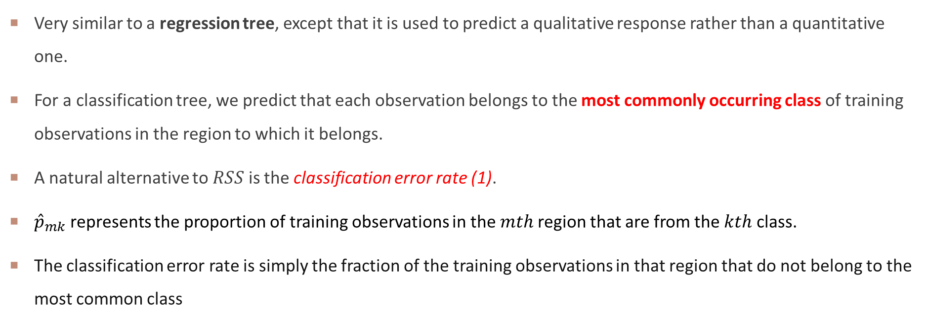
Classification trees
Very similar to a regression tree, except that it is used to predict a qualitative response rather than a quantitative one.
For a classification tree, we predict that each observation belongs to the most commonly occurring class of training observations in the region to which it belongs.
A natural alternative to $RSS$ is the classification error rate (1).
${\hat{p}}_{mk}$ represents the proportion of training observations in the $mth$region that are from the $kth$ class.
The classification error rate is simply the fraction of the training observations in that region that do not belong to the most common class

Slide 4
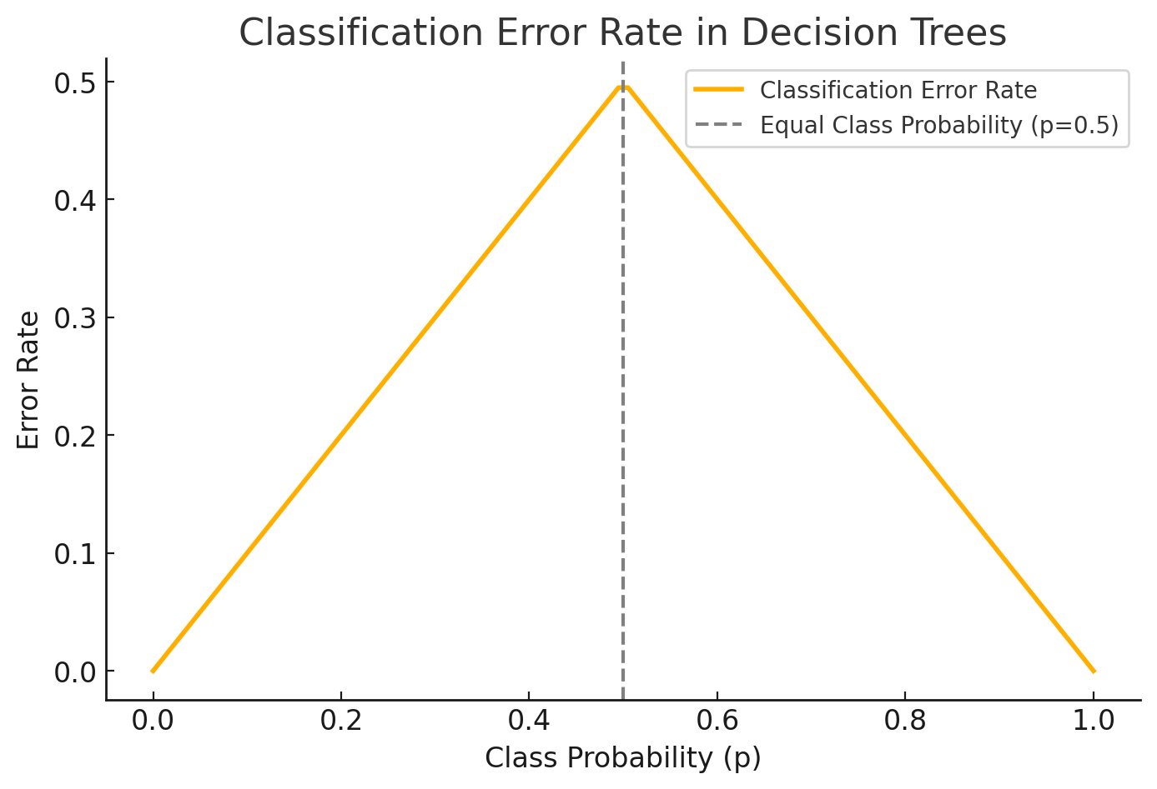
CLASSIFICATIO ERROR RATE

Slide 5
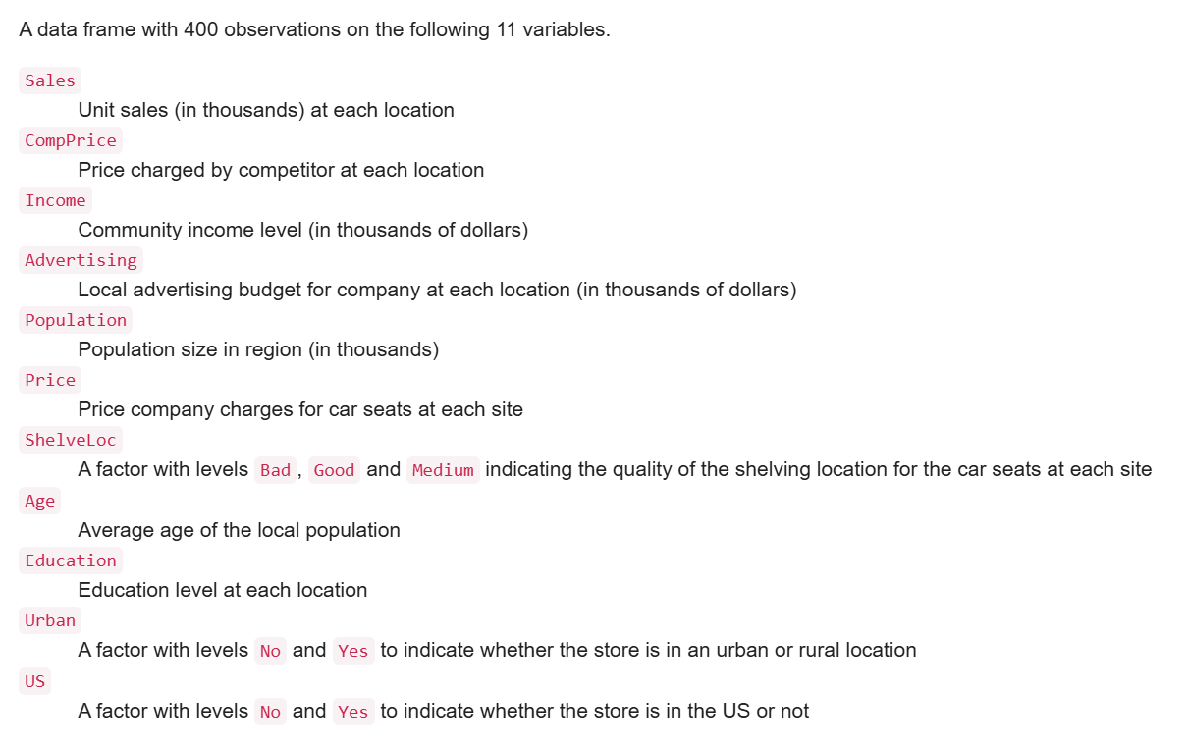
DATA
A simulated data set containing sales of child car seats at 400 different stores.
https://rdrr.io/cran/ISLR/man/Carseats.html

Slide 6
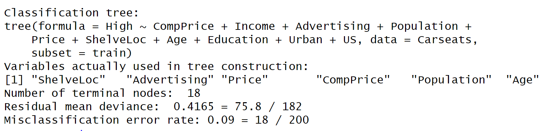
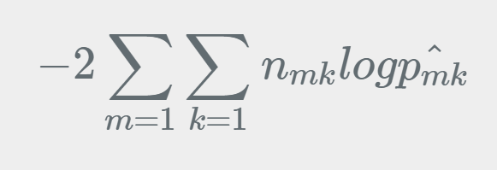
SUMMARY OF DECISION TREE
tree.carseats =tree(High~CompPrice+Income+Advertising+Population+Price+ShelveLoc+Age+Education+Urban+US, Carseats, subset =train)summary(tree.carseats)

Slide 7
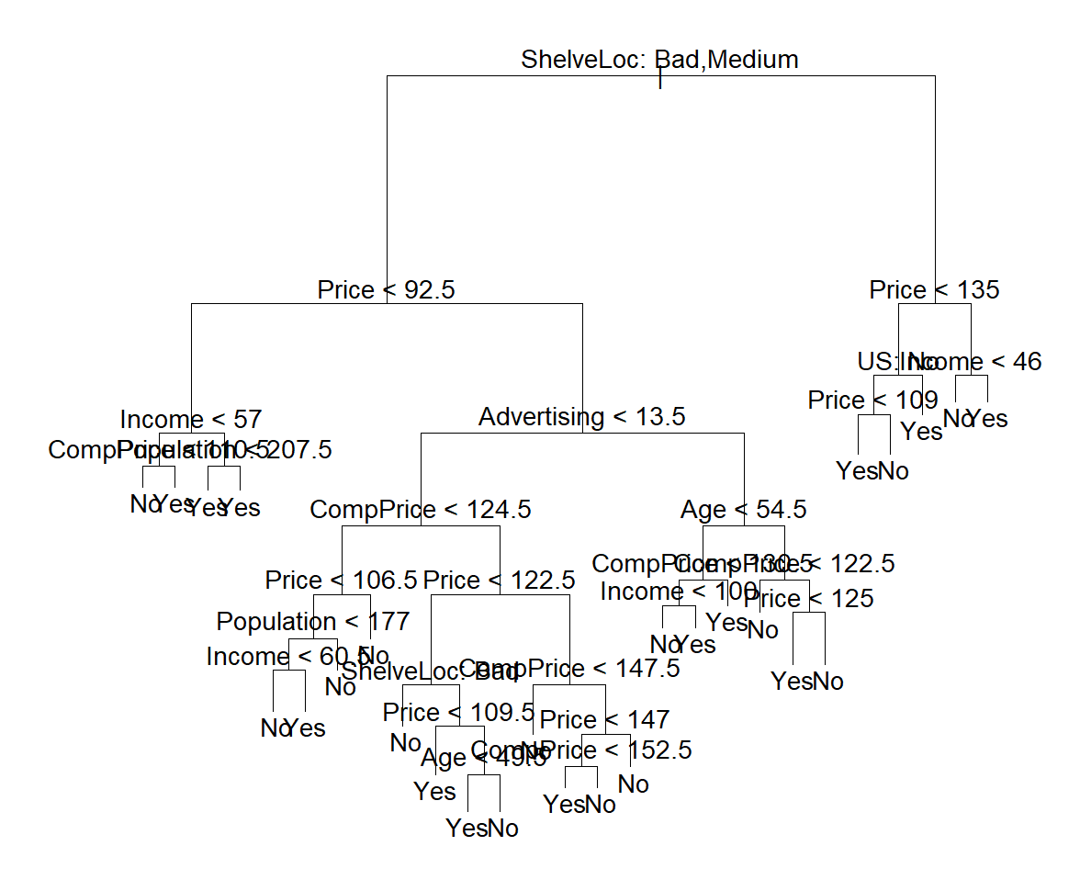
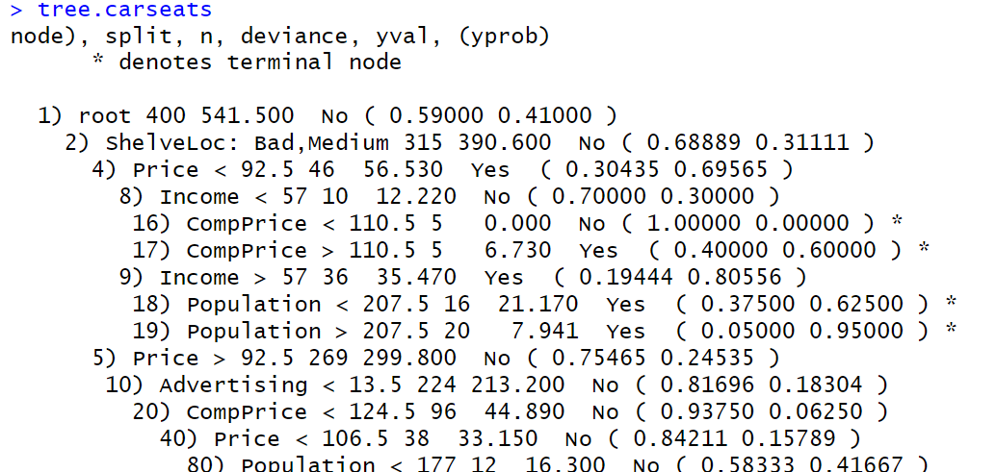
STRUCTURE of decis tree

Slide 8
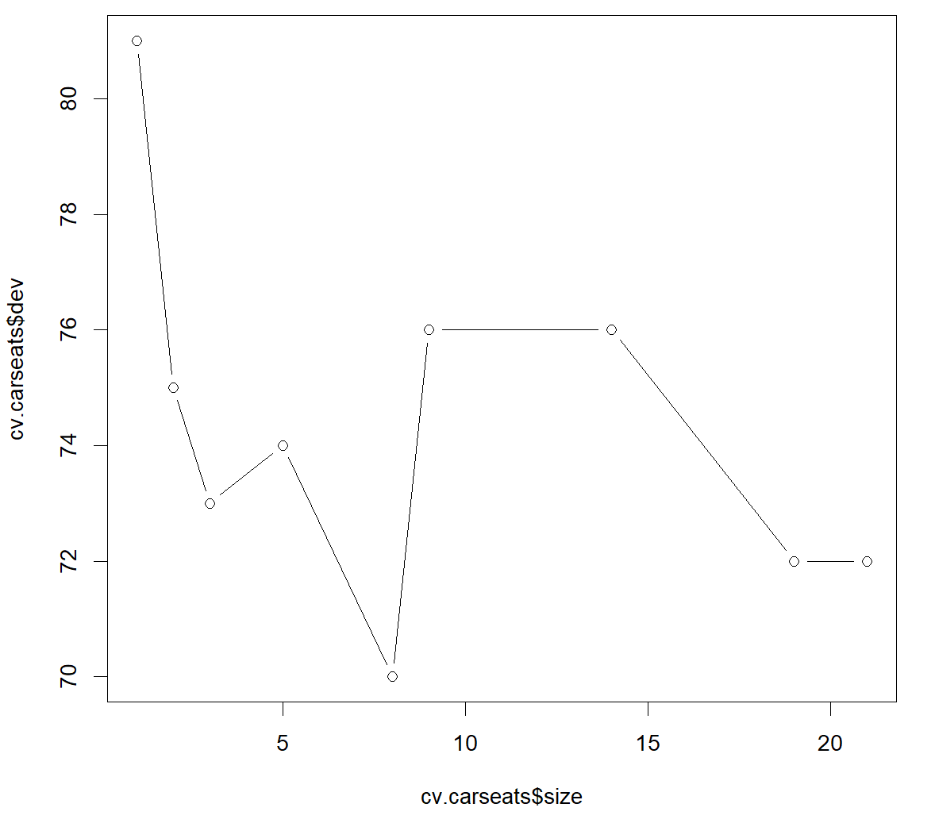
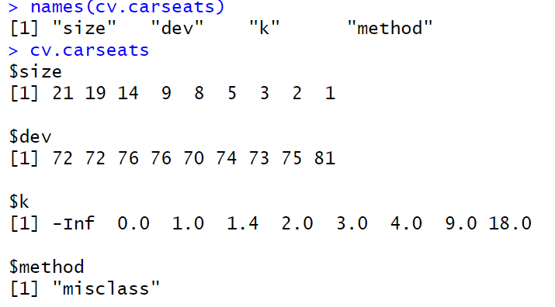
CROSS VALIDATION

Slide 9
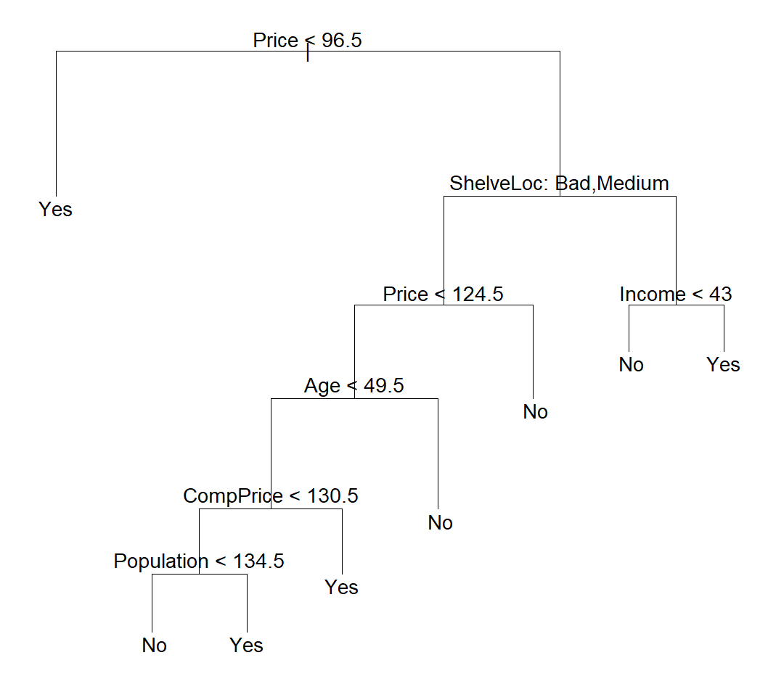
Prune tree

Slide 10
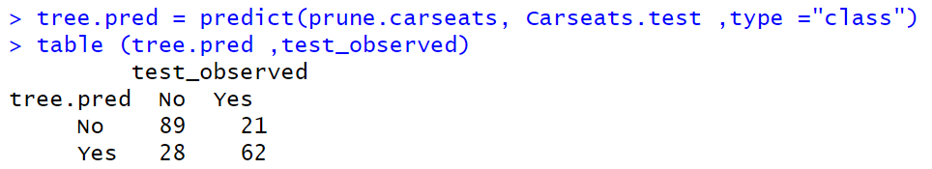
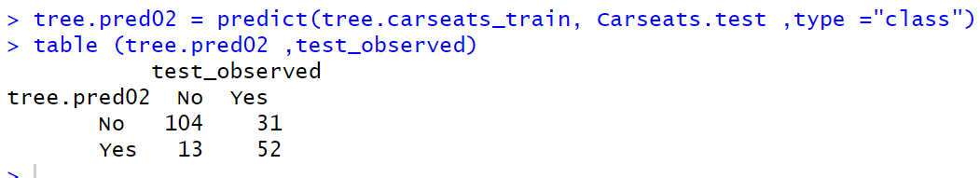
Prediction result
Prune Tree
Initial Tree

Slide 11
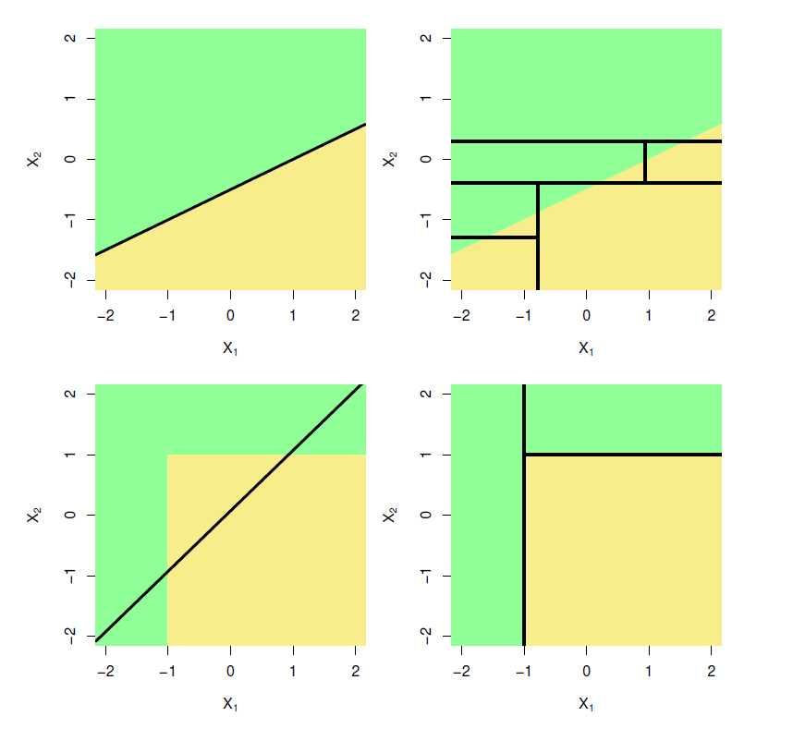
Advantages and Disadvantages of Trees
Advantages
Trees are very easy to explain to people.
Trees can be displayed graphically.
Trees can easily handle qualitative predictors without the need to create dummy variables.
Trees will not consider irrelevant features; no feature selection is needed.
Disadvantages
Standard pruned trees usually do not achieve the same predictive accuracy than other regression or classification methods
Trees can be very volatile from sample to sample, i.e., they exhibit a high variance. This leads to refined tree-building strategies aimed at reducing the variance.
Top Row: True linear boundary; Bottom row: true non-linear boundary.
Left column: linear model; Right column: tree-based model

Slide 12
WEEK 09 CODE DEMO session
Instructor: Yanan Wu
TA: Khadija Nisar
Spring 2025

