Slide 1

WEEK 08
Instructor: Yanan Wu
TA: Khadija Nisar
Spring 2025

Slide 2
8.1 LOGISTIC REGRESSION

Slide 3
Regression & classification
Supervised learning
regression
Ordinary Lest Squares regression
classification
Logistic Regression

Slide 4
classification
Dependent variable: Categorical (OLS assumes a continuous distribution)
Independent variable: mix of continuous variable and categorical variables
Classification problem
Types of Classification Problems
Binary Classification – When there are only two possible classes (e.g., spam vs. not spam in email filtering).
Multiclass Classification – When there are more than two possible classes (e.g., classifying images of animals into cats, dogs, or birds).

Slide 5
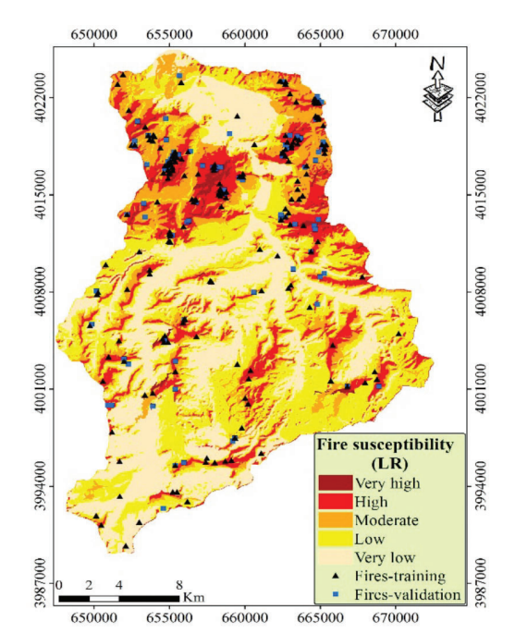
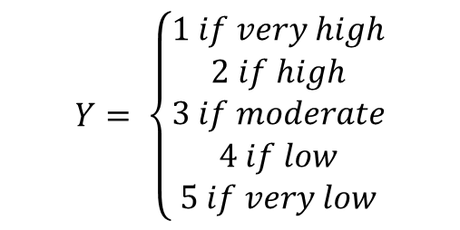
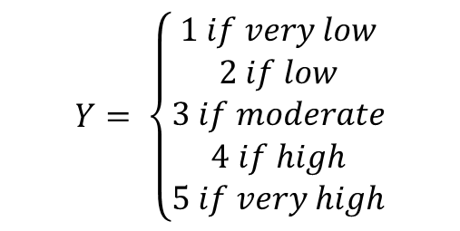
Multiple class
$$Y= \left\{\begin{aligned}1 if very high \\ 2 if high \\ 3 if moderate \\ 4 if low \\ 5 if very low\end{aligned}\right.$$
$$Y= \left\{\begin{aligned}1 if very low \\ 2 if low \\ 3 if moderate \\ 4 if high \\ 5 if very high\end{aligned}\right.$$
Which label is correct or we can use either of them?

Slide 6
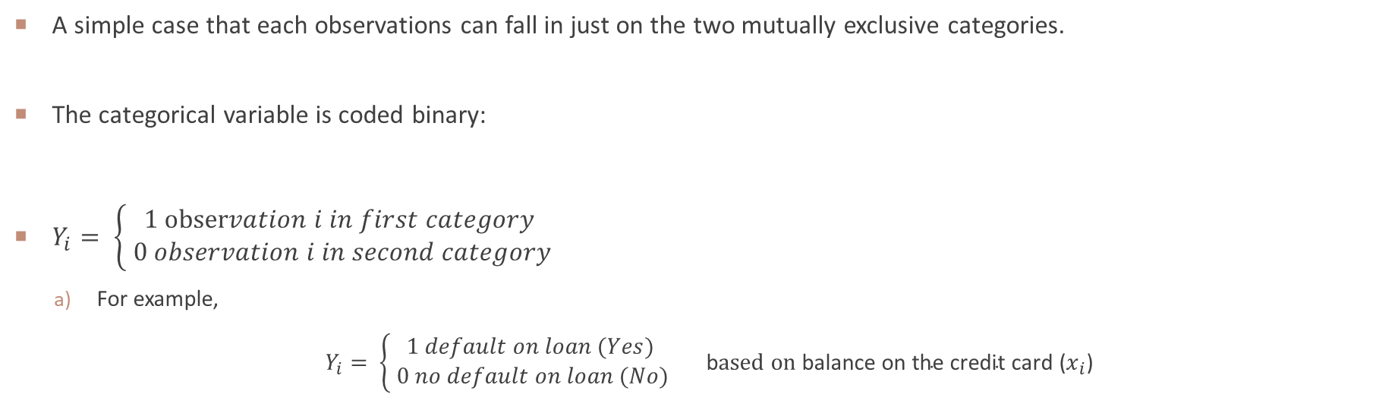
Basic logistic regression
A simple case that each observations can fall in just on the two mutually exclusive categories.
The categorical variable is coded binary:
$Y_{i}= \left\{\begin{aligned}1 observation i in first category \\ 0 observation i in second category\end{aligned}\right.$
For example,
$Y_{i}= \left\{\begin{aligned}1 default on loan (Yes) \\ 0 no default on loan (No)\end{aligned}\right.$ b$ased on \text{balance} \text{on} \text{the} \text{credit} \text{card}$ ($x_{i}$)

Slide 7
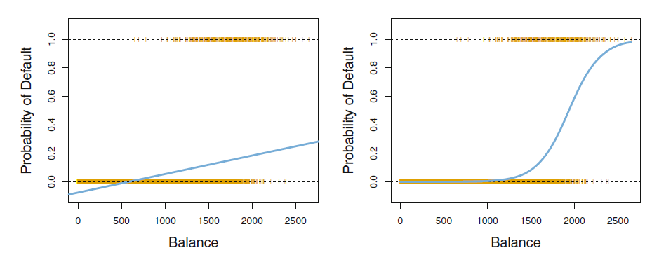
Problem of modeling binary dependent variable by linear regression
Problem 1: Linear Predictions outside the feasible range
The predicted value can fall outside the feasible range of probabilities [0,1]

Slide 8
Probability of y
We can predict default = Yes for any individual for whom p(balance) > 0.5.
if a company wishes to be conservative in predicting individuals who are at risk for default, then they may choose to use a lower threshold, such as p(balance) > 0.1.
We use 0.5 as the threshold value. If the probability of default (Default = Yes) is 0.6, the person would be classified as "Default (category 1)" or ‘Not Default (category 0)’ ?
We use 0.7 as the threshold value. If the probability of default (Default = Yes) is 0.6, the person would be classified as "Default (category 1)" or ‘Not Default (category 0)’ ?

Slide 9
Comparison between linear regression and logistic regression
Linear Regression | Logistic Regression
Predicts continuous outcome | Predict probability of class
Output can be any number | Output is probability (o to 1)
Sensitive to outliers | Handles classification tasks well

Slide 10
MROZ DATA IN r
The Mroz data frame has 753 rows and 8 columns. The observations, from the Panel Study of Income Dynamics (PSID), are married women.
Data Introduction
Dependent variable
lfp: labor-force participation; a factor with levels: no (0); yes (1).
Independent variable
K5, k618, …inc

Slide 11

Logistic function
Pr(lfc = Yes| $X_{i}$), which we abbreviate $p(x)$
We must model $p(x)$ using a function that gives outputs between 0 and 1.
$p\left(x\right)=\frac{e^{β_{o}+β_{1}x}}{1+e^{β_{0}+β_{1}x}}$ (1.1)
Now, if we assume that $β_{0}=3, β_{1}=2$
$$p\left(x\right)=\frac{e^{3+2x}}{1+e^{3+2x}}$$
Now, if we assume that $β_{0}=3, β_{1}=−2$
$$p\left(x\right)=\frac{e^{3−2x}}{1+e^{3−2x}}$$
Graph Calculator

Slide 12
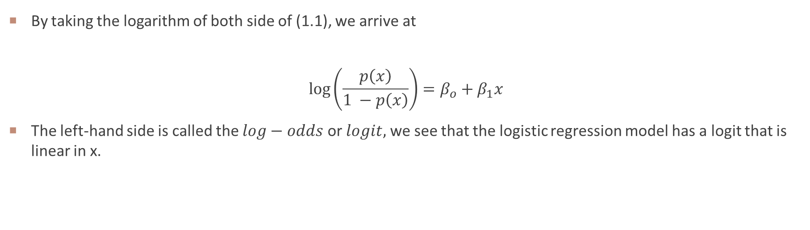
Logit model
By taking the logarithm of both side of (1.1), we arrive at
$$\log\left(\frac{p\left(x\right)}{1 −p\left(x\right)}\right)=β_{o}+β_{1}x$$
The left-hand side is called the $log−odds$ or $logit,$ we see that the logistic regression model has a logit that is linear in x.

Slide 13
8.2 MULTIPLE LOGISTIC REGRESSION

Slide 14
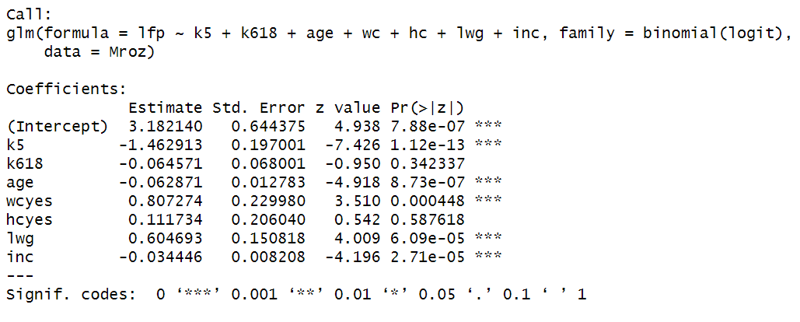
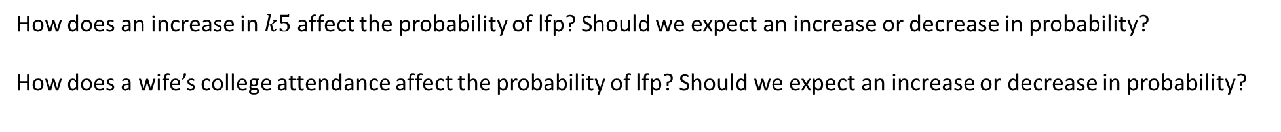
Estimating the regression coefficients
How does an increase in $k5$affect the probability of lfp? Should we expect an increase or decrease in probability?
How does a wife’s college attendance affect the probability of lfp? Should we expect an increase or decrease in probability?

Slide 15
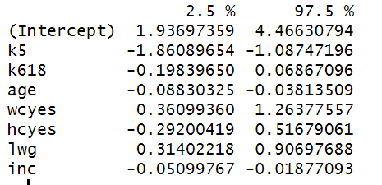
Confidence interval

Slide 16
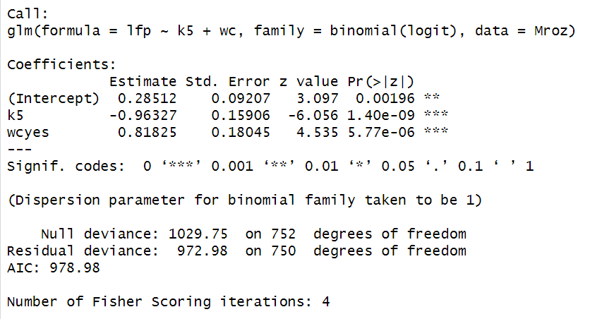
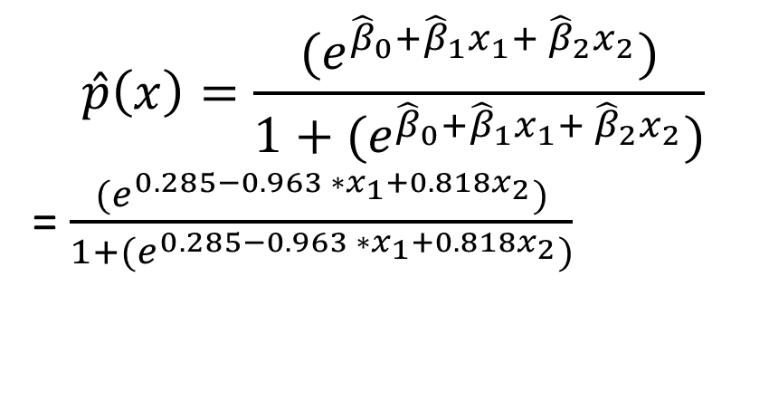
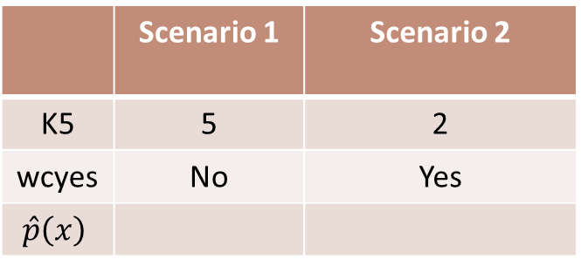
Making prediction
$$\hat{p}\left(x\right)=\frac{{(e}^{{\hat{β}}_{0}+{\hat{β}}_{1}x_{1}+ {\hat{β}}_{2}x_{2}})}{1+{(e}^{{\hat{β}}_{0}+{\hat{β}}_{1}x_{1}+ {\hat{β}}_{2}x_{2}})}$$
= $\frac{{(e}^{0.285−0.963 ∗x_{1}+0.818x_{2}})}{1+{(e}^{0.285−0.963 ∗x_{1}+0.818x_{2}})}$
 | Scenario 1 | Scenario 2
K5 | 5 | 2
wcyes | No | Yes
$$\hat{p}\left(x\right)$$
What is the probability for lfc in two scenario?

Slide 17
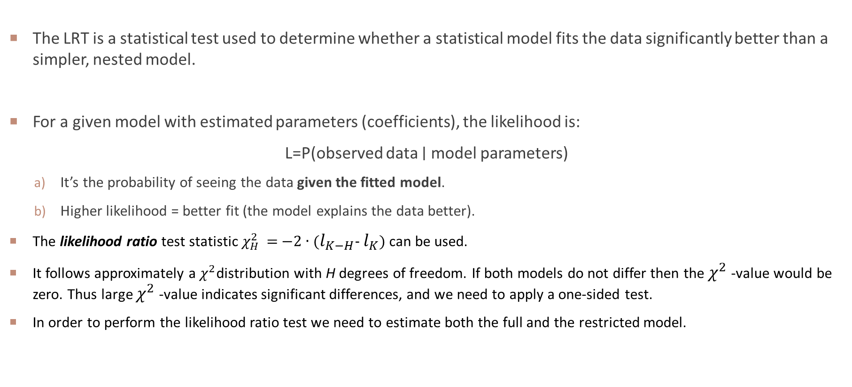
LIKELIHOOD RATIO TEST (LRT)
The LRT is a statistical test used to determine whether a statistical model fits the data significantly better than a simpler, nested model.
For a given model with estimated parameters (coefficients), the likelihood is:
L=P(observed data ∣ model parameters)
It’s the probability of seeing the data given the fitted model.
Higher likelihood = better fit (the model explains the data better).
The likelihood ratio test statistic $χ_{H}^{2}$ = −2 ∙ ($l_{K−H}$- $l_{K}$) can be used.
It follows approximately a $χ^{2}$distribution with H degrees of freedom. If both models do not differ then the $χ^{2}$-value would be zero. Thus large $χ^{2}$-value indicates significant differences, and we need to apply a one-sided test.
In order to perform the likelihood ratio test we need to estimate both the full and the restricted model.

Slide 18
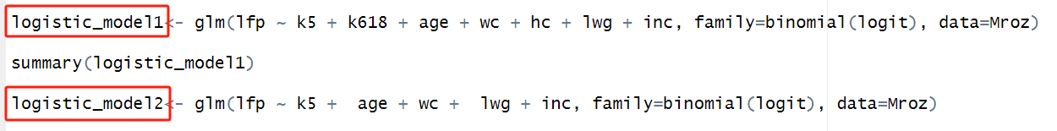

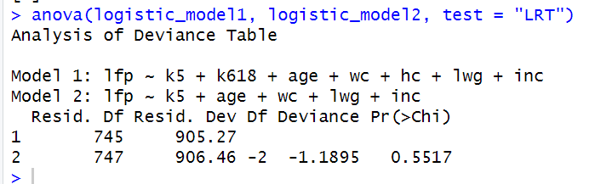
Anova TEST

Slide 19
8.3 PARAMETER INTERPRETATION

Slide 20
All effects plot
Effect plots help visualize how predictor variables influence the probability of the outcome while holding other variables constant.
All effects plots show the individual impact of each predictor in a logistic regression model in a single visualization.
What is an All Effects Plot?
Definition: A collection of conditional effect plots, each displaying how one independent variable affects the predicted probability of the outcome.
Purpose: Helps interpret the contribution of each predictor in the model.
Includes:
Continuous variables: Show smooth probability curves.
Categorical variables: Show probability differences between groups.

Slide 21
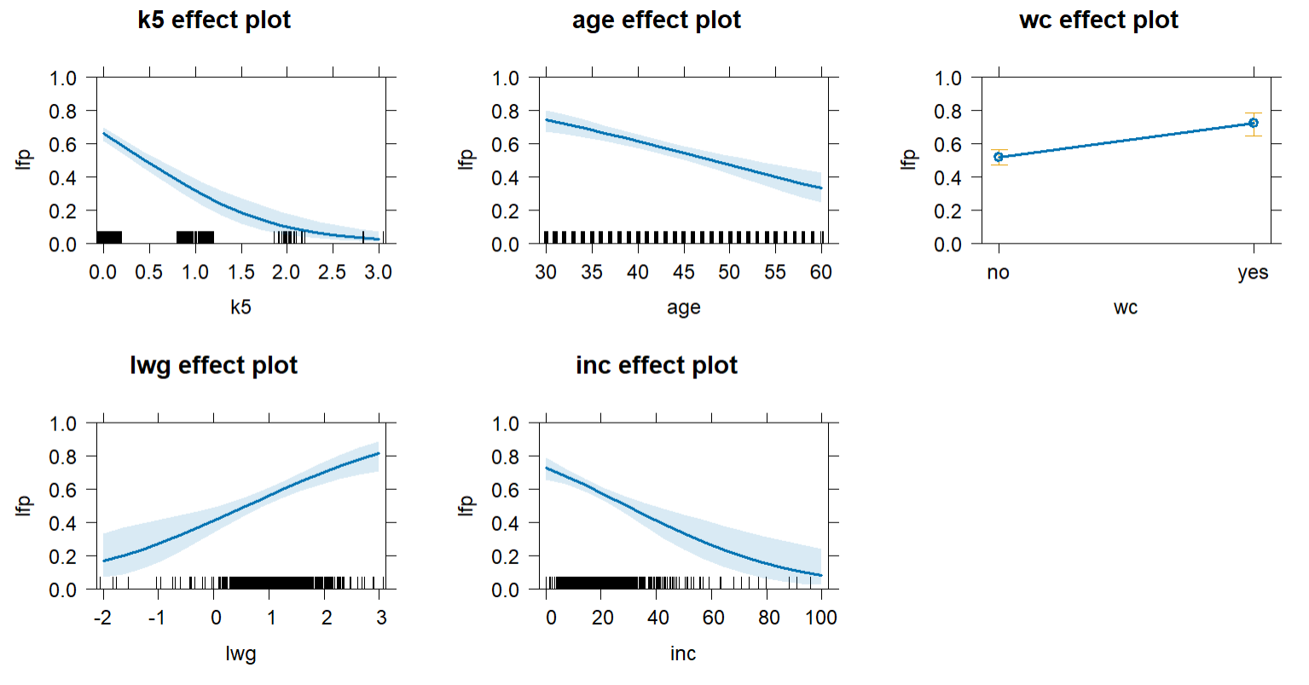
Conditional effect plot
x axis
Y axis
Blue line
Shaded region
When the number of children under 5 years old (k5) is 0, what is the approximate probability of labor force participation (lfp)?
When the number of children under 5 years old (k5) is 3, what is the approximate probability of labor force participation (lfp)?

Slide 22
Conditional effect plot
When the wife has attended college, what is the approximate probability of labor force participation (lfp)?
When the wife has not attended college, what is the approximate probability of labor force participation (lfp)?

Slide 23
Conditional effect plot
What is a Conditional Effect Plot?
A conditional effect plot (also called a marginal effects plot) visualizes how the predicted probability of the outcome changes with respect to one predictor while holding other variables constant.
It helps interpret non-linear relationships in logistic regression.
Key Features:
Shows how one variable affects the outcome probability.
Other covariates can be fixed at their mean/median or set to specific values.
Helps in understanding interaction effects.

Slide 24
Probability change for two scenarios
logistic_model2<- glm(lfp ~ k5 + age + wc + lwg + inc, family=binomial(logit), data=Mroz)
How does the probability of LFP change as k5 varies, while keeping other independent variables fixed at specific values?
 | Scenario 1 | Scenario 2
age | 40 | 25
wcyes | No | Yes
inc | 20 | 5

Slide 25
WEEK 08 CODE DEMO session
Instructor: Yanan Wu
TA: Khadija Nisar
Spring 2025

