Slide 1

WEEK 04
Instructor: Yanan Wu
TA: Khadija Nisar
Spring 2025

Slide 2
2.1.1 regression

Slide 3
CAUSALITY & REGRESSION
Causality
The change in
Co-variation

Slide 4
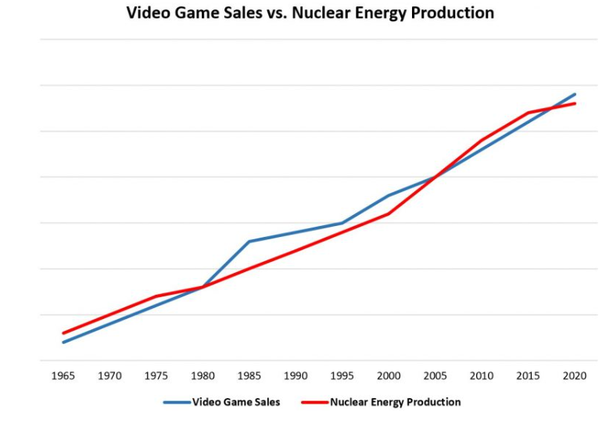
Spurious relationship
The covariation between $X$ and $Y$ can be influenced by their joint relationship to another variable $Z$ (or a set of variables)

Slide 5
Conditional distribution

Slide 6
2.1.2 bivariate regression

Slide 7
2.1.3 confidence interval

Slide 8
2.1.3 TRANSFORMATION

Slide 9
2.1.3 confidence interval

Slide 11
WEEK 03 Lab session
Instructor: Yanan Wu
TA: Khadija Nisar
Spring 2025

