Slide 1

WEEK 05 Advanced sql
Instructor: Yanan Wu
TA: Vanchy Li
Spring 2025

Slide 2
WEEK 05 lecture session
Instructor: Yanan Wu
TA: Vanchy Li
Spring 2025

Slide 3
5.1 SPATIAL RELATIONSHIP

Slide 4
SPATIAL RELATIONSHIP
So far we have only used spatial functions that measure (ST_Area, ST_Length), serialize (ST_GeomFromText) or deserialize (ST_AsGML) geometries. What these functions have in common is that they only work on one geometry at a time.
Spatial databases are powerful because they not only store geometry, they also have the ability to compare relationships between geometries.
Questions like “Which are the closest bike racks to a park?” or “Where are the intersections of subway lines and streets?” can only be answered by comparing geometries representing the bike racks, streets, and subway lines.

Slide 5
Background
Buffer analysis involves creating a zone around spatial features (points, lines, polygons).
Common SQL functions in PostGIS:
ST_Buffer: Creates a buffer around geometries.
ST_Intersects: Checks if geometries intersect.
ST_Contains: Checks if one geometry contains another.
ST_Touches: Returns true if geometries have at least one point in common.
ST_Overlaps: Checks if geometries overlap.
ST_DWithin: Checks geometry within a distance
ST_Centroid: Finds the centroid of a geometry.
ST_Union: Merges multiple geometries into one.

Slide 6
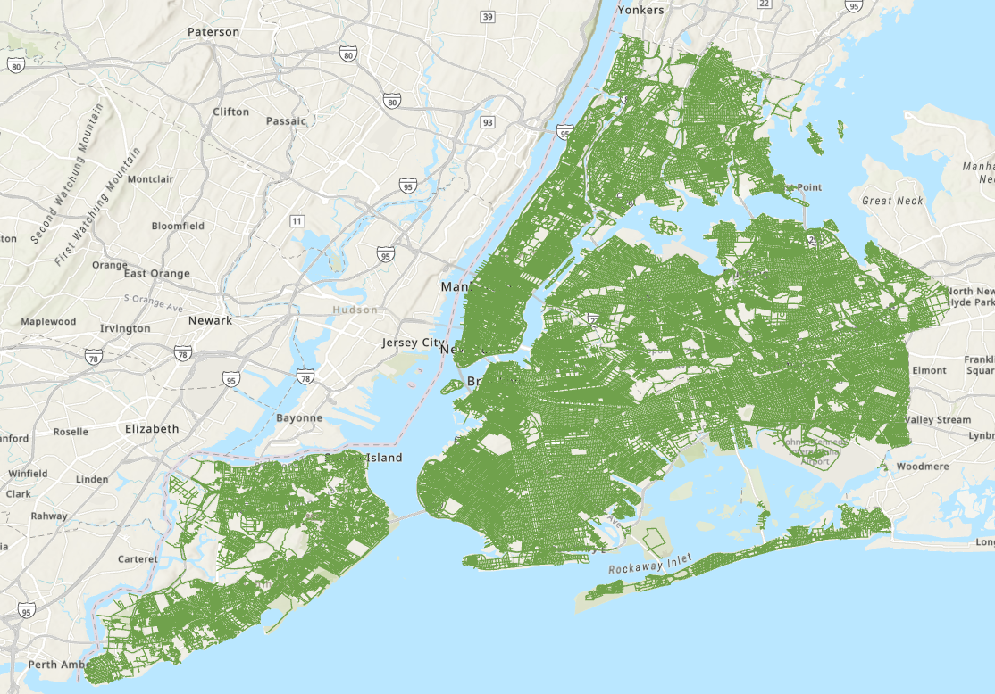
NYC Data
NYC streets (WKID: 26918)
The street centerlines form the transportation network of the city.
name | Name of the street
oneway | Is the street one-way? “yes” = yes, “” = no
type | Road type (primary, secondary, residential, motorway)
geom | Linear centerline of the street

Slide 7
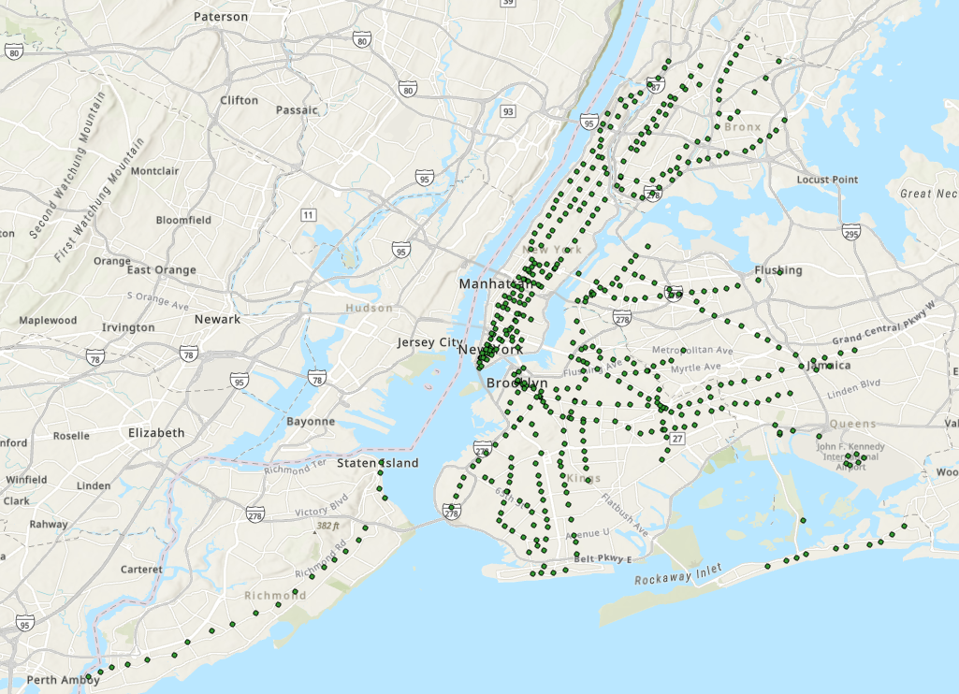
NYC Data
NYC subway stations (WKID: 26918)
The subway station determine how easy it is for different people to enter the subway system
name | Name of the station
borough | Name of the New York borough. Manhattan, The Bronx, Brooklyn, Staten Island, Queens
routes | Subway lines that run through this station
transfers | Lines you can transfer to via this station
express | Stations where express trains stop, “express” = yes, “” = no
geom | Point location of the station

Slide 8
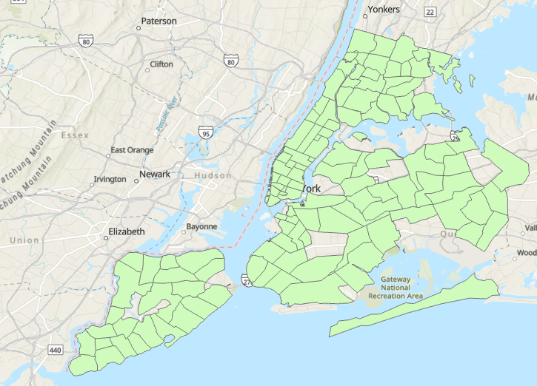
NYC Neighborhoods
New York has a rich history of neighborhood names and extent. Neighborhoods are social constructs that do not follow lines laid down by the government. (WKID: 26918)
name | Name of the neighborhood
boroname | Name of the New York borough. Manhattan, The Bronx, Brooklyn, Staten Island, Queens
geom | Polygon boundary of the neighborhood

Slide 9
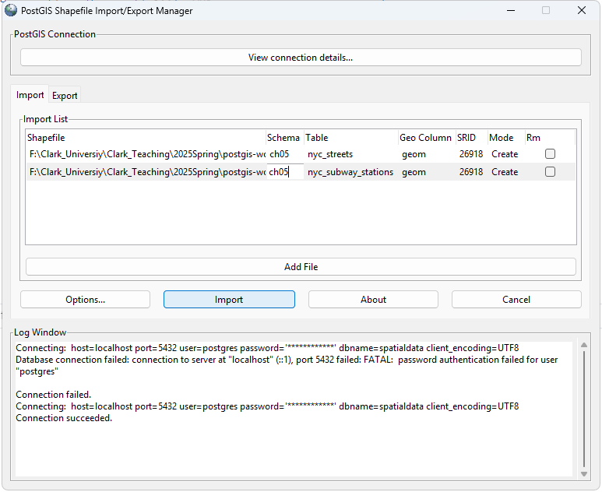
Import data

Slide 10
ST_Distance
The ST_Distance(geometry A, geometry B) calculates the shortest distance between two geometries and returns it as a float. This is useful for actually reporting back the distance between objects.
SELECT
a.NAME AS station_a,
b.NAME AS station_b,
ST_Distance(a.geom, b. geom) AS distance_meters
FROM
ch05.nyc_subway_stations a
JOIN
ch05.nyc_subway_stations b
ON
a.gid < b.gid
ORDER BY
distance_meters;

Slide 11
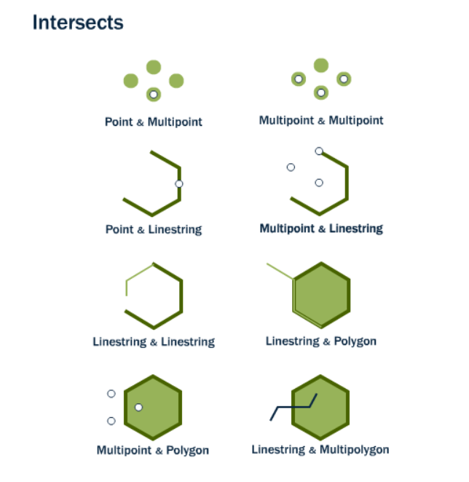
ST_Intersects
ST_Intersects(geometry A, geometry B)

Slide 12
Exercise 1: ST_Intersects
Identify all subway stations that intersect with neighborhoods (Manhattan)
SELECT nbh.NAME AS nbh_name, subways.NAME AS subway_name
FROM ch05.nyc_neighborhoods nbh, ch05.nyc_subway_stations subways
WHERE ST_Intersects(nbh. geom, subways. geom) AND nbh.BOROUGH = 'Manhattan';

Slide 13
Connect python with SQL DATABASE
Step 1: Install Vscode or miniconda
conda create --name sql python=3.9
conda activate sql
pip install ipykernel
pip install ipython-sql
pip install psycopg2
pip install SQLAlchemy
pip install matplotlib
pip install geopandas

Slide 14
Connect python with SQL DATABASE
Step 2: Right click Anaconda prompt and select ‘run as Administrator’
Step 3: Create a virtual environment and install relevant packages
conda create --name sql python=3.9
conda activate sql
pip install ipykernel ipython-sql psycopg2 SQLAlchemy matplotlib geopandas
Step 4: Open ‘spatial_relationship.ipynb’ and select ‘sql’ as kernel

