Slide 1

WEEK 04 Intro to sql
Instructor: Yanan Wu
TA: Vanchy Li
Spring 2025

Slide 2
WEEK 04 lecture session
Instructor: Yanan Wu
TA: Vanchy Li
Spring 2025

Slide 3
4.1 intro

Slide 4
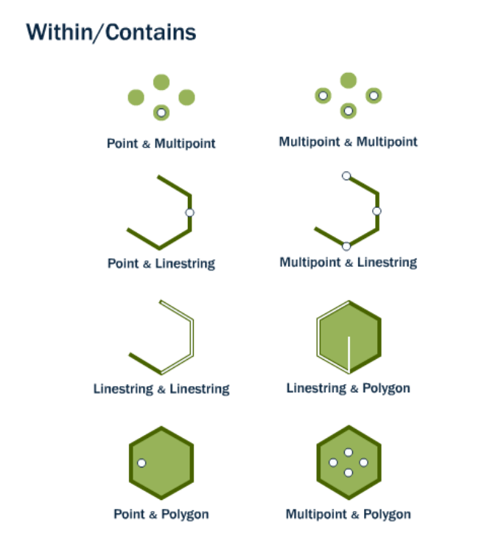
ST_DWithin

Slide 5
Example 1: ST_Intersects
Find all streets within 50 meters of subway stations (using buffer).
SELECT name, borough_name
FROM ch05.streets , ch05.subway
WHERE ST_Intersects(ch05.streets.geom, ST_Buffer(ch05.subway.geom, 50))

Slide 6
Exercise 1: ST_Intersects
Find all one-way streets within 50 meters of subway stations.
SELECT name, borough_name
FROM ch05.streets, ch05.subway
WHERE oneway = 'Yes’ AND ST_Intersects(ch05.streets.geom, ST_Buffer(ch05.subway.geom, 50))

Slide 7
Example 2: ST_Intersects
Identify neighborhoods where there are subway stations
SELECT boroname, COUNT(*) AS station_count
FROM ch05.neighborhoods, ch05.subway
WHERE ST_Intersects(ch05.neighborhoods.geom, ch05.subway.geom)
GROUP BY boroname;

Slide 8
Exercise 2: ST_Intersects
Identify neighborhoods with more than 3 subway stations
SELECT boroname, COUNT(*) AS station_count
FROM ch05.neighborhoods, ch05.subway
WHERE ST_Intersects(ch05.neighborhoods.geom, ch05.subway.geom)
GROUP BY boronameHAVING COUNT(*) > 3;

Slide 9
Example 3: ST_Intersects
List all subway stations where express trains stop that are within 50 meters of major roads.
SELECT station_name, name AS street_name
FROM ch05.subway, ch05.streets
WHERE express_stop = 'Yes'AND road_type = 'Major'AND ST_Intersects(ST_Buffer(ch05.subway.geom, 50), ch05.streets.geom);

Slide 10
Exercise 3: ST_Intersects
List express subway stations within 50 meters of one-way major streets.
SELECT station_name, name AS street_name
FROM ch05.subway, ch05.streets
WHERE express_stop = 'Yes'AND road_type = 'Major'AND oneway = 'Yes'AND ST_Intersects(ST_Buffer(ch05.subway.geom, 50), ch05.streets.geom);

Slide 11
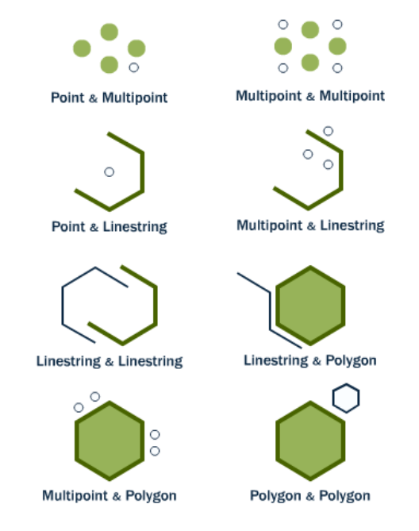
ST_Disjoint
ST_Intersects(geometry A, geometry B) returns (TRUE) if the two shapes have any space in common, i.e., if their boundaries or interiors intersect.

Slide 12
Example 1: ST_Disjoint
Find streets that do not intersect with any subway station.
SELECT name
FROM ch05.streets
WHERE NOT EXISTS (
SELECT 1 FROM ch05.subway
WHERE ST_Disjoint(ch05.streets.geom, ST_Buffer(ch05.subway.geom, 50)) = FALSE);

Slide 13
Exercise 1: ST_Disjoint
List one-way streets that do not intersect with any subway station.
SELECT name
FROM ch05.streets
WHERE oneway = 'Yes’
AND NOT EXISTS (
SELECT 1 FROM ch05.subway
WHERE ST_Disjoint(ch05.streets.geom, ST_Buffer(ch05.subway.geom, 50)) = FALSE);

Slide 14
Example 2: ST_Disjoint
List neighborhoods with no subway stations.
SELECT boroname
FROM ch05.neighborhoods
WHERE NOT EXISTS (
SELECT 1 FROM ch05.subway
WHERE ST_Disjoint(ch05.neighborhoods.geom, ch05.subway.geom) = FALSE);

Slide 15
Exercise 2: ST_Disjoint
Find subway stations that are disjoint from major roads.
SELECT station_name
FROM ch05.subway
WHERE NOT EXISTS (
SELECT 1 FROM ch05.streets
WHERE road_type = 'Major'
AND ST_Disjoint(ST_Buffer(ch05.subway.geom, 50), ch05.streets.geom) = FALSE);

Slide 16
Scenario 2
Identify potential flood zones by buffering the coastline and identifying streets within the buffer.
SELECT s.NAME
FROM nyc_streets s, nyc_coastline c
WHERE ST_Intersects(ST_Buffer(c.geometry, 1000), s.geometry);

Slide 17
Real-World Project Example
NYC Emergency Response Planning:
Buffer zones around subway stations are used to plan emergency evacuation routes and resource allocation.
Example: During Hurricane Sandy, buffer analysis helped identify critical infrastructure within flood-prone zones, aiding in evacuation and resource deployment.
SELECT st.NAME AS station_name, s.NAME AS street_name
FROM nyc_subway_stations st, nyc_streets s
WHERE ST_DWithin(st.geometry, s.geometry, 300) AND st.BOROUGH = 'Manhattan' AND s.TYPE = 'residential';

Slide 18
TOOLS IN PGADMIN 4 – MATERIALIZED VIEWS
Create materialized views to store complex buffer analysis results for faster querying.
CREATE MATERIALIZED VIEW ch05.station_buffers AS
SELECT NAME, ST_Buffer(geometry, 300) AS buffer_geom
FROM ch05.nyc_subway_stations;

Slide 19
TOOLS IN PGADMIN 4 - FUNCTIONS
Write custom SQL functions to automate repetitive buffer analysis tasks.
CREATE FUNCTION ch05.get_stations_within_buffer(distance FLOAT)
RETURNS TABLE(station_name TEXT, street_name TEXT) AS $$
BEGIN
RETURN QUERY
SELECT st.NAME, s.NAME
FROM ch05.nyc_subway_stations st, ch05.nyc_streets s
WHERE ST_DWithin(st.geometry, s.geometry, distance);
END;$$ LANGUAGE plpgsql;

Slide 20
TOOLS IN PGADMIN 4 - VIEWS
Simplify complex queries with views for better data visualization.
CREATE VIEW ch05.residential_near_stations AS
SELECT s.NAME AS street_name, st.NAME AS station_name
FROM ch05.nyc_streets s
JOIN ch05.nyc_subway_stations st
ON ST_DWithin(s.geometry, st.geometry, 300)
WHERE s.TYPE = 'residential';

