Slide 1

WEEK 03
Instructor: Yanan Wu
TA: Vanchy Li
Spring 2025

Slide 2
WEEK 03 lecture session
Instructor: Yanan Wu
TA: Vanchy Li
Spring 2025

Slide 3
2.1.1 geometry

Slide 4
geometry
The geometry data type is the core data type in PostGIS used to store spatial objects. It can represent geometric shapes such as:
Points (e.g., a location on a map)
Lines (e.g., a road or river)
Polygons (e.g., a building footprint or city boundary)
Collections of geometries (e.g., MULTIPOINT, MULTILINESTRING, MULTIPOLYGON)
The geometry data type in PostGIS supports two-dimensional (2D), three-dimensional (3D), and even four-dimensional (4D) spatial data.

Slide 5
Spatial reference system (SRS)
A Spatial Reference System (SRS) (also called a Coordinate Reference System (CRS)) defines how geometry is referenced to locations on the Earth.
Three types of SRS;
A geodetic SRS uses angular coordinates (longitude and latitude) which map directly to the surface of the earth.
A projected SRS uses a mathematical projection transformation to "flatten" the surface of the spheroidal earth onto a plane. It assigns location coordinates in a way that allows direct measurement of quantities such as distance, area, and angle. The coordinate system is Cartesian, which means it has a defined origin point and two perpendicular axes (usually oriented North and East). Each projected SRS uses a stated length unit (usually meters or feet). A projected SRS may be limited in its area of applicability to avoid distortion and fit within the defined coordinate bounds.
A local SRS is a Cartesian coordinate system which is not referenced to the earth's surface. In PostGIS this is specified by a SRID value of 0.

Slide 6
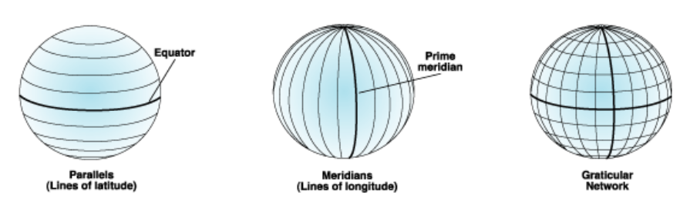
GEOGRAPHIC COORDINATE SYSTEM (or geodetic)
A geographic coordinate system (GCS) is a spherical or geodetic coordinate system for measuring and communicating positions directly on Earth as latitude and longitude

Slide 7
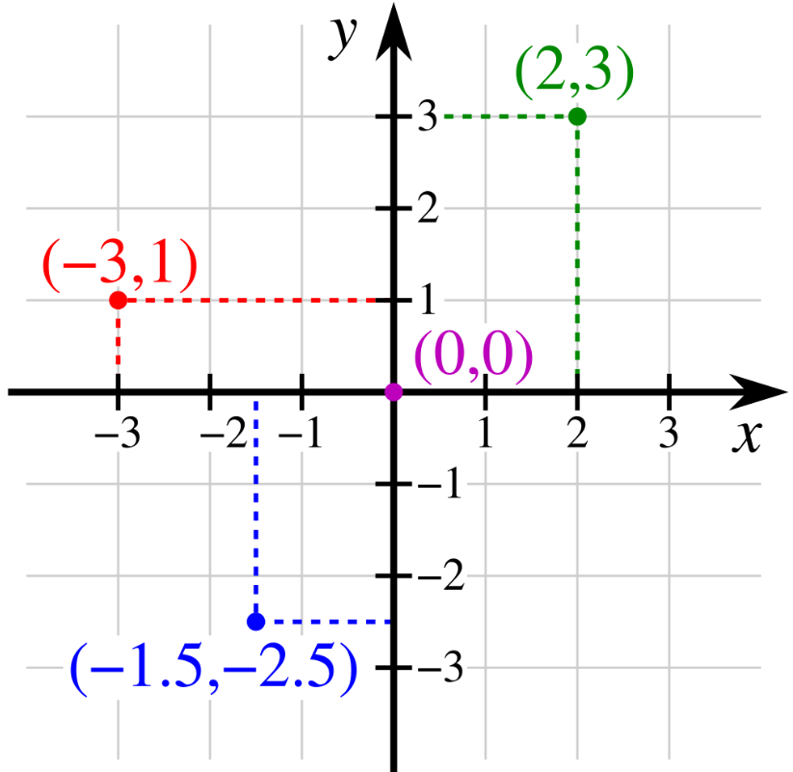
Projected Coordinate System (or planar, grid)
The projected coordinate system assumes a flat, two-dimensional space where spatial measurements are made using X and Y coordinates.
X-coordinate: Represents the horizontal position.
Y-coordinate: Represents the vertical position.
It is a type of spatial reference system that represents locations on Earth using Cartesian coordinates (x, y) on a planar surface created by a particular map projection.

Slide 8
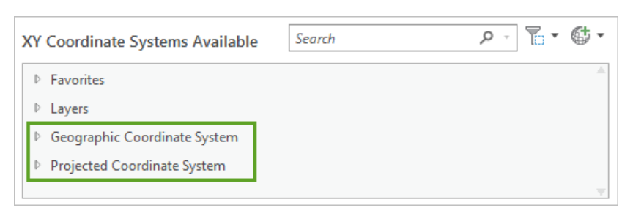
Unit of coordinate system
Insert data dallas here to show the unit of gcs and pcs.
A Geographic Coordinate System (GCS) represents locations on a round surface, recording them in angular units (typically degrees). In contrast, a Projected Coordinate System (PCS) represents locations on a flat, two-dimensional plane, using linear units (usually meters).

Slide 9
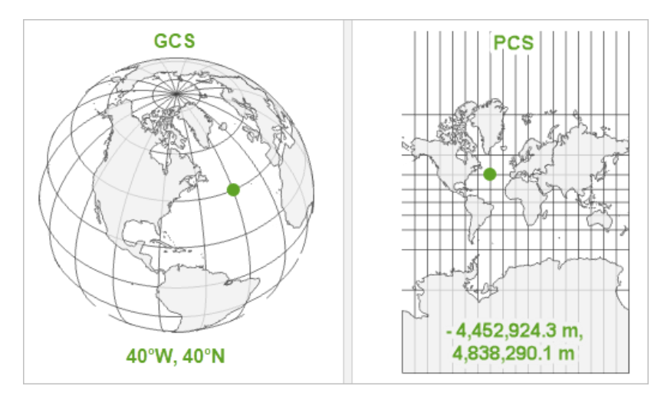
Gcs and pcs

Slide 10
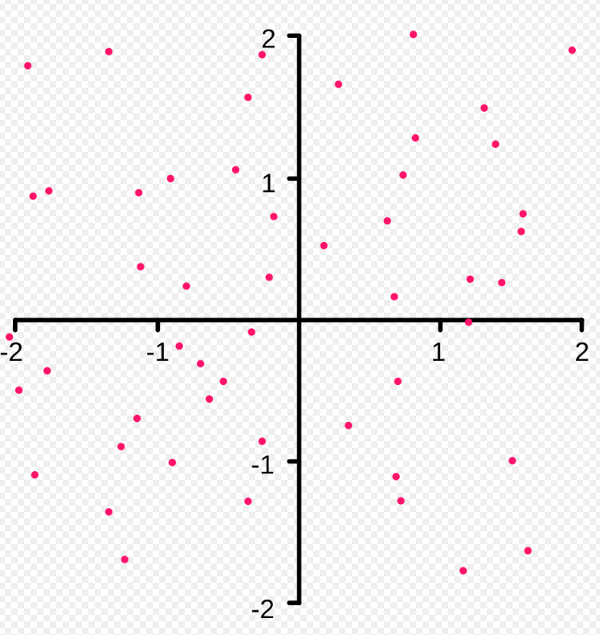
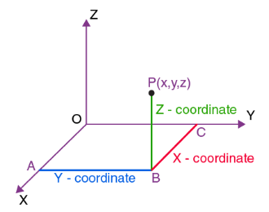
Subtype of geometry - points
POINTZ
A point in 3D space specified by its X, Y, and Z coordinates
POINT
A point in 2D space specified by its X and Y coordinates
POINTM
point in 2D space with a measured value specified by its spatial X and Y coordinates plus an M value
M (housing value): 10,0000
🤔 What is POINTZM?

Slide 11
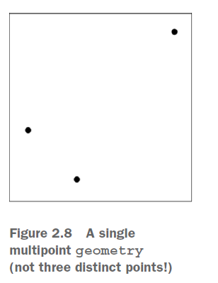
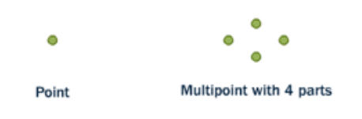
Subtype of geometry - multipoints
A spatial point represents a city on the earth
A multipoints with four points within one geometry to represent four cities on the earth

Slide 12
Subtype of geometry - linestrings
A linestring is a path between locations. It takes the form of an ordered series of two or more points.
Roads and rivers are typically represented as linestrings.
A linestring is said to be closed if it starts and ends on the same point.
It is said to be simple if it does not cross or touch itself (except at its endpoints if it is closed).
A linestring can be both closed and simple.

Slide 13
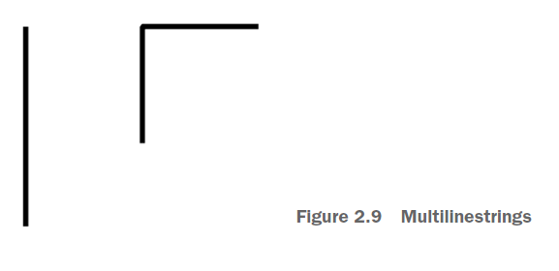
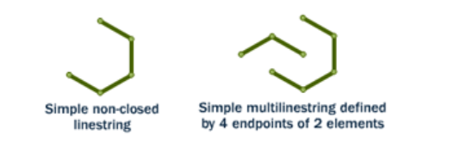
Subtype of geometry - multilinestrings
Multilinestring is a collection of linestrings.

Slide 14
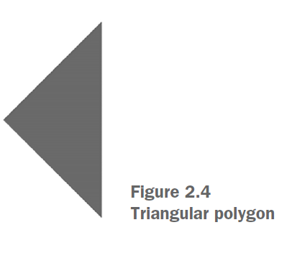
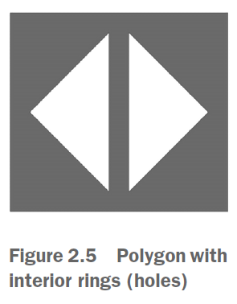
Subtype of geometry - polygons
Closed linestrings are the building blocks of polygons.
Polygon: Composed of one outer linear ring and optionally one or more inner rings.

Slide 15
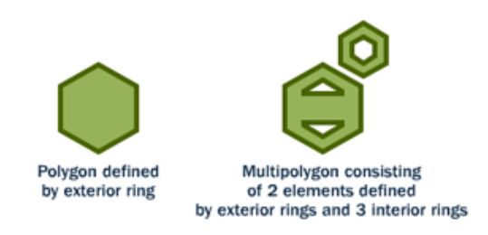
Subtype of geometry - multipolygons
A polygon is a representation of an area.
The outer boundary of the polygon is represented by a ring. This ring is a linestring that is both closed and simple as defined above.
Holes within the polygon are also represented by rings.

Slide 16
geometrycollection
The GEOMETRYCOLLECTION is a PostGIS geometry subtype that can contain heterogeneous geometries.
Unlike multi-geometries, where the constituent geometries must be of the same subtype, GEOMETRYCOLLECTION can include points, linestrings, polygons, and their collection counterparts.
Provide map here

Slide 17
2.1.2 geography

Slide 18
GEOGRAPHY
geography starts by assuming that all your data is based on a geodetic coordinate system, specifically the WGS 84 lon/lat SRID of 4326.
SRID: Spatial Reference Identifier is a unique identifier that defines the spatial reference system (SRS) used to interpret spatial data in PostGIS and other GIS systems.
It specifies how spatial coordinates (such as longitude, latitude, or X/Y values) relate to the real world by defining the coordinate system, projection, and datum.

Slide 19
Function for geometry
The structure of the geography data subtypes mirrors that of geometry.
Accordingly, functions for geometry can be applied to geography with minimal changes, primarily involving the substitution of the term geometry with geography in both data types and function names.

Slide 20
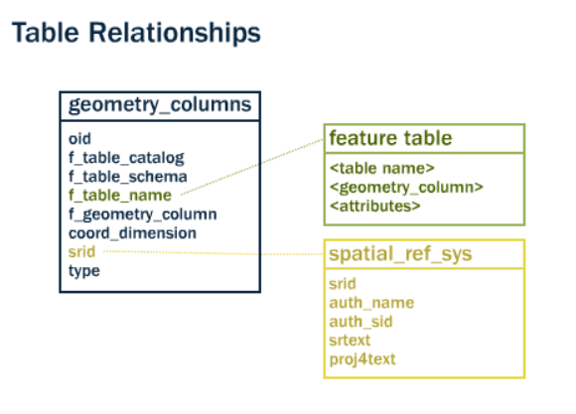
Metadata tables
PostGIS provides two tables to track and report on the geometry types available in a given database.
The first table, spatial_ref_sys, defines all the spatial reference systems known to the database and will be described in greater detail later.
The second table (actually, a view), geometry_columns, provides a listing of all “features” (defined as an object with geometric attributes), and the basic details of those features.

Slide 21
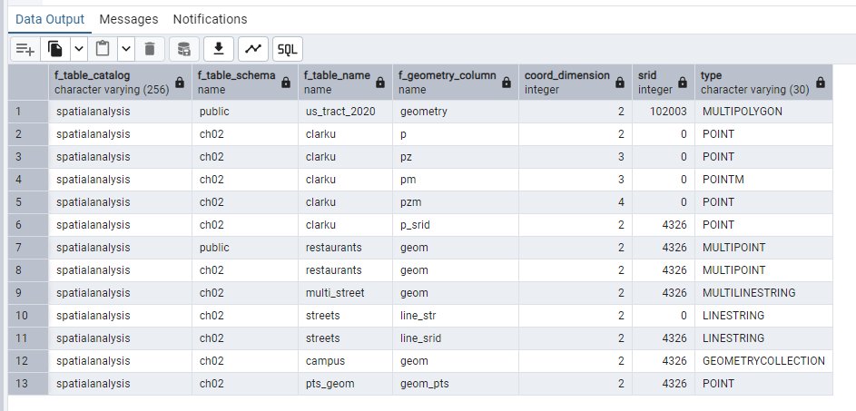
Geometry_columns table in database
SELECT * FROM geometry_columns;

Slide 22
2.1.2.1 Function for points

Slide 23
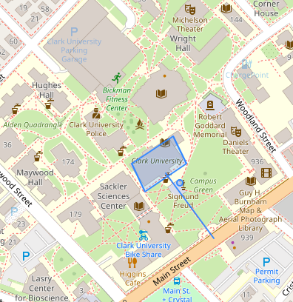
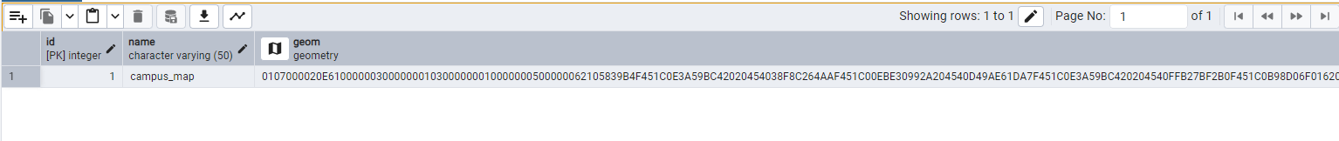
Select function
SELECT name, ST_AsText(geom) FROM ch02.campus;

Slide 24
Create points
CREATE TABLE ch02.my_geogs (
id serial PRIMARY KEY,
name varchar(20),
my_point geography(POINT)
);
INSERT INTO ch02.my_geogs (name, my_point)
VALUES
('Clark',ST_GeogFromText('POINT(-71.8241 42.2521)')),
('WAirport',ST_GeogFromText('POINT(-71.8743 42.2688)')),
('Park',ST_GeogFromText('POINT(-71.8144 42.2691)'));

Slide 25
2.1.3 difference between geometry and geograph

Slide 26
CREATE TABLE ch02.pts_geom (
id serial PRIMARY KEY,
name varchar(50),
geom_pts geometry(POINT,4326),
geoy_pts geography(POINT));
INSERT INTO ch02.pts_geom(name, geom_pts, geoy_pts)
VALUES
('711', ST_GeomFromText('POINT(-71.8236 42.2489)',4326), NULL),
('pizza',NULL, ST_GeogFromText('POINT(-71.823 42.242)'));

Slide 27
WEEK 02 Lab session
Instructor: Yanan Wu
TA: Vanchy Li
Spring 2025

Slide 28
Create table with spatial data in postgis
Create schema
Create a table with geometry columns
Insert values to table

Slide 29
Create schema
CREATE SCHEMA ch02;
A schema in PostGIS (and PostgreSQL) is a logical container used to organize and manage database objects, such as tables, views, functions, and spatial data.
Schema provides a namespace to avoid naming conflicts between objects and helps manage database permissions more effectively.
Think of a schema as a folder inside a database, where you can group related objects together to keep things organized.

Slide 30
Create table with geometry
id: This is a unique identifier for each row in the table.
serial: This is an auto-incrementing integer column.
PRIMARY KEY: This ensures the id is unique and cannot be NULL.
CREATE TABLE ch02.clarku (
id serial PRIMARY KEY,
p geometry(POINT),
pz geometry(POINTZ),
pm geometry(POINTM),
pzm geometry(POINTZM),
p_srid geometry(POINT,4326));
p: The column name.
geometry(POINT): This defines a 2D point geometry with X and Y coordinates.
Example: A point representing a latitude/longitude location or X/Y coordinates in a planar system

Slide 31
Insert values
INSERT INTO ch02.clarku(p, pz, pm, pzm, p_srid)
VALUES (
ST_GeomFromText('POINT(-71.824 42.252)'),
ST_GeomFromText('POINT Z(-71.824 42.252 10)'),
ST_GeomFromText('POINT M(-71.824 42.252 72)'),
ST_GeomFromText('POINT ZM(-71.824 42.252 10 72)'),
ST_GeomFromText('POINT(-71.824 42.252)',4326)
);

Slide 32
Create table with multipoint in postgis
Create a table with geometry columns
Insert values to table

Slide 33
Create multipoint geometry
CREATE TABLE ch02.restaurants (
id serial PRIMARY KEY,
name varchar(50),
geom geometry(MULTIPOINT, 4326));
Insert values to table
INSERT INTO ch02.restaurants (name, geom)
VALUES
('BBQ', ST_GeomFromText('MULTIPOINT(-71.824 42.249,-71.8256 42.2486, -71.8268 42.2479)', 4326));

Slide 34
Create a linestrings
REATE TABLE ch02.streets (
id serial PRIMARY KEY,
name varchar(20),
line_str geometry(LINESTRING),
line_srid geometry(LINESTRING, 4326));
INSERT INTO ch02. streets(name, line_str, line_srid)
VALUES
('main', ST_GeomFromText('LINESTRING( -71.82359 42.24951, -71.82160 42.25056, -71.81836 42.25227)'),
ST_GeomFromText('LINESTRING( -71.82359 42.24951, -71.82160 42.25056, -71.81836 42.25227)', 4326)),
('str_squre', ST_GeomFromText('LINESTRING(-71.8267 42.2536, -71.8259 42.2544, -71.8240 42.2530, -71.8249 42.2523, -71.8267 42.2536)'),
ST_GeomFromText('LINESTRING(-71.8267 42.2536, -71.8259 42.2544, -71.8240 42.2530, -71.8249 42.2523, -71.8267 42.2536)', 4326));

Slide 35
Create multilinestring
CREATE TABLE ch02.streets (
id serial PRIMARY KEY,
name varchar(20),
line_str geometry(LINESTRING),
line_srid geometry(LINESTRING, 4326));
INSERT INTO ch02. streets(name, line_str, line_srid)
VALUES
('main', ST_GeomFromText('LINESTRING( -71.82359 42.24951, -71.82160 42.25056, -71.81836 42.25227)'),
ST_GeomFromText('LINESTRING( -71.82359 42.24951, -71.82160 42.25056, -71.81836 42.25227)', 4326)),
('str_squre', ST_GeomFromText('LINESTRING(-71.8267 42.2536, -71.8259 42.2544, -71.8240 42.2530, -71.8249 42.2523, -71.8267 42.2536)'),
ST_GeomFromText('LINESTRING(-71.8267 42.2536, -71.8259 42.2544, -71.8240 42.2530, -71.8249 42.2523, -71.8267 42.2536)', 4326));

Slide 36
Create geometrycollection
CREATE TABLE ch02.campus (
id serial PRIMARY KEY,
name varchar(50),
geom geometry(GEOMETRYCOLLECTION, 4326));
INSERT INTO ch02.campus (name, geom)
VALUES
( 'campus_map',
ST_GeomFromText(
'GEOMETRYCOLLECTION(
POLYGON((-71.8235 42.2510, -71.8229 42.2513, -71.8227 42.2510, -71.8233 42.2507, -71.8235 42.2510)),
LINESTRING(-71.8230 42.2509, -71.8223 42.2502),
POINT(-71.8228 42.2508))',4326));

Slide 37
2.2.1 create point

Slide 38
2.2.2 create linestring

