Slide 1

WEEK 07 Geotagging
Instructor: Yanan Wu
TA: Vanchy Li
Spring 2025

Slide 2
WEEK 07 lecture session
Instructor: Yanan Wu
TA: Vanchy Li
Spring 2025

Slide 3
7.1 geotagging

Slide 4
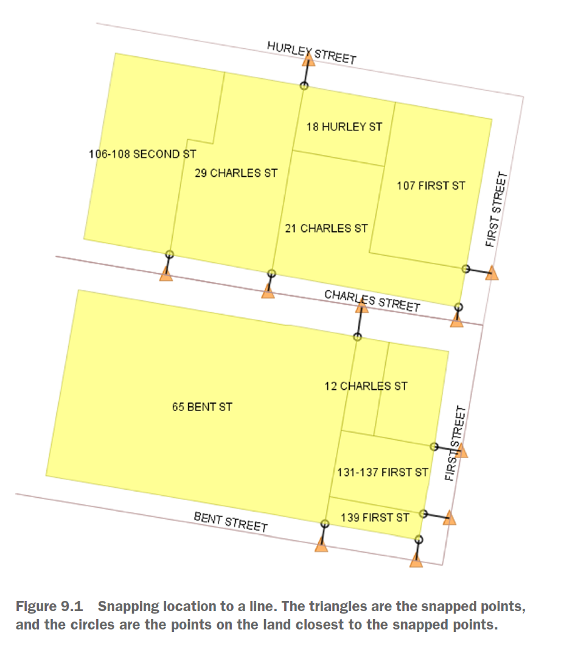
Linear referencing
Snapping points to the closest linestring

Slide 5
Linear referencing - procedures
Use ST_DWithin to narrow your choices. If a parcel has no road within 30 meters, eliminate it from consideration.
For every pairing of parcel and road, use ST_ClosestPoint to pinpoint the closest point on the road to the parcel.
Use a combination of DISTINCT ON and the ST_Distance function to only keep the pair of parcel and road that are closest.

Slide 6
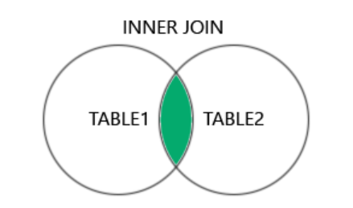
Linear referencing
nap points on the nearest road to each parcel when a road is located within 20 meters of the parcel.
SELECT DISTINCT ON (land.pid)
land.addr_num || ' ' || full_str AS parcel,
road.road_name AS road,
FROM ch09.land AS land INNER JOIN ch09.road AS road
ON
ORDER BY land.pid, ST_Distance(land.geom,road.geom);
ST_ClosestPoint(geometry geom1, geometry geom2)

Slide 7
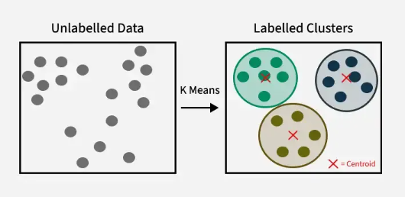
Cluster window function - kmeans
ST_ClusterKMeans(geometry winset geom, integer number_of_clusters, float max_radius)

Slide 8
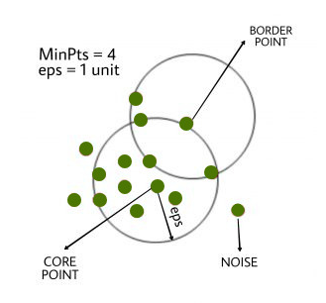
Cluster window function - DBSCAN
ST_ClusterDBSCAN(geometry winset geom, float8 eps, integer minpoints);

Slide 9
K-means and dbscan
Create cluster based on K means with number of cluster = 4
Create cluster based on DNSCAN with eps = 15 and minpoints = 2
SELECT land.pid, land.geom,
COALESCE(land.addr_num || ' ','') || full_str AS address,
FROM ch09.land AS land;

