Slide 1

WEEK 10 Raster
Instructor: Yanan Wu
TA: Vanchy Li
Spring 2025

Slide 2
WEEK 10 lecture session
Instructor: Yanan Wu
TA: Vanchy Li
Spring 2025

Slide 3
10.1 Loading raster data

Slide 4
Introduction
PostGIS enables the combined use of geometry and raster data.
Focus on raster aggregate functions, pixel-level manipulation, and raster-to-geometry conversion.
Built-in summary statistic functions help analyze pixel value distributions.
Using geometry to isolate specific pixel values for targeted analysis.

Slide 5
Data
Climate data from WorldClim (WorldClim Data).
Precipitation, and temperature rasters (monthly data, 10-minute degree intervals, covering 1970–2000).
Data format: .tif raster files.
Units:
Elevation – meter (elev 10m)
Precipitation – millimeters (prec 10m)
Average Temperature – degrees Celsius (tavg 10m)
Additional dataset: Elevation data for Kauai, Hawaii (Hawaii GIS Data).

Slide 6
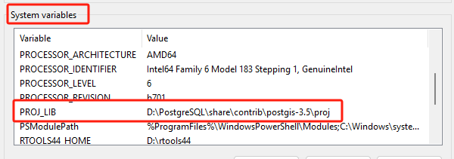
Pre-configuration
CREATE schema ch10;
CREATE EXTENSION postgis_raster;
Add folder contianing proj.db to system variables
Variable name: PROJ_LIB
Variable value (the folder containing proj.db): D:\PostgreSQL\share\contrib\postgis-3.5\proj

Slide 7
Load data
Load data in cmd
raster2pgsql -s 4326 -I -C -M "E:\\Clark\\Spring2025\\elev\\wc2.1_10m_elev.tif" -F -t 256x256 ch10.elev | psql -U postgres -d spatial
-s 4326 → Sets the spatial reference system (SRID 4326, WGS 84).
-I → Creates a GiST spatial index on the raster column.
-C → Apply raster constraints (such as width, height, pixel size).
-M → Vacuum analyze the table after loading to optimize performance.
"E:\\Clark\\Spring2025\\elev\\wc2.1_10m_elev.tif" → Specifies the input raster file.
-F → Stores raster data in the standard PostGIS raster format.
-t 256x256 → Tiles the raster into 256x256 pixel blocks.
ch10.elev → Specifies the target table (elev) in schema ch10.
| psql -U postgres -d spatial → Pipes the output into PostgreSQL, connecting as user postgres to the spatial database.

Slide 8
Load PRECIPITATION, TEMPERATURE, ELEVATION
raster2pgsql -s 4326 -I -C -M E:\\Clark\\Spring2025\\tavg\\*.tif -F -t 256x256 ch10.tmean | psql -U postgres -d spatial
raster2pgsql -s 4326 -I -C -M E:\\Clark\\Spring2025\\prec\\*.tif -F -t 256x256 ch10.prec | psql -U postgres -d spatial
raster2pgsql -s 26904 -Y -I -C -M E:\\Clark\\Spring2025\\Kauai\\*.bil -t 200x200 ch10.kauai | psql -U postgres -d spatial

Slide 9
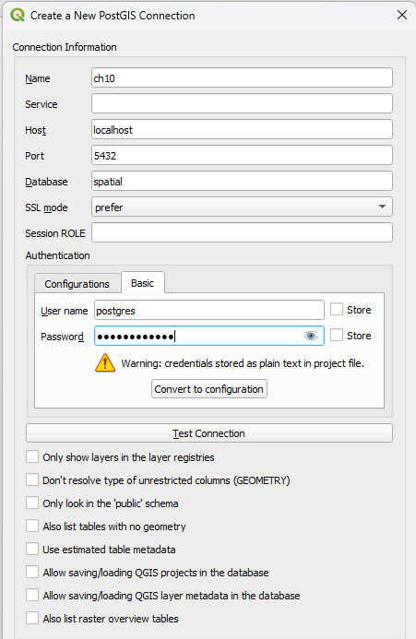
Qgis VIEW
Right click PostgreSQL to create new connection

Slide 10
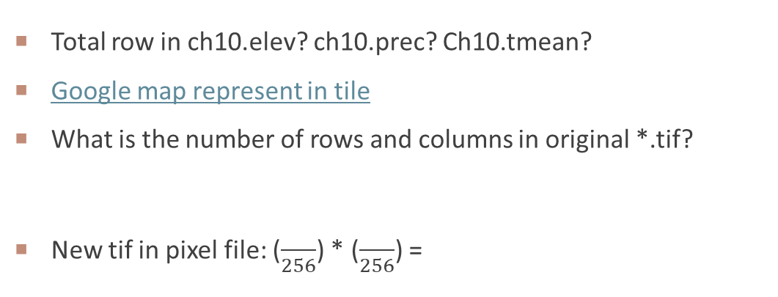
DATA EXAMINATION
Total row in ch10.elev? ch10.prec? Ch10.tmean?
Google map represent in tile
What is the number of rows and columns in original *.tif?
New tif in pixel file: ($\frac{}{256}$) * ($\frac{}{256}$) =

Slide 11
Why load tif USING pixel tile?
Faster Query Performance
Efficient Memory Usage
Parallel Processing
Supports Large Rasters
Better Rendering in Web Applications

Slide 12
LOAD TIFF WITHOUT TILING
Compared to previous one, we remove ‘-t 256x256 ’
raster2pgsql -s 4326 -I -C -M E:\\Clark\\Spring2025\\tavg\\*.tif -F ch10.tmean_tif | psql -U postgres -d spatial
How many rows are in ch10.tmean_tif? How is the loading and rendering speed?

Slide 13
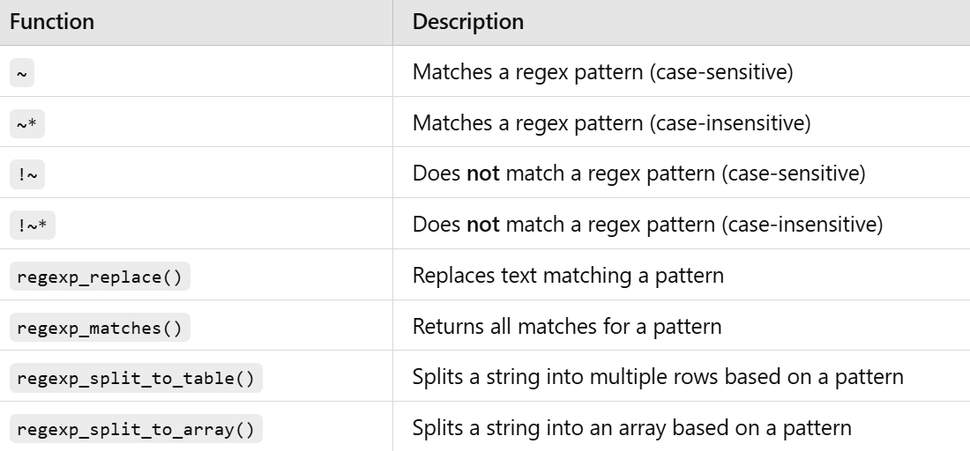
Regular expression
Regular expressions (regex) in SQL are patterns used for matching, searching, and manipulating text data within queries. They allow you to find complex patterns in strings, extract specific substrings, and transform data efficiently.

Slide 14
Assign month column to table
ALTER TABLE ch12.prec ADD COLUMN month smallint;
UPDATE ch12.prec SET month = regexp_replace( filename, E'(.*)([0-9]{2}).tif’, E'\\2' )::integer;
Extracts the month number from the filename column using a regular expression.
(.*) → Captures any characters before the month digits.
([0-9]{2}) → Captures exactly two digits, which represent the month.
.tif → Ensures the filename ends with ".tif" to match only valid filenames.
Replacement (E'\\2'):
\\2 → Extracts only the two-digit month from the filename.
Type Conversion (::integer):
Converts the extracted string into an integer

Slide 15
Reconstituting tiled files
ST_Union function is used to aggregate tiles by filename
All raster tiles are:
Georeferenced to WGS 84
Created in the same way
Have the same pixel size, grid positioning, and spatial reference system (same alignment)
ST_Union requires the same alignment for all tiles being merged
Union operation considers only same-positioned pixels when forming a new pixel
SELECT filename, COUNT(rast) As num_tiles, ST_Union(rast) As rast
FROM ch10.prec
WHERE filename IN ('wc2.1_10m_prec_01.tif','wc2.1_10m_prec_12.tif')
GROUP BY filename;

Slide 16
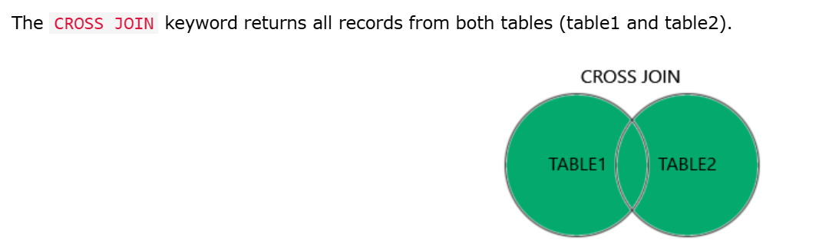
Clipping and unioning
Functions used in the process:
ST_MakeEnvelope: Creates a bounding rectangle polygon.
ST_Intersects: Selects tiles that intersect the region of interest.
ST_Clip: Isolates the portion of each tile that intersects the envelope.
ST_Union: Merges clipped tiles into a single raster.
The final raster represents a new tile covering only the area of interest.

Slide 17
Clip raster
Worcester: xmin:-71, ymin: 42, xmax: -71.5, ymax: 42.5, SRID: 4326
CREATE TABLE ch10.elev_clipped (
id SERIAL PRIMARY KEY,
rast raster
);
INSERT INTO ch10.elev_clipped (rast)
SELECT ST_Union(ST_Clip(rast, geom)) AS rast
FROM ch10.elev
CROSS JOIN
WHERE;

