Slide 1

WEEK 03 Spatial data
Instructor: Yanan Wu
TA: Vanchy Li
Spring 2025

Slide 2
WEEK 03 lecture session
Instructor: Yanan Wu
TA: Vanchy Li
Spring 2025

Slide 3
3.1 geometry

Slide 4
geometry
The geometry data type is the core data type in PostGIS used to store spatial objects. It can represent geometric shapes such as:
Points (e.g., a location on a map)
Lines (e.g., a road or river)
Polygons (e.g., a building footprint or city boundary)
Collections of geometries (e.g., MULTIPOINT, MULTILINESTRING, MULTIPOLYGON)
The geometry data type in PostGIS supports two-dimensional (2D), three-dimensional (3D), and even four-dimensional (4D) spatial data.

Slide 5
Spatial reference system (SRS)
A Spatial Reference System (SRS) (also called a Coordinate Reference System (CRS)) defines how geometry is referenced to locations on the Earth.
Three types of SRS;
A geodetic SRS uses angular coordinates (longitude and latitude) which map directly to the surface of the earth.
A projected SRS uses a mathematical projection transformation to "flatten" the surface of the spheroidal earth onto a plane. It assigns location coordinates in a way that allows direct measurement of quantities such as distance, area, and angle. The coordinate system is Cartesian, which means it has a defined origin point and two perpendicular axes (usually oriented North and East). Each projected SRS uses a stated length unit (usually meters or feet). A projected SRS may be limited in its area of applicability to avoid distortion and fit within the defined coordinate bounds.
A local SRS is a Cartesian coordinate system which is not referenced to the earth's surface. In PostGIS this is specified by a SRID value of 0.

Slide 6
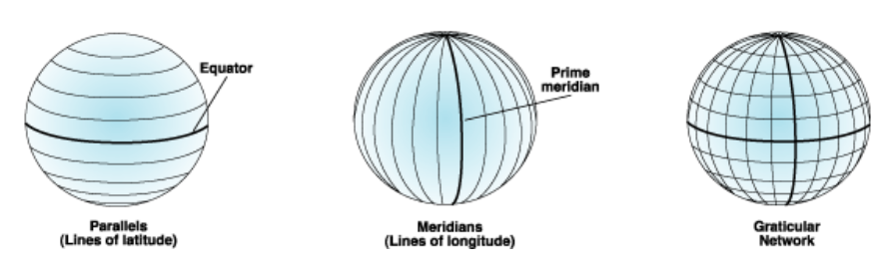
GEOGRAPHIC COORDINATE SYSTEM (or geodetic)
A geographic coordinate system (GCS) is a spherical or geodetic coordinate system for measuring and communicating positions directly on Earth as latitude and longitude

Slide 7
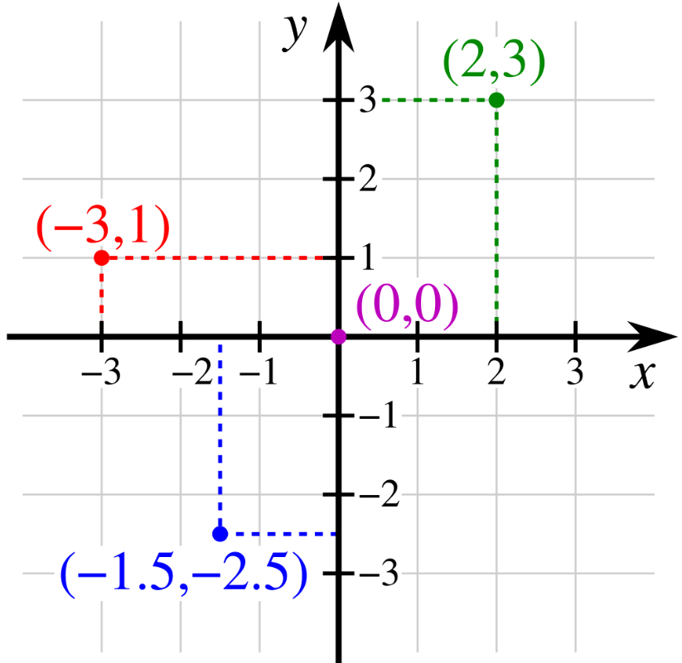
Projected Coordinate System (or planar, grid)
The projected coordinate system assumes a flat, two-dimensional space where spatial measurements are made using X and Y coordinates.
X-coordinate: Represents the horizontal position.
Y-coordinate: Represents the vertical position.
It is a type of spatial reference system that represents locations on Earth using Cartesian coordinates (x, y) on a planar surface created by a particular map projection.

Slide 8
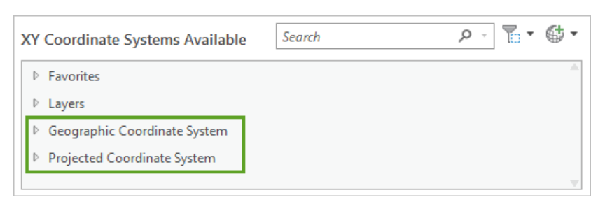
Setting coordinate system in arcgispro
A Geographic Coordinate System (GCS) represents locations on a round surface, recording them in angular units (typically degrees).
In contrast, a Projected Coordinate System (PCS) represents locations on a flat, two-dimensional plane, using linear units (usually meters).

Slide 9
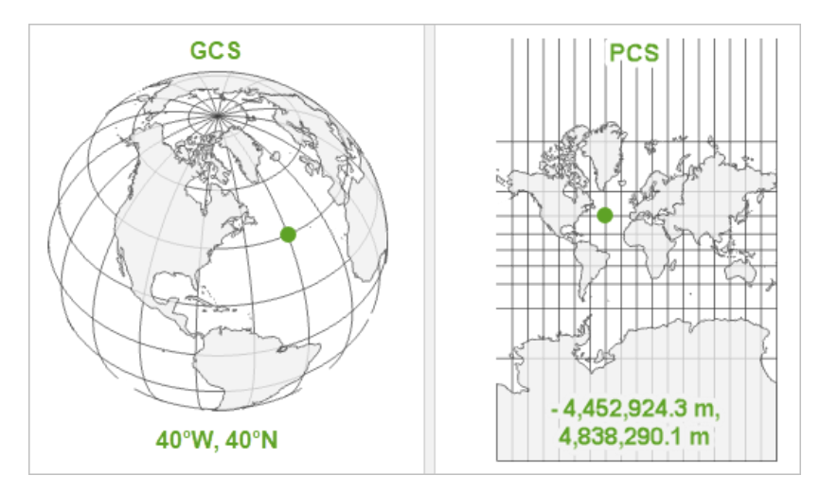
Gcs and pcs

Slide 10
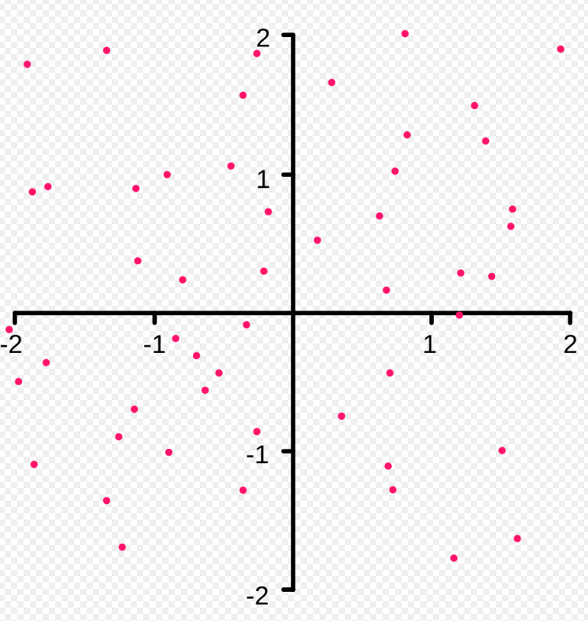
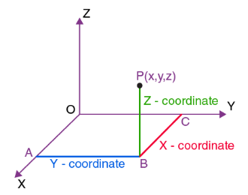
Subtype of geometry - points
POINTZ
A point in 3D space specified by its X, Y, and Z coordinates
POINT
A point in 2D space specified by its X and Y coordinates
POINTM
point in 2D space with a measured value specified by its spatial X and Y coordinates plus an M value
M (housing value): 10,0000
🤔 What is POINTZM?

Slide 11
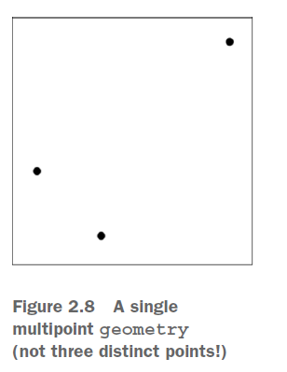
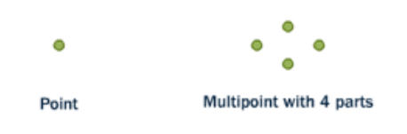
Subtype of geometry - multipoints
A spatial point represents a city on the earth
A multipoints with four points within one geometry to represent four cities on the earth

Slide 12
3.1.1create point

Slide 13
Create points with spatial data in postgis
1.Create schema
2. Create a table with geometry columns
3. Insert values to table

Slide 14
1. Create schema
CREATE SCHEMA ch03;
A schema in PostGIS (and PostgreSQL) is a logical container used to organize and manage database objects, such as tables, views, functions, and spatial data.
Schema provides a namespace to avoid naming conflicts between objects and helps manage database permissions more effectively.
Think of a schema as a folder inside a database, where you can group related objects together to keep things organized.

Slide 15
2. Create table: SYNTAX
Syntax:
CREATE TABLE table_name ( column1 datatype, column2 datatype, column3 datatype, .... );

Slide 16
2. Create table: EXAMPLE
id: This is a unique identifier for each row in the table.
serial: This is an auto-incrementing integer column.
PRIMARY KEY: This ensures the id is unique and cannot be NULL.
CREATE TABLE ch03.clarku (
id serial PRIMARY KEY,
p geometry(POINT),
pz geometry(POINTZ),
pm geometry(POINTM),
pzm geometry(POINTZM),
p_srid geometry(POINT,4326));
p: The column name.
geometry(POINT): This defines a 2D point geometry with X and Y coordinates.
Example: A point representing a latitude/longitude location or X/Y coordinates in a planar system

Slide 17
3. Insert value: example
INSERT INTO ch03.clarku (p, pz, pm, pzm, p_srid)
VALUES ( ST_GeomFromText('POINT(-71.8231 42.2510)’),
ST_GeomFromText('POINTZ(-71.8231 42.2510 100)’),
ST_GeomFromText('POINTM(-71.8231 42.2510 200)’),
ST_GeomFromText('POINTZM(-71.8231 42.2510 300 400)’),
ST_SetSRID(ST_GeomFromText('POINT(-71.8231 42.2510)’), 4326));

Slide 18
Well-known binary (wkb)
Well-Known Binary (WKB) is a binary encoding standard used to represent geometric objects such as points, lines, and polygons in spatial databases,
PostGIS supports WKB as part of the Open Geospatial Consortium (OGC) standards, allowing spatial data to be stored, retrieved, and processed efficiently.
01010000009B559FABADF451C0E3A59BC420204540
Component | Value | Explanation
Byte Order | 01 | Little-endian
Geometry Type | 01000000 | POINT (1)
X Coordinate | 9B559FABADF451C0 | Longitude (-71.8231)
Y Coordinate | E3A59BC420204540 | Latitude (42.2510)

Slide 19
3.1.2 create MULTIpoint

Slide 20
Create table with multipoint in postgis
Create a table with geometry columns
Insert values to table

Slide 21
Create multipoint geometry
CREATE TABLE ch03.restaurants (
id serial PRIMARY KEY,
name varchar(50),
geom geometry(MULTIPOINT, 4326));
Insert values to table
INSERT INTO ch03.restaurants (name, geom)
VALUES
('BBQ', ST_GeomFromText('MULTIPOINT(-71.824 42.249,-71.8256 42.2486, -71.8268 42.2479)', 4326));

Slide 22
Subtype of geometry - linestrings
A linestring is a path between locations. It takes the form of an ordered series of two or more points.
Roads and rivers are typically represented as linestrings.
A linestring is said to be closed if it starts and ends on the same point.
It is said to be simple if it does not cross or touch itself (except at its endpoints if it is closed).
A linestring can be both closed and simple.

Slide 23
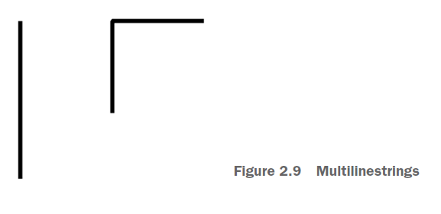
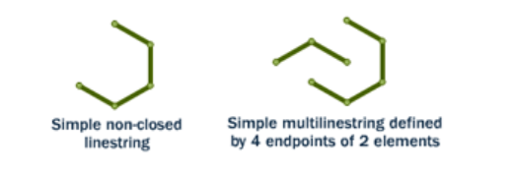
Subtype of geometry - multilinestrings
Multilinestring is a collection of linestrings.

Slide 24
3.1.3 CREATE LINESTRINGS

Slide 25
Create a linestrings
CREATE TABLE ch03.streets (
id serial PRIMARY KEY,
name varchar(20),
line_str geometry(LINESTRING),
line_srid geometry(LINESTRING));
INSERT INTO ch03. streets(name, line_str, line_srid)
VALUES
('main', ST_GeomFromText('LINESTRING( -71.82359 42.24951, -71.82160 42.25056, -71.81836 42.25227)'),
ST_GeomFromText('LINESTRING( -71.82359 42.24951, -71.82160 42.25056, -71.81836 42.25227)', 4326)),
('str_squre', ST_GeomFromText('LINESTRING(-71.8267 42.2536, -71.8259 42.2544, -71.8240 42.2530, -71.8249 42.2523, -71.8267 42.2536)'),
ST_GeomFromText('LINESTRING(-71.8267 42.2536, -71.8259 42.2544, -71.8240 42.2530, -71.8249 42.2523, -71.8267 42.2536)', 4326));

Slide 26
3.1.4 CREATE MULTILINESTRINGS

Slide 27
Create multilinestring
DROP TABLE IF EXISTS ch04.multi_street;
CREATE TABLE ch04.multi_street (
id serial PRIMARY KEY,
name varchar(20),
line_str geometry(MULTILINESTRING),
line_srid geometry(MULTILINESTRING, 4326)
);
INSERT INTO ch04.multi_street(name, line_str, line_srid)
VALUES
('multi_street',
ST_GeomFromText('MULTILINESTRING((-71.82359 42.24951, -71.82160 42.25056, -71.81836 42.25227),
(-71.8267 42.2536, -71.8259 42.2544, -71.8240 42.2530, -71.8249 42.2523, -71.8267 42.2536))'),
ST_GeomFromText('MULTILINESTRING((-71.82359 42.24951, -71.82160 42.25056, -71.81836 42.25227),
(-71.8267 42.2536, -71.8259 42.2544, -71.8240 42.2530, -71.8249 42.2523, -71.8267 42.2536))', 4326)
);

Slide 28
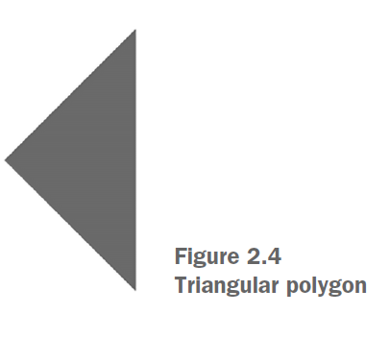
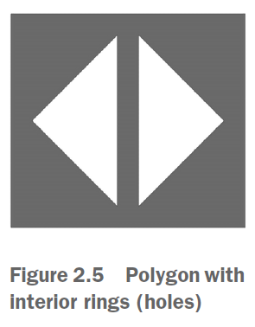
Subtype of geometry - polygons
Closed linestrings are the building blocks of polygons.
Polygon: Composed of one outer linear ring and optionally one or more inner rings.

Slide 29
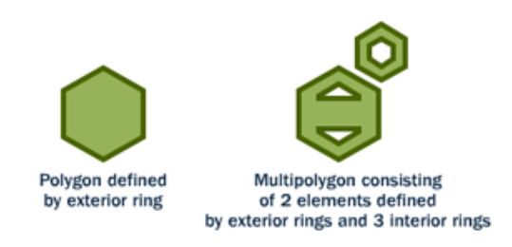
Subtype of geometry - multipolygons
A polygon is a representation of an area.
The outer boundary of the polygon is represented by a ring. This ring is a linestring that is both closed and simple as defined above.
Holes within the polygon are also represented by rings.

Slide 30
geometrycollection
The GEOMETRYCOLLECTION is a PostGIS geometry subtype that can contain heterogeneous geometries.
Unlike multi-geometries, where the constituent geometries must be of the same subtype, GEOMETRYCOLLECTION can include points, linestrings, polygons, and their collection counterparts.

Slide 31
3.1.5 CREATE GEOMETRYCOLLECTION

Slide 32
Create geometrycollection
CREATE TABLE ch03.campus (
id serial PRIMARY KEY,
name varchar(50),
geom geometry(GEOMETRYCOLLECTION, 4326));
INSERT INTO ch03.campus (name, geom)
VALUES
( 'campus_map',
ST_GeomFromText(
'GEOMETRYCOLLECTION(
POLYGON((-71.8235 42.2510, -71.8229 42.2513, -71.8227 42.2510, -71.8233 42.2507, -71.8235 42.2510)),
LINESTRING(-71.8230 42.2509, -71.8223 42.2502),
POINT(-71.8228 42.2508))',4326));

Slide 33
3.2 geography

Slide 34
GEOGRAPHY
geography starts by assuming that all your data is based on a geodetic coordinate system, specifically the WGS 84 lon/lat SRID of 4326.
Unlike GEOMETRY, which assumes a flat plane, GEOGRAPHY accounts for the earth's curvature, making it more suitable for applications that span large geographic areas, such as tracking movement across regions or calculating great-circle distances.
It specifies how spatial coordinates (such as longitude, latitude, or X/Y values) relate to the real world by defining the coordinate system, projection, and datum.

Slide 35
3.3 difference between geography and geometry

Slide 36


Distance calculation on geometry and geography (far)
SELECT ST_Distance(
'SRID=4326;POINT(-71.8011 42.2694)'::geography, -- Worcester
'SRID=4326;POINT(2.5559 49.0083)'::geography -- Paris
);
SELECT ST_Distance(
'SRID=4326;POINT(-71.8011 42.2694)'::geometry, -- Worcester
'SRID=4326;POINT(2.5559 49.0083)'::geometry -- Paris
);
one degree is approximately 110.944 kilometers

Slide 37


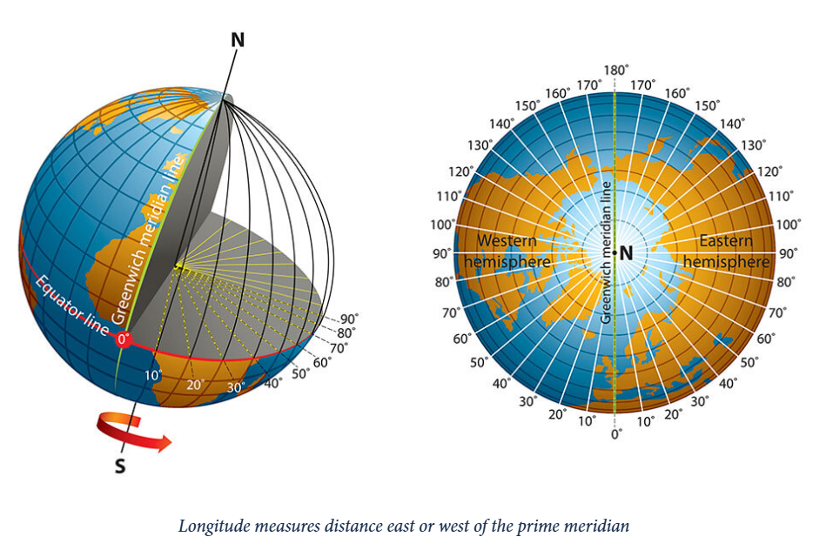
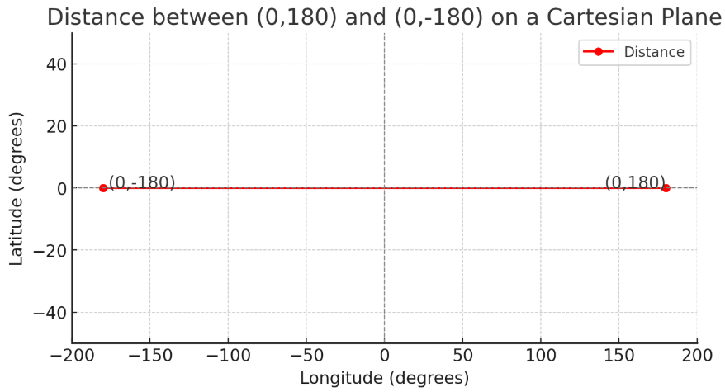
Distance between near locations
SELECT
ST_Distance(ST_Point(0,180)::geography, ST_Point(0,-180)::geography) AS geography_distance,
ST_Distance(ST_Point(0,180)::geometry, ST_Point(0,-180)::geometry) AS geometry_distance;

Slide 38
conclusion
Geography (Spherical Model) - More Accurate Distance Calculation:
The geography data type treats coordinates as points on a spherical model of the Earth, considering its curvature.
When you use ::geography, it applies geodesic (great-circle) distance calculations, which provide accurate real-world distances over large and small areas.
Geometry (Planar Model) - Less Accurate for Larger Areas:
The geometry data type assumes a flat Cartesian plane, which does not account for Earth's curvature.
The calculation treats latitude and longitude values as simple X-Y Cartesian coordinates (degrees), which leads to distortion, especially for distances spanning larger areas or when further from the equator.
Result: Distance in degrees, interpreted linearly in a flat space, leading to potential inaccuracies.

Slide 39
3.4 raster

Slide 40
raster
Raster data represents geographic information using a grid of cells (pixels), where each cell has a value representing information such as elevation, land cover, or temperature.
Common raster file formats: GeoTIFF, JPEG, PNG, ASCII Grid.
Raster data is often used for continuous data representation, such as satellite imagery, terrain modeling, and environmental monitoring.

Slide 41
Raster support in postgis
PostGIS extends PostgreSQL to support geographic objects, including raster data.
Raster functionality in PostGIS allows storage, analysis, and manipulation of raster data within a spatial database.
To use raster capabilities, PostGIS must be installed with raster support enabled.

Slide 42
3.4.1 CREATE RASTER

Slide 43
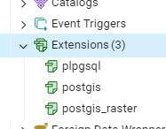
INSTALL POSTGIS_RASTER EXTENSION
CREATE EXTENSION postgis_raster;
postgis_raster is used to create raster data from scratch and how to insert the data using SQL

Slide 44
CREATE RASTER
DROP TABLE IF EXISTS ch04.rasters02;
CREATE TABLE ch04.rasters02
(rid SERIAL PRIMARY KEY,
name varchar(255),
rast raster);
INSERT INTO ch04.rasters02 (name, rast)
SELECT
'quad ' || x::text || ' ' || y::text,
ST_AddBand(
ST_MakeEmptyRaster(
100, 100,
-71.824 + (x*0.01) ,42.249 - (y * 0.01),
0.001, -0.001, 0, 0,4326),
'16BUI'::text,1)
FROM generate_series(0,3) As x CROSS JOIN generate_series(0,3) As y;

Slide 45
3.4.2 check raster in QGIS

Slide 46
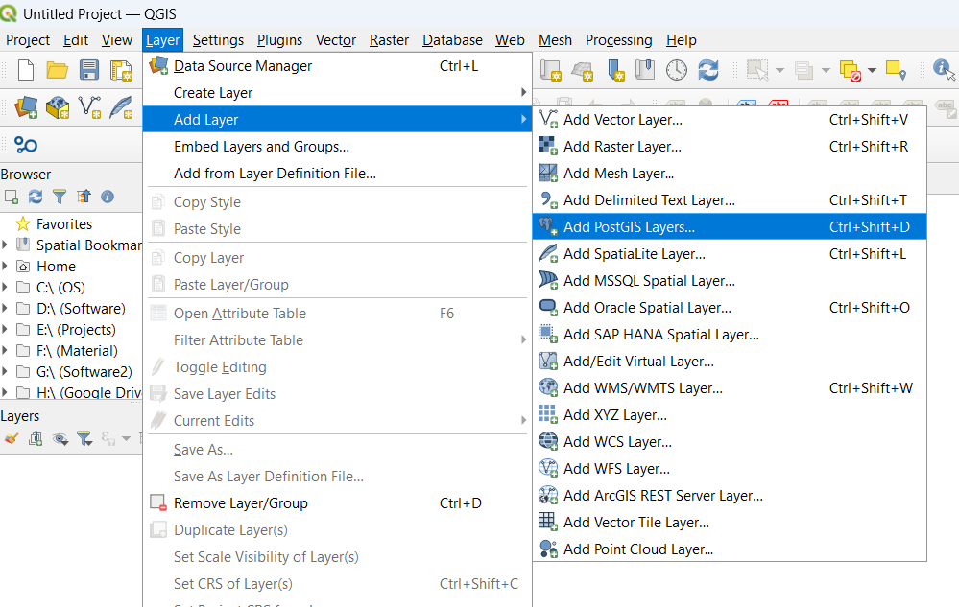
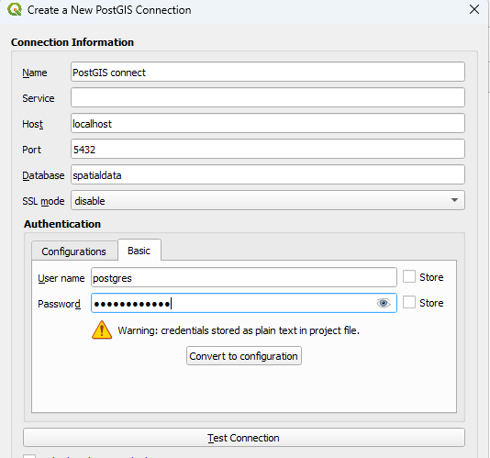

Slide 47
3.4.3 CHECK METADATA

Slide 48
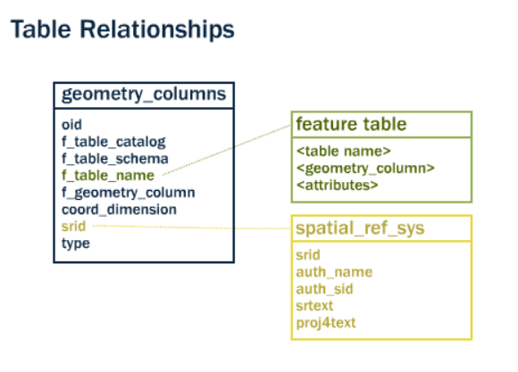
Metadata tables
PostGIS provides two tables to track and report on the geometry types available in a given database.
The first table, spatial_ref_sys, defines all the spatial reference systems known to the database and will be described in greater detail later.
The second table (actually, a view), geometry_columns, provides a listing of all “features” (defined as an object with geometric attributes), and the basic details of those features.

Slide 49
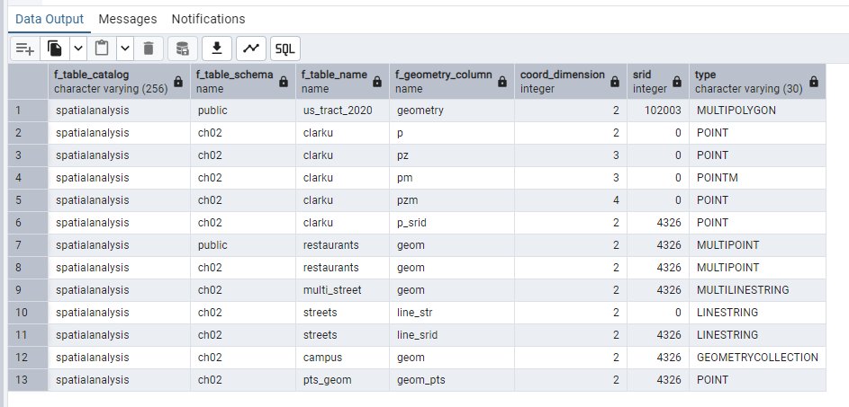
Geometry_columns table in database
SELECT * FROM geometry_columns;

