Slide 1

WEEK 02
Instructor: Yanan Wu
TA: Vanchy Li
Spring 2025

Slide 2
WEEK 02 lecture session
Instructor: Yanan Wu
TA: Vanchy Li
Spring 2025

Slide 3
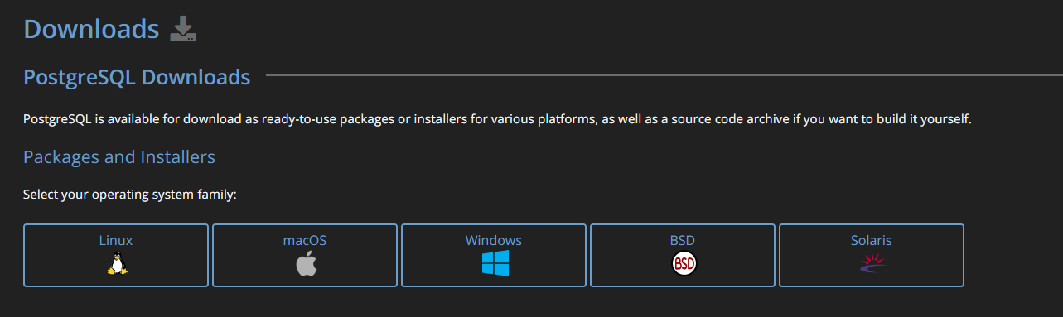
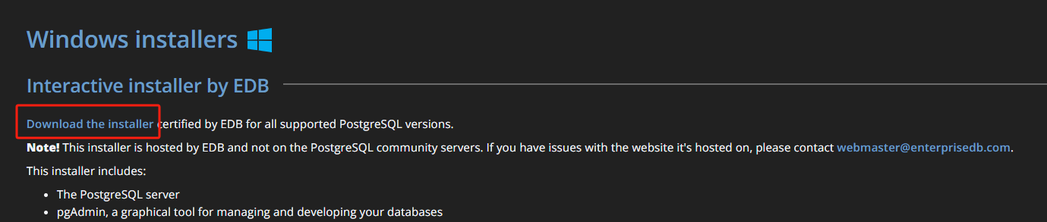
Download
PostgreSQL Download link
https://www.postgresql.org/
Select your operating system family
Select ‘Download the installer’

Slide 4
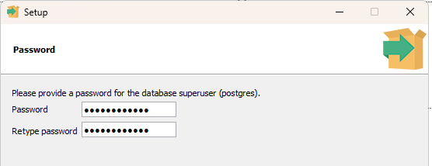
installation
Set up file directory and data directory (It is recommended to stick to the path suggested by the installer)
Set up the password
2.1 You need to use this password to access the database
2.2 You will be asked multiple times for creating a password
2.3 It is wise to choose the same password for all PostgreSQL related programs

Slide 5
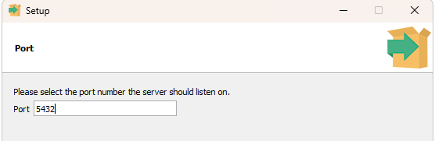
installation
Set up port number
3.1 You can accept the default one as your port number
3.2 A port number is a numerical identifier used in networking to distinguish different services or applications on a device
Accept default locale
Click ‘next’ to install the PostgreSQL

Slide 6
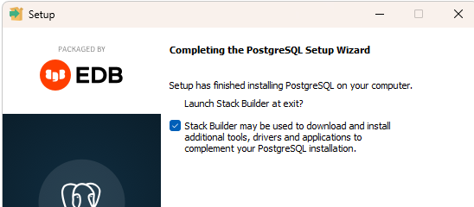
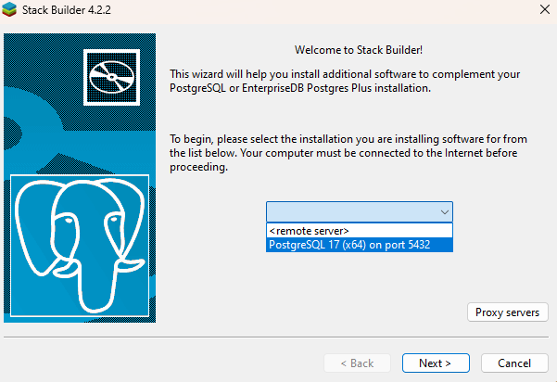
installation
Select ‘Stack builder’
In the stack builder, Select your port

Slide 7
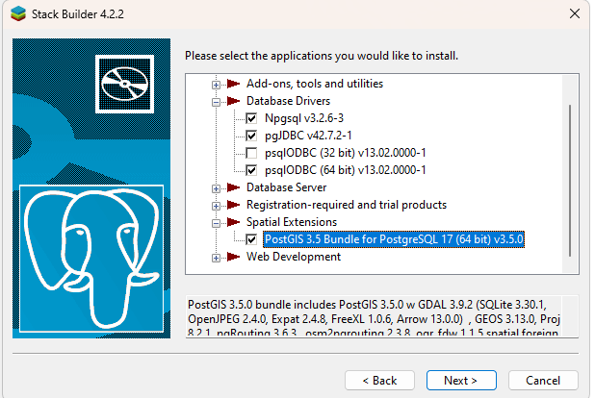
installation
For now, you only need to select PostGIS under Spatial Extensions

Slide 8
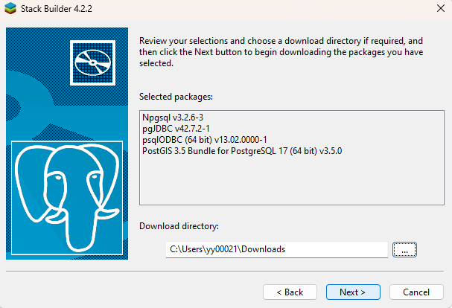
installation
Set up the download directory to store the installer

Slide 9
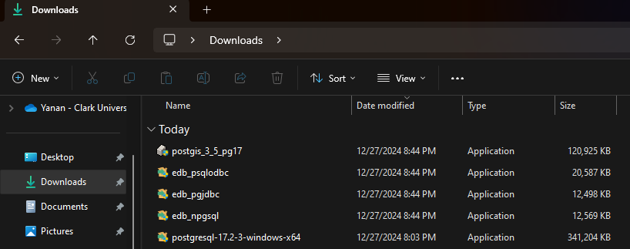
installation
After download, the several installers for database server and spatial extensions should appear in your downloading directory

Slide 10
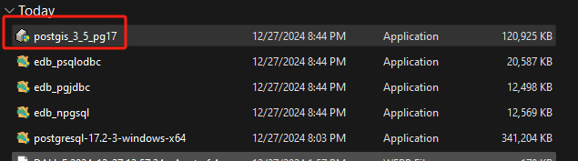
Installation OF POSTGIS
Install PostGIS extension

Slide 11
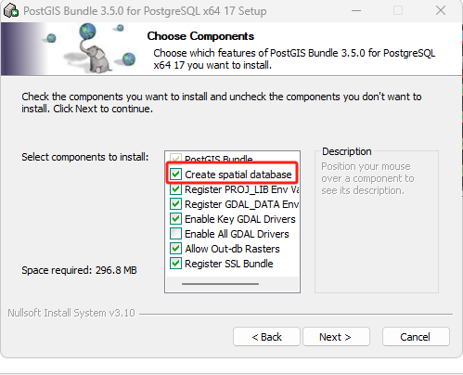
Installation OF POSTGIS
Select ‘Create Spatial Database’

Slide 12
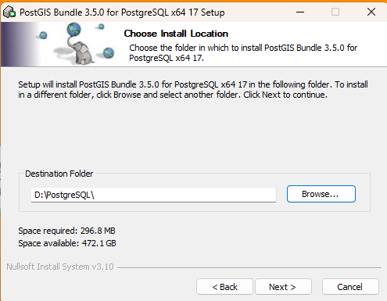
Installation OF POSTGIS
Set up the destination folder (PostGIS must be installed within the PostgreSQL folder where PostgreSQL is stored)
If you accept the default path (C:\) when you install PostgreSQL, in this step, please also accept the default path

Slide 13
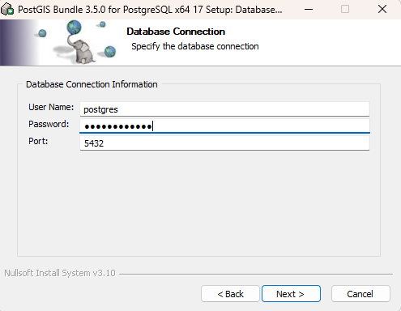
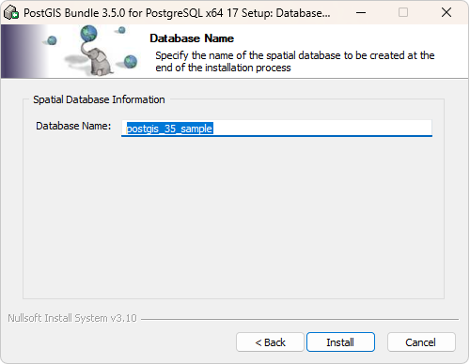
Installation OF POSTGIS
Type the password you set up earlier when you install PostgreSQL
Accept all the suggested parameters

Slide 14
Two popular tools come with postgresql
pdAdmin
Graphical User Interface
SQL Editor
Database Management
Multi-Platform
https://github.com/pgadmin-org/pgadmin4
psql
Command-line Interface

Slide 15
Access pgadmin 4
By installing PostgreSQL you will automatically get the PgAdmin as well.
Open PgAdmin and set up the password for it (It is recommended using the password for PostgreSQL)

Slide 16
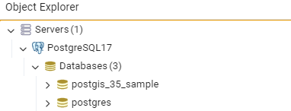
Databases under server
The server contains two databases
One is the default postgres database
The other one is the database we created while installing PostgreSQL
If one of the servers has a red cross on it means that it is not connected
You can check on it to have access
Sometimes you are required to provide the password

Slide 17
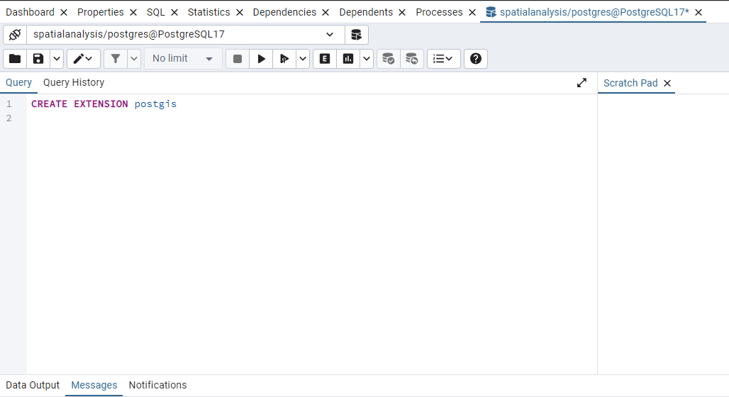
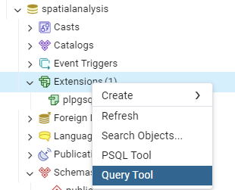
Check extension under
The default extension is plpgsql
Adding postgis extension through Query tool
Type ‘’CREATE EXTENSION postgis’’ in Query
Then the postgis extension was created under Extensions

Slide 18

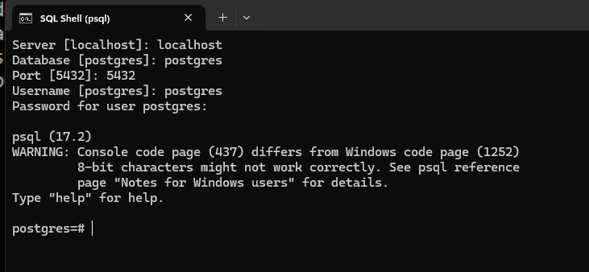
What if I do not (want to) use pgadmin
PSQL
Search SQL Shell in tool

Slide 19
WEEK 02 Lab session
Instructor: Yanan Wu
TA: Vanchy Li
Spring 2025

