Slide 1

WEEK 01
Instructor: Yanan Wu
TA: Vanchy Li
Spring 2025

Slide 2
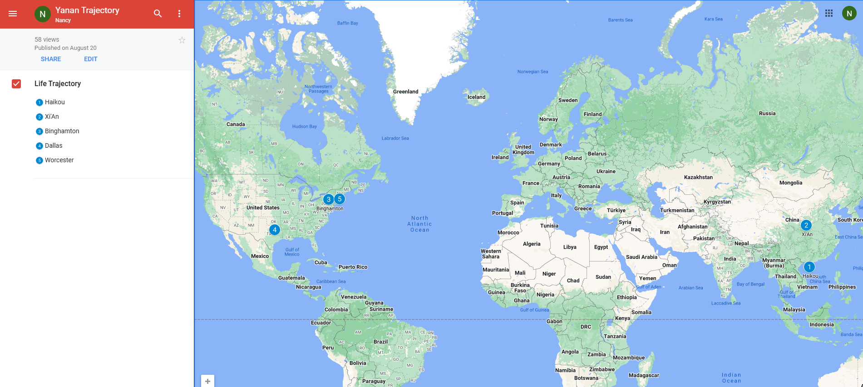
Yanan wu – visiting assistant professor
Education & Experience

Slide 3
teaching
Intermediate Statistics
Python Programming in GIS
Manipulating spatial data
Web mapping
Processing Raster
Data Analysis
Creating Custom Tool
Data visualization
Spatial Database

Slide 4
Ta introduction
Office Hours: 1: 00 – 3:00 PM on Monday
Office Location: EROS, the first floor of the Geography Building.

Slide 5
How about you?
Your background (e.g., name, major, where you come from)
What is your funniest thing that happened during your winter break?
What relevant experience do you have with spatial database?
What are your expectations for this course?

Slide 6
Course format
Lectures: Instructor & TA
Location: Physics/Math BP310 & Jonas Clark Hall JC105
Time: 10:25 – 11:40 on Monday & 14:50 – 16:40 on Tuesday
Labs: TA
Location: Physics/Math BP310
Time: 10:25 – 11:40 on Friday

Slide 7
learning resource
Introduction to PostGIS
Obe, R., & Hsu, L. S. (2021). PostGIS in action. Simon and Schuster.

Slide 8
Course requirements
Labs: 9 labs in total
For any graded assignment, if the you do not agree with the grade received, the instructor and TA must be notified within one week after the assignment is graded.
Late policy for lab (excluding midterm and final project)
One midterm exam & One final project (oral presentation and paper report)

Slide 9
gRADE
Assignments 80% = nine labs
Final Project 20% = 15% oral + 5% written
A (93.0 to 100.0) | B (83.0 to 86.9) | C (73.0 to 76.9) | D (63.0 to 66.9)
A- (90.0 to 92.9) | B- (80.0 to 82.9) | C- (70.0 to 72.9) | D- (60.0 to 62.9)
B+ (87.0 to 89.9) | C+ (77.0 to 77.9) | D+ (67.0 to 69.9) | F (0.0 to 59.9)

Slide 10
WEEK 01 lecture session
Instructor: Yanan Wu
TA: Vanchy Li
Spring 2025

Slide 11

Week 01
Introduction to the Course
Software Installation
PostgreSQL: The world’s most advanced open source database
PostGIS: About PostGIS

Slide 12

Week 02
Introduction to the PostGIS, PostgreSQL, and pgAdmin
Basic operations in pgAdmin
Introducing PostGIS
Introduction to psql

Slide 13
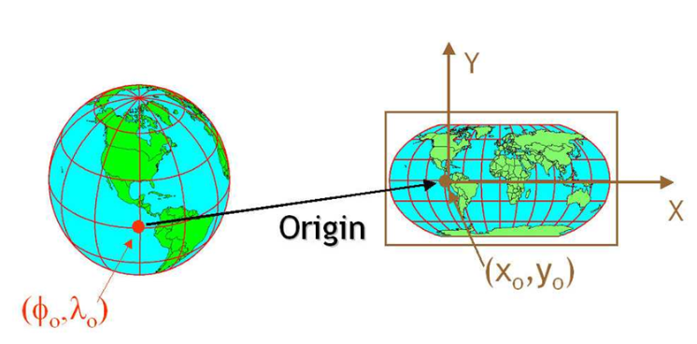
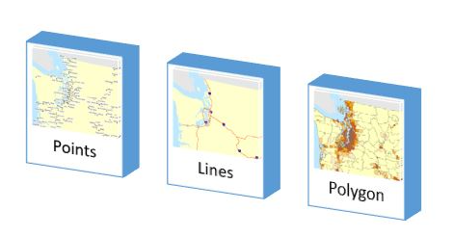
Week 03
Spatial data and geodatabases
Spatial data types
Spatial reference systems
Working with real data

Slide 14
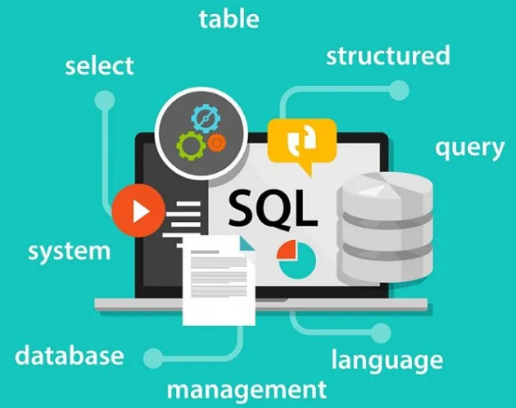
Week 04
Introduction to SQL (It is pronounced as “Escuel “, but most often you can hear the slang “Sequel”.)
Simple SQL
SELECT
INSERT
UPDATE
DELETE
Working with spatial data

Slide 15
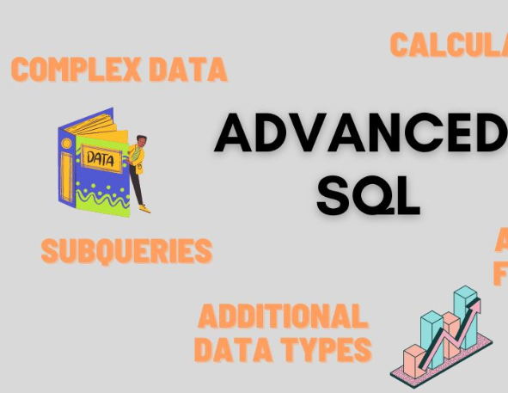
WEEK 05
Complex Queries and Database Management
Combine Information
Write Queries to run faster and use less data

Slide 16
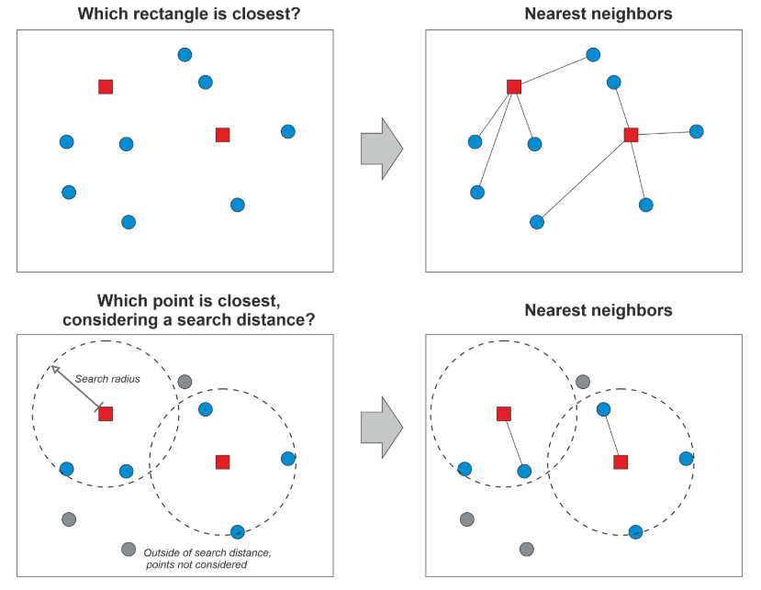
Week 06 & week 07
Proximity Analysis
Nearest Neighbor Search

Slide 17

WEEK 08
No Class Meeting
Spring Break

Slide 18
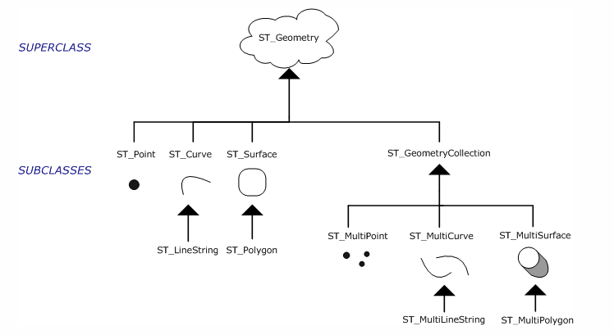
Week 09
Geometry processing

Slide 19
Week 10
Raster Processing
Raster output
Raster Accessors and setters
Reclassing functions

Slide 20



Week 11
PostgreSQL and ArcGIS or QGIS

Slide 21


WEEK 12
PostGIS with Python
Week 13
PostGIS in Web Application

