Slide 1

WEEK 12
Instructor: Yanan Wu
TA: Vanchy Li
Spring 2025

Slide 2
WEEK 12 lecture session
Instructor: Yanan Wu
TA: Vanchy Li
Spring 2025

Slide 3
12.1 spatial analysis in raster

Slide 4
INTRODUCTION
Map Algebra
A spatial analysis technique that allows you to perform mathematical operations on raster pixels — one layer at a time or between multiple layers.
Raster Indices
Spectral indices like NDVI, NBR, GCI, and BI are commonly used in remote sensing to identify land cover types, monitor vegetation, assess burn severity, and detect urban or barren surfaces.
Use ST_MapAlgebra to compute new rasters from existing Landsat imagery
Apply algebraic expressions to combine multiple spectral bands
Create normalized indices to highlight specific land surface properties
Store and interpret the resulting rasters in PostGIS

Slide 5
Load data
Load data in cmd
Load band 1 – 7 to postgresql
Please make sure to change the file name ‘LC08_044034_20170614_B1.tif ’ and correspond file names ‘ch12.b1 ’ in database
raster2pgsql -s 4326 -I -C -M E:\\Clark\\Spring2025\\rs\\LC08_044034_20170614_B1.tif -F -t 256x256 ch12.b1 | psql -U postgres -d spatial

Slide 6
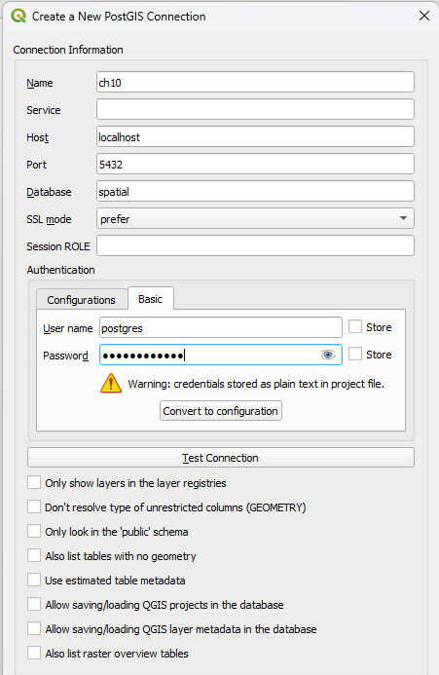
Qgis VIEW
Right click PostgreSQL to create new connection

Slide 7
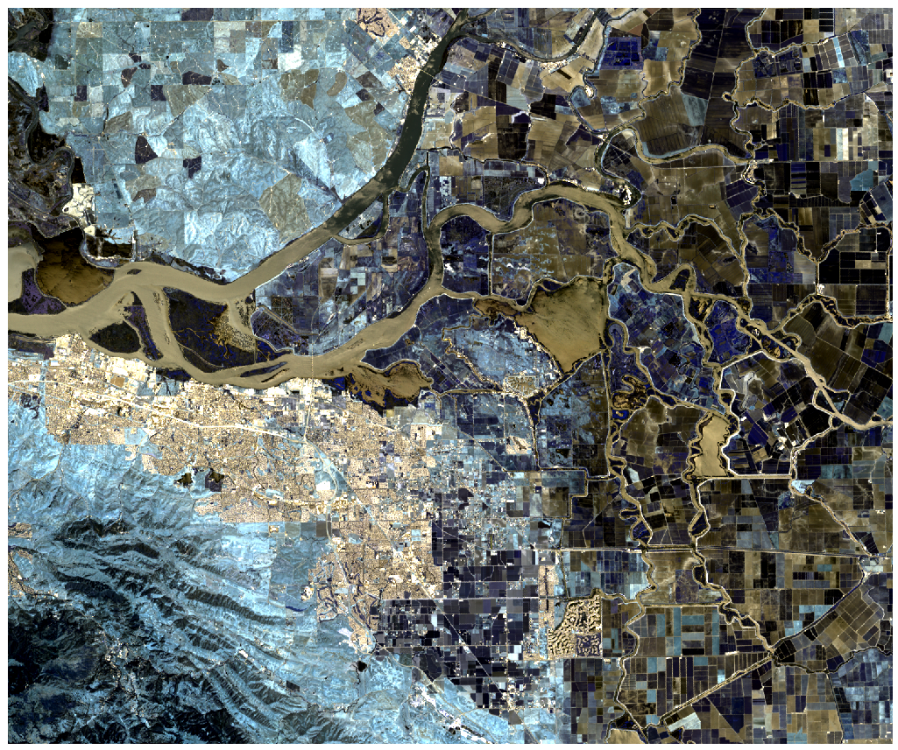
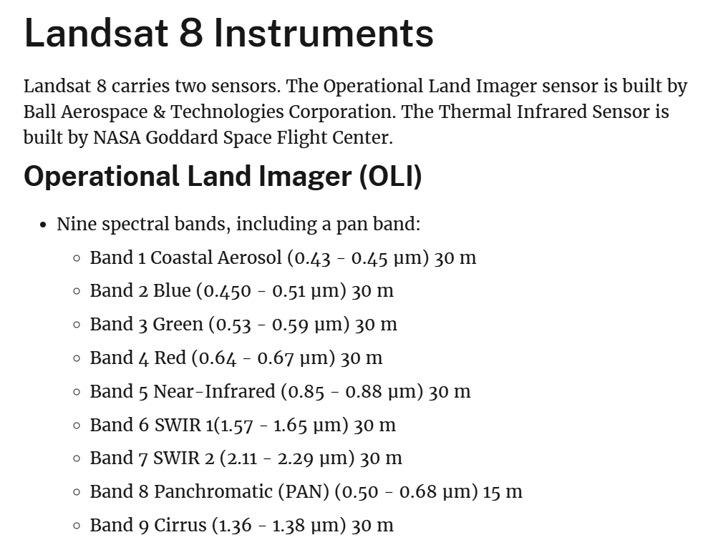
Data introduction
Spatial Coverage: Concord and Stockton, in California, USA
Landsat 8, Sensor-Satellite OLI/TIRS

Slide 8
Check metadata of the raster table
Check width, height, number of bands
SELECT
rid,
ST_SRID(rast) AS srid,
ST_Width(rast) AS width,
ST_Height(rast) AS height,
ST_NumBands(rast) AS num_bands
FROM ch12.b1;

Slide 9
Exercise 01: Check metadata of the raster table
Check pixel resolution, x and y of the starting point
ST_ScaleX()
ST_ScaleY()
ST_UpperLeftX()
ST_UpperLeftY()

Slide 10
Merge THREE band
CREATE TABLE ch12.threebands AS
SELECT
AS rast
FROM ch12.b1 AS b1
JOIN ch12.b2 AS b2 ON b1.rid = b2.rid
JOIN ch12.b3 AS b3 ON b1.rid = b3.rid;
Creates a new table ch12. threebands that combine Band 1, Band 2, and Band 3 raster images (stored in separate tables) into a single raster with 3 bands.
Joins the three tables b1, b2, and b3 using the rid (raster ID) so that:
Only matching raster tiles (same location and extent) are merged together.
This ensures each row in the new table contains corresponding tiles from all three bands.

Slide 11
Exercise 02: Merge four band
Merge b1,b2,b3,b4

Slide 12
Exercise: Merge seven bands
CREATE TABLE ch12.landsat AS
SELECT
b1.rid,
ST_AddBand(
ST_AddBand(
ST_AddBand(
ST_AddBand(
ST_AddBand(
ST_AddBand(
b1.rast, -- Band 1
b2.rast -- Band 2
),
b3.rast -- Band 3
),
b4.rast -- Band 4
),
b5.rast -- Band 5
),
b6.rast -- Band 6
),
b7.rast -- Band 7
) AS rast
FROM ch12.b1 AS b1
JOIN ch12.b2 AS b2 ON b1.rid = b2.rid
JOIN ch12.b3 AS b3 ON b1.rid = b3.rid
JOIN ch12.b4 AS b4 ON b1.rid = b4.rid
JOIN ch12.b5 AS b5 ON b1.rid = b5.rid
JOIN ch12.b6 AS b6 ON b1.rid = b6.rid
JOIN ch12.b7 AS b7 ON b1.rid = b7.rid;

Slide 13
BAND STATISTICS
(stats).min, (stats).max, (stats).mean, (stats).stddev: These extract individual summary values from the stats composite type returned by the inner query.
min, max, mean, stddev, and count

Slide 14
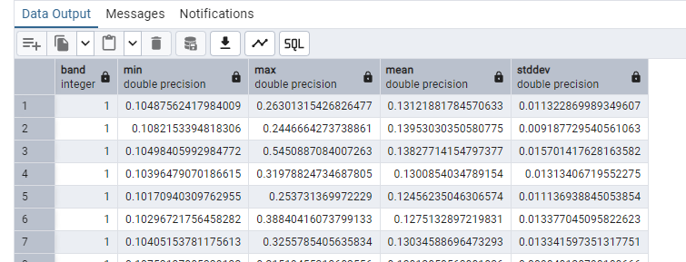
BAND STATISTICS for single band
1 AS band: This just creates a column called band and fills it with the value 1, indicating that these stats are for band 1.
ST_SummaryStats(rast, 1) is a PostGIS raster function that returns a composite object with summary statistics for band 1 of the raster
FROM ch12.b1: This is your raster table; rast is assumed to be the raster column in that table.
SELECT
1 AS band,
FROM (
SELECT ST_SummaryStats(rast, 1) AS stats
FROM ch12.b1
) AS foo;

Slide 15
Exercise: BAND STATISTICS for data with multiple band
Calculate the band statistics for band 3 in ch12.landsat

Slide 16
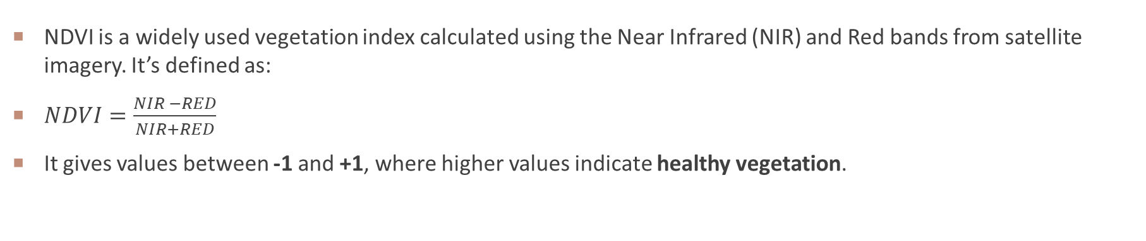
Ndvi calculation
NDVI is a widely used vegetation index calculated using the Near Infrared (NIR) and Red bands from satellite imagery. It’s defined as:
$NDVI=\frac{NIR −RED}{NIR+RED}$
It gives values between -1 and +1, where higher values indicate healthy vegetation.

Slide 17
Ndvi calculation
MapAlgebra: Documentation
Pixel type: https://postgis.net/docs/RT_ST_BandPixelType.html
CREATE TABLE ch12.ndvi_raster AS
SELECT
rid,
ST_MapAlgebra(
) AS rast
FROM ch12.landsat;

Slide 18
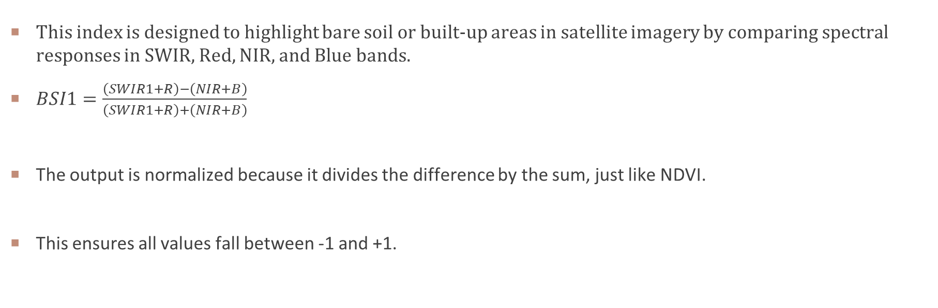
Bare soil index 1
This index is designed to highlight bare soil or built-up areas in satellite imagery by comparing spectral responses in SWIR, Red, NIR, and Blue bands.
$BSI1=\frac{\left(SWIR1+R\right)−\left(NIR+B\right)}{\left(SWIR1+R\right)+\left(NIR+B\right)}$
The output is normalized because it divides the difference by the sum, just like NDVI.
This ensures all values fall between -1 and +1.

