Slide 1

WEEK 01
Instructor: Yanan Wu
TA: Vanchy Li
Spring 2025

Slide 2
WEEK 01 lecture session
Instructor: Yanan Wu
TA: Vanchy Li
Spring 2025

Slide 3
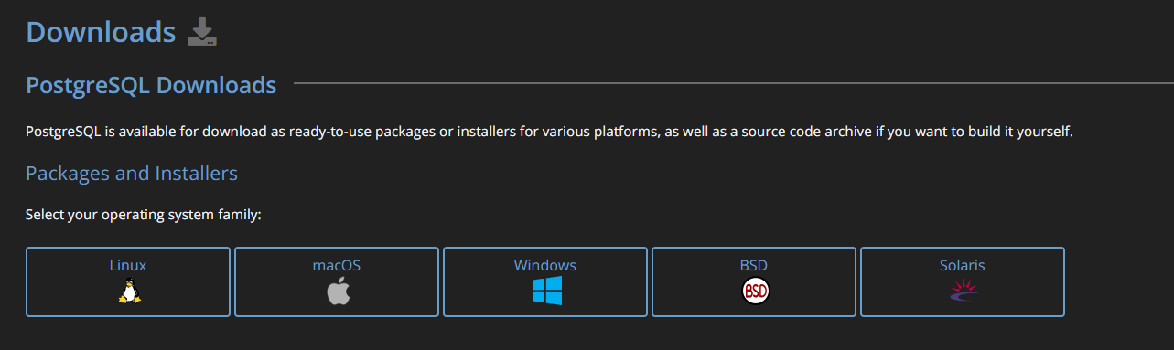
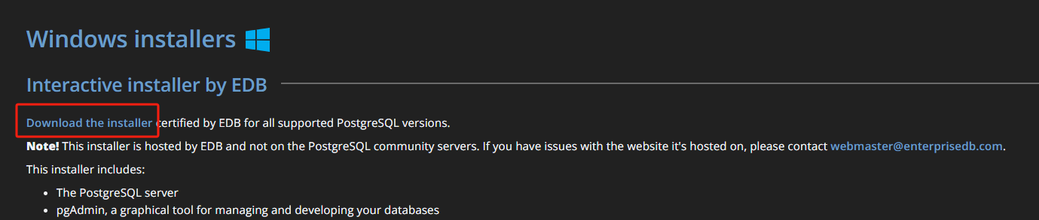
Download
PostgreSQL Download link
https://www.postgresql.org/
Select your operating system family
Select ‘Download the installer’

Slide 4
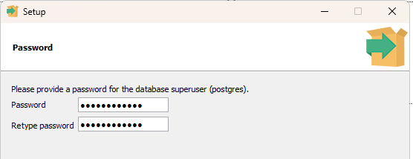
installation
Set up file directory and data directory (It is recommended to stick to the path suggested by the installer)
Set up the password
2.1 You need to use this password to access the database
2.2 You will be asked multiple times for creating a password
2.3 It is wise to choose the same password for all PostgreSQL related programs

Slide 5
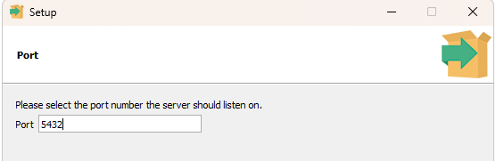
installation
Set up port number
3.1 You can accept the default one as your port number
3.2 A port number is a numerical identifier used in networking to distinguish different services or applications on a device
Accept default locale
Click ‘next’ to install the PostgreSQL

Slide 6
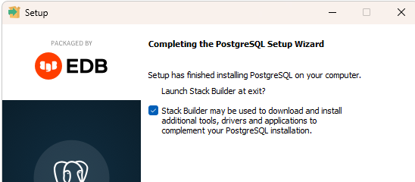
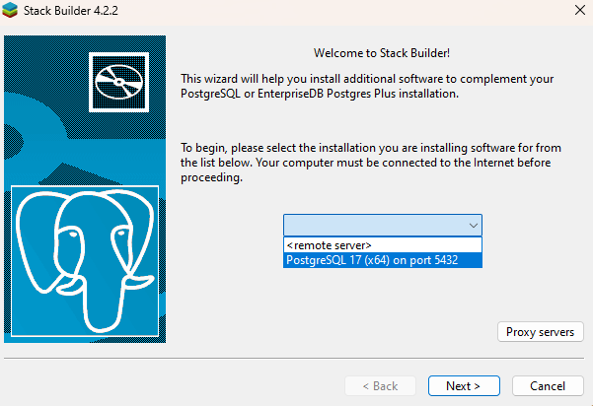
installation
Select ‘Stack builder’
In the stack builder, Select your port

Slide 7
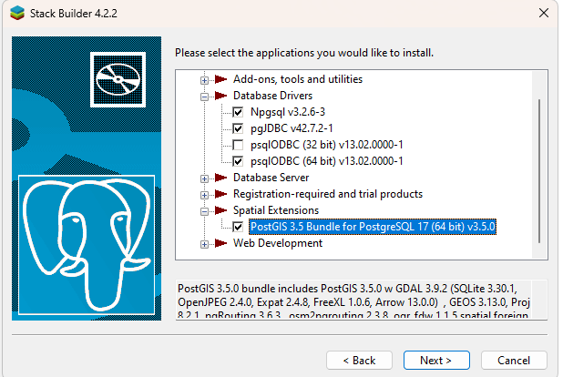
installation
For now, you only need to select PostGIS under Spatial Extensions

Slide 8
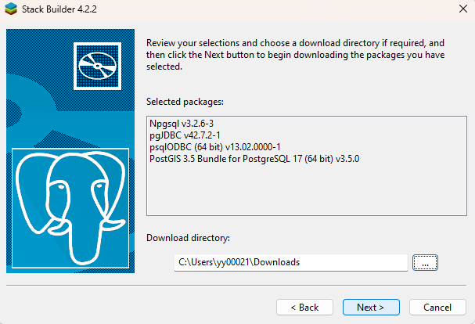
installation
Set up the download directory to store the installer

Slide 9
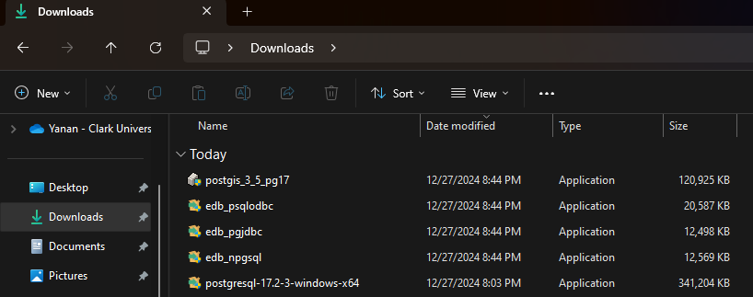
installation
After download, the several installers for database server and spatial extensions should appear in your downloading directory

Slide 10
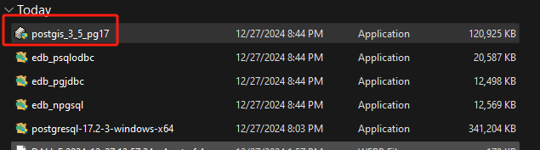
Installation OF POSTGIS
Install PostGIS extension

Slide 11
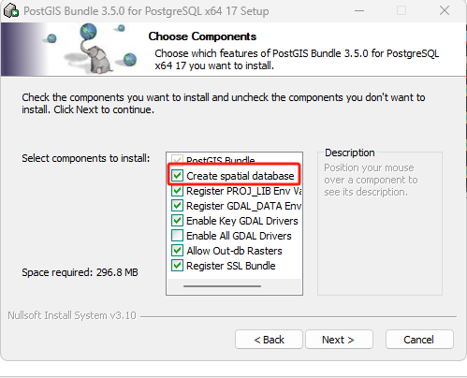
Installation OF POSTGIS
Select ‘Create Spatial Database’

Slide 12
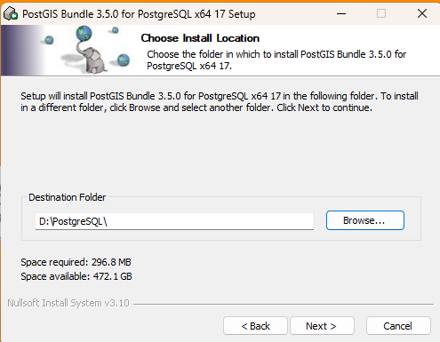
Installation OF POSTGIS
Set up the destination folder (PostGIS must be installed within the PostgreSQL folder where PostgreSQL is stored)
If you accept the default path (C:\) when you install PostgreSQL, in this step, please also accept the default path

Slide 13
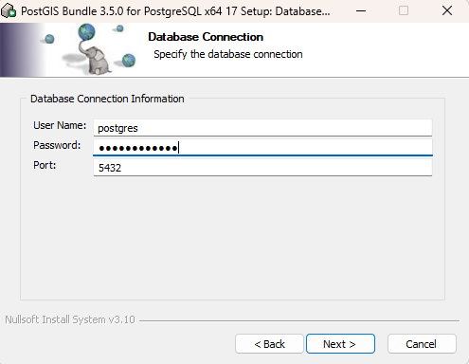
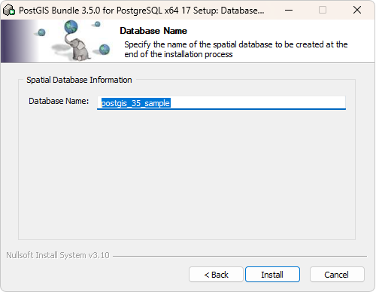
Installation OF POSTGIS
Type the password you set up earlier when you install PostgreSQL
Accept all the suggested parameters

Slide 14
Two popular tools come with postgresql
pdAdmin
Graphical User Interface
SQL Editor
Database Management
Multi-Platform
https://github.com/pgadmin-org/pgadmin4
psql
Command-line Interface

Slide 15
Access pgadmin 4
By installing PostgreSQL you will automatically get the PgAdmin as well.
Open PgAdmin and set up the password for it (It is recommended using the password for PostgreSQL)

Slide 16
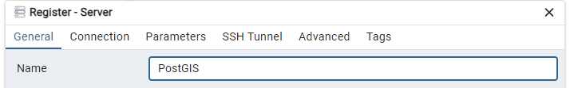
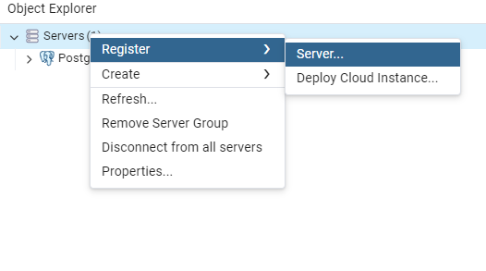
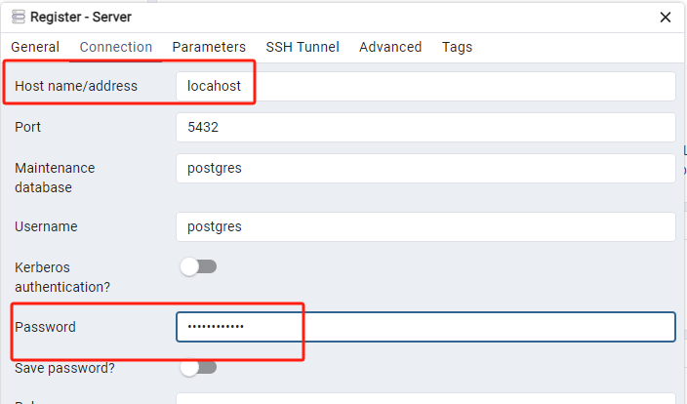
Access server in PGADMIN 4
Right click the Servers in the left panel to register server
Name your server and input relevant information

