Slide 1

WEEK 05 ADVANCED sql
Instructor: Yanan Wu
TA: Vanchy Li
Spring 2025

Slide 2
WEEK 05 lecture session
Instructor: Yanan Wu
TA: Vanchy Li
Spring 2025

Slide 3
5.1 intro

Slide 4
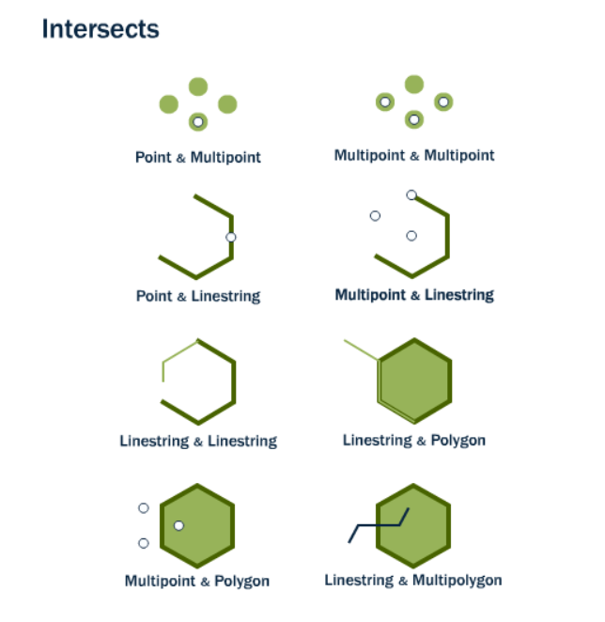
ST_Intersects
ST_Intersects(geometry A, geometry B)

Slide 5
Example 1: ST_Intersects
Find all streets within 50 meters of subway stations (using buffer).
SELECT street.name, subway.borough
FROM ch05.streets AS street, ch05.subway AS subway
WHERE ST_Intersects(street.geom, ST_Buffer(subway.geom, 50));

Slide 6
Exercise 1: ST_Intersects
Find all one-way streets within 50 meters of subway stations.
SELECT name, borough_name
FROM ch05.streets, ch05.subway
WHERE oneway = 'Yes’ AND ST_Intersects(ch05.streets.geom, ST_Buffer(ch05.subway.geom, 50))

Slide 7
Example 2: ST_Intersects
Identify neighborhoods where there are subway stations
SELECT nbh.boroname, COUNT(*) AS station_count
FROM ch05.neighborhoods AS nbh, ch05.subway as subway
WHERE ST_Intersects(nbh.geom, subway.geom)
GROUP BY boroname;

Slide 8
Exercise 2: ST_Intersects
Identify neighborhoods with more than 100 subway stations
SELECT nbh.boroname, COUNT(*) AS station_count
FROM ch05.neighborhoods AS nbh, ch05.subway as subway
WHERE ST_Intersects(nbh.geom, subway.geom)
GROUP BY boroname
HAVING COUNT(*) > 100;

Slide 9
Example 3: ST_Intersects
List all subway stations where express trains stop that are within 50 meters of major roads.
SELECT station_name, name AS street_name
FROM ch05.subway, ch05.streets
WHERE express_stop = 'Yes'AND road_type = 'Major’ AND ST_Intersects(ST_Buffer(ch05.subway.geom, 50), ch05.streets.geom);

Slide 10
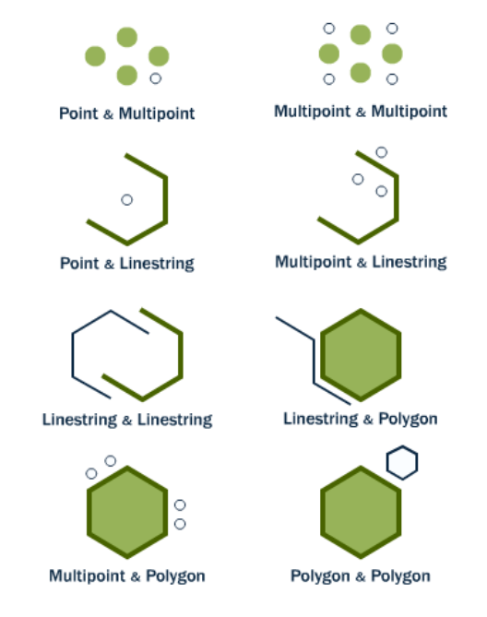
ST_Disjoint
The opposite of ST_Intersects is ST_Disjoint(geometry A , geometry B). If two geometries are disjoint, they do not intersect, and vice-versa. In fact, it is often more efficient to test “not intersects” than to test “disjoint” because the intersects tests can be spatially indexed, while the disjoint test cannot.

Slide 11
Example 1: ST_Disjoint
List neighborhoods Disjoint with 500 meters buffer of subway stations.
SELECT nbh.boroname, nbh.geom
FROM ch05.neighborhoods AS nbh, ch05.subway
WHERE ST_Disjoint(nbh.geom, ch05.subway.geom);
Do you find any problems with the results

Slide 12
Exercise 1: ST_Disjoint
List neighborhoods Disjoint with 500 meters buffer of subway stations.
ST_Disjoin – Subquery with NOT EXISTS (faster)
SELECT nbh.boroname, nbh.geom
FROM ch05.neighborhoods AS nbh
WHERE NOT EXISTS (
SELECT *
FROM ch05.subway AS sb
WHERE ST_Disjoint(nbh.geom, sb.geom) = FALSE);
Remove neighborhoods that intersect (Not Disjoint) with subway

Slide 13
Exercise 1: ST_Intersect and ST_Buffer
List neighborhoods Disjoint with 500 meters buffer of subway stations.

Slide 14
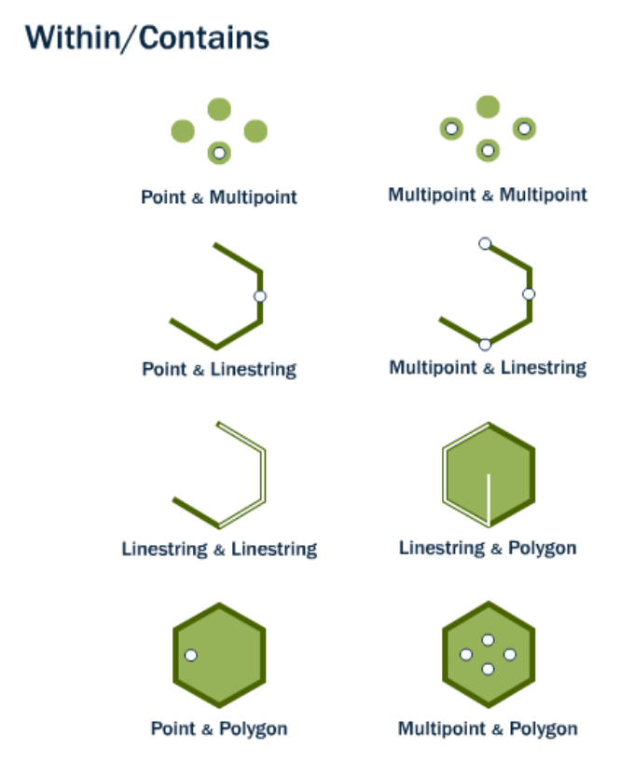
ST_Within

Slide 15
Example 1: ST_Within
List street segments that outside of 500m buffer of subway station
SELECT street.name, street.geom
FROM ch05.streets AS street
WHERE NOT EXISTS (
SELECT 1
FROM ch05.subway
WHERE ST_DWithin(street.geom, ch05.subway.geom, 500));

Slide 16
5.2 FUNCTION

Slide 17
Function: ST_Disjoint
Creating a Function for Intersecting Streets and Neighborhoods
Open pgAdmin 4.
Navigate to your database, then go to Functions.
Right-click on Functions > Create > Function.
Enter the function details:

Slide 18
Function: ST_Disjoint
Write custom SQL functions to automate repetitive buffer analysis tasks.
CREATE OR REPLACE FUNCTION get_intersecting_streets()
RETURNS TABLE(street_name TEXT, neighborhood_name TEXT) AS $$
BEGIN
RETURN QUERY
SELECT s.street_name, n.neighborhood_name
FROM streets s, neighborhoods n
WHERE ST_Intersects(s.geom, n.geom);
END;
$$ LANGUAGE plpgsql;

Slide 19
FUNCTION
Simplify complex queries with views for better data visualization.
CREATE VIEW ch05.residential_near_stations AS
SELECT s.NAME AS street_name, st.NAME AS station_name
FROM ch05.nyc_streets s
JOIN ch05.nyc_subway_stations st
ON ST_DWithin(s.geometry, st.geometry, 300)
WHERE s.TYPE = 'residential';

Slide 20
CREATE OR REPLACE FUNCTION get_intersecting_geometries(
streets_table TEXT,
neighborhoods_table TEXT,
buffer_geom_column TEXT,
intersect_geom_column TEXT,
buffer_size DOUBLE PRECISION)
RETURNS TABLE(street_name TEXT, neighborhood_name TEXT) AS $$
SELECT s.street_name, n.neighborhood_name
FROM
(SELECT *, ST_Buffer(ST_GeomFromEWKT(buffer_geom_column), buffer_size) AS buffered_geom
FROM public."" || streets_table || "") s,
public."" || neighborhoods_table || "" n
WHERE ST_Intersects(s.buffered_geom, n."" || intersect_geom_column || "");
$$ LANGUAGE sql;
-- Example usage:-- SELECT * FROM get_intersecting_geometries('streets', 'neighborhoods', 'geom', 'geom', 100);

