Slide 1

WEEK 01
Instructor: Yanan Wu
TA: Vanchy Li
Spring 2025

Slide 2
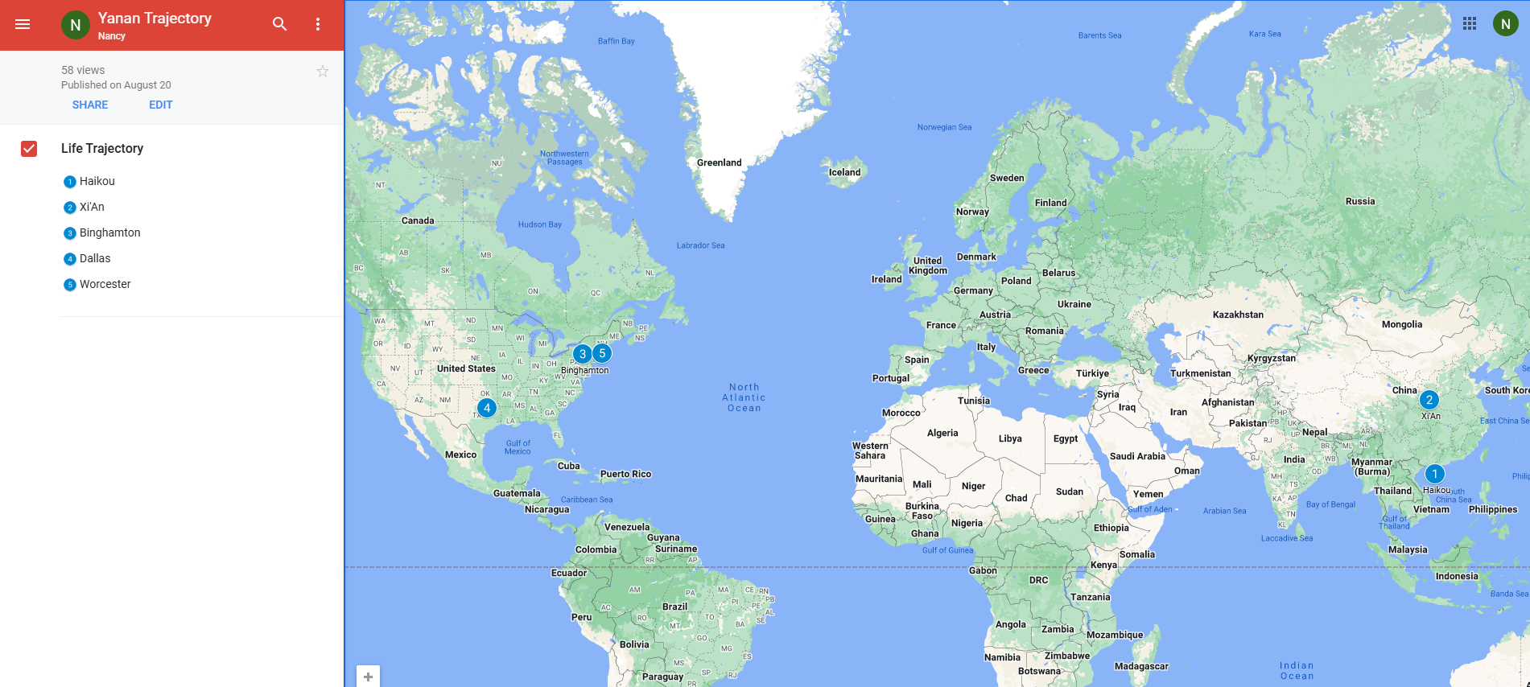
Yanan wu – visiting assistant professor
Education & Experience

Slide 3
teaching
Intermediate Statistics
Python Programming in GIS
Manipulating spatial data
Web mapping
Processing Raster
Data Analysis
Creating Custom Tool
Data visualization
Spatial Database

Slide 4
Ta introduction
Office Hours:
Office Location

Slide 5
How about you?
Your background (e.g., name, major, where you come from)
What is your funniest thing that happened during your winter break?
What relevant experience do you have with statistics?
What are your expectations for this course?

Slide 6
Course format
Lectures: Instructor & TA
Location:
Time
Labs: TA
Location
Time
Office Hours
Office Location

Slide 7
Course requirements
Labs: 11 in total
For any graded assignment, if the you do not agree with the grade received, the instructor and TA must be notified within one week after the assignment is graded.
Late policy for lab (excluding midterm and final project)
One midterm exam & One final project (oral presentation and paper report)

Slide 8
gRADE

Slide 9
WEEK 01 lecture session
Instructor: Yanan Wu
TA: Vanchy Li
Spring 2025

Slide 10
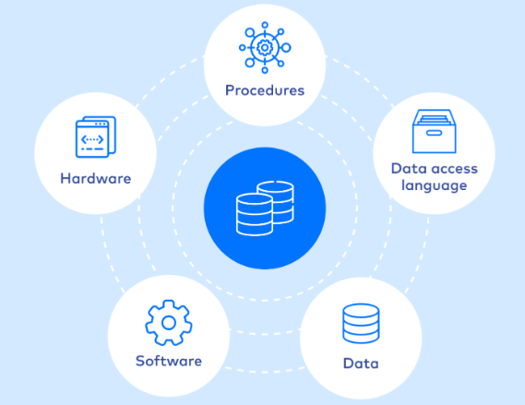
dATABASE
A database is an organized collection of structured data, or information, typically stored electronically in a computer that can be easily accessed, managed, and updated
Source

Slide 11
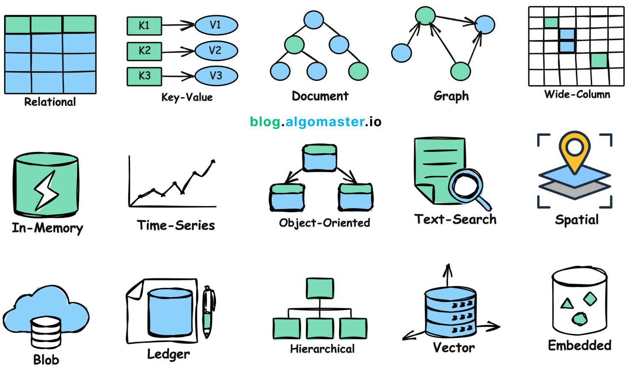
Types of database
Source

Slide 12
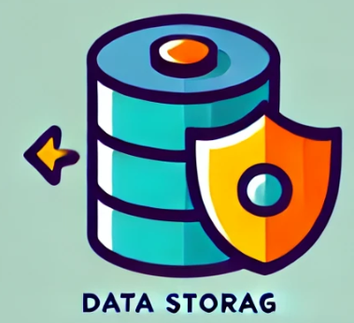



Database management system (dbms)
A software system that is designed to manage and organize data in a structured manner.
Key features of DBMS
Store large amounts of data systematically
Implements access control to protect data from unauthorized access
Ensure the consistency of data through constraints
Provide tools to back up the database

Slide 13





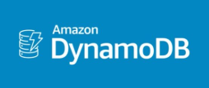
OPEN-SOURCE TECHNOLOGIES
MySQL
PostgreSQL
MongoDB
SQLite
DynamoDB
MariaDB

Slide 14
Key attributes of a robust dbms
Reliability
The system can function correctly and consistently over time
The system must be able to offer continual uninterrupted service
Consistency
Refers to ensuring that the database remains accurate, valid, and follows defined rules or constraints
Technology-Proof
The system is adapted to evolving technologies and its long-term viability

Slide 15
GEODATABASE
A Geodatabase is a specialized type of database designed to store, manage, and analyze spatial and geographic data.
It serves as a comprehensive framework for organizing spatial data and associated attribute information, allowing users to perform advanced geographic analysis, mapping, and data management tasks.

Slide 16
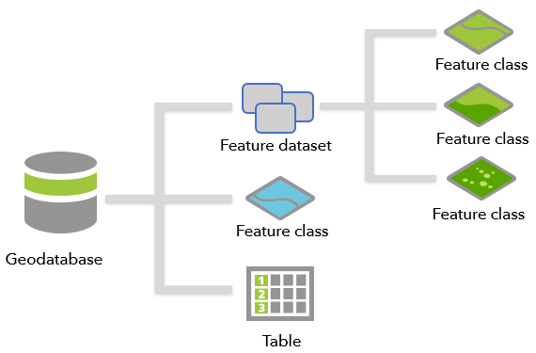
Geodatabase in gis

Slide 17
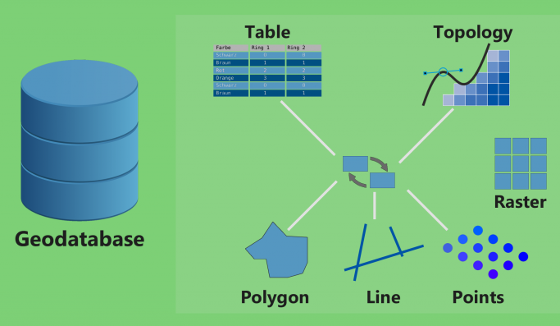
Advantages of using a geodatabase
Centralized Data Management
Combines spatial (maps, shapes) and non-spatial (tabular) data in a single database.
Provides a unified framework for managing diverse data types, including vector, raster, and attribute data.

Slide 18


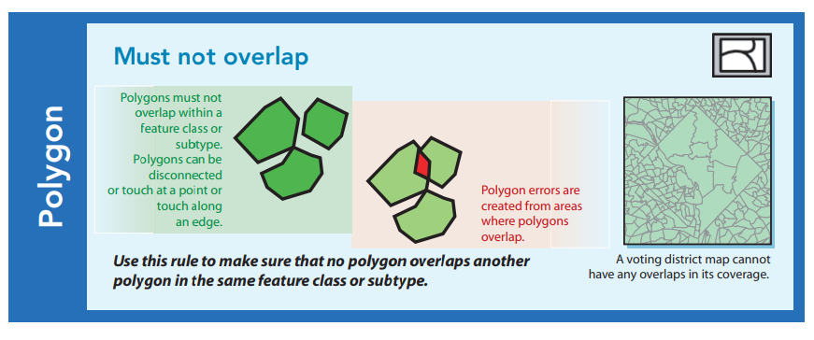

Advantages of using a geodatabase
Data Integrity and Consistency
Supports topology rules to ensure data accuracy (e.g., no overlapping polygons or gaps).
Enforces data validation and constraints to maintain reliable relationships between features.
Versioning support allows multiple users to work on the same dataset without conflicts.

Slide 19




Advantages of using a geodatabase
Cross-Platform Compatibility
Compatible with various GIS software tools, such as ArcGIS, QGIS, and GeoServer.
Works with relational database systems like PostgreSQL/PostGIS, Oracle, or SQL Server.
=

Slide 20
Advantages of using a geodatabase
Scalability
Supports various levels of implementation:
File Geodatabases: A file geodatabase is stored as multiple files in a folder with a .gdb extension. For team collaboration on medium-scale projects.
Enterprise Geodatabases: Also known as multiuser geodatabases, enterprise geodatabases are stored in relational databases. They can be virtually unlimited in size and number of users; the limits differ depending on the database management system (DBMS) vendor. For large organizations and multi-user environments.
Mobile Geodatabases: A mobile geodatabase is stored in an SQLite database that is entirely contained in a single file and has a .geodatabase extension.
Capable of handling large datasets efficiently in enterprise environments.

Slide 21
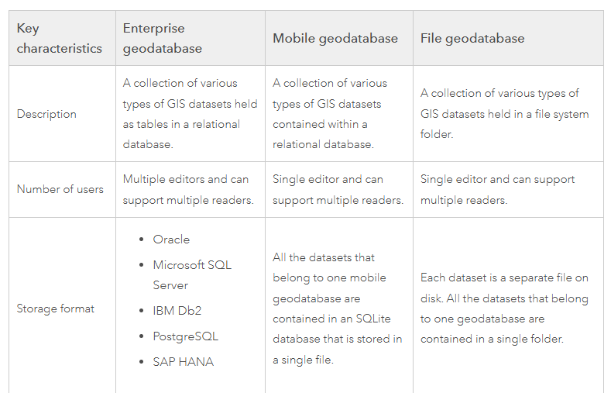
Comparing types of geodatabases
More detailed comparison of geodatabases

Slide 22
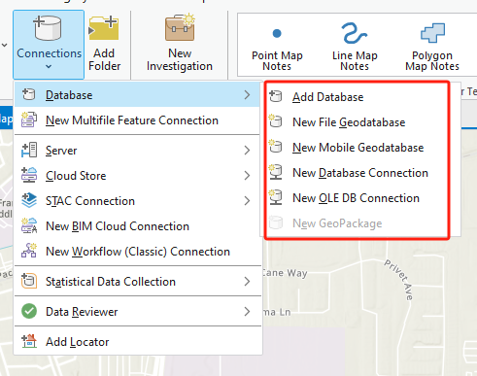
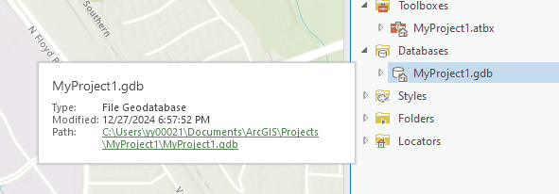
Geodatabase in arcgis pro

Slide 23
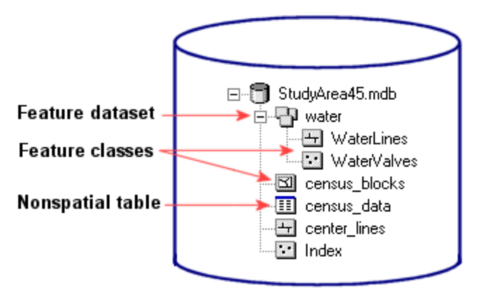
Feature datasets and feature class
A feature dataset is composed of feature class
A feature class is a collection of geographic features with the same geometry type, attributes, and spatial reference.

Slide 24
Standard query language (SQL)
SQL is a standard programming language specifically designed for managing and manipulating relational databases.
It allows users to interact with a DBMS to perform various operations such as querying, updating, and managing database structures.

Slide 25
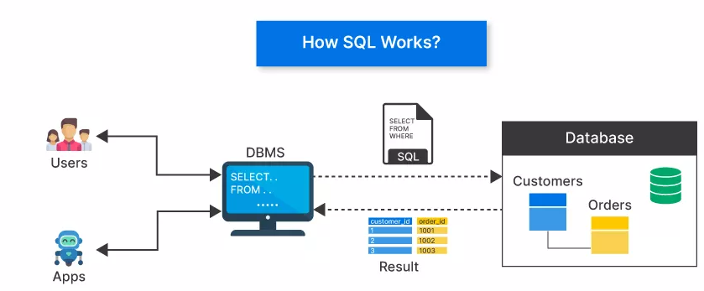
How sql works
It serves as a standard interface for interacting with relational database management systems (RDBMS), allowing users to perform a variety of routine tasks and operations on data
such as querying, updating, inserting, and deleting records.
Source

Slide 26
Key points between dbms and sql
SQL is Independent of DBMS: While SQL is a standard, each DBMS may implement it with slight variations or extensions (e.g., PL/SQL in Oracle, T-SQL in SQL Server).
DBMS Without SQL: Some DBMS types, such as NoSQL databases (e.g., MongoDB), do not rely on SQL but use alternative query languages.
SQL Requires a DBMS: SQL commands need a DBMS to interpret and execute them. Without a DBMS, SQL commands would have no database to operate on.

Slide 27
SOFTWAREs
PostgreSQL
What is PostgreSQL?
An open-source, powerful, object-relational database system.
Known for its reliability, extensibility, and SQL compliance.
Why PostgreSQL for GIS?
Supports structured queries for data management and manipulation.
Extensible via plugins, making it adaptable for spatial needs.

Slide 28
SOFTWARE
What is PostGIS?
A spatial database extension for PostgreSQL.
Adds support for geographic objects like points, lines, and polygons.
Key Features of PostGIS:
Spatial data types: GEOMETRY and GEOGRAPHY.
Spatial functions:
Query and manipulate spatial data (ST_Intersects, ST_Buffer, ST_Distance).
Perform spatial analyses (e.g., clipping, union, or proximity searches).

Slide 29
WEEK 01 No Lab
Instructor: Yanan Wu
TA: Vanchy Li
Spring 2025

