Slide 1

WEEK 02
Instructor: Yanan Wu
TA: Vanchy Li
Spring 2025

Slide 2
WEEK 02 lecture session
Instructor: Yanan Wu
TA: Vanchy Li
Spring 2025

Slide 3
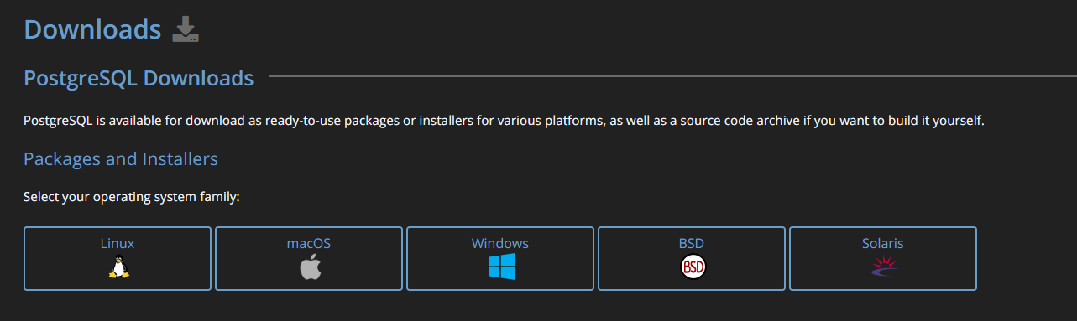
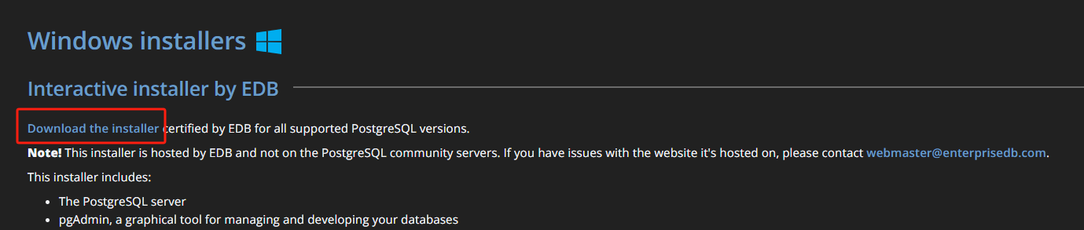
Download
PostgreSQL Download link
https://www.postgresql.org/
Select your operating system family
Select ‘Download the installer’

Slide 4
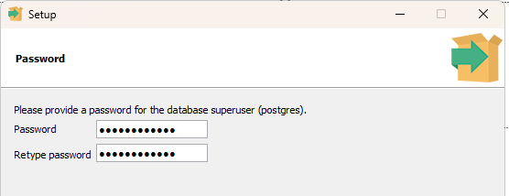
installation
Set up file directory and data directory
Set up the password
2.1 You need to use this password to access the database

Slide 5
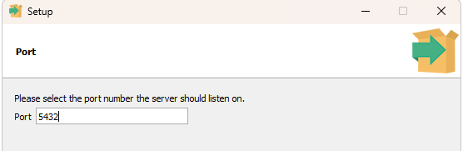
installation
Set up port number
3.1 You can accept the default one as your port number
3.2 A port number is a numerical identifier used in networking to distinguish different services or applications on a device
Accept default locale
Click ‘next’ to install the PostgreSQL

Slide 6
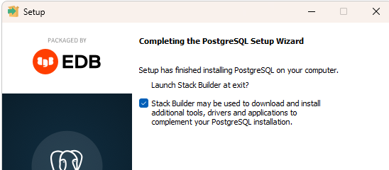
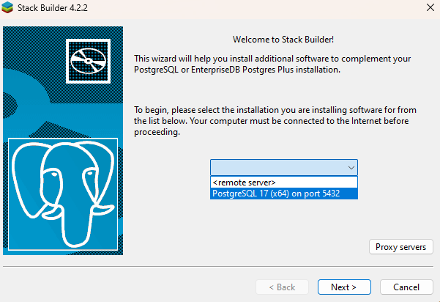
installation
Select ‘Stack builder’
Select your port

Slide 7
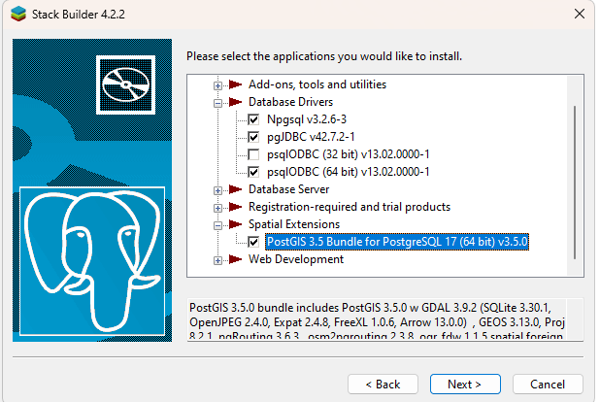
installation
Select the database driver and Spatial Extensions

Slide 8
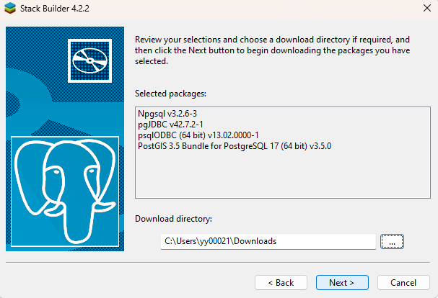
installation
Set up the download directory to store the installer

Slide 9
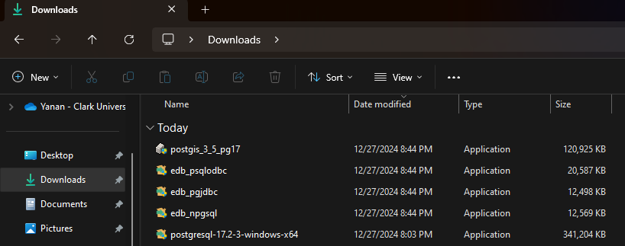
installation
After download, the several installers for database server and spatial extensions should appear in your downloading directory

Slide 10
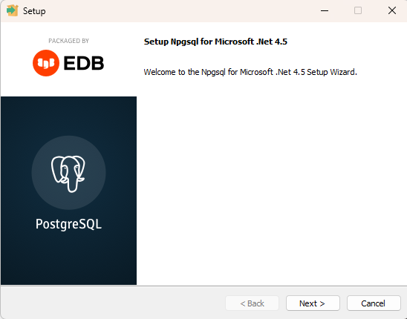
installation
Set up the download directory for Npgsql

Slide 11
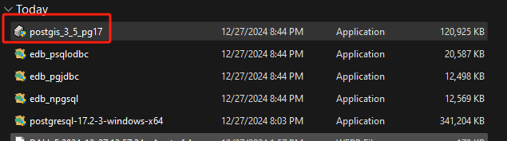
installation

Slide 12
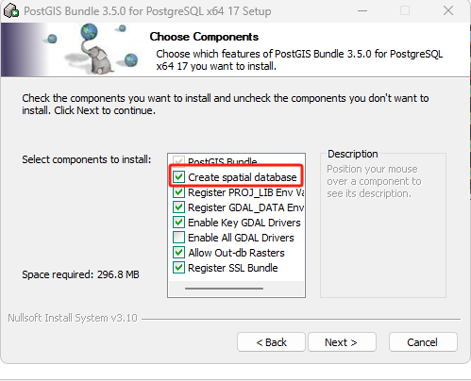
installation
Select ‘Create Spatial Database’

Slide 13
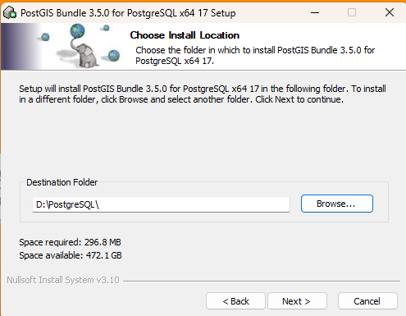
installation
Set up the destination folder (PostGIS must be installed within the PostgreSQL folder where PostgreSQL is stored)
If you accept the default path (C:\) when you install PostgreSQL, in this step, please also accept the default path

Slide 14
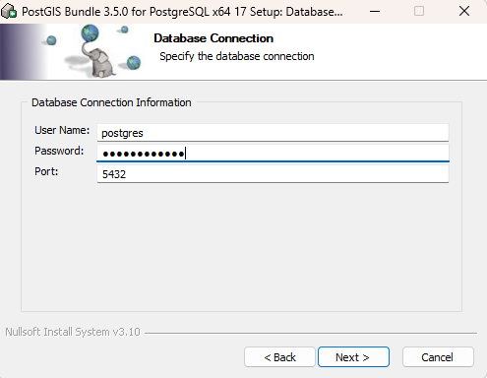
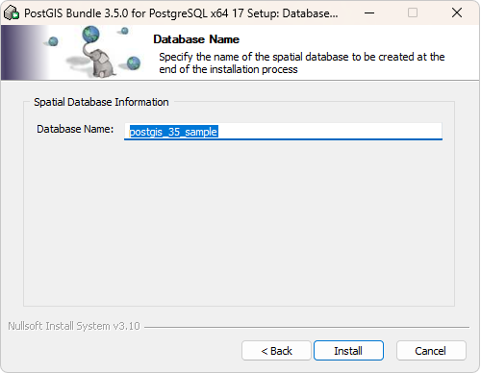
installation
Type the password you set up earlier when you install PostgreSQL
Accept the database name

Slide 15
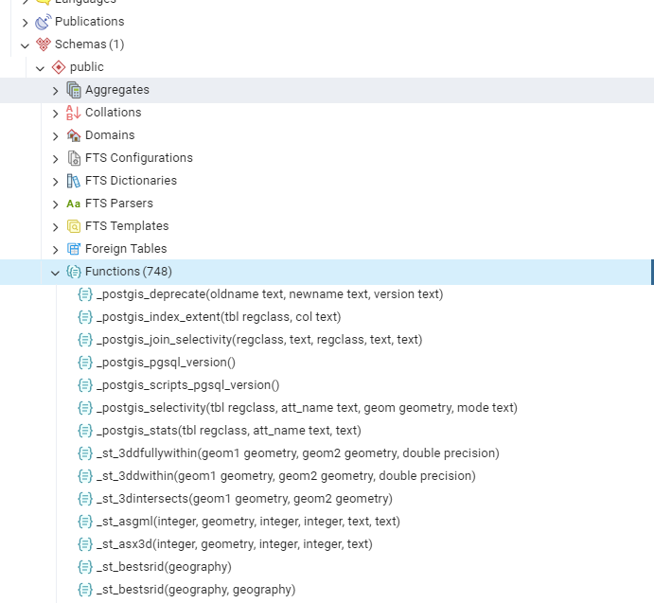
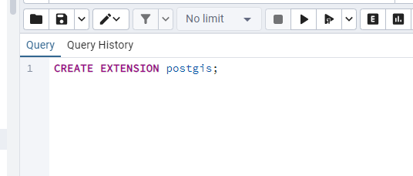
PGADMIN

Slide 16
WEEK 02 Lab session
Instructor: Yanan Wu
TA: Vanchy Li
Spring 2025

