Slide 1

WEEK 07 Geotagging
Instructor: Yanan Wu
TA: Vanchy Li
Spring 2025

Slide 2
WEEK 07 lecture session
Instructor: Yanan Wu
TA: Vanchy Li
Spring 2025

Slide 3
7.1 geotagging

Slide 4
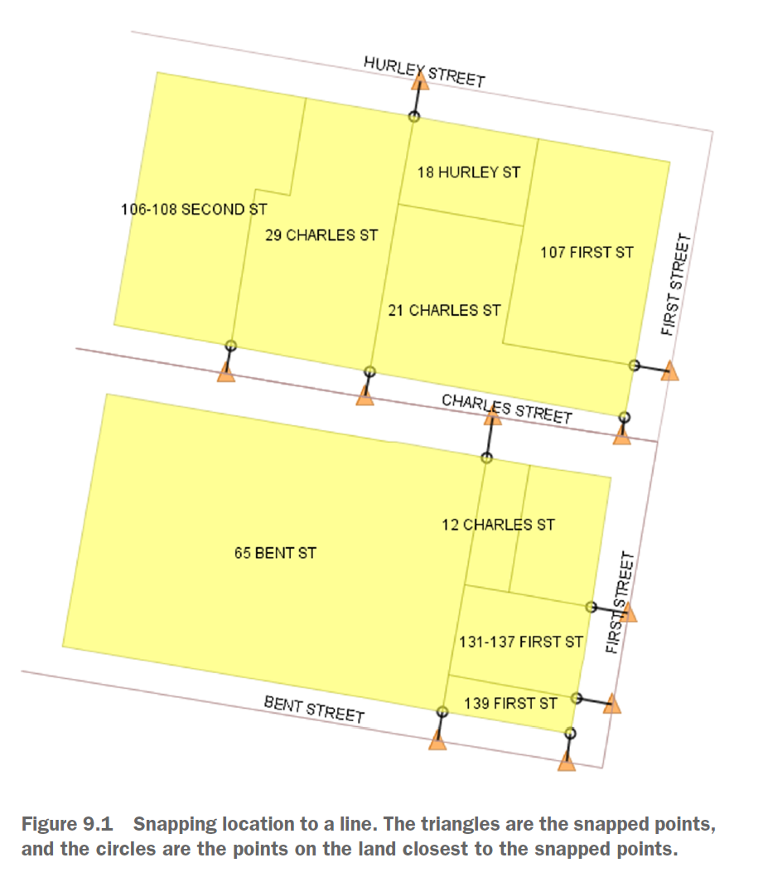
Linear referencing
Snapping points to the closest linestring

Slide 5
Linear referencing - procedures
Use ST_DWithin to narrow your choices. If a parcel has no road within 30 meters, eliminate it from consideration.
For every pairing of parcel and road, use ST_ClosestPoint to pinpoint the closest point on the road to the parcel.
Use a combination of DISTINCT ON and the ST_Distance function to only keep the pair of parcel and road that are closest.

Slide 6
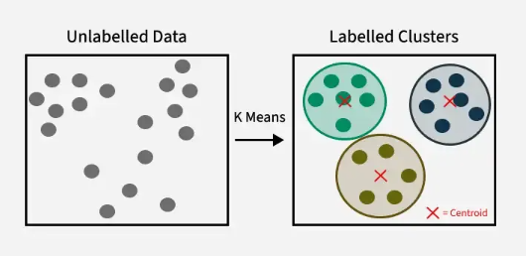
Cluster window function - kmeans
ST_ClusterKMeans(geometry winset geom, integer number_of_clusters, float max_radius)

Slide 7
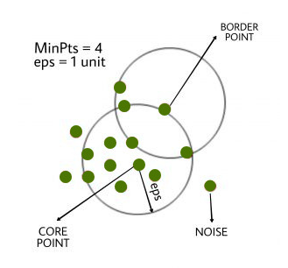
Cluster window function - DBSCAN
ST_ClusterDBSCAN(geometry winset geom, float8 eps, integer minpoints);

