Slide 1

WEEK 01
Instructor: Yanan Wu
TA: Vanchy Li
Spring 2025

Slide 2
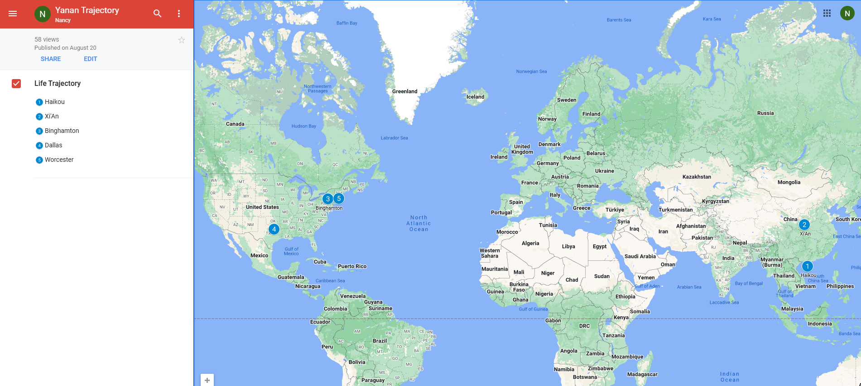
Yanan wu – visiting assistant professor
Education & Experience

Slide 3
teaching
Intermediate Statistics
Python Programming in GIS
Manipulating spatial data
Web mapping
Processing Raster
Data Analysis
Creating Custom Tool
Data visualization
Spatial Database

Slide 4
Ta introduction
Office Hours:
Office Location

Slide 5
How about you?
Your background (e.g., name, major, where you come from)
What is your funniest thing that happened during your winter break?
What relevant experience do you have with statistics?
What are your expectations for this course?

Slide 6
Course format
Lectures: Instructor & TA
Location:
Time
Labs: TA
Location
Time
Office Hours
Office Location

Slide 7
learning resource
Introduction to PostGIS
Obe, R., & Hsu, L. S. (2021). PostGIS in action. Simon and Schuster.

Slide 8
Course requirements
Labs: 11 in total
For any graded assignment, if the you do not agree with the grade received, the instructor and TA must be notified within one week after the assignment is graded.
Late policy for lab (excluding midterm and final project)
One midterm exam & One final project (oral presentation and paper report)

Slide 9
gRADE

Slide 10
WEEK 01 lecture session
Instructor: Yanan Wu
TA: Vanchy Li
Spring 2025

Slide 11
Week 02
Introduction to the Database and PostGIS
What is spatial database
Introducing PostGIS
Spatial data types

Slide 12
Week 03
Spatial data and geodatabases

Slide 13
Week 04
Introduction to SQL

Slide 14
WEEK 05
Advanced SQL for spatial data

Slide 15
Week 06 & week 07
Python API for PostgreSQL and PostGIS

Slide 16
WEEK 09
Raster Processing

Slide 21
WEEK 01
Instructor: Yanan Wu
TA: Vanchy Li
Spring 2025

