Slide 1

WEEK 09 geometry processing
Instructor: Yanan Wu
TA: Vanchy Li
Spring 2025

Slide 2
WEEK 09 lecture session
Instructor: Yanan Wu
TA: Vanchy Li
Spring 2025

Slide 3
9.1 geometry processing

Slide 4
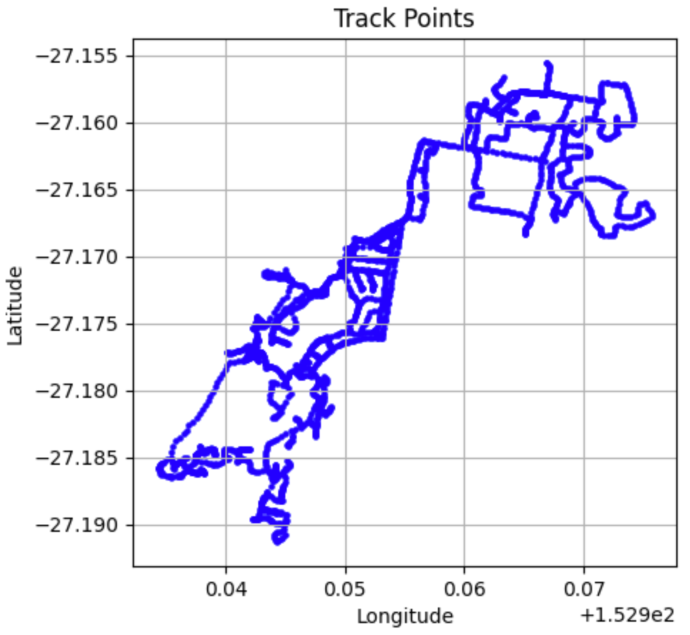
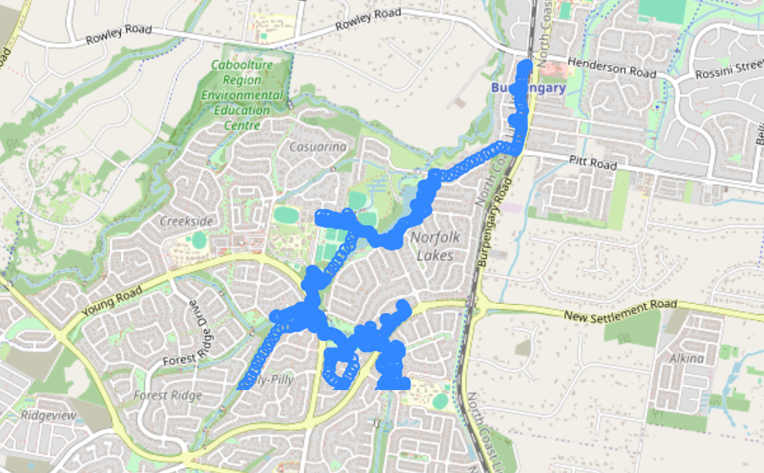
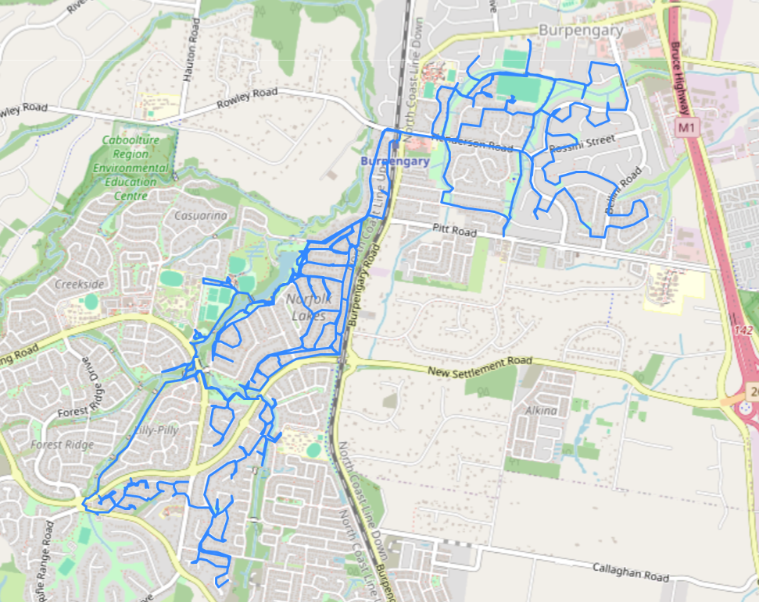
Data introduction
aussie_track_points
aussie_track
Aussie tracks is data GPS data loaded from OpenStreetMap
https://www.openstreetmap.org/user/Ash%20Kyd/traces/468761 (Bike Trip around Naragba, Queensland, Australia

Slide 5
Linear path from point observations
Examples of applications: GPS tracking (e.g., vehicle movement, animal migration).
Route reconstruction from timestamped observations.
Mapping historical travel routes.

Slide 6
workflow
GPS RAW DATA
Grouping time into 15-mins intervals
Find start and end time of interval
Create a line string
Store results into a new table

Slide 7
Step 1: grouping Time into 15-min intervals
GPS data is often recorded at irregular intervals.
To analyze movement trends, we group timestamps into 15-minute intervals.
Function
date_trunc(field, source [, time_zone ])
Truncates the time column to the field(e.g., minute), removing seconds.
source is a value expression of type timestamp, timestamp with time zone, or interval.
field selects to which precision to truncate the input value.
SELECT date_trunc('minute', TIMESTAMP '2001-02-16 20:38:40');

Slide 8
Extract the minute from the timestamp
DATE_PART(‘field’, source):
Extracts the minute component from time
field parameter needs to be a string value, not a name.
source is a value expression of type timestamp, timestamp with time zone, or interval.
SELECT DATE_PART('minute’, '2009-07-18 04:31:00-04');

Slide 9
Mod function and cast function
CAST(... AS interval): Converts the number or text into a time interval.
SELECT CAST(DATE_PART('minute', TIMESTAMP '2009-07-18 04:31:00-04') AS)
mod(..., 15): Finds how far the minute is from the last 15-minute mark.
SELECT mod(CAST(DATE_PART('minute', TIMESTAMP '2009-07-18 04:30:00-04') AS integer),);

Slide 10
NORMALIZE TIMESTAMP
The query normalizes timestamps to the nearest lower 15-minute interval,
Ensuring all timestamps fit within standard tracking periods (e.g., 00:00, 00:15, 00:30, 00:45).
Example Calculation
Input Timestamp: 2009-07-18 04:31:00-04
DATE_PART('minute', time) = 31
mod(31, 15) = 1
CAST('1 minutes' AS interval) = interval '1 minute'
DATE_TRUNC('minute', time) - interval '1 minute'
2009-07-18 04:31:00 → 2009-07-18 04:30:00
04:31:00 - 1 minute = 04:30:00

Slide 11
Normalize time interval to 15-min interval
SELECT
DATE_TRUNC('minute', time) -
AS track_period
FROM ch11.aussie_track_points;

Slide 12
Step 2: Finding Start and End Times for Each Interval
To understand the duration of movement within each 15-minute interval.
MIN(time): Earliest recorded timestamp in the interval.
MAX(time): Latest recorded timestamp in the interval.
SELECT
DATE_TRUNC('minute', time) -
CAST(
mod(CAST(DATE_PART('minute', time) AS integer), 15) || ' minutes' AS interval
) AS track_period,
FROM ch11.aussie_track_points
GROUP BY track_period;

Slide 13
Step 3: Creating a LineString to Connect Points
We use ST_MakeLine() to connect points within the same interval.
The points are ordered by time to form a meaningful trajectory.
SELECT
DATE_TRUNC('minute', time) -
CAST(
mod(CAST(DATE_PART('minute', time) AS integer), 15) || ' minutes' AS interval
) AS track_period,
MIN(time) AS t_start,
MAX(time) AS t_end,
--- make line
---
FROM ch11.aussie_track_points
GROUP BY track_period;

Slide 14
Create a new table to store the data
INTO
FROM

Slide 15
DATA ANALYSIS
Convert stored data into readable values.
Calculate distance traveled and number of points.
SELECT
CAST(track_period AS),
CAST(t_start AS) AS t_start,
CAST(t_end AS) AS t_end,
-- How many points for each time interval
--
-- Length of the distance
--
-- Time duration
--
FROM ch11.aussie_run;

Slide 16
Final Summary: What Have We Learned?
Key Steps:
Group timestamps into 15-minute intervals.
Find start and end times for each interval.
Create a path using ST_MakeLine().
Filter out intervals with insufficient data.
Store results into a table.
Extract movement statistics (distance, duration).
Applications in GIS:
GPS tracking (e.g., analyzing car, ship, or animal movement).
Human mobility studies.
Urban transportation analysis.

