Slide 1

WEEK 04 Intro to sql
Instructor: Yanan Wu
TA: Vanchy Li
Spring 2025

Slide 2
WEEK 04 lecture session
Instructor: Yanan Wu
TA: Vanchy Li
Spring 2025

Slide 3
4.1 intro

Slide 4
Structured query language
SQL (Structured Query Language):
SQL is a standard language for managing relational databases. It provides a set of commands for performing various operations such as querying data, updating data, creating and modifying database schema, and managing access controls.

Slide 5
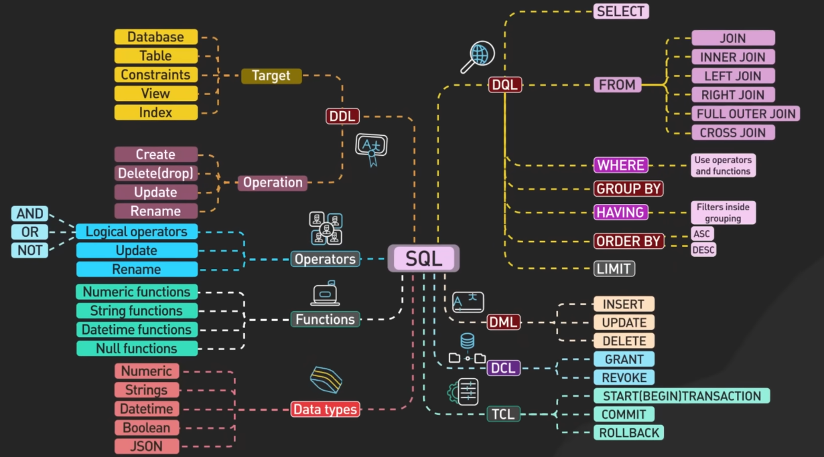
Sql COMMANDAS

Slide 6
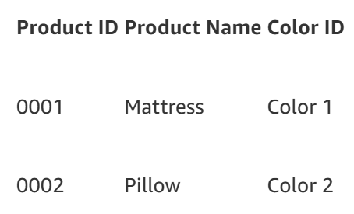
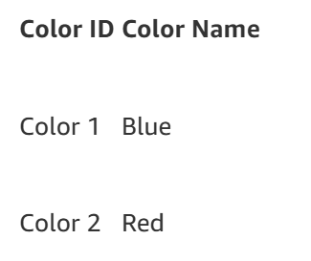
SQL TABLE
A SQL table is a fundamental component of a relational database, organizing data into rows and columns. Database engineers establish relationships between multiple tables to enhance data efficiency and optimize storage.
For example, a database engineer might create a SQL table to store product details in a retail store:

Slide 7
4.2 spatial data

Slide 8
shapefile
Shapefile: a collection of files with .shp, .shx, .dbf, and other extensions on a common prefix name (e.g., nyc_census_blocks). The actual shapefile relates specifically to files with the .shp extension. However, the .shp file alone is incomplete for distribution without the required supporting files.
Mandatory files:
.shp—shape format; the feature geometry itself
.shx—shape index format; a positional index of the feature geometry
.dbf—attribute format; columnar attributes for each shape, in dBase III
Optional files include:
.prj—projection format; the coordinate system and projection information, a plain text file describing the projection using well-known text format

Slide 9
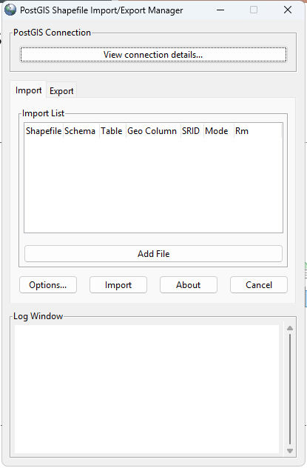
Loading with shp2pgsql -GUI
Open the Shapefile Import/Export Manager.
In the Shapefile field, browse and select US_tract_2020.shp.
Set the SRID to 102003 and Geo Column to geometry (or the SRID and Geo Column match your shapefile).
Choose a target schema (e.g., postgis) and set a table name (e.g., us_tracts).
Click Import. The tool will: Create a new table. Insert shapefile data into the table. Create a spatial index for faster querying.

Slide 10
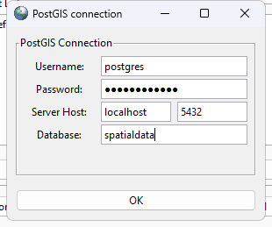
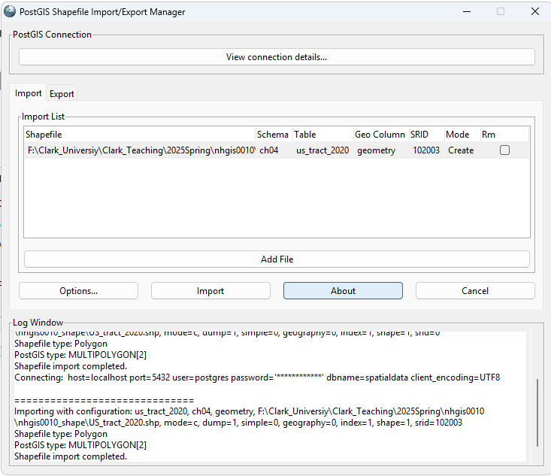
Loading with shp2pgsql -GUI
Geo Column: assign a name to the geometry column in data
SRID: spatial reference system

Slide 11
Loading with shp2pgsql -GUI
Step 3: Verify the Import
Check if the shapefile was imported successfully:
Open the query tool in pgAdmin.
Run the following query:
SELECT geometry FROM ch04.us_tract_2020 LIMIT 10;

Slide 12
CREATE TABLE ch04.us_attribute (
GEO_ID VARCHAR(20) PRIMARY KEY, -- Census Geographic Area Identifier (Primary Key)
GISJOIN VARCHAR(20), -- GIS Join Match Code
STUSAB VARCHAR(20), -- State Abbreviation
STATE VARCHAR(50), -- State Name
STATEA VARCHAR(50), -- State Code
COUNTY VARCHAR(50), -- County Name
COUNTYA INTEGER, -- County Code
TRACTA VARCHAR(20), -- Census Tract Code
TL_GEO_ID VARCHAR(20), -- TIGER/Line Shapefile Geographic Area Identifier
NAME_E VARCHAR(255), -- Full Geographic Area Name (Estimates)
-- Population Data
AQNFE001 INTEGER, -- Total Population
AQNGE002 INTEGER, -- White Population
AQNGE003 INTEGER, -- Black or African American Population
AQNGE004 INTEGER, -- American Indian/Alaska Native Population
AQNGE005 INTEGER, -- Asian Population
AQNGE006 INTEGER, -- Native Hawaiian/Other Pacific Islander Population
AQNGE007 INTEGER, -- Another Race Category
-- Education Data
AQPKE017 INTEGER, -- Some Education Field
AQPKE021 INTEGER, -- Associate’s Degree
AQPKE022 INTEGER, -- Another Degree Field
AQPKE023 INTEGER, -- Master’s Degree
AQPKE024 INTEGER, -- Professional School Degree
AQPKE025 INTEGER -- Doctorate Degree);
Import csv file
Create a table with column names, the column names should align with the column names in csv file
Import Data to table (right click table in server, select Import/Export data)

Slide 13
4.3 data types in sql

Slide 14
DATA TYPES
Numeric Types
INTEGER (or INT): Represents whole numbers.
NUMERIC (or DECIMAL): Represents fixed-point numbers with exact precision.
String Types
VARCHAR: Represents variable-length character strings with a maximum length specified.
TEXT: Represents variable-length character strings with a maximum length that can be extremely large

Slide 15
DATA TYPES
Date/Time Types
DATE: Represents a date value without time.
TIMESTAMP: Represents date and time values.
Boolean Type
BOOLEAN: Represents a boolean value (TRUE, FALSE, or NULL)

Slide 16
4.4 data definition languages (ddl)

Slide 17
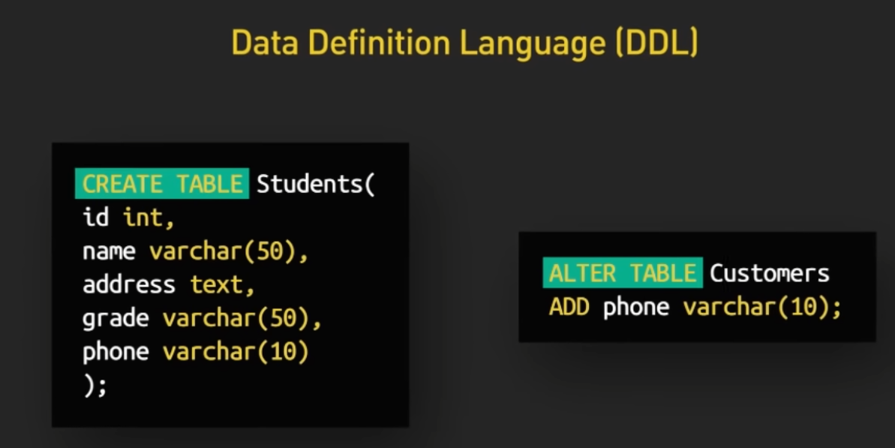
Data definition language (ddl)
DDL is used to define the structure and schema of a database. It includes commands for creating, modifying, and deleting database objects such as tables, indexes, views, and schemas.
It does not manipulate data but manages the structure.

Slide 18
Key ddl commands
CREATE – To create databases, tables, or indexes.
ALTER – To modify existing structures.
DROP – To delete objects.
TRUNCATE – To remove all data without deleting the structure.
COMMENT – To add metadata.
RENAME – To rename tables or columns.

Slide 19
CREATE statement
Topics on week 03
Create Geometry
CREATE DATABASE …
CREATE TABLE…

Slide 20
alter statement
Used to modify an existing table (add, modify, drop columns).
ALTER TABLE ch04. us_attribute ADD COLUMN POP VARCHAR(255);
ALTER TABLE ch04. us_attribute ALTER COLUMN POP TYPE SMALLINT;
ALTER TABLE ch04. us_attribute RENAME COLUMN POP TO POPULATION;
ALTER TABLE ch04. us_attribute DROP COLUMN POPULATION;

Slide 21
EXERCISE: RENAME TABLE NAME
ALTER TABLE ch04.us_attribute RENAME COLUMN AQNFE001 TO total_pop;
ALTER TABLE ch04.us_attribute RENAME COLUMN AQNGE002 TO white_pop;
ALTER TABLE ch04.us_attribute RENAME COLUMN AQNGE003 TO black_pop;
ALTER TABLE ch04.us_attribute RENAME COLUMN AQNGE004 TO native_pop;
ALTER TABLE ch04.us_attribute RENAME COLUMN AQNGE005 TO asian_pop;
ALTER TABLE ch04.us_attribute RENAME COLUMN AQNGE006 TO pacific_pop;
ALTER TABLE ch04.us_attribute RENAME COLUMN AQNGE007 TO other_race;

Slide 22
Sample But in MySQL
ALTER TABLE table_name
RENAME COLUMN AQNFE001 TO total_pop,
RENAME COLUMN AQNGE002 TO white_pop,
RENAME COLUMN AQNGE003 TO black_pop,
RENAME COLUMN AQNGE004 TO native_pop,
RENAME COLUMN AQNGE005 TO asian_pop,
RENAME COLUMN AQNGE006 TO pacific_pop,
RENAME COLUMN AQNGE007 TO other_race;
PostgreSQL does not support renaming multiple columns at once, so if you are using PostgreSQL, you must keep one ALTER TABLE statement per line.
However, MySQL 8.0+ allows multiple RENAME COLUMN statements to be combined.

Slide 23
Check Column name and Data Type
SELECT column_name, data_type
FROM information_schema.columns
WHERE table_schema = 'ch04' AND table_name = 'us_attribute';

Slide 24
4.5 data QUERY LANGUAGE

Slide 25
RENAME TABLE
ALTER TABLE ch04.us_attribute RENAME COLUMN AQPKE021 TO Associate;
ALTER TABLE ch04.us_attribute RENAME COLUMN AQPKE022 TO Another;
ALTER TABLE ch04.us_attribute RENAME COLUMN AQPKE023 TO Master;
ALTER TABLE ch04.us_attribute RENAME COLUMN AQPKE024 TO Professional;
ALTER TABLE ch04.us_attribute RENAME COLUMN AQPKE025 TO Doctorate;

Slide 26
dql
DQL (Data Query Language) is used to retrieve records from the database.
SELECT statement: Used to retrieve data from tables.
Basic Queries, Filtering, and Aggregation.

Slide 27
THE SELECT STATEMENT
Basic syntax
SELECT column1, column2 FROM table_name;
Selecting all columns
SELECT * FROM ch04.us_attribute;
Display unique value for column
SELECT DISTINCT * FROM ch04.us_attribute;

Slide 28
Filtering Data with WHERE
Filtering by a single condition:
SELECT stusab, statea, total_pop FROM ch04.us_attribute WHERE stusab = 'New Jersey’;
Exercise:
Retrieve the gisjoin, statea, and total_pop columns for records where gisjoin is equal to 'MA'

Slide 29
Filtering Data with WHERE
Using comparison operators (=, !=, >, <, >=, <=):
SELECT stusab, statea, total_pop FROM ch04.us_attribute WHERE total_pop > 10000;
Exercise
Retrieve the gisjoin, statea, and black_pop columns for records where black_pop is less than 10000

Slide 30
Filtering Data with WHERE
Using logical operators (AND, OR, NOT):
SELECT stusab, statea, total_pop FROM ch04.us_attribute WHERE stusab = 'California' AND total_pop > 10000;
Exercise:
Retrieve the gisjoin, statea, and black_pop, master columns for records where gisjoin = ‘MA’, total_pop > 5000, master > 500

Slide 31
ORDER Data with ORDER BY
Display the top 10 most populated counties.
SELECT stusab, statea, total_pop
FROM ch04.us_attribute
ORDER BY total_pop DESC
LIMIT 10;
Exercise:
Retrieve the stusab, statea, and total_pop columns for records which are 10 least populated region

Slide 32
Group data by group by
The GROUP BY clause is used to create one output row per each group and produces summary values for the selected columns.
Find the number of counties in each state.
SELECT stusab, COUNT(COUNTY) AS county_count
FROM ch04.us_attribute
GROUP BY stusab
ORDER BY county_count DESC;
Exercise:
Retrieve the top 10 states (stusab) with the highest number of census tracts

Slide 33
4.6 data QUERY LANGUAGE: AGGREGATE FUNCTION

Slide 34
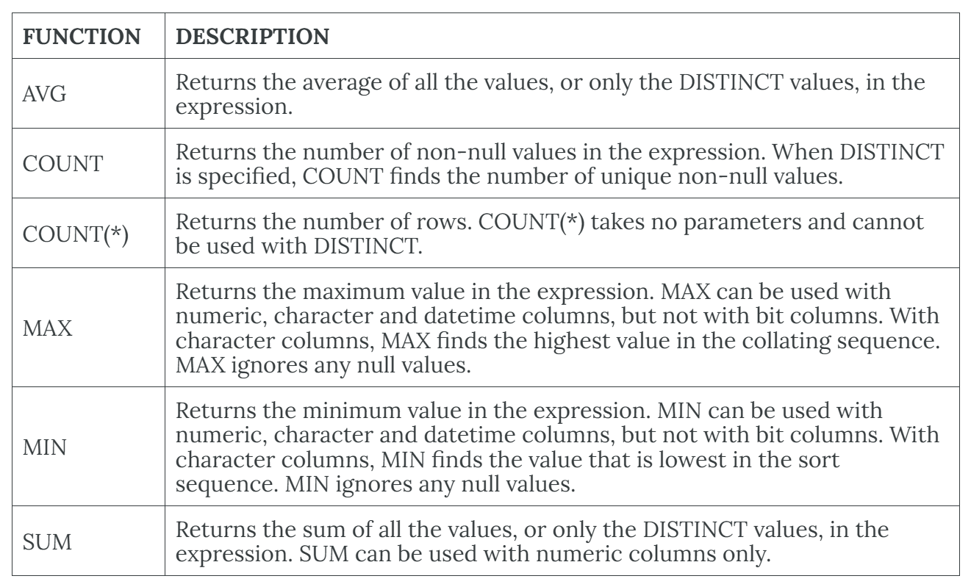
AGGREGATE FUNCTION
Aggregate functions perform a calculation on a set of values and return a single, or summary, value.

Slide 35
Calculate the Total Population by State (SUM)
Find the total population for each state.
SELECT stusab, SUM(total_pop ) AS total_population
FROM ch04.us_attribute
GROUP BY stusab
ORDER BY total_population DESC;

Slide 36
For each census tract, what percentage of the population is white?
SELECT
stusab,statea,
100.0 * Sum(white_pop)/Sum(total_pop) AS white_pct
FROM ch04.us_attribute
GROUP BY statea,stusab
ORDER BY white_pct DESC;
Exercise:
Calculate the proportion of people with both an associate and a master’s degree as a percentage of the total population, and sort the results in descending order.

Slide 37
Find the Average Population of Counties (AVG)
Calculate the average population of all counties in each state.
SELECT stusab, AVG(total_pop) AS avg_population
FROM ch04.us_attribute
GROUP BY stusab
ORDER BY avg_population DESC;

Slide 38
Pattern matching using like
SELECT stusab, statea
FROM ch04.us_attribute
WHERE stusab LIKE 'Mass%’;
Exercise:
Calculate the total_pop for stusab WHERE stusab start with letter 'A'

Slide 39
Pattern matching using like
LIKE ‘% Mc’
LIKE ‘Mc%’ searches for all records that end with the letters “Mc”
LIKE ‘%en%’
LIKE ‘%en%’ searches for all records that have the letters “en”

Slide 40
Pattern matching using in and between
SELECT stusab, statea, total_pop
FROM ch04.us_attribute
WHERE stusab IN ('Texas', 'Florida’);
SELECT stusab, statea, total_pop
FROM ch04.us_attribute
WHERE total_pop BETWEEN 10000 AND 20000;

Slide 41
CREATE A TABLE FROM EXISTING TABLE
CREATE TABLE ch04.MA AS
SELECT geo_id, stusab,statea, total_pop
FROM ch04.us_attribute
WHERE gisjoin IN ('MA');

Slide 42
4.7 data MANIPULATE LANGUAGE

Slide 43
INSERT STATEMENT
The INSERT statement adds rows to a table. In addition,
INSERT specifies the table or view that data will be inserted into.
Column_list lists columns that will be affected by the INSERT.
If a column is omitted, each value must be provided.
If you are including columns, they can be listed in any order.
VALUES specifies the data that you want to insert into the table. VALUES is required.

Slide 44
SYNTAX FOR INSERT
INSERT [INTO] Table_name | view name [column_list] DEFAULT VALUES | values_list |
Exercise:
INSERT value to column geo_id,stusab, master, professional

Slide 45
ADD NEW COLUMN: ALTER
SYNTAX:
ALTER TABLE table_name
ADD COLUMN column_name data_type;
Exercise:
Insert a new column ‘Area’ to us_attribute table

Slide 46
UPDATE statement
The UPDATE statement changes data in existing rows either by adding new data or modifying existing data.
UPDATE ch04.us_attribute
SET gisjoin = 'MA_state'
WHERE gisjoin = 'MA';

