Slide 1

WEEK 07 Proximity analysis
Instructor: Yanan Wu
TA: Vanchy Li
Spring 2025

Slide 2
WEEK 07 lecture session
Instructor: Yanan Wu
TA: Vanchy Li
Spring 2025

Slide 3
7.1 Nearest neighbor

Slide 4
Introduction
Proximity Analysis Overview:
Determines how far something is located from another object.
Examples include finding the nearest highway, estimating commute distances, or assigning field reps efficiently.
Methods Covered:
Traditional closest neighbor searches.
k-Nearest Neighbor (KNN) indexes for performance optimization.
PostGIS clustering window functions for spatial grouping.

Slide 5
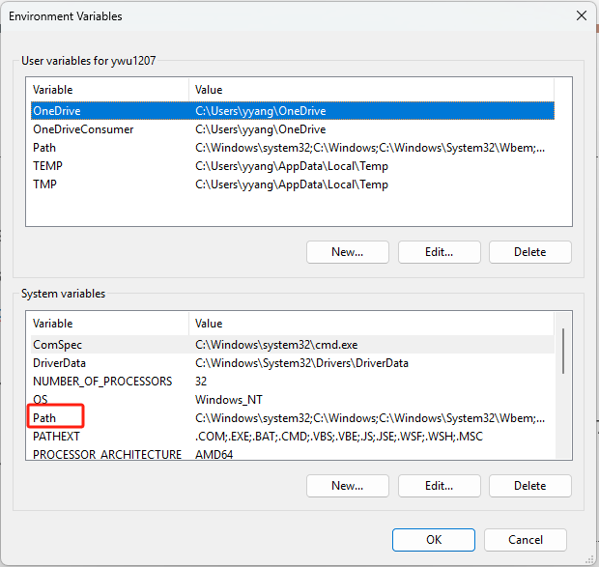
DATA
ch09_data.sql construct data using SQL
In terminal:
Load data into spatial database in pgadmin
psql -U postgres -d spatial -f E:/Clark/ch09_data.sql
If your terminal does not recognize psql
Find the PostgreSQL installation folder
(e.g., C:\Program Files\PostgreSQL\17\bin\)
Copy the path of postgresql installation to system variable

Slide 6
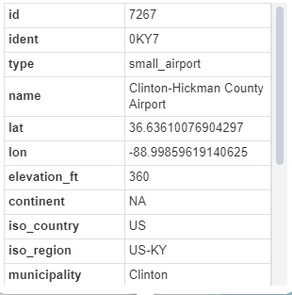
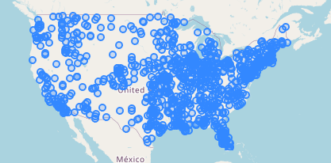
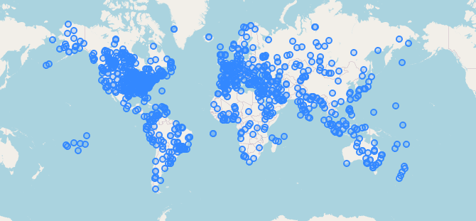
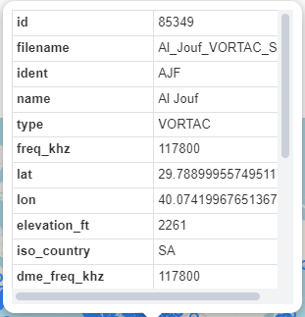
Data introduction
Airports across U.S
Navigational aid across U.S

Slide 7
NEAREST NEIGHBOR SEARCHES
Which places are within X distance?
ST_Dwithin
N closest results
ST_Dwithin
ST_Distance
LIMIT5

Slide 8
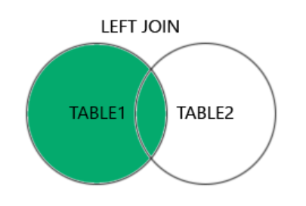
FIND CLOSET LOCATIONS
The LEFT JOIN keyword returns all records from the left table (table1), and the matching records from the right table (table2). The result is 0 records from the right side, if there is no match.

Slide 9
FIND CLOSET LOCATIONS
Please finds the closest navaid (navigational aid) to each airport
SELECT DISTINCT ON (a.ident)
a.ident,
a.name As airport,
n.name As closest_navaid,
(ST_Distance(a.geog,n.geog)/1000)::integer As dist_km
FROM LEFT JOIN
ON ST_DWithin(a.geog, n.geog,100000)
ORDER BY a.ident, dist_km;
This query uses a left join instead of an inner join to ensure that even if you find no navaids, the airport will still be in the results.

Slide 10
FIND CLOSET LOCATIONS – EXERCISE 01
Please finds the closest navaid (navigational aid) to each airport and order the result from shortest distance to longest
Select * FROM () AS subquery ORDER BY dist_km

Slide 11
FIND CLOSET LOCATIONS – EXERCISE 02
Please finds the closest airport to each navaid (navigational aid)

Slide 12
Items between distances
Sometimes, you need to find locations that are within a certain distance but also beyond a minimum distance (e.g., finding a place far enough for a workout but not too far).
Example: Finding an airport that is close enough to catch a flight but far enough to enjoy a scenic trip.
This type of query requires checking two distance conditions:
The location should be within the upper distance limit.
The location should be beyond the lower distance limit.
SELECT name, iso_country, iso_region
FROM ch09.airports
WHERE ST_DWithin(geog,
ST_Point(-75.8008, 40.2610)::geography, 100000)
AND NOT ;

Slide 13
K nearest neighbor
A classic nearest-neighbor question is finding the N nearest points of interest to a fixed location.
<->—This is the KNN distance operator for both geometry and geography.
A <-> B returns the distance between two geometries A and B.
Find 10 nearest large airport (type = ‘large_airport’) for Boston airport (ident = 'KBOS’)
SELECT ident, name, geog,
geog <->
FROM ch09.airports
WHERE ident != 'KBOS' AND type = 'large_airport'
ORDER BY dist LIMIT 10;

Slide 14
K nearest neighbor – exercise 01
Find 10 nearest navigation aid for navigation aid (filename = 'Bedds_NDB_US')

Slide 15
WINDOW FUNCTION IN K nearest neighbor
In previous examples, we only output the N closest places but did not number them.
Sometimes, numbering these places instead of just listing distances is useful.
ROW_NUMBER, and RANK window functions help in outputting an ordinal ordering of a row.
A window function allows querying across the entire dataset while providing information about each row's position.
Window functions work similarly to aggregate functions, but instead of collapsing multiple rows into one, they return all rows with additional computed values.
The difference between RANK and ROW_NUMBER is in how they handle ties.
RANK: 1,2,3,3,3,6,7.
ROW_NUMBER: 1,2,3,4,5,6,7

Slide 16
K nearest neighbor WITH ROW_NUMBER – exercise 01
Find 10 nearest airports for Boston Airport(ident = 'KBOS ')
WITH ranked_airports AS (
SELECT
ident,
name,
geog,
geog <-> (SELECT geog FROM ch09.airports WHERE ident = 'KBOS') AS dist,
FROM ch09.airports
WHERE ident != 'KBOS' AND type = 'large_airport'
)
SELECT rank_num, ident, name, geog, dist
FROM ranked_airports
WHERE rank_num <= 10;

