Slide 1

WEEK 09 geometry processing
Instructor: Yanan Wu
TA: Vanchy Li
Spring 2025

Slide 2
WEEK 09 lecture session
Instructor: Yanan Wu
TA: Vanchy Li
Spring 2025

Slide 3
9.1 geometry processing

Slide 4
Introduction
Spatial Aggregation
Combines multiple geometries into a single geometry or multipolygon
Common geography aggregates:
ST_MakLine
ST_Union
ST_Collect
ST_Polygonize

Slide 5
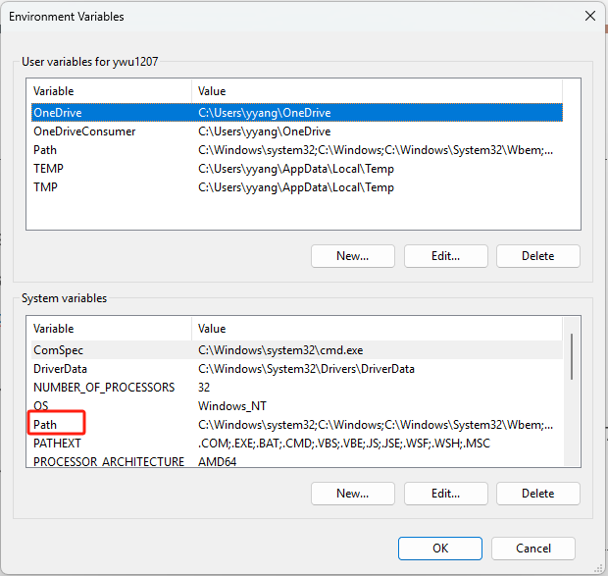
DATA
ch11_data.sql construct data using SQL
In terminal:
Load data into spatial database in pgadmin
psql -U postgres -d spatial -f E:/Clark/ch11_data.sql
If your terminal does not recognize psql
Find the PostgreSQL installation folder
(e.g., C:\Program Files\PostgreSQL\17\bin\)
Copy the path of postgresql installation to system variable

Slide 6
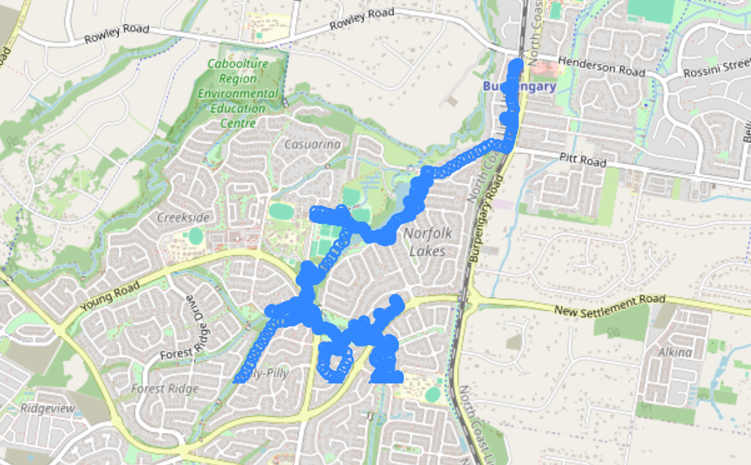
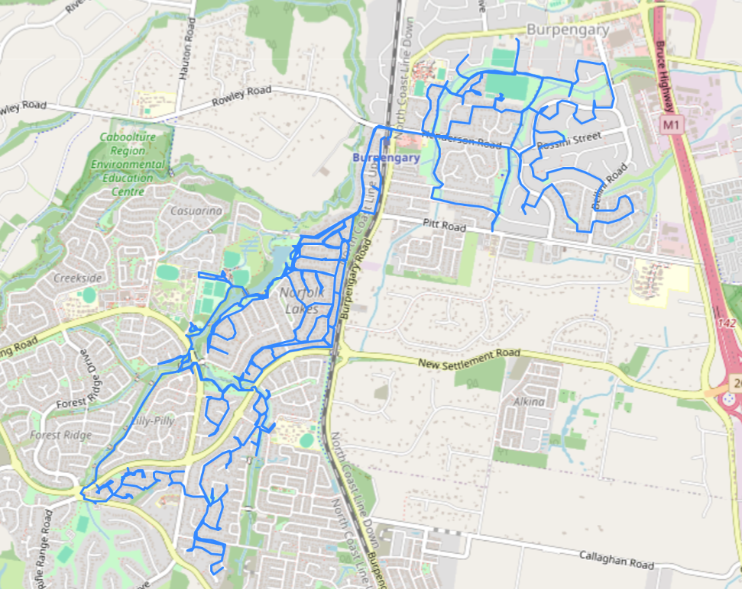
Data introduction
aussie_track_points
aussie_track

Slide 7
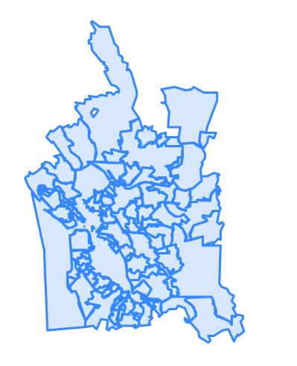
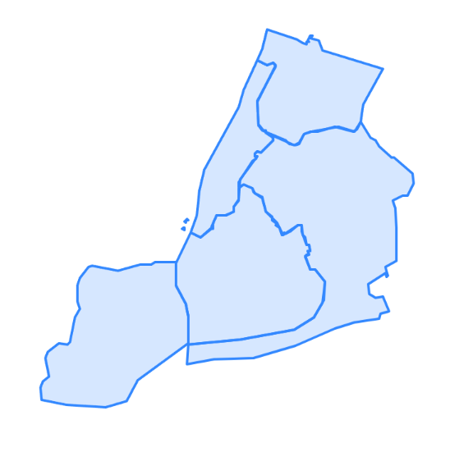
Data introduction
boroughs
cities

Slide 8
ST_Union function
Unions the input geometries, merging geometry to produce a result geometry with no overlaps.
The output may be an atomic geometry, a MultiGeometry, or a Geometry Collection.
If geometries are touching or overlapping
ST_Union merges them into a single geometry by dissolving boundaries.
If geometries are disjoint (do not touch):
ST_Union does NOT merge them into a single polygon but keeps them together in a MULTIPOLYGON.

Slide 9
Synopsis
geometry ST_Union(geometry g1, geometry g2)
geometry ST_Union(geometry g1, geometry g2, float8 gridSize)
Requires GEOS (Geometry Engine – Open Source) >= 3.9.0 to use the gridSize parameter
A gridSize can be specified to work in fixed-precision space. The inputs are snapped to a grid of the given size, and the result vertices are computed on that same grid
Check the GEOS library
SELECT PostGIS_Full_Version();

Slide 10
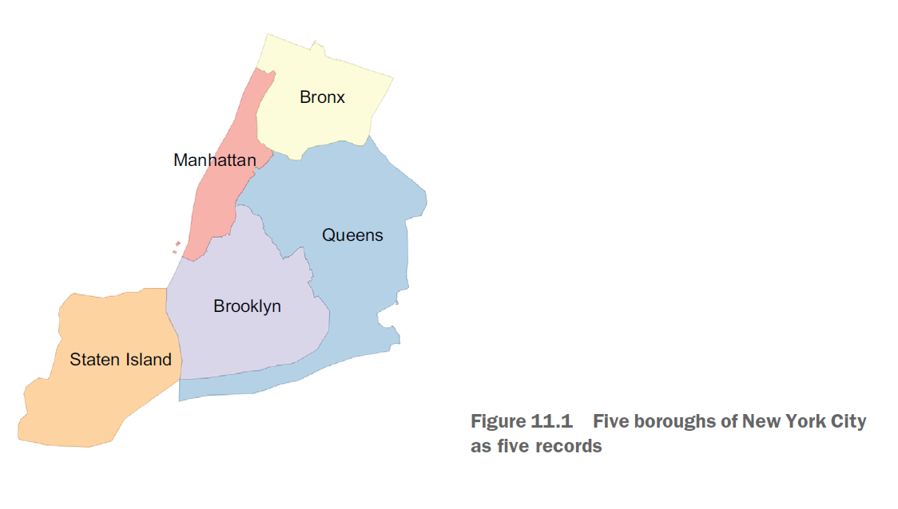
St_union
CREATE TABLE ch11.boroughs_city AS
Based on the geom in ch11.boroughs_city , any issue you found?
ST_UNION

Slide 11
Arbitrary Floating Precision
Geometries in spatial database are stored using floating-point precision (e.g., DOUBLE PRECISION), which can introduce issues, such as:
Tiny Gaps (Slivers) between merged polygons
When using ST_Union, small numerical errors can cause boundaries not to align perfectly.
Example: Two adjacent polygons that should share a border might have a tiny gap due to floating-point precision differences.
Rounding Errors in Coordinate Values
Example: (10.0000000001, 5.9999999999) instead of (10.0, 6.0), which can cause issues in topology operations.
Unstable Results in Topological Operations
Some spatial operations (like ST_Union) can behave inconsistently if geometries are slightly misaligned.

Slide 12
St_union() CONSIDER GRID SIZE
Our geometries are in NY State Plane Feet spatial reference, so our grid units will be in feet. Having the grid size option allows you to control the
Having the grid size option allows you to control the resolution of the output and discard artifacts of floating precision.
St_union() based on 500-foot
CREATE TABLE ch11.boroughs_citi_500 AS
Now take a look the new map and check the generated boundary in ch11.boroughs_citi_500

Slide 13
St_union() based on 10000-foot
Now please use 10000 as the grid size to merge the polygon
How is the boundary change?

Slide 14
St_union() based on 1-foot
Now please use 1 as the grid size to merge the polygon
How is the boundary change?

Slide 15
Compare the number of vertices for three borough
Merge geometry based on grid size is similar to rasterizing a geometry with a fixed size of pixels
Points that collide in the same pixel are consolidated into one.
SELECT
(SELECT SUM(ST_NPoints(geom)) FROM ch11.boroughs) AS pts_original,

Slide 16
7.1 multi geometry

Slide 17
AGGREGATE GEOMETRY WITH CONDITONS
Aggregate the geometry with pre-defined conditions to control the aggregating process
Assess the data: ch11.cities
Check how many geometry for each city
SELECT city,COUNT(city) AS num_records
FROM ch11.cities

Slide 18
AGGREGATE DISJOINT(DO NOT TOUCH) GEOMETRY
ST_NumGeometries()
ST_Multi()
ST_Union()
SELECT city,COUNT(city) AS num_records,
SUM(ST_NumGeometries(geom)) AS numpoly_before,
ST_NumGeometries(ST_Union(geom)) AS num_poly_after
FROM ch11.cities
GROUP BY city
HAVING COUNT(city) > 1;
Which cities have a smaller number in num_poly_after compared to numpoly_before? And why

Slide 19
CHECK WHICH GEOMETRIES ARE TOUCHING WITHIN SAME CITY GROUP
This SQL query is used to find pairs of geometries in the ch11.cities table that:
Belong to the same city (a.city = b.city)
Are not duplicates or self-matches (a.gid < b.gid)
Share a boundary (ST_Touches(a.geom, b.geom))
SELECT a.city, a.gid AS gid_1, b.gid AS gid_2
FROM ch11.cities a
JOIN ch11.cities b

Slide 20
WRITE TABLE INTO NEW GEOMETRY
CREATE TABLE ch11.cities_merged AS

