Slide 1

WEEK 12
Instructor: Yanan Wu
TA: Vanchy Li
Spring 2025

Slide 2
WEEK 12 lecture session
Instructor: Yanan Wu
TA: Vanchy Li
Spring 2025

Slide 3
10.1 Loading raster data

Slide 4
Routing problem
pgRouting
An extension for PostGIS and PostgreSQL that adds routing capabilities to your spatial database.
It enables network analysis by providing functions for shortest path, traveling salesman problem, driving distance, isochrones, and more.
Analyze movement through a network
Finding the shortest path from point A to B
Calculating service areas based on travel distance or time

Slide 5
Learning resource
pgRouting Web Site： https://pgrouting.org/
Textbook: https://locatepress.com/book/pgr

Slide 6
Add data
In terminal:
Load data into spatial database in pgadmin
psql -U postgres -d spatial -f E:/Clark/ch16_data.sql

Slide 7
extension
Add pgrouting extension to schema ch16
CREATE EXTENSION pgrouting SCHEMA ch16;
Check Functions in ch16 to see the complete list
Upgrade from an earlier version of pgRouting:
ALTER EXTENSION pgrouting UPDATE;
On occasion, especially if you were running a prereleased version, you may run into errors upgrading. In these cases, do this to upgrade:
DROP EXTENSION pgrouting;
CREATE EXTENSION pgrouting SCHEMA postgis;

Slide 8
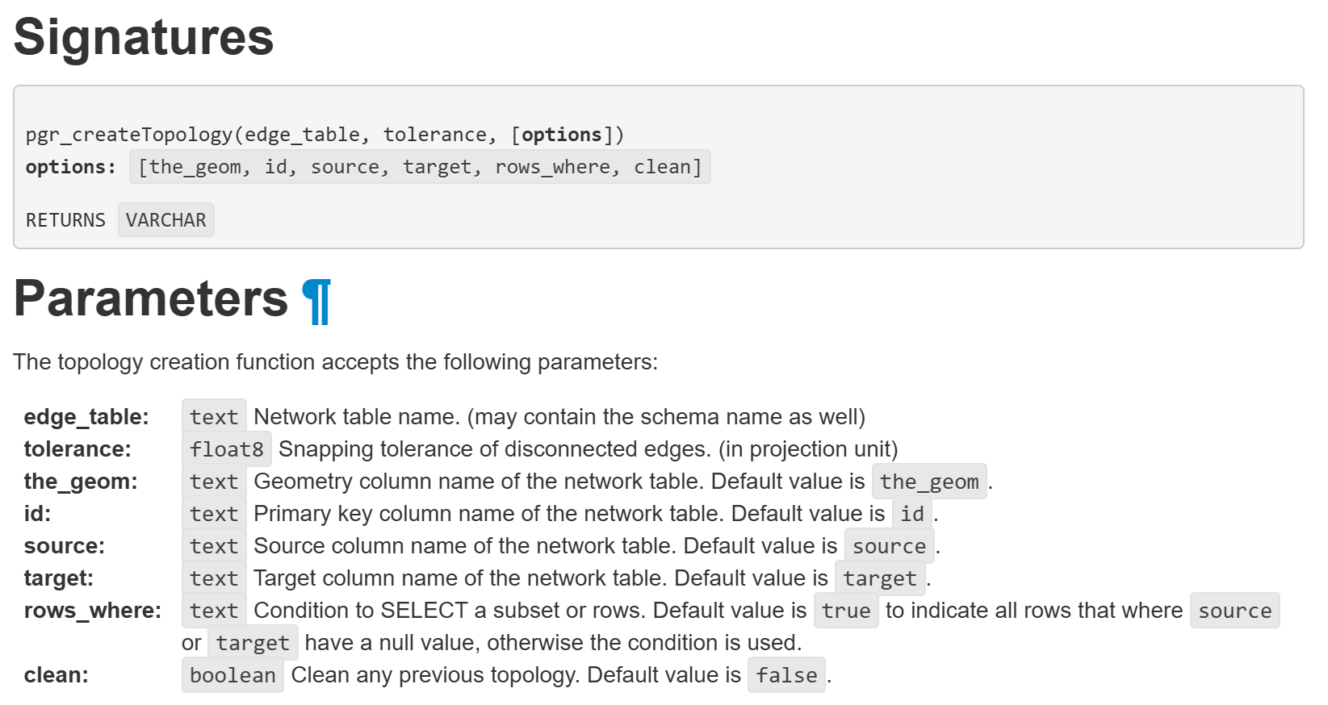
network topology

Slide 9
BUILDING A NETWORK TOPOOGY
Prepares your twin_cities line network for routing analysis
Adds source and target node IDs for each line
Once this is done, you're ready to:
Run shortest path queries (pgr_dijkstra, pgr_astar)
Visualize networks
Perform driving distance or service area analyses

Slide 10
ALTER TABLE ch16.twin_cities ADD COLUMN source integer;
ALTER TABLE ch16.twin_cities ADD COLUMN target integer;
ALTER TABLE ch16.twin_cities
ALTER COLUMN geom type geometry(LINESTRING,4326) USING
ST_Transform(geom,4326);

Slide 11
CREATE TOPOLOGY
SELECT ch16.pgr_CreateTopology(
'ch16.twin_cities',
0.000001,
'geom',
'gid',
'source',
'target',
'',
clean => true
);

Slide 12
ALTER TABLE ch16.twin_cities ADD COLUMN length float8;
UPDATE ch16.twin_citiesSET length = ST_Length(geom::geography);

