Slide 1

WEEK 10 Raster Part02
Instructor: Yanan Wu
TA: Vanchy Li
Spring 2025

Slide 2
WEEK 10 lecture session
Instructor: Yanan Wu
TA: Vanchy Li
Spring 2025

Slide 3
10.1 working with band

Slide 4
Introduction – working with bands
Consolidation of Singleband Rasters: Multiple singleband rasters covering the same area can be combined into a multiband raster for better efficiency and usability.
Example of CMYK Color Space: Storing each band separately in a CMYK image is inefficient; combining them into one multiband raster is preferred.
Requirements for Multiband Raster Assembly:
Same Alignment: All rasters must have identical cell size and skew.
Same Dimensions: Each raster must have the same height and width, ensuring the same number of pixels.
Same Spatial Reference: The pixel scale and size must match, and all rasters must cover the same georeferenced area with the same upper-left coordinate.
Example - Climate Data: A practical example involves combining precipitation and temperature rasters into a two-band raster.

Slide 5
workflow
Create table
Mergen band
Same spatial coverage
Same month
Create index for new band

Slide 6
Create table
Create table:
CREATE TABLE ch10.tmean_prec (
rid serial primary key,
);
Name | Data type
rast | raster
filename_tmean | text
filename_prec | text
month | smallint

Slide 7
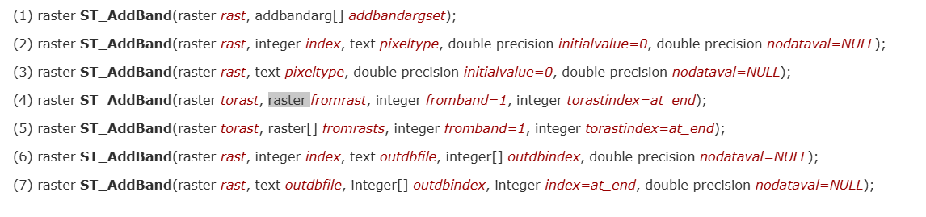
ADD BAND
ST_AddBand is a PostGIS Raster function used to add new bands to an existing raster. It allows you to insert additional bands into a raster, which is useful when dealing with multiband raster operations.

Slide 8
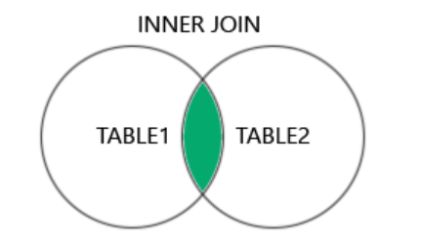
ADD BAND & Select data
SELECT
ST_AddBand()
t.filename As filename_tmean, p.filename As filename_prec, t.month
FROM ch10.tmean As t INNER JOIN ch10.prec As p

Slide 9
Condition of add band
Two condition:
1. Save spatial coverage: the raster should have same spatial coverage
2. Same month: we merge the raster that belongs to the same month
ON condition 1 AND condition 2 ;

Slide 10
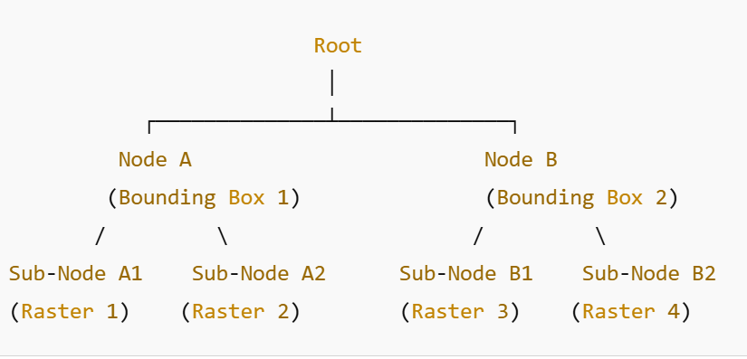
Add index
GiST (Generalized Search Tree)

Slide 11
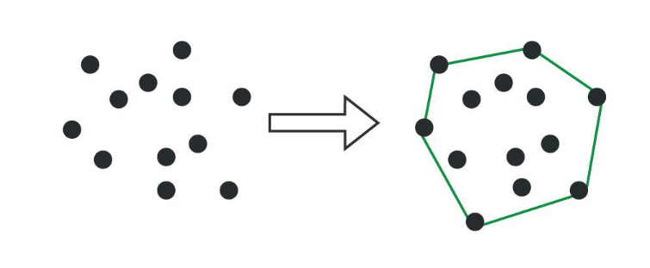
ADD INDEX
CONVEX HULL
Computes the convex hull of a geometry. The convex hull is the smallest convex geometry that encloses all geometries in the input.

Slide 12
ADD INDEX
CREATE INDEX idx_tmean_prec_rast_gist ON ch10.tmean_prec
USING gist (ST_ConvexHull());

Slide 13
10.2 Raster statistics

Slide 14
Raster statistics
Create a point
Query value on raster
Get value
This SQL query retrieves temperature and precipitation values from a raster dataset at a specific point location, filtering the results for January and July.

Slide 15
Create a point geometry
ST_SetSRID(, 4326) AS pt
ST_Point(8.55, 47.36667) → Creates a point geometry at latitude 47.36667 and longitude 8.55.
ST_SetSRID(..., 4326) → Assigns the SRID 4326 (WGS 84) to the point to ensure proper spatial reference.

Slide 16
QUERY TEMPERATURE AND PRECIPITATION
ST_Value(rast, , pt) AS temp_c,
ST_Value(rast, , pt) AS precip
ST_Value(rast, 1, pt):
Retrieves the temperature value from band 1 of the raster at the specified point.
The first band stores temperature data (temp_c).
ST_Value(rast, 2, pt):
Retrieves the precipitation value from band 2 of the raster at the same point.
The second band stores precipitation data (precip).

Slide 17
FILTERING CONDITIONS
ON ( AND )
ORDER BY month;
ON (month IN (1,7) AND ST_Intersects(rast, pt))
month IN (1,7):
Selects only data for January and July.
ST_Intersects(rast, pt):
Ensures that the raster tile contains the point before trying to extract values.
Now, please check the temperature and precipitation for Worcester, and Los Angelas

Slide 18
10.2 raster and geometry

Slide 19
Raster and geometry
Create a buffer area around a point
Clip and extract raster values within he buffer
Group by raster value and merge geometries
This query extracts raster values, clips them based on a buffered point, groups them, and merges geometries based on the raster values.

Slide 20
CREATE A BUFFER AREA AROUND A POINT
SELECT ST_Buffer(
ST_GeomFromText('POINT(444205 2438785)', 26904), 100
) AS geom
ST_GeomFromText('POINT(444205 2438785)', 26904): Creates a point geometry at coordinates (444205, 2438785) using SRID 26904 (UTM Zone 4).
ST_Buffer(..., 100): Generates a 100-meter buffer around the point.
Alias buf.geom: The result is a circular geometry centered at the point.

Slide 21
Clip & Extract Raster Values Within the Buffer
SELECT ST_Intersection( ST_Clip(rast, ST_Envelope(buf.geom)), 1, buf.geom ) AS gval
FROM ch10.kauai
INNER JOIN ( ) AS buf
ON ST_Intersects( , )
ST_Intersects(rast, buf.geom):
Filters raster tiles from ch10.kauai that intersect the buffered area.
ST_Clip(rast, ST_Envelope(buf.geom)):
Clips the raster to the bounding box of the buffer (not the exact shape, just its rectangle).
ST_Intersection(..., 1, buf.geom):
Extracts raster values where the clipped raster intersects the buffered geometry.
1 specifies band 1 of the raster.
Alias gval:
(gval).val → The integer value of the raster pixel.
(gval).geom → The geometry corresponding to the raster pixel.

Slide 22
Group by Raster Value and Merge Geometries
SELECT CAST((gval).val AS integer) AS val, ST_Union((gval).geom) AS geom
FROM () As foo
GROUP BY (gval).val
ORDER BY (gval).val;
CAST((gval).val AS integer) AS val: Converts raster values into integers for grouping.
ST_Union((gval).geom) AS geom:
Merges geometries of raster pixels that have the same value.
GROUP BY (gval).val:
Groups pixels by their raster value.
ORDER BY (gval).val:
Sorts the results in ascending order of raster values.

Slide 23
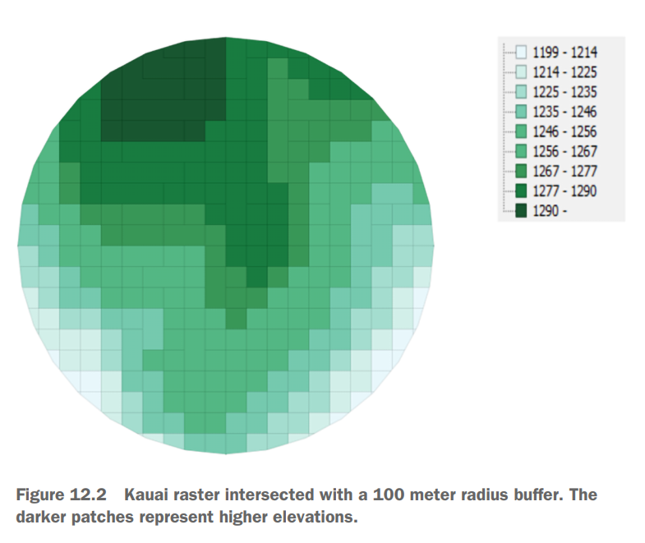
Final output

