Slide 1


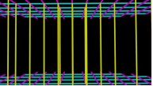
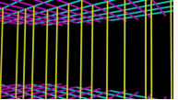

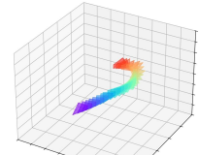


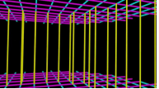
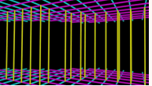
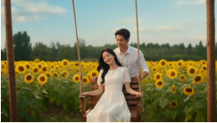



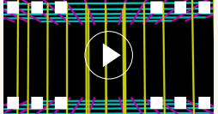


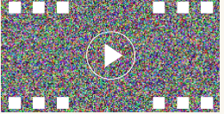

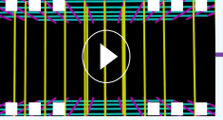
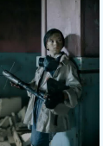
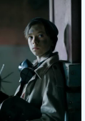
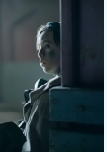
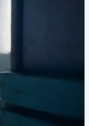

Reference Video V
Camera Grid Rendering
Camera Grid G
Camera Extrinsics
...
Pose
Focal Length
...
Estimator
$$f=a×max(H,W)$$
Training
Reference Image I
Visual Encoding
Frame
Output
Concatenation
$$z_{vis}$$
$$z_{I}∈R^{1×H×W×C}$$
x
3D VAE
Patchify
M
N
Camera Grid G
...
M
D
$$z_{v}∈R^{T×H×W×C}$$
i
T
B
3D VAE
l
$$z_{t}$$
o
c
Noisy Latent
k
$$z_{c}∈R^{T×H×W×C}$$
Text
$$T^{′}$$
...
Referencing
camera motion
from the video
Inference
Transition
Transition
User
Reference
Camera Prompt Generator Training
Detection
Frames
Prompt
$$T_{u}$$
Image
$$I$$
Camera
Transition
1. Multi-shot relationship analyzing
Reference
Prompt
Semantic
Frames
$$F$$
2. Pose-to-prompt translation
Video V
Generator
Fusion
+
3. Video-based correction
Camera
Pose
Camera
Camera
$$P$$
4. Human annotation
Prompt
$$T_{c}$$
Estimation
Poses
Final Prompt
Poses
$$T_{f}$$
Input
Label
User
MLLM
Prompt
$$T_{u}$$
Output
OmniDirector
...
Reference
Image
$$I$$

