Slide 1




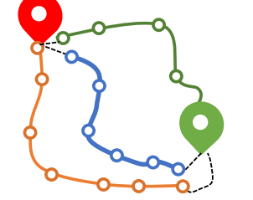
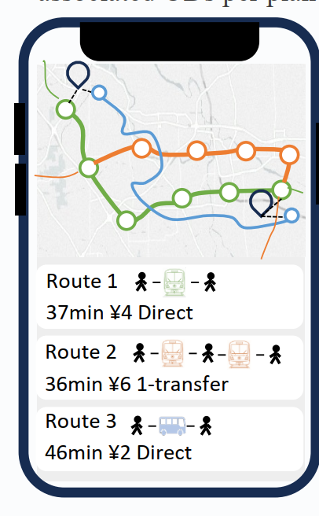


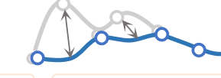
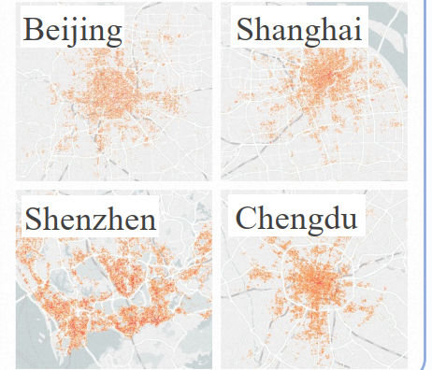





Data Source
TransitBench
TransitLM
From Amap
3 Evaluation Tasks
General LLMs perform poorly on
TransitBench
A. Route plans
B1. Station Information
Optimal Route
Personalized Route
Diverse Route
···
Multiple detailed routes and
Generation (ORG)
Generation (PRG)
Generation (DRG)
associated ODs per plan
x station
Our Solution: TransitLM
Name
Coordinates
TransitData
Description
Exclude benchmark data
from the data sources
10K
10K
10K
CPT
SFT
120K stations
Text
10 Evaluation Metrics Across 5 Categories
Align
3 Tasks
3 data sources
ORG PRG DRG
B2. Station Connectivity
1. Connectivity
2. Access Feasibility
30k samples for training
First-order station
Conn
Knowledge
Ratio
connectivity
Station Grounding
Distance Plausibility
A
route
Various
Input Formats
S₁
S₂
SG
DP
B1
station
100%
Prompt:
task definition
Accuracy of feeder
B2
connectivity
100%
Input:
query + OD
distance estimation
C
line
100%
information
S₂
S₁
S₇
13M route plans
· · ·
3. Route Overlap
Consistency with ground truth routes
Training
Evaluation
C. Line Information
Covers 4 cities
Line Overlap
Station Sequence
Route Exact Match
Varied Data Settings
On TransitBench
Line length, stop sequences,
Overlap
REM
Multi-CPT × Multi-SFT
Query = [O→D] +
LO
SSO
LO = 1 & SSO = 1
{Preference, k-
operating hours
routes}*
Line 1
5. Task-Specific
Vocabulary Expansion
4. Numeric Field Accuracy
Stations
IDs
Line 2
Correctness of predicted route features
Preference
PC
Line 3
···
Estimation
Mean Absolute
Compliance
3 Base Model Sizes
· · ·
Accuracy
Percentage Error
Route
0.6B / 1.7B / 4B
13K transit lines
EA
MAPE
Diversity
RD

