Slide 1

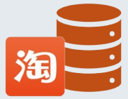
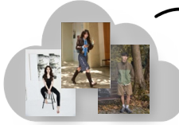
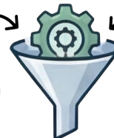
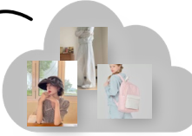












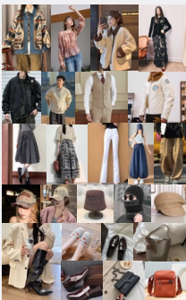

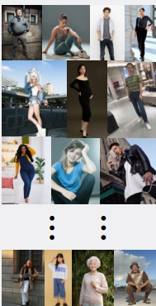



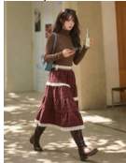
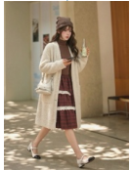


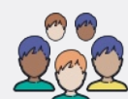

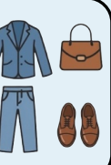







Stage 2: Data Filtering, Refinement,
Stage 3: Try-on Pairing
Stage 1: Data Collection
and Anonymization
Strategy
Model Data
Cloth Data
Quality Filtering with Hierarchical policy
Shared
Blur Image
Low Resolution
Internet Data
E-commerce Data
Polity
Pairing Policy
Watermark
......
Model-domain Policy
Cloth-domain Policy
Expert-Tagged Data Retrieval
VLM
Pose
$$>{90}^{∘}$$
Judge
Incomplete
Upper
Coat
Lower
Shoes
Bag
Hat
Non-human
Expert
Multi-subject
Tag List
...
...
Check
...
...
Multi-cloth Try-on
Multi-Layered
Automated
& Manual
Tagging Refinement
Privacy Protection
Diverse Pairs
Retrieval
Garment and
Human-collected Tags
Match
Accessory Data
Model Data
Taobao SKU Tags
Tag
Face Library
Library
Switch
Retrieved
Raw Data
VLM
Diverse & Intricate
(>500K)
Dense Attributes
Quality Check
Try-on Benchmark

