Slide 1



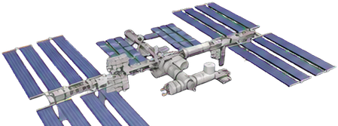
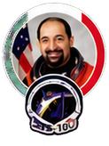
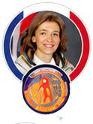
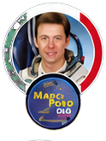
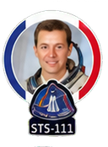


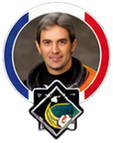

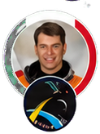


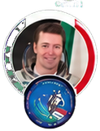


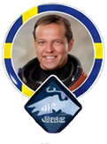
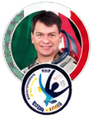
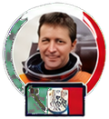
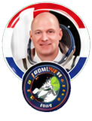

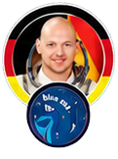
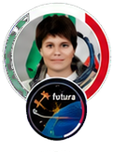
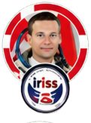
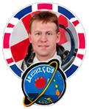
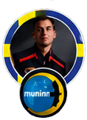


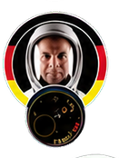






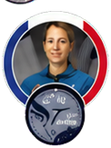
INTERNATIONAL SPACE STATION
EUROPEAN SPACE AGENCY
ESA astronauts' missions
Umberto Guidoni
Claudie Haigneré
Roberto Vittori
Philippe Perrin
Frank De Winne
STS-100
Andromède
Marco Polo
STS-111
Odissea
April - May 2001
October 2001
April - May 2002
June 2002
October - November 2002
Frank De Winne
Léopold Eyharts
Hans Schlegel
Paolo Nespoli
Christer Fuglesang
Thomas Reiter
Roberto Vittori
André Kuipers
Pedro Duque
OasISS
STS-122
STS-122
Esperia
Celsius
Astrolab
Eneide
DELTA
Cervantes
May - December 2009
February - March 2008
February 2008
October - November 2007
December 2006
July - December 2006
April 2005
April 2004
October 2003
Christer Fuglesang
Paolo Nespoli
Roberto Vittori
André Kuipers
Luca Parmitano
Alexander Gerst
Samantha Cristoforetti
Andreas Mogensen
Tim Peake
Alissé
MagISStra
DAMA
PromISSe
Volare
Blue Dot
Futura
Iriss
Principia
August - September 2009
December 2010 - May 2011
May 2011
December 2011 - July 2012
May - November 2013
May - November 2014
November 2014 - June 2015
September 2015 - October 2015
December 2015 - June 2016
Marcus Wandt
Andreas Mogensen
Samantha Cristoforetti
Matthias Maurer
Thomas Pesquet
Luca Parmitano
Alexander Gerst
Paolo Nespoli
Thomas Pesquet
Muninn
Huginn
Minerva
Cosmic Kiss
Alpha
Beyond
Horizons
Vita
Proxima
January 2024 - February 2024
August 2023 - March 2024
April 2022 - October 2022
November 2021 - May 2022
April - November 2021
July 2019 - February 2020
June - December 2018
July - December 2017
November 2016 - May 2017
Sławosz
Sophie Adenot
Uznański-Wiśniewski
Ignis
εpsilon
June-July 2025
February-November 2026

