Slide 1


Build a Personalized Online Course Recommender System with Machine Learning
Young Rha
2023-12-18

Slide 2

Outline
Introduction and Background
Exploratory Data Analysis
Content-based Recommender System using Unsupervised Learning
Collaborative-filtering based Recommender System using Supervised learning
Conclusion
Appendix

Slide 3
Introduction
Goal
This project aims to explore recommendation system through analyzing online courses dataset. Both content based and collaborative filtering methods will be used to measure the performance between the various methods.
Problem:
The online courses dataset consist of courses data and user profile data. The recommendation system aims to generate course recommendations to the user where the likelihood of accepted recommendation is optimized.
The recommendation system will assume several hypotheses such as:
A user will likely accept courses similar to courses they have taken in the past
Users with the similar interest are likely to accept courses taken by other users with the group

Slide 4
Exploratory Data Analysis

Slide 5
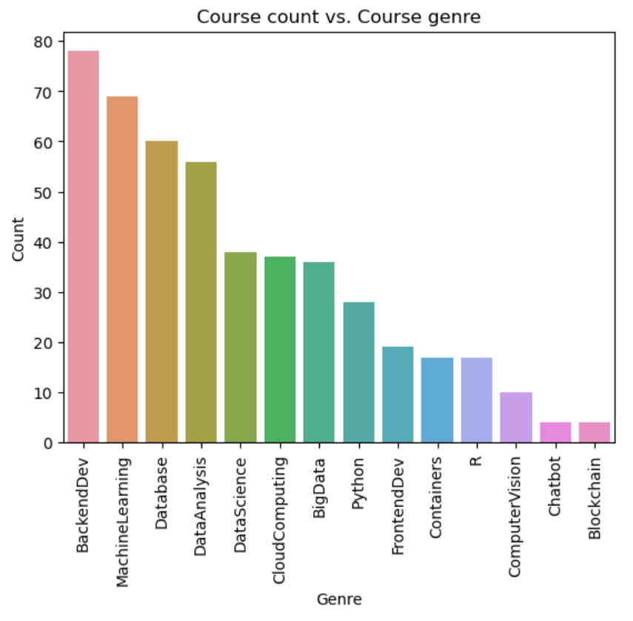
Course counts per genre
Notes:
The bar chart displays count vs. genre from the course dataframe.
We can see that backend dev genre is the most occurrence within the dataset whereas chatbox and blockchain have the least occurrences.
We can also see that the count ranges from 4 – 78 with the total sum over 307 (number of courses within the dataset) as expected since there will be some overlap of genre per courses.

Slide 6
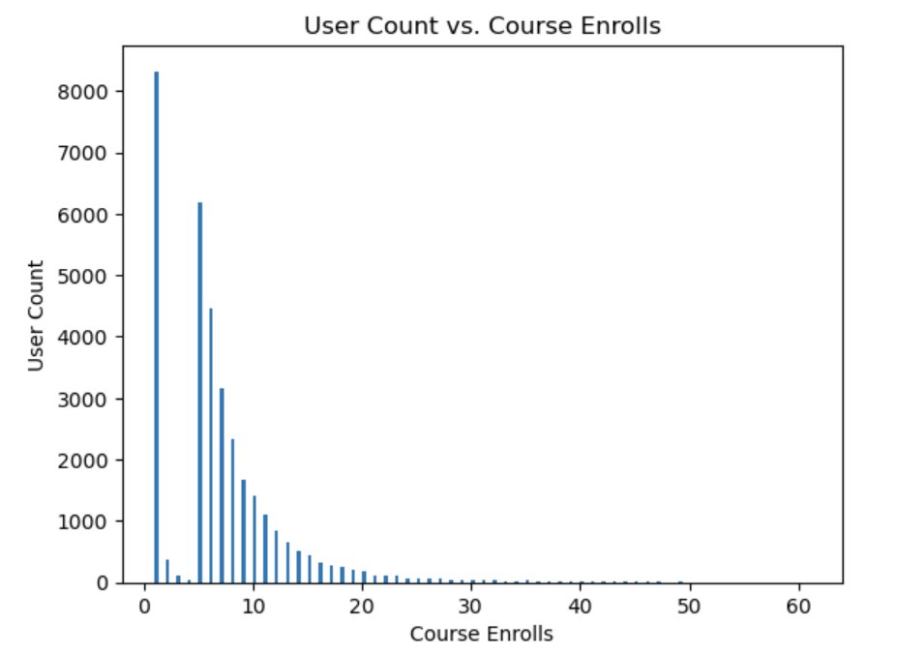
Course enrollment distribution
Notes:
This is a histogram of user count vs. course enrolls to observe the distribution.
We can see that majority of users only enroll to a single course.
however, if they do enroll for more than one, they do seem to continue enrolling to more courses with the curve approaching a plateau toward ~50 enrolls.

Slide 7
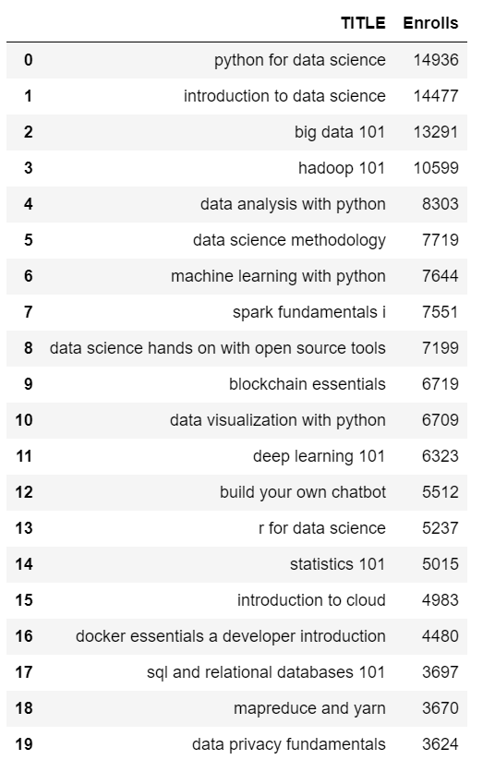
20 most popular courses
Notes:
Here we have top 20 most popular courses from the dataset.
We can see that python for data science is the most popular course with 14936 enrolls followed by introduction to data science with 14477 and big data 101 13291.
The 20th popular course is data privacy fundamentals with the enrollment of 3624

Slide 8
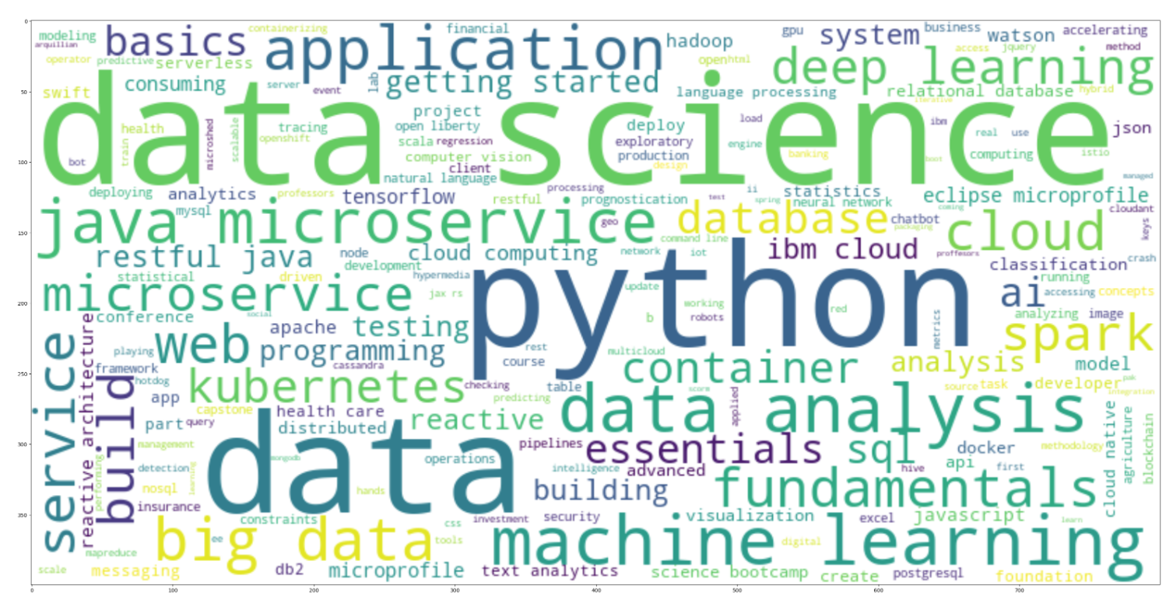
Word cloud of course titles
Notes:
The wordcloud of the course titles show the popularity of key words in the course titles such as data science, python, machine learning, and big data.

Slide 9
Content-based Recommender System using Unsupervised Learning

Slide 10
Flowchart of content-based recommender system using user profile and course genres
Raw data
Feature Engineering
Vectorized Features
Calculate Score
Recommendation scores
Threshold evaluation
Recommendations
Notes:
The categorical features are extracted from raw data in form of profile and course genres.
Both profile and course genre is then turned into vectors for score calculation.
The recommendation score is then calculated via dot product of a course vector and a profile vector.
The only hyperparameter in recommender system is score threshold. If the score is higher than the threshold, the course will be recommended to the user.
The threshold value is then fine tuned to adjust the number of recommendations.

Slide 11
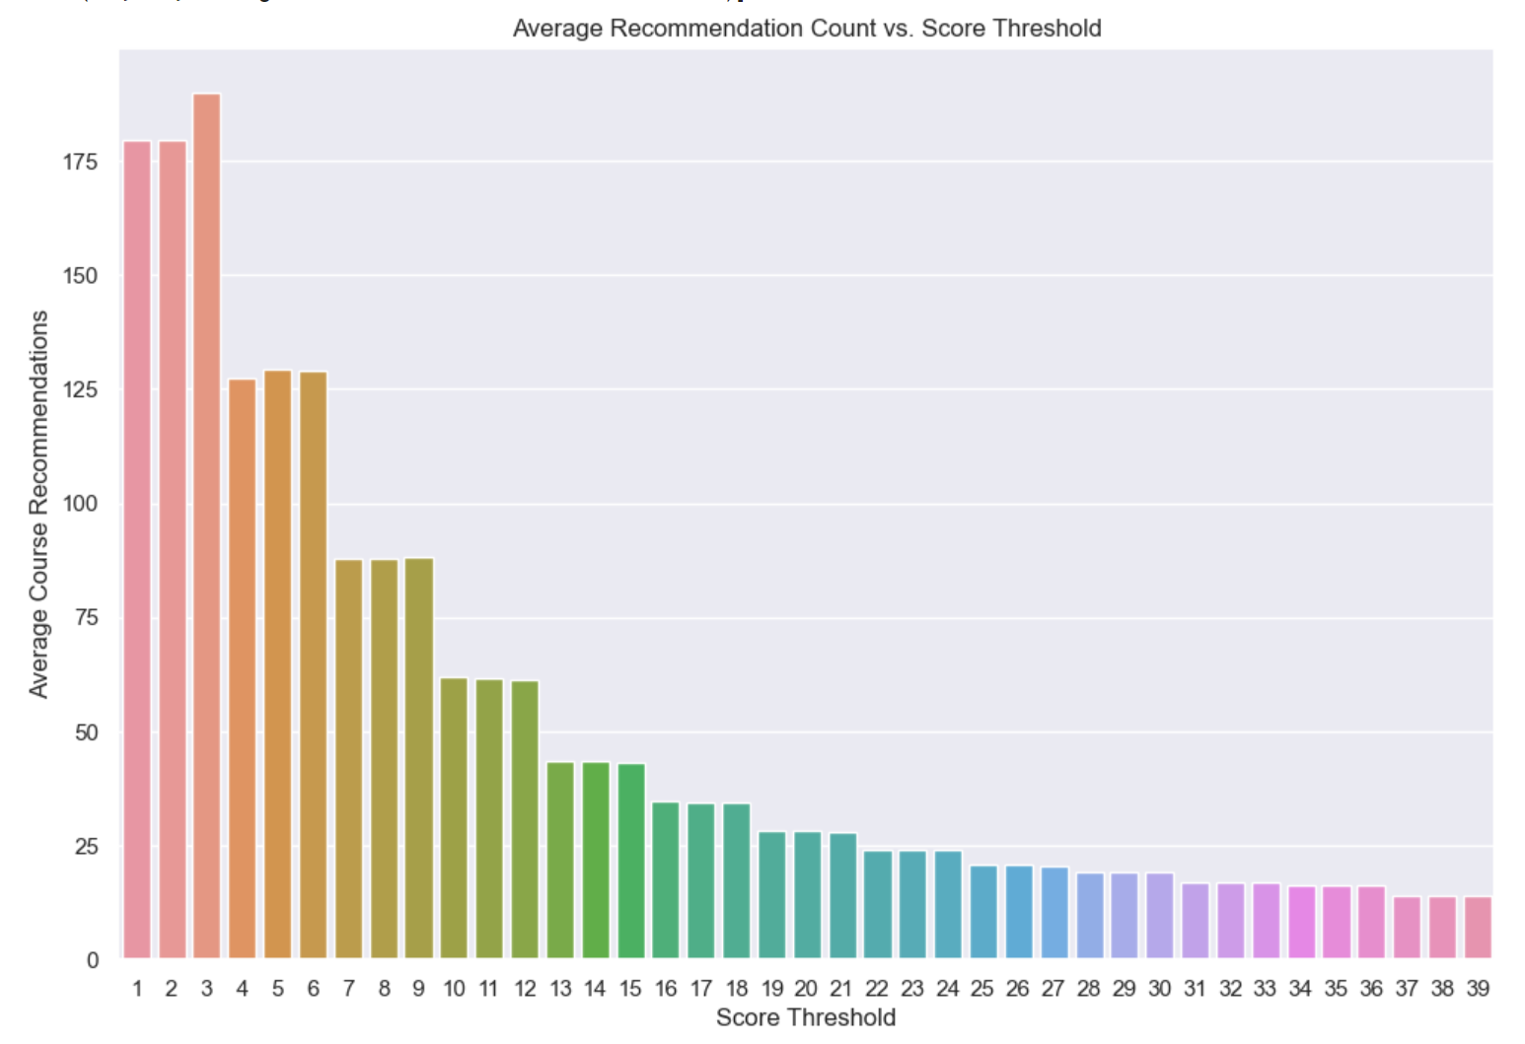
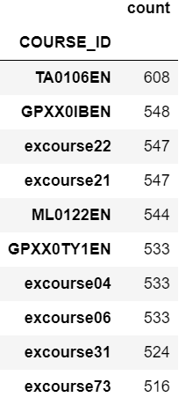
Evaluation results of user profile-based recommender system
Top 10 Courses
Threshold: 10
Notes:
Iterating through threshold score of 1 – 39
The number of recommendation goes down over increasing threshold as expected.
The top 10 was found from the recommendations using score threshold of 10

Slide 12
Flowchart of content-based recommender system using course similarity
Raw data
Feature Engineering
BoW Features
Calculate Similarity Score
Similarity Score Matrix
Threshold evaluation
Recommendations
Search matrix by user course
Similarity score
Notes:
The raw data consist of courses with their title and description.
The feature engineering step takes the course titles and create bag of words features per course.
The pairwise similarity score was calculated based on bow features between all pair of courses resulting in the similarity score matrix.
The recommendations were then generated by using each user’s enrolled course information as an input. Here, we are excluding the enrolled course from the list of available courses to avoid recommending the same course.
The similarity score is retrieved from the score matrix calculated in step 3 between the enrolled course and the rest of available courses. Each recommendation is required to pass a certain similarity score threshold which can be fine tuned to control the size and quality of recommendations.

Slide 13
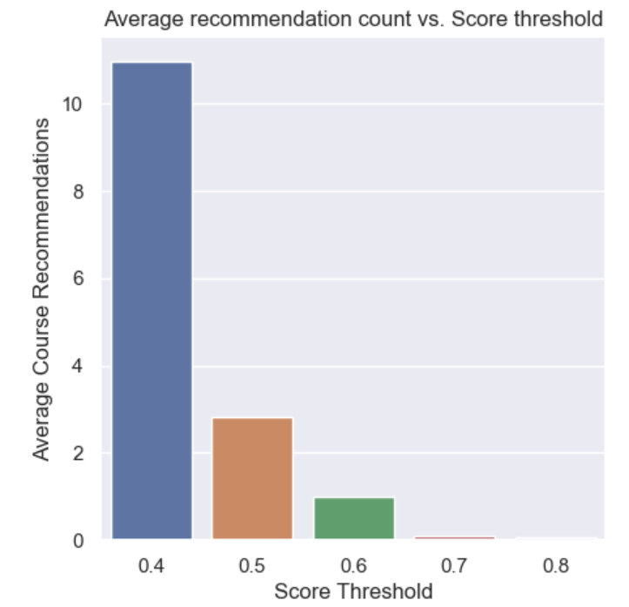
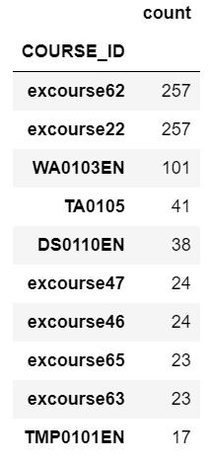
Evaluation results of course similarity based recommender system
Top 10 courses
Threshold: 0.6
Notes:
The graph displays average number of recommendations per similarity score ranging from 0.4 ~ 0.8
At 0.7 similarity score, the average number of recommendation approaches below 1 indicating that most courses have less than 0.7 similarity score given the dataset

Slide 14
Flowchart of clustering-based recommender system
Raw data
Data processing
Scaled dataset
Threshold evaluation
Recommendations
Feature Engineering
Features
Search Cluster
Courses within matching cluster
Notes:
Data processing step takes care of unbalanced dataset and uses standardscaler to normalized the skew
Feature engineering step includes PCA and clustering (ie: k-means) to reduce the dimensionality of the dataset as well as adding on cluster label as a new feature.
The features are then re-grouped based on the cluster label and user.
For each input (user), the matching cluster is searched for the list of available courses, which is then evaluated based on the threshold popularity of the course within the cluster.
If it passes the evaluation, the courses within the cluster will be recommended.

Slide 15
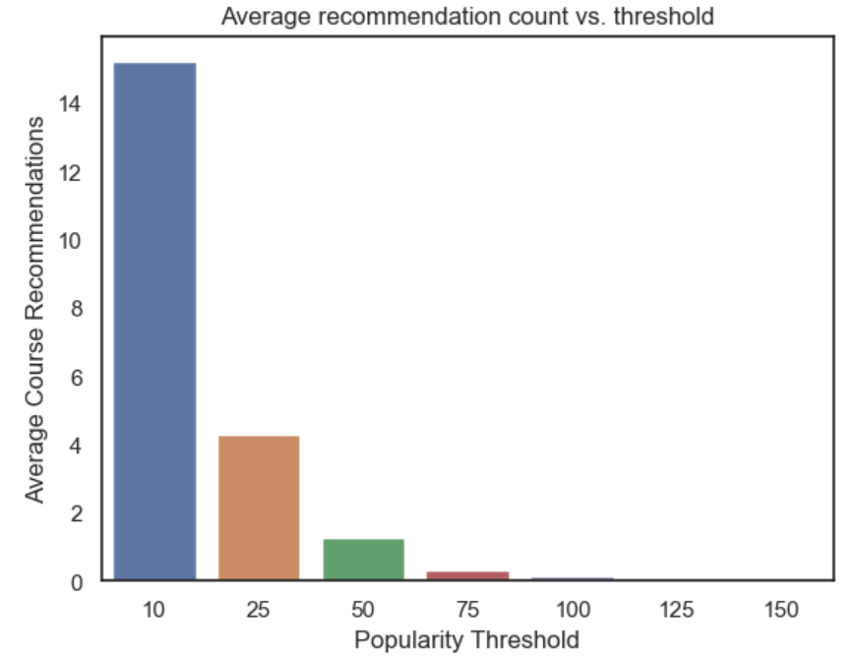
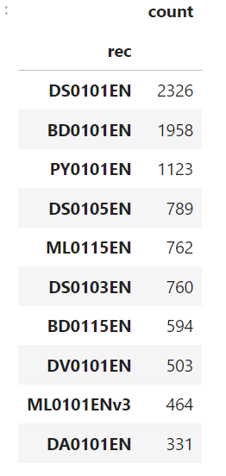
Evaluation results of clustering-based recommender system
K-Means: n_clusters = 15
PCA: n_components: 9
Top 10 Courses
Threshold: 50
Notes:
The average recommendation vs. popularity threshold graph shows that at threshold beyond ~75, the number of recommendation approaches near 0

Slide 16
Collaborative-filtering Recommender System using Supervised Learning

Slide 17
Flowchart of KNN based recommender system
Raw data
Data processing
Predict
Predicted Ratings
Cleaned Dataset
Feature Engineering
Features
Evaluate
Recommendation
Train KNN Model
Trained Model
Notes:
The raw data is cleaned up and engineered to retrieve relevant features.
The dataset of features are then split into train and test set
KNN model trained based on train set.
The model is then tested on the test set for validation.
The hyperparameters such as min/max number of neighbours as well as distance metrics can be further tuned until the desired validation result is achieved.
The model can be used to predict score/rating of an unknown items based on their similarity, which is then used to provide recommendation (ie: via collaborative filtering)

Slide 18
Flowchart of NMF based recommender system
Raw data
Data processing
Cleaned Dataset
Evaluate
Recommendation
Feature Engineering
Features
NMF
Estimated Ratings
Notes:
After clean up and engineering features, NMF will be applied to the dataset (m * n) to generate factorized matrices of non-negative features.
NMF can be used to estimate the original rating which can be then used to generate the estimated rating while reducing its dimensionality as well as highlighting the important features.
The estimated ratings then can be used to generate recommendations by collaborative filter.

Slide 19
Flowchart of Neural Network Embedding based recommender system
Raw data
Data processing
Embedding
Latent Features
Cleaned Dataset
Feature Engineering
Features
Evaluate Score
Estimated Score
Vectorize input
One hot encoded categorical features
Evaluate
Recommendation
Notes:
The features are processed into one hot encoded categorical features per feature and fed into the embedding layer of neural network.
The neural network will construct a latent features from the input which will be then evaluated to predict the outcome.
The neural network will be trained to minimize the loss function on train set.
Once the model is trained, the further optimization can be done by tuning the hyperparameters.
The model then can be used to predict the outcome (ie: probability of completing the course) based on unknown input (ie: user, course)
Based on the evaluation (ie: probability threshold), the recommendation then can be generated.

Slide 20
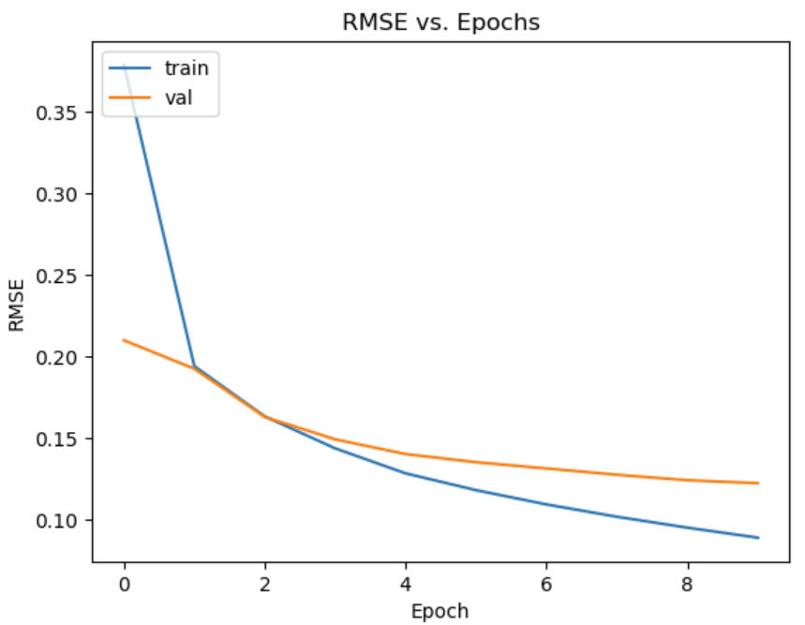
Validation result of Neural Network Embedding based recommender system
Hyperparameters
Loss: MSE
Optimizer: adam
Metrics: RMSE
Epochs: 10
Batch size: 64
Embedding layers: 16
Notes:
The graph displays RMSE value of train and validation set over 10 epochs
The RMSE value seem slowly decrease with the epochs though not as much as the train value

Slide 21
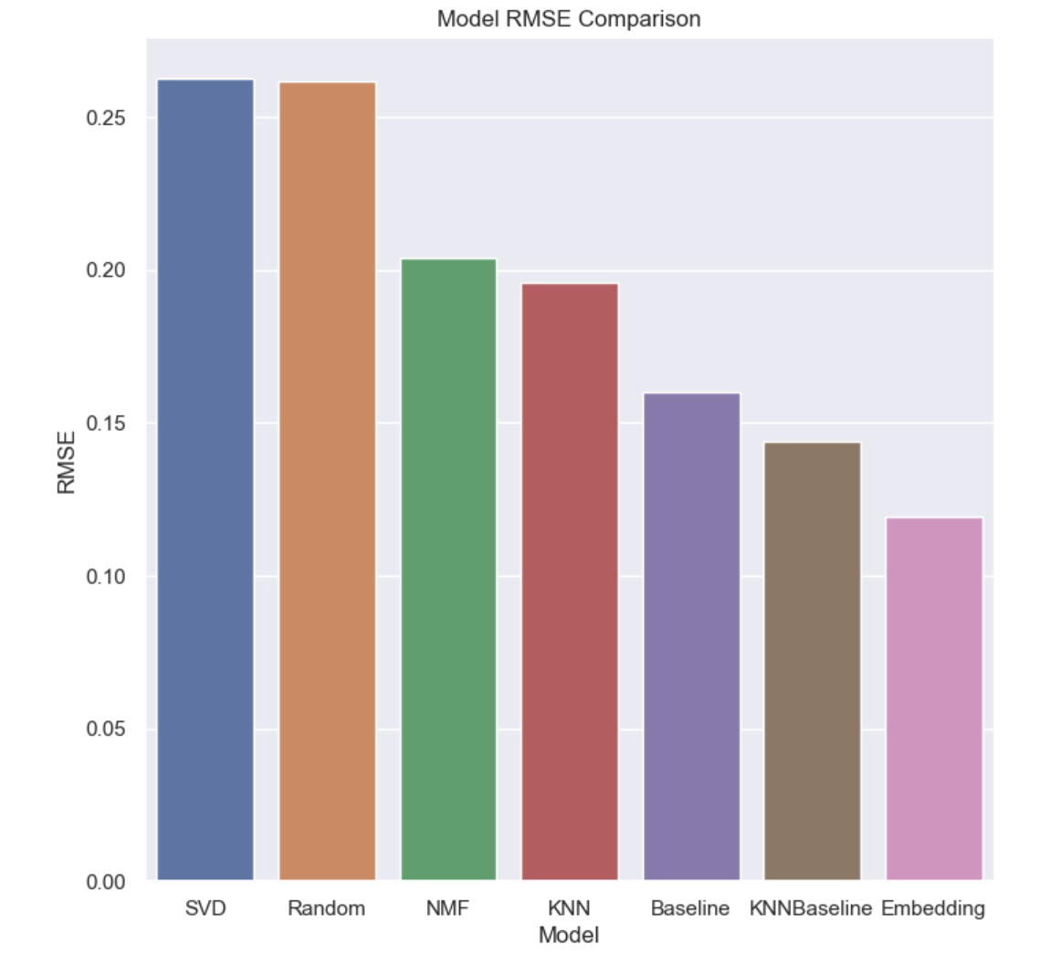
Compare the performance of collaborative-filtering models
Notes:
SVD: n_factors = 100, epochs =20, yields RMSE value of 0.2627
Random: yields RMSE value of 0.2615
NMF: n_factors = 15, epochs = 50 yields RMSE value of 0.2040
KNN: k = 40, yields RMSE value of 0.1958
Baseline: yields RMSE value of 0.1598
KNNBaseline: k=40, yields RMSE value of 0.1440
Embedding: 16 embedding layers, yields RMSE value of 0.1190
The result shows that SVD performed the worst with RMSE value of 0.2647 and embedding with the best RMSE value of 0.1190

Slide 22
Conclusions
Content-based recommendation methods
All 3 methods seem to return varying courses as their top recommendations. Suggesting that they capture different area of interest for the recommendation.
The results seem to heavily depend on the type of methods as well as the hyperparameters.
Choosing hyperparameters requires good insight into the dataset as well as the objective of the recommendation system.
Perhaps combining various content based recommendation methods may yield a better result as it may capture a larger scope of the user’s interest. It may also be possible to capture the hit rate of each method and build a supervised learning model such as neural network to further improve the results.
Collaborative filtering
Given the strong performance of the baseline method, the dataset doesn’t seem to suffer from the overfit. It may be the reason why knn and nmf based methods performed worse than the baseline method as well. Perhaps the hyperparameters for knn and nmf require more tuning.
Embedding based method seems to have decreasing RMSE value at 10 epochs. The results may be further improved with fine tuning the hyperparameters.
While all methods seem to yield relatively low RMSE value, the embedding method seems to be the best method for the recommendation system.

Slide 23
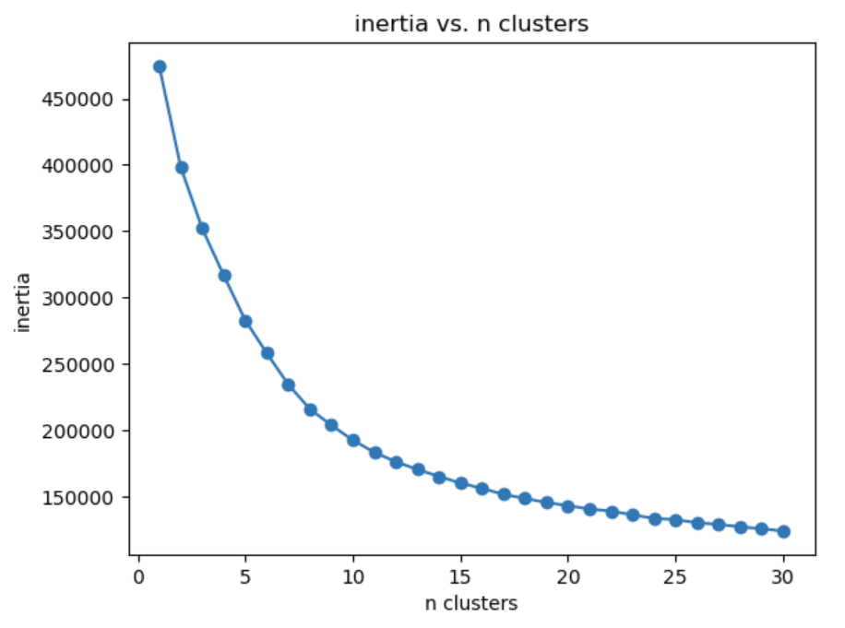
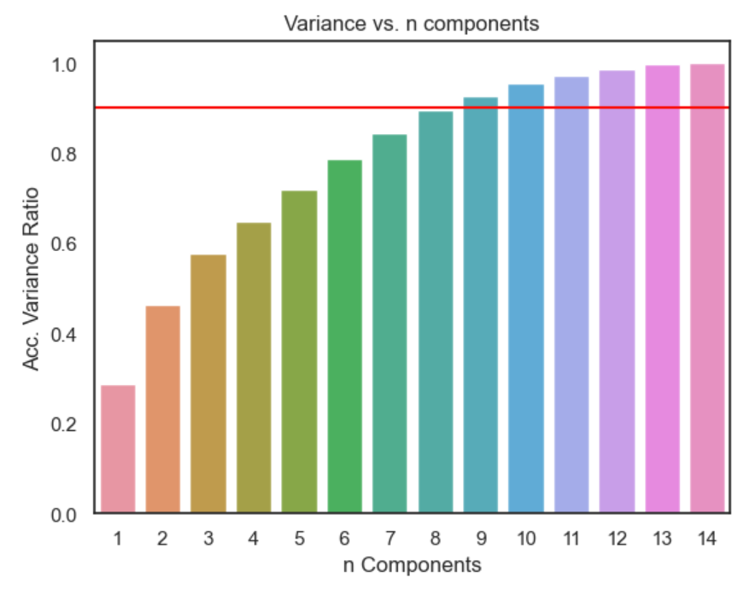
Appendix
Content-based clustering
Kmeans inertia vs. clusters
PCA acc. variance vs. n components

