Slide 1
GYMBUDDY
FIND YOUR FITNESS BUDDY
Final Project Presentation — COMP-8347: Internet Applications and Distributed Systems
Group 15
Chen, Mingran | Shaukat, Abdullah | Singh, Harpreet | Thakur, Chetan | Zhang, Yarong
July 22, 2026

Slide 2
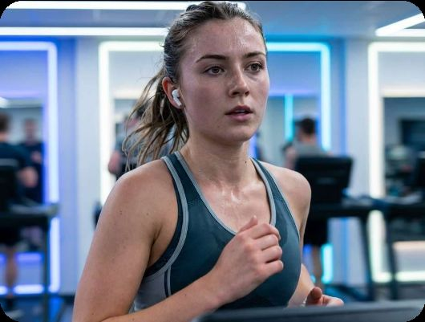
Problem & Motivation
● Motivation Gap: Many students struggle with consistency when training alone.
● Sync Hurdles: Hard to find peers with a similar fitness level and a matching schedule.
● Isolation: Especially difficult for new students to integrate into campus gym life.
● Specialized Needs: Difficulty finding partners for specific needs (gender preference, niche sports).
GymBuddy | Group 15
2

Slide 3

Our Solution — Delivered
Building Confidence Through Community.
GymBuddy connects Windsor students and alumni through a full-stack web platform: a server-rendered Django + Bootstrap site with session auth, plus an optional Next.js client talking to the same JWT-secured REST API.
Accountability. Connection. Consistency.
GymBuddy | Group 15
3

Slide 4
Core Features
👤
🔍
📅
Smart Profiles
Buddy Search & Filters
Workout Booking
Photo uploads, fitness level, goals and weekly availability on every member profile.
Keyword search plus a fitness-level dropdown filter in the navbar, on every list page.
Create, request-to-join and manage 1-on-1 or group sessions with accept/reject flows.
★
👥
🕑
Public Ratings
Fitness Groups
Session History
1–5 star community rating system, recalculated live and shown on profiles.
Create or join campus micro-communities that meet on a recurring schedule.
Middleware-tracked visit counts, recent pages and a last_visit cookie — no account required.
GymBuddy | Group 15
4

Slide 5
Tech Stack
Layer | Technology | Implementation Highlights
Backend | Django 5.2 + DRF | Models, forms, class-based views, session auth, JWT API for the SPA client
Template Site | Django Templates + Bootstrap 5 | Server-rendered pages, responsive navbar/footer, ModelForms
Frontend | Next.js 14 (App Router) | Optional richer client consuming the same DRF API
Database | SQLite (dev) / PostgreSQL-ready | Relational storage for users, sessions, groups, ratings
Auth | Django session auth + JWT | Login/logout/forgot-password on the site; token auth for the API
Media Storage | Local filesystem (media/) | Profile pictures and group images
Two interfaces, one API: the Django site and the Next.js client both run against the same DRF backend.
GymBuddy | Group 15
5

Slide 6
Mandatory Requirements — Coverage
Requirement | Where It Lives
Auth (login/logout/forgot pw) | gymbuddy/urls.py, apps/users/forms.py, templates/registration/
Forms, models, full CRUD | apps/*/forms.py, apps/*/models.py — sessions & groups support create/read/update/delete
Sessions & cookies (History) | gymbuddy/middleware.py (VisitHistoryMiddleware), users/history.html
Search + dropdown filter | Navbar search in base.html; SessionSearchForm, GroupSearchForm, MemberSearchForm
File upload | ProfileForm (profile picture), GroupForm (group image) — stored under media/
Registered vs. guest interface | @login_required / LoginRequiredMixin; guest pages stay open (home, about, lists)
Class-based index/detail views | SessionListView/DetailView, GroupListView/DetailView
Bootstrap styling + footer | static/vendor/bootstrap/, static/css/site.css, base.html
JSON fixtures | apps/*/fixtures/initial_data.json, loaded via manage.py loaddata
Minimal API use | Only the project's own DRF API (for the Next.js client) — no third-party APIs
GymBuddy | Group 15
6

Slide 7
Testing Summary
● Guest access: member-only pages correctly redirect to login.
● Registration & login: wrong password rejected; correct password succeeds.
● Profile & upload: bio and profile picture both persist to media/.
● Sessions: creation, keyword + intensity search, and zero-result search all verified.
● Groups: unique slug on create; a second member can join and becomes active.
● Ratings: submitting a rating recalculates the recipient's average_rating.
● History: visit count, recent pages and last_visit cookie all update correctly.
● Password reset: full request → email → confirm → complete flow verified end to end.
34 / 34
automated checks
passed
End-to-end smoke test against the real database and templates, covering every mandatory feature.
GymBuddy | Group 15
7

Slide 8
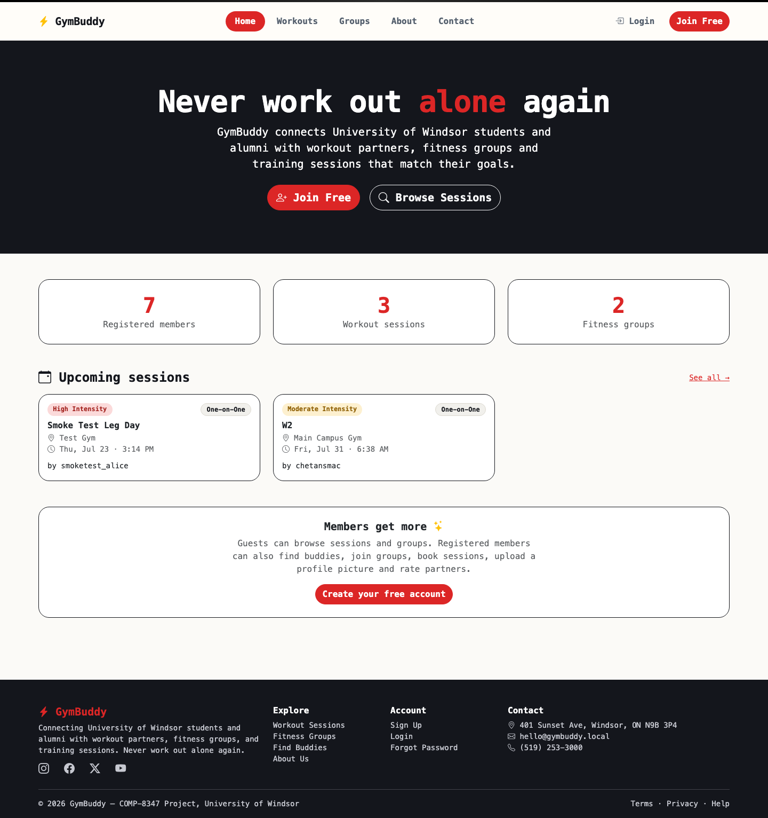
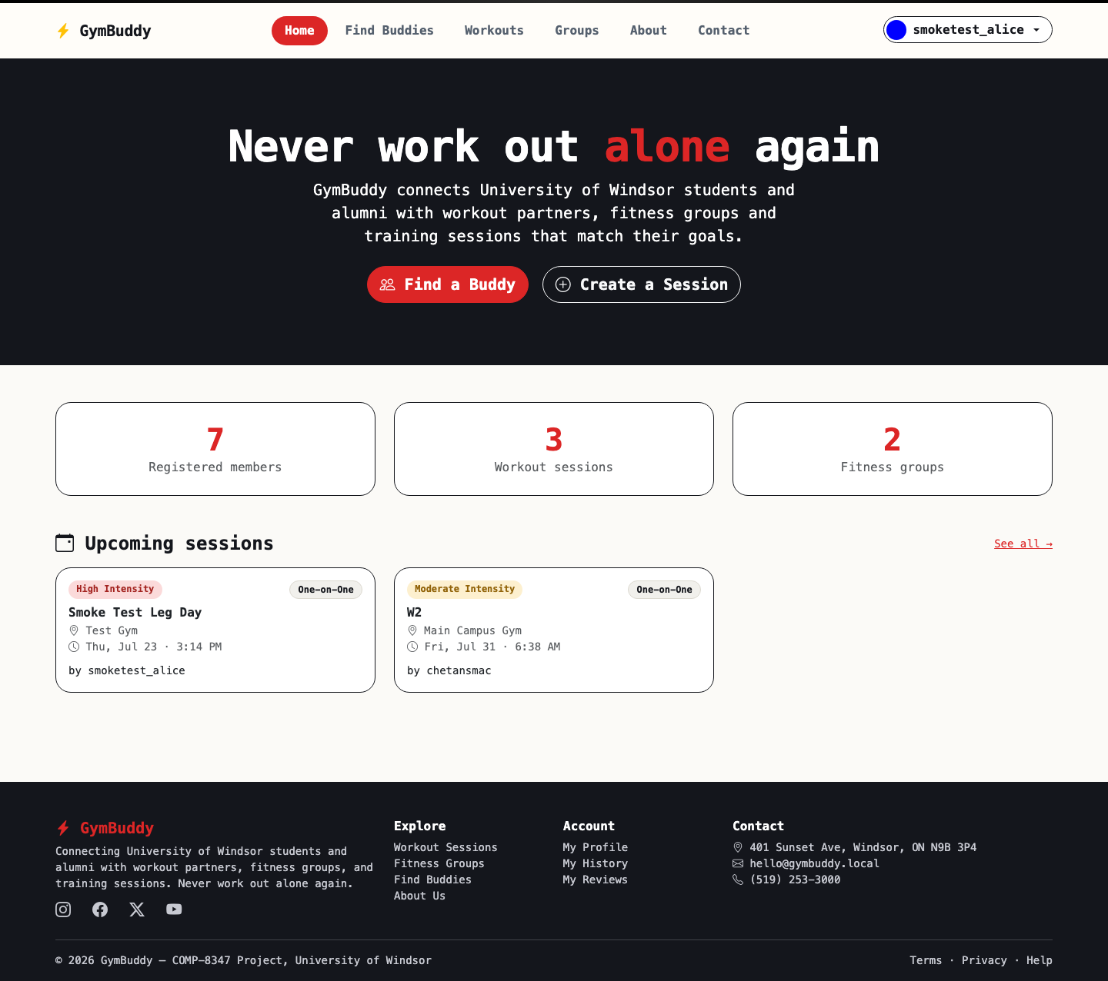
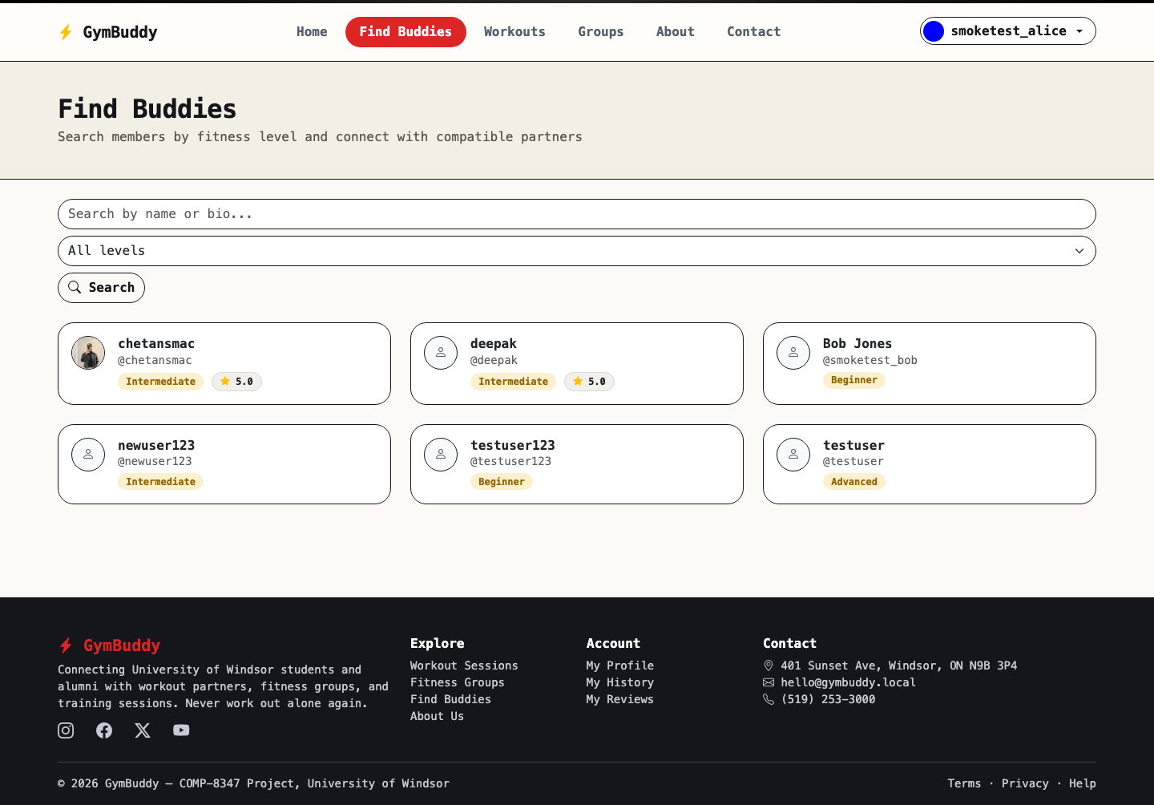
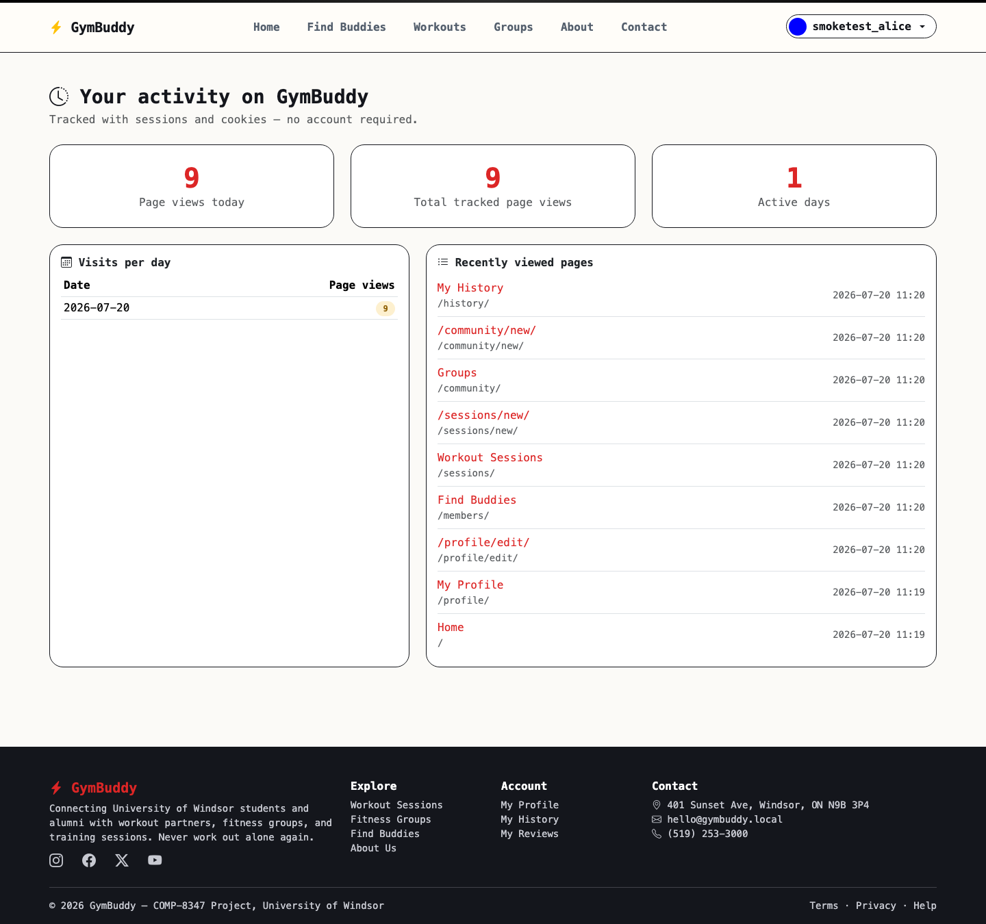
Product Walkthrough
Guest home — live stats & upcoming sessions
Member home — signed-in navbar
Buddy directory — keyword + level search
History — sessions & cookies in action
GymBuddy | Group 15
8

Slide 9
Team Roles & Contributions
Member | Primary Role | Contribution
Thakur, Chetan | Project Integration & Architecture | Settings/URLs, base.html + navbar/footer, home/about/contact, VisitHistoryMiddleware, fixtures, E2E testing
Chen, Mingran | Django Backend (Workouts) | WorkoutSession model, WorkoutSessionForm/SessionSearchForm, class-based session views
Shaukat, Abdullah | Auth & Users | Custom User/UserProfile models, SignUpForm/ProfileForm, profile & buddy directory views
Singh, Harpreet | Frontend UI | Next.js/Tailwind client consuming the DRF API; UI styling support for the template site
Zhang, Yarong | Groups & Ratings | WorkoutGroup model, GroupForm + GroupSearchForm, join/leave logic, RatingForm & views
GymBuddy | Group 15
9

Slide 10
THANK YOU
Questions & Discussion
Group 15 | July 2026
University of Windsor | GymBuddy Project
github.com/git-amcelo/Final-Project

