Slide 1


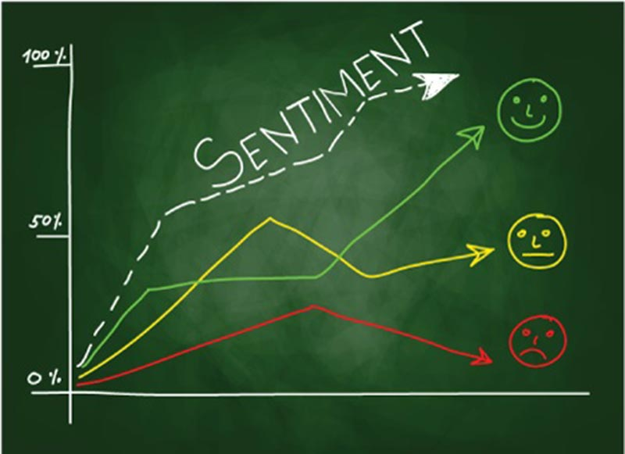
Sentiment Analysis
Bornita: bd1599
Ishan: it732
Veronica: yj1609

Slide 2


Slide 3
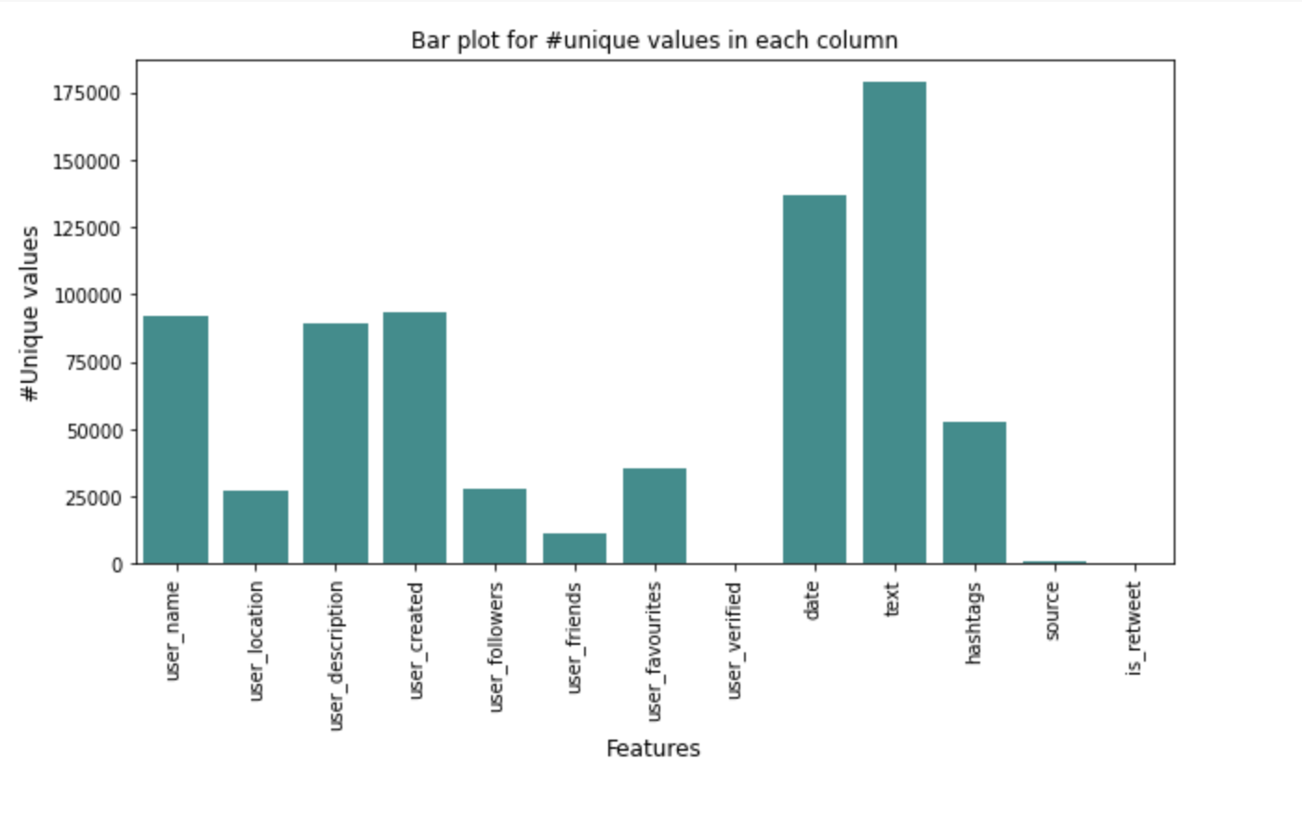
Distribution of Unique Values in each column

Slide 4
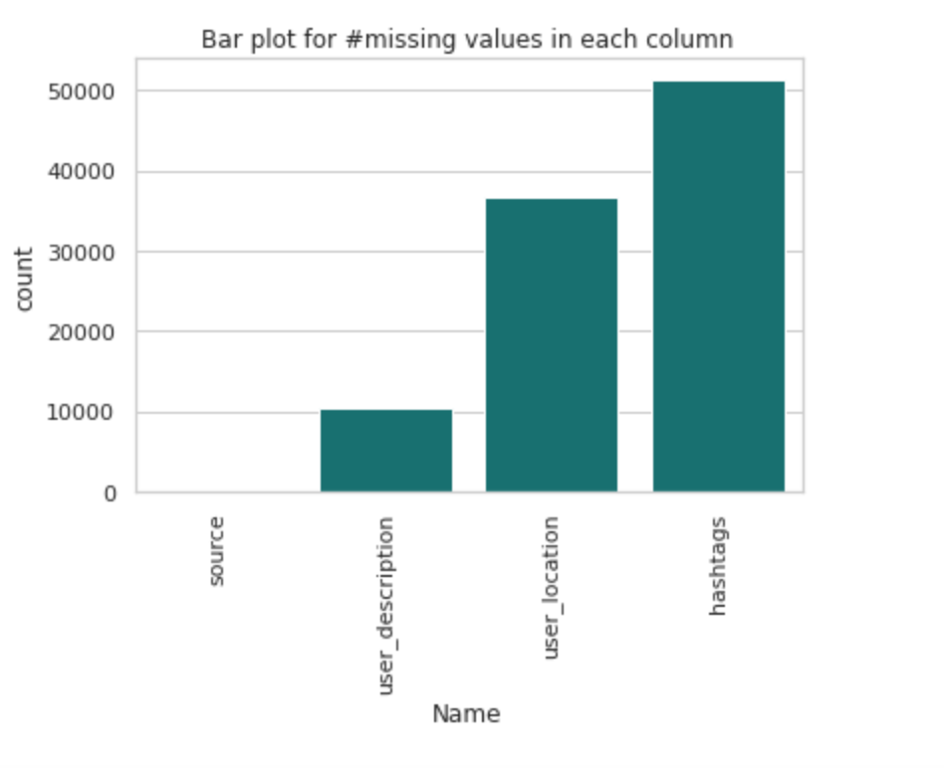
Distribution of Missing Values in each column

Slide 5
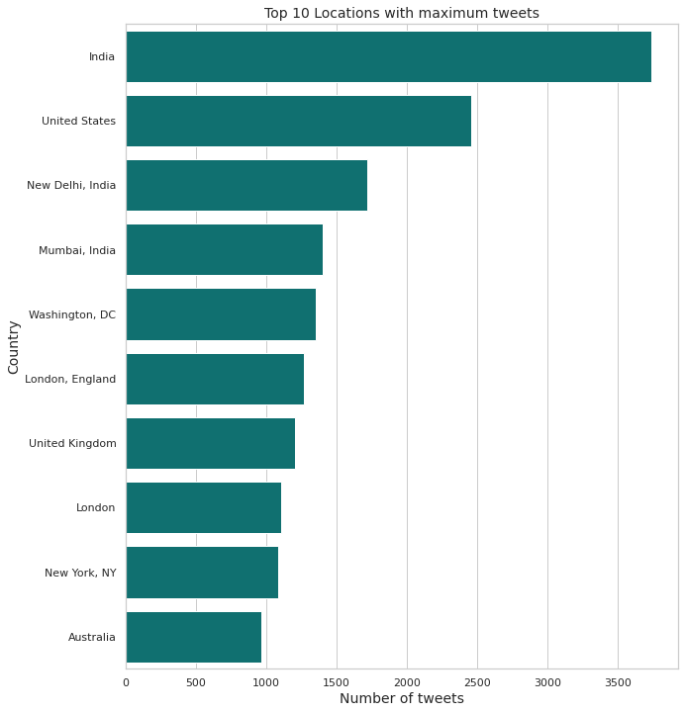
Distribution of Tweets by geographic location

Slide 6
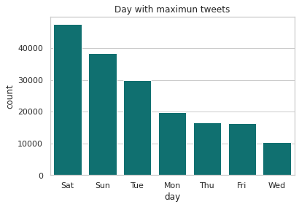
Distribution of #tweets by Day

Slide 7
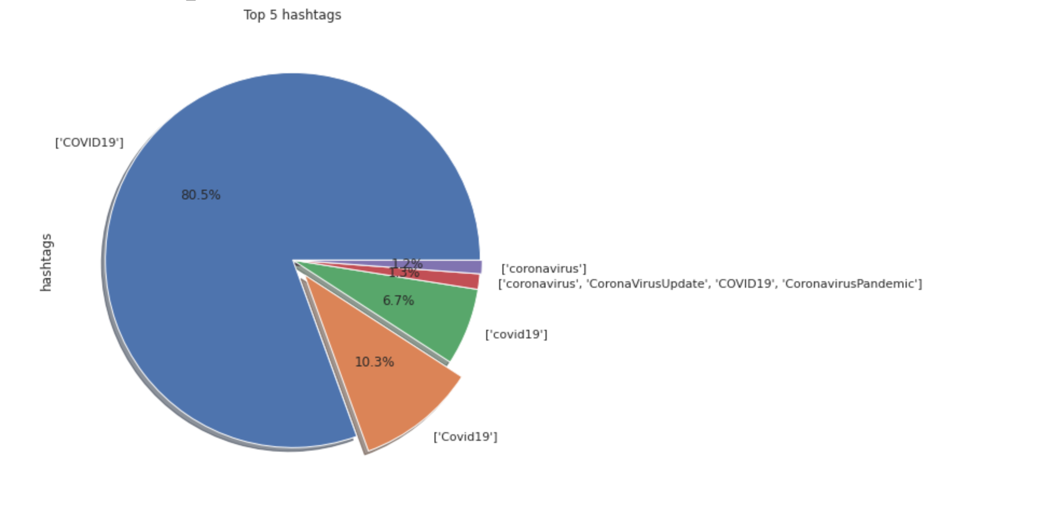
Visualization of Top 5 hashtags

Slide 8
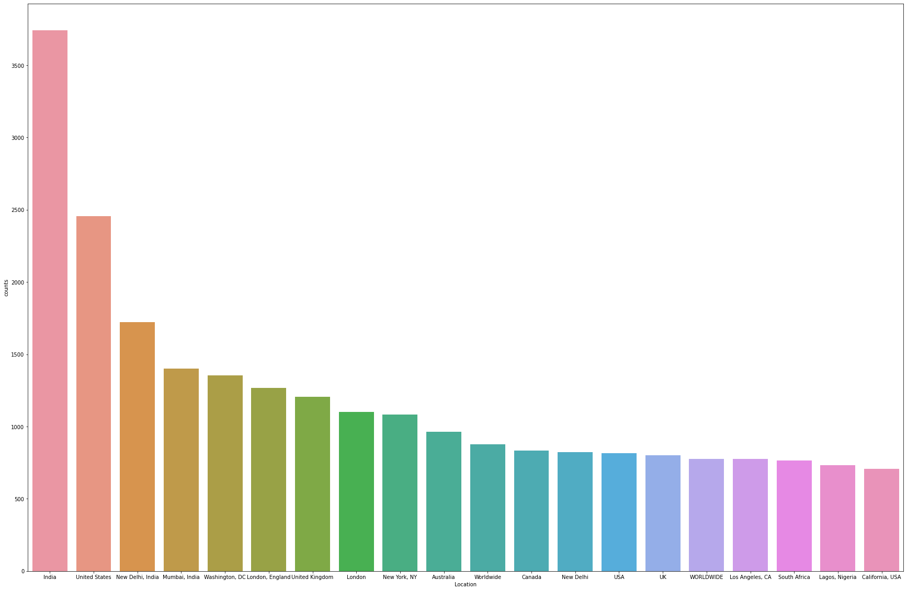
Top 20 countries with most tweets

Slide 9
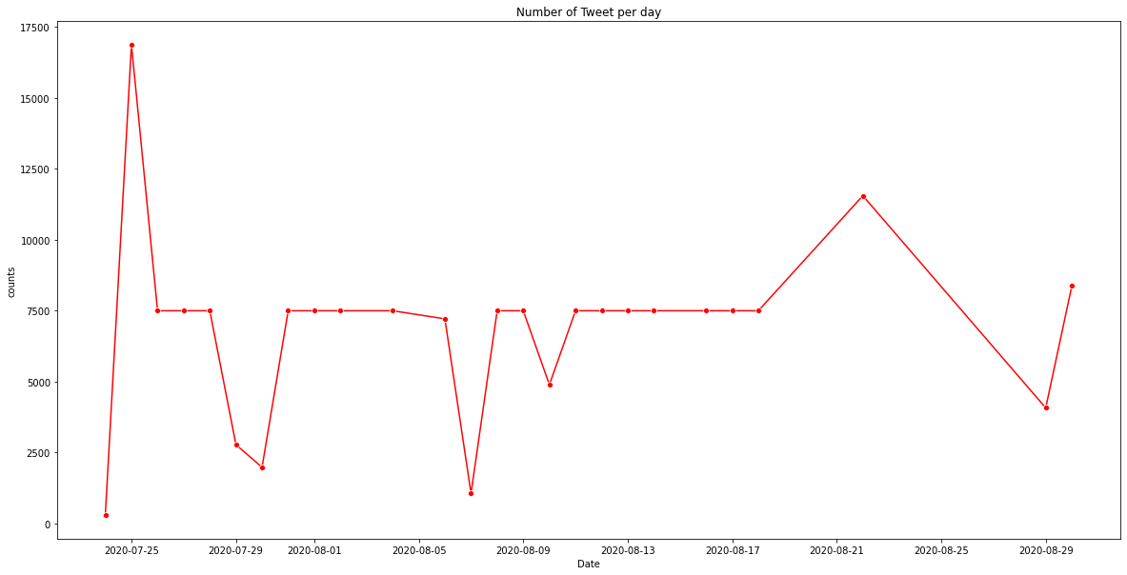
Number of tweets per day (trend)

Slide 10
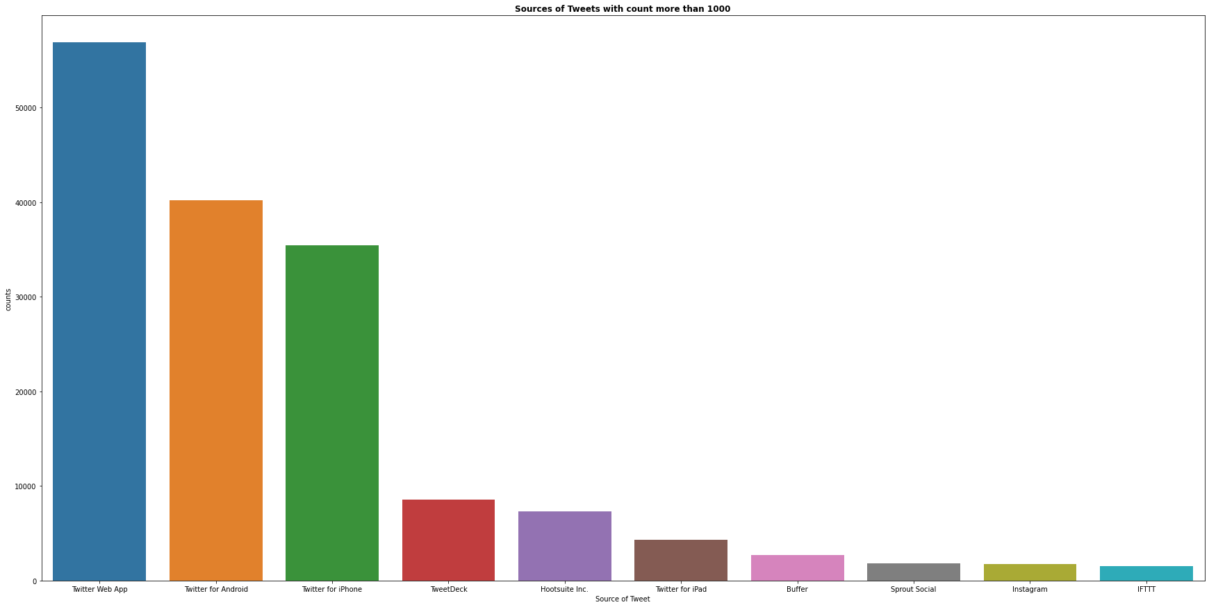
Top sources of Tweets

Slide 11
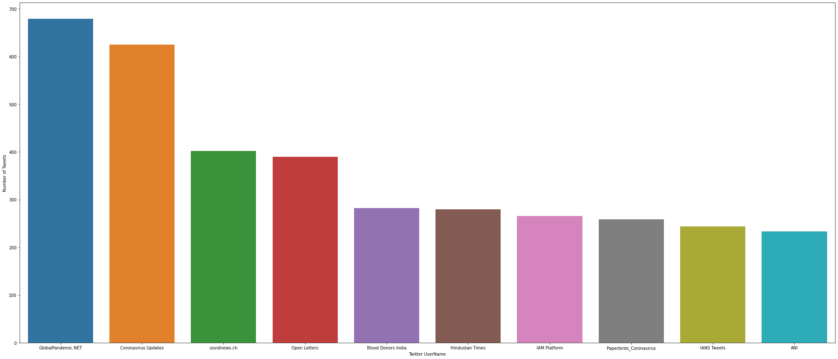
Top usernames with maximum number of tweets

Slide 12
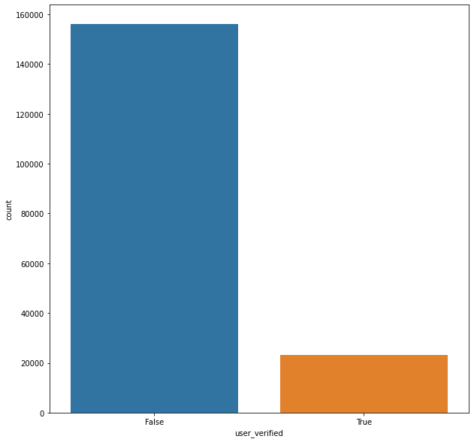
Verified users analysis

Slide 13
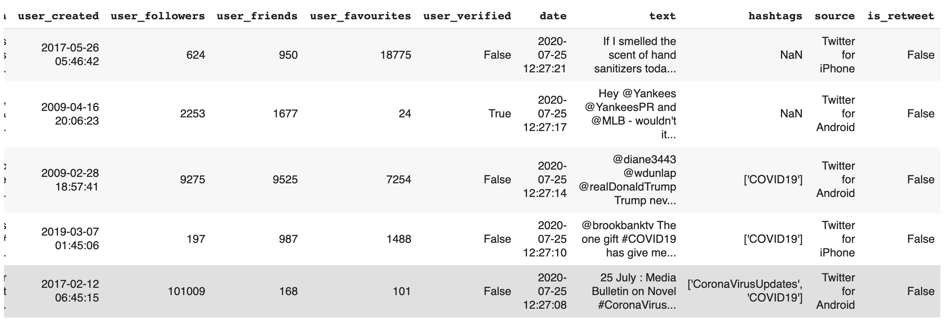
Data Cleaning - text col (remove special chars,spaces, emojis)

Slide 14
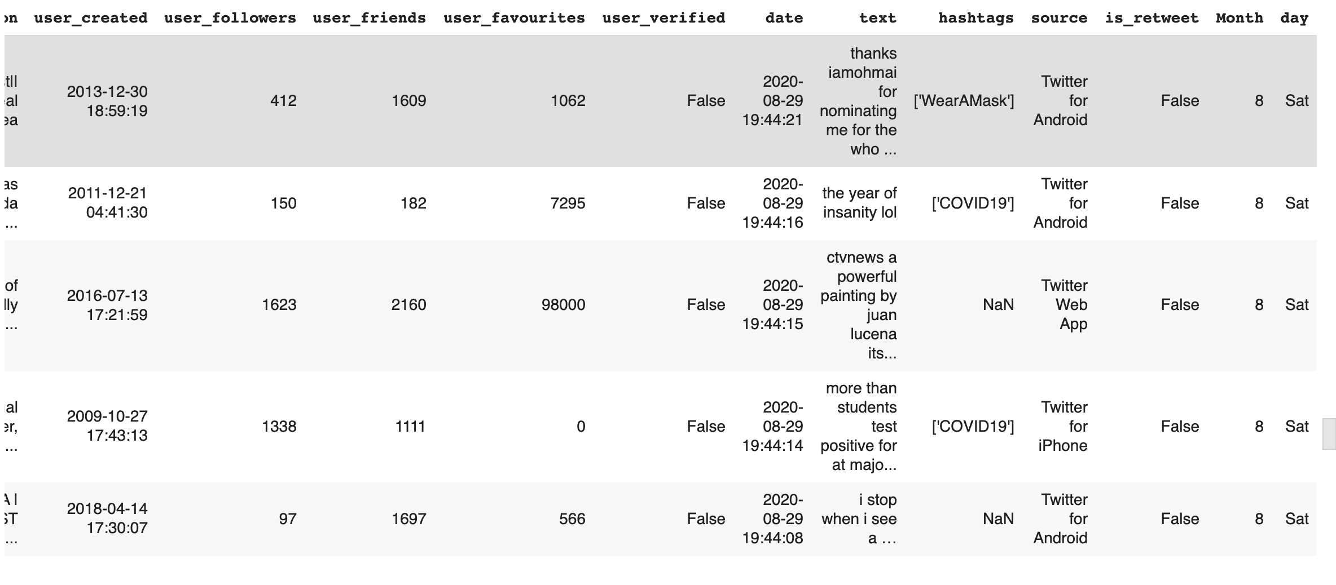
After - Data Cleaned for text column

Slide 15
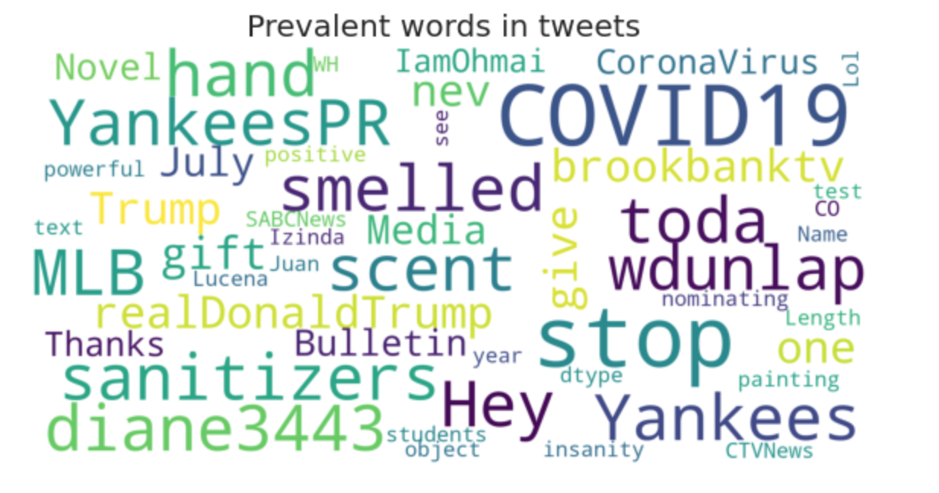
Word Cloud

Slide 16
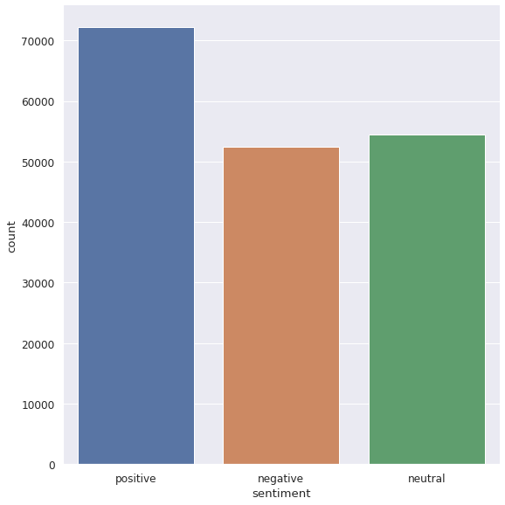
Sentiment Analysis

Slide 17

Predictive Model
Notes:
For our predictive model we had to clean the tweets. By defining our own preprocessing function

Slide 18
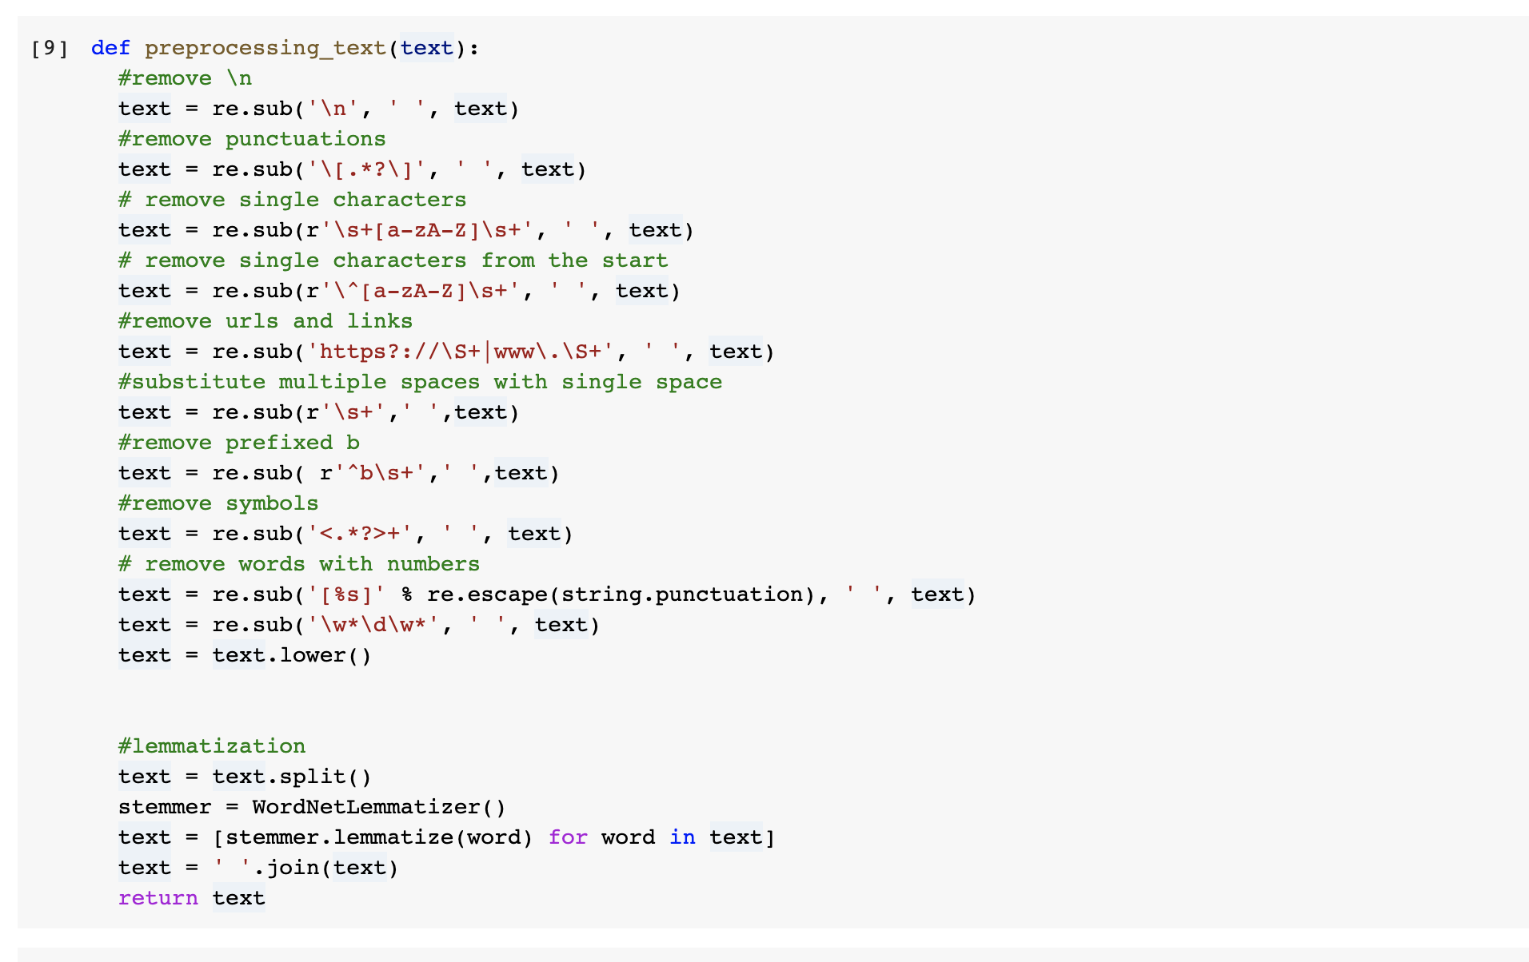
Tweet Preprocessing
Notes:
Explain lemmatization

Slide 19
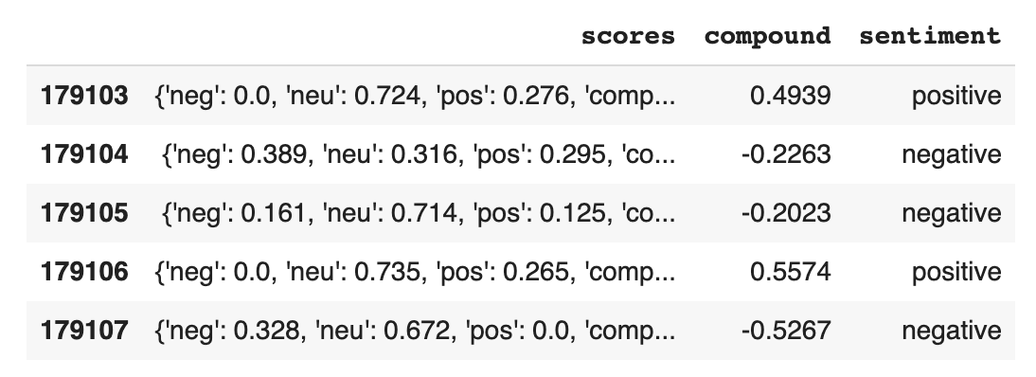

Assigning Sentiment
Vader(Valence Aware Dictionary and Sentiment Reasoner) is a pre-trained model that uses rule based values tuned to sentiments from social media.
Output: {'neg': 0.0, 'neu': 0.436, 'pos': 0.564, 'compound': 0.3802}
The compound value reflects the overall sentiment ranging from -1 being very negative and +1 being very positive.
Here we have divided sentiment into positive, negative and neutral.
Notes:
VADER (Valence Aware Dictionary and sEntiment Reasoner) is a lexicon and rule-based sentiment analysis tool that is specifically attuned to sentiments expressed in social media

Slide 20
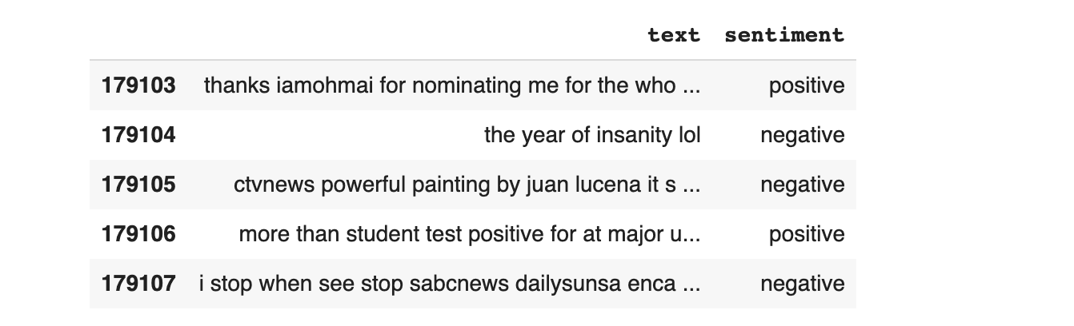
New Dataframe
Notes:
We create a new dataframe with only tweets and sentiment. With tweets as our only feature and sentiment as our target. Then we split the data into training and testing. And we have used a count vectorizer on the training and testing text values. CountVectorizer tokenizes(tokenization means breaking down a sentence or paragraph or any text into words) the text along with performing very basic preprocessing like removing the punctuation marks, converting all the words to lowercase,

Slide 21
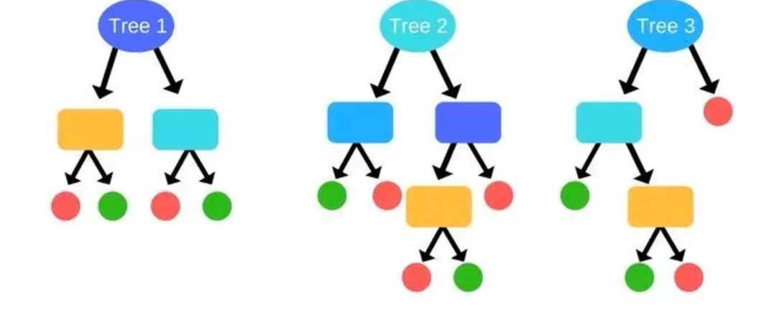
Machine Learning Models
Here we have 3 sentiments to consider (Positive, negative and neutral), so that makes this problem a multiclass classification problem.
We have used the following models:
Multinomial Naive Bayes
Random Forest
Stochastic Gradient Descent Classifier

Slide 22
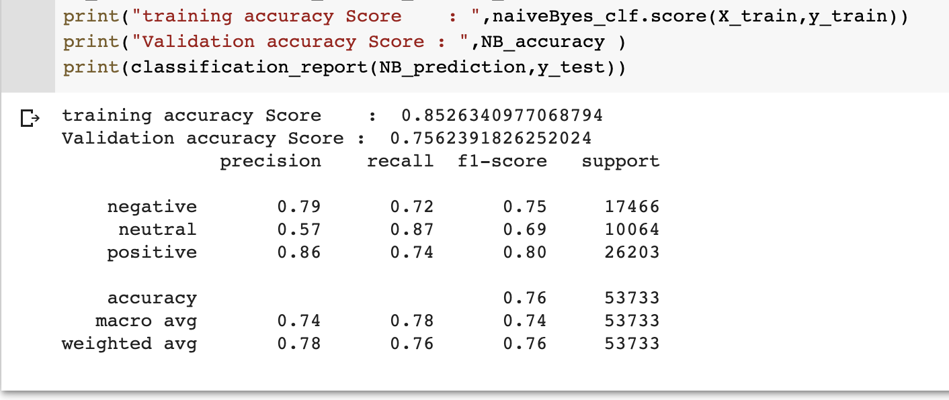
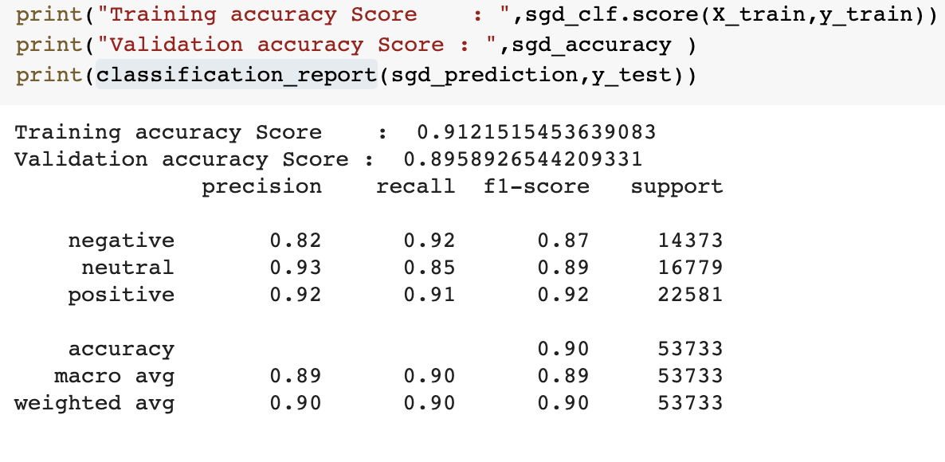
Classification scores
Multinomial Naive Bayes
Stochastic Gradient Descent-SGD Classifier

Slide 23
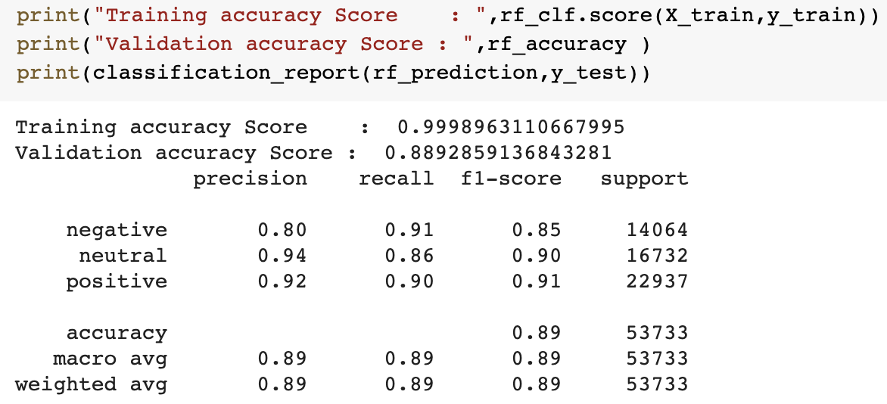
Classification scores continued
Random Forest

Slide 24
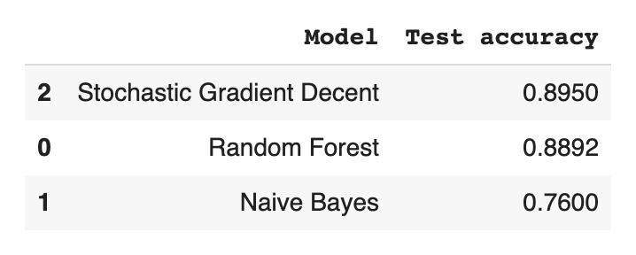
Model Comparison for Multiclass Classification

Slide 25
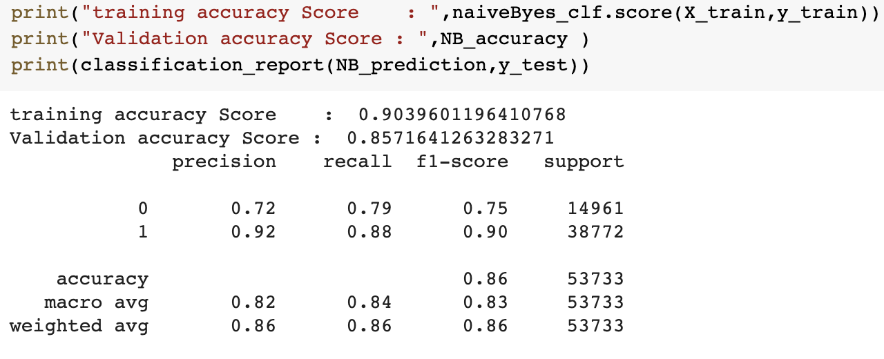
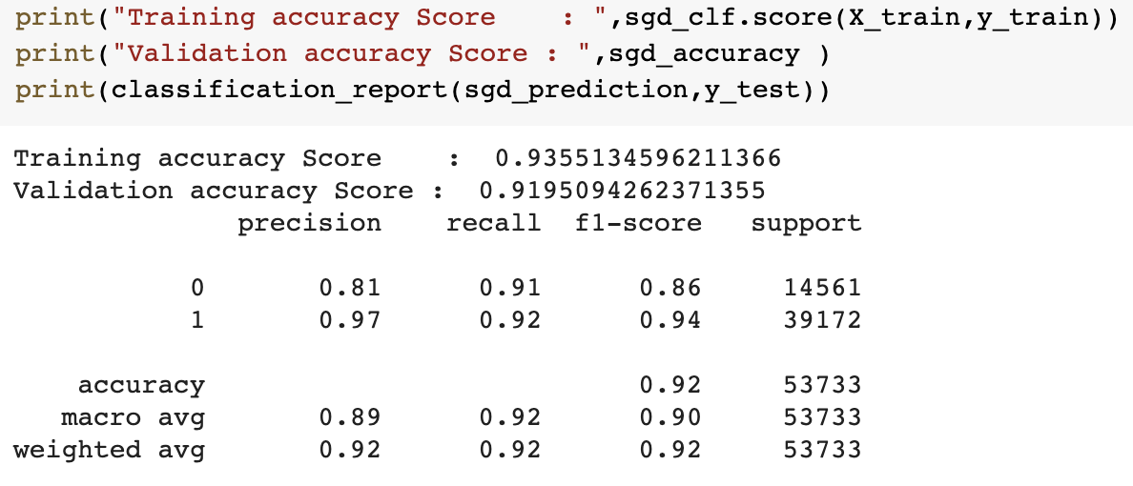
Classification Scores for Binary Classification
Multinomial Naive Bayes
Stochastic Gradient Descent-SGD Classifier

Slide 26
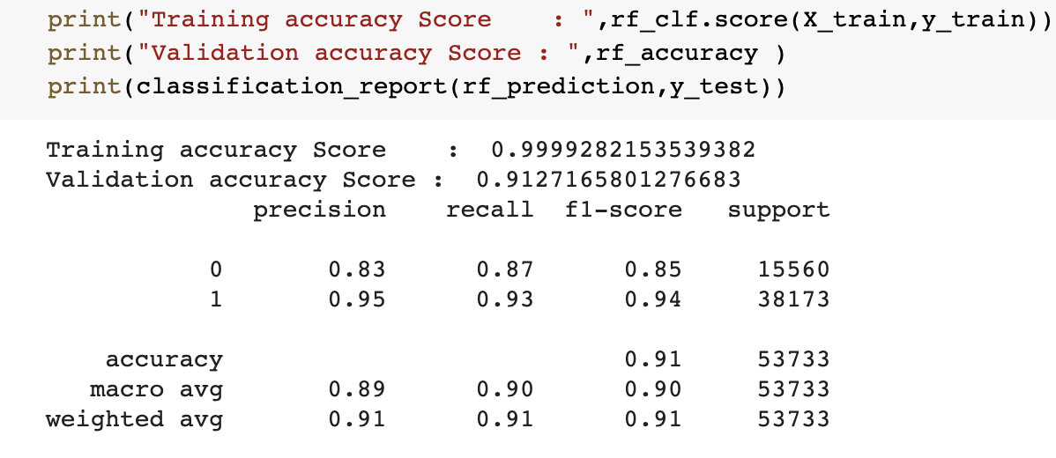
Classification scores Continued
Random Forest

Slide 27
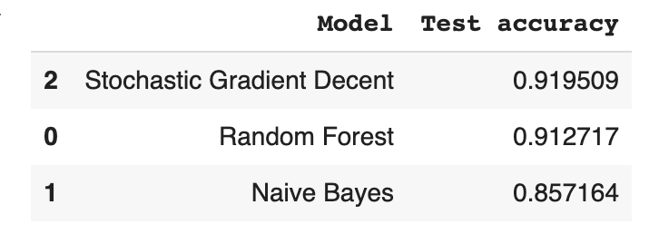
Model Comparison for binary Classification

Slide 28
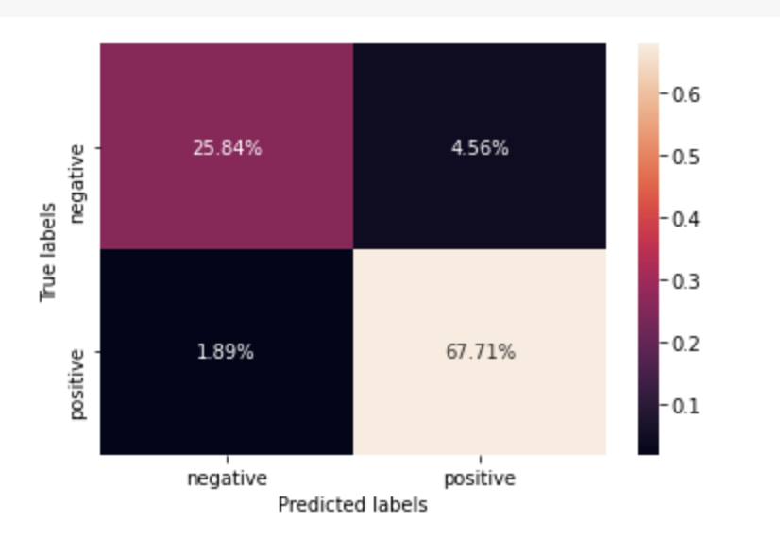
Confusion matrix

Slide 29
References
https://www.kaggle.com/gpreda/covid19-tweets/code

