Slide 1
IQR
Validation Platform · Controls & Compliance Hub
INTERFACE DESIGNS
Validating every SOX 404 control — with a citation for every claim
The reviewer's web app: runs dashboard, validation console, exception review, plan approval, the audit-ready pack, and the evidence graph.
01 Runs
02 Console
03 Exceptions
04 Plan
05 Pack
06 Evidence
Notes:
IQR Validation Platform — the human surface for the agentic SOX 404 validation system. Six screens, one connected web app.

Slide 2
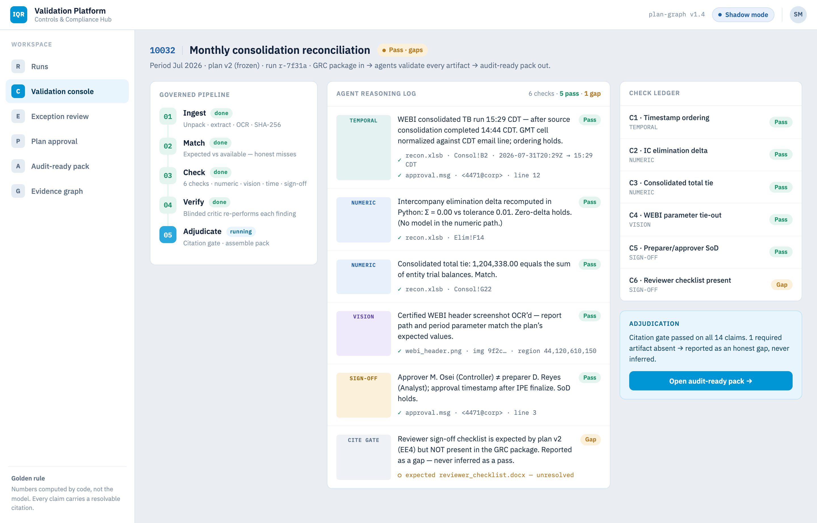
IQR
SCREEN 01 · RUNS DASHBOARD
VALIDATION PLATFORM
One row per control-period, one verdict at a glance
Filter by control, verdict or period; open any run straight into the validation console.
Notes:
The landing surface — one row per control-period with its verdict, citation count, gaps and rollout mode. Filter by control, verdict or period; click a row to open the console.

Slide 3

IQR
SCREEN 02 · VALIDATION CONSOLE
VALIDATION PLATFORM
Evidence in, agents reason, audit-ready pack out
The governed pipeline, a cited reasoning log, and the per-check ledger — control 10032, Jul 2026.
Notes:
The hero screen — one control end to end. Left: the governed pipeline. Center: a cited agent reasoning log, including the GMT/CDT timestamp check and the honest checklist gap. Right: the per-check ledger.

Slide 4
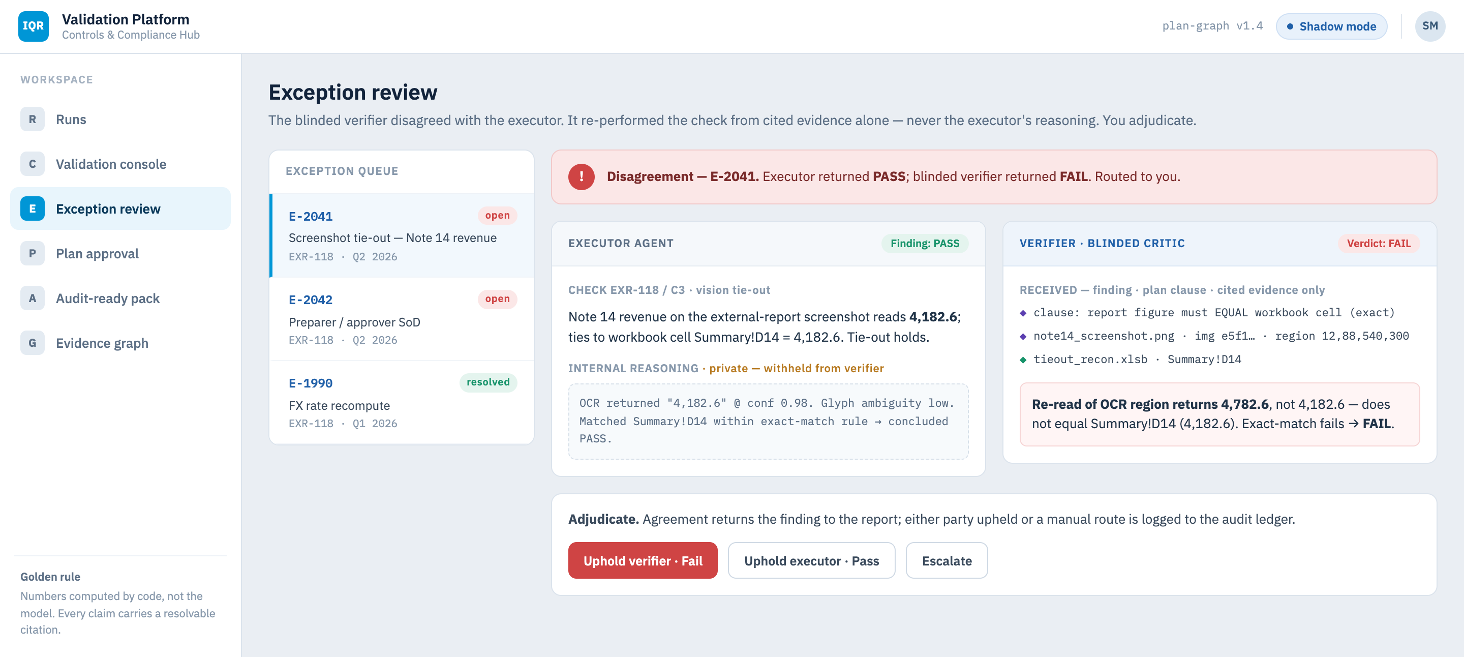
IQR
SCREEN 03 · EXCEPTION REVIEW
VALIDATION PLATFORM
The critic never sees the reasoning — only the evidence
Executor PASS vs blinded verifier FAIL on a screenshot tie-out. You adjudicate; the decision is logged to the audit ledger.
Notes:
Executor returned PASS; the blinded verifier — which sees only the finding, plan clause and cited evidence, never the reasoning — returned FAIL on a screenshot tie-out. The reviewer adjudicates and every decision is logged.

Slide 5

IQR
SCREEN 04 · PLAN APPROVAL
VALIDATION PLATFORM
The SME freezes the plan before runtime touches it
Expected-evidence register, ordered checks, scope exclusions and the SoD rule — reviewed, approved, versioned. Rebate control RBT-204.
Notes:
Design-time. The SME reviews the Validation Plan the compiler drafted — expected-evidence register, ordered checks with types and tolerances, scope exclusions and the SoD sign-off rule — and freezes it at a version. Runtime never re-decides which checks to run.

Slide 6
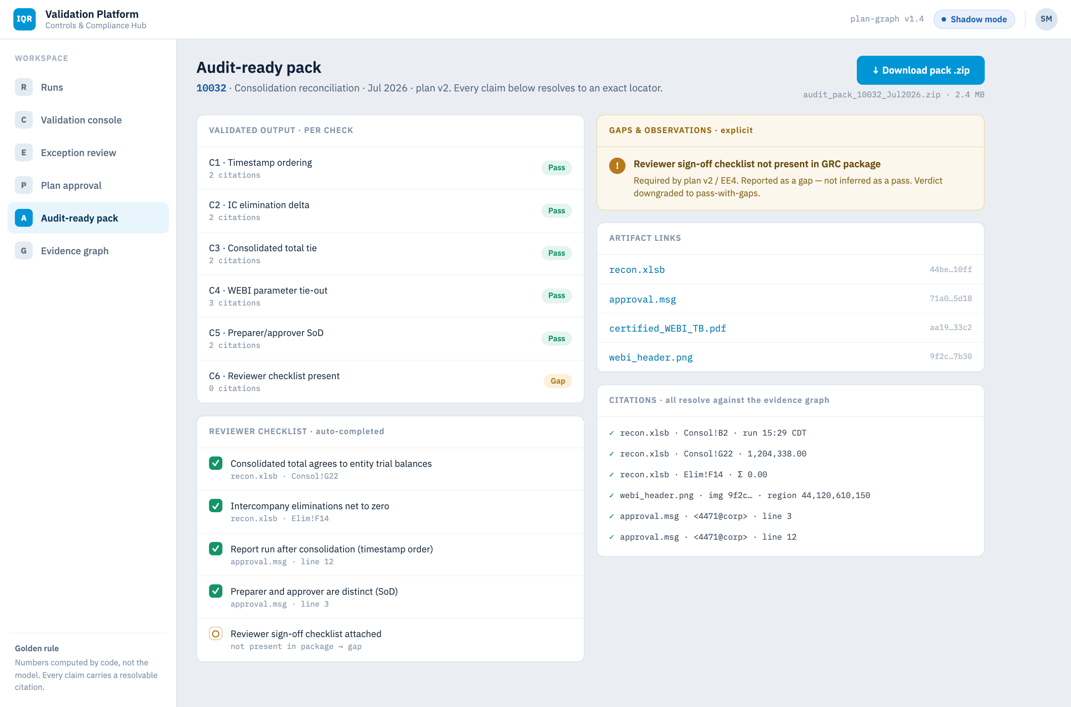
IQR
SCREEN 05 · AUDIT-READY PACK
VALIDATION PLATFORM
Every claim resolves to an exact locator
Per-check output, auto-completed checklist, an explicit gaps register, artifact links and citations — one downloadable .zip.
Notes:
The downloadable output. Per-check validated result, an auto-completed reviewer checklist, an explicit gaps-and-observations register, artifact links, and a citation list where every locator resolves against the evidence graph — assembled into one .zip.

Slide 7
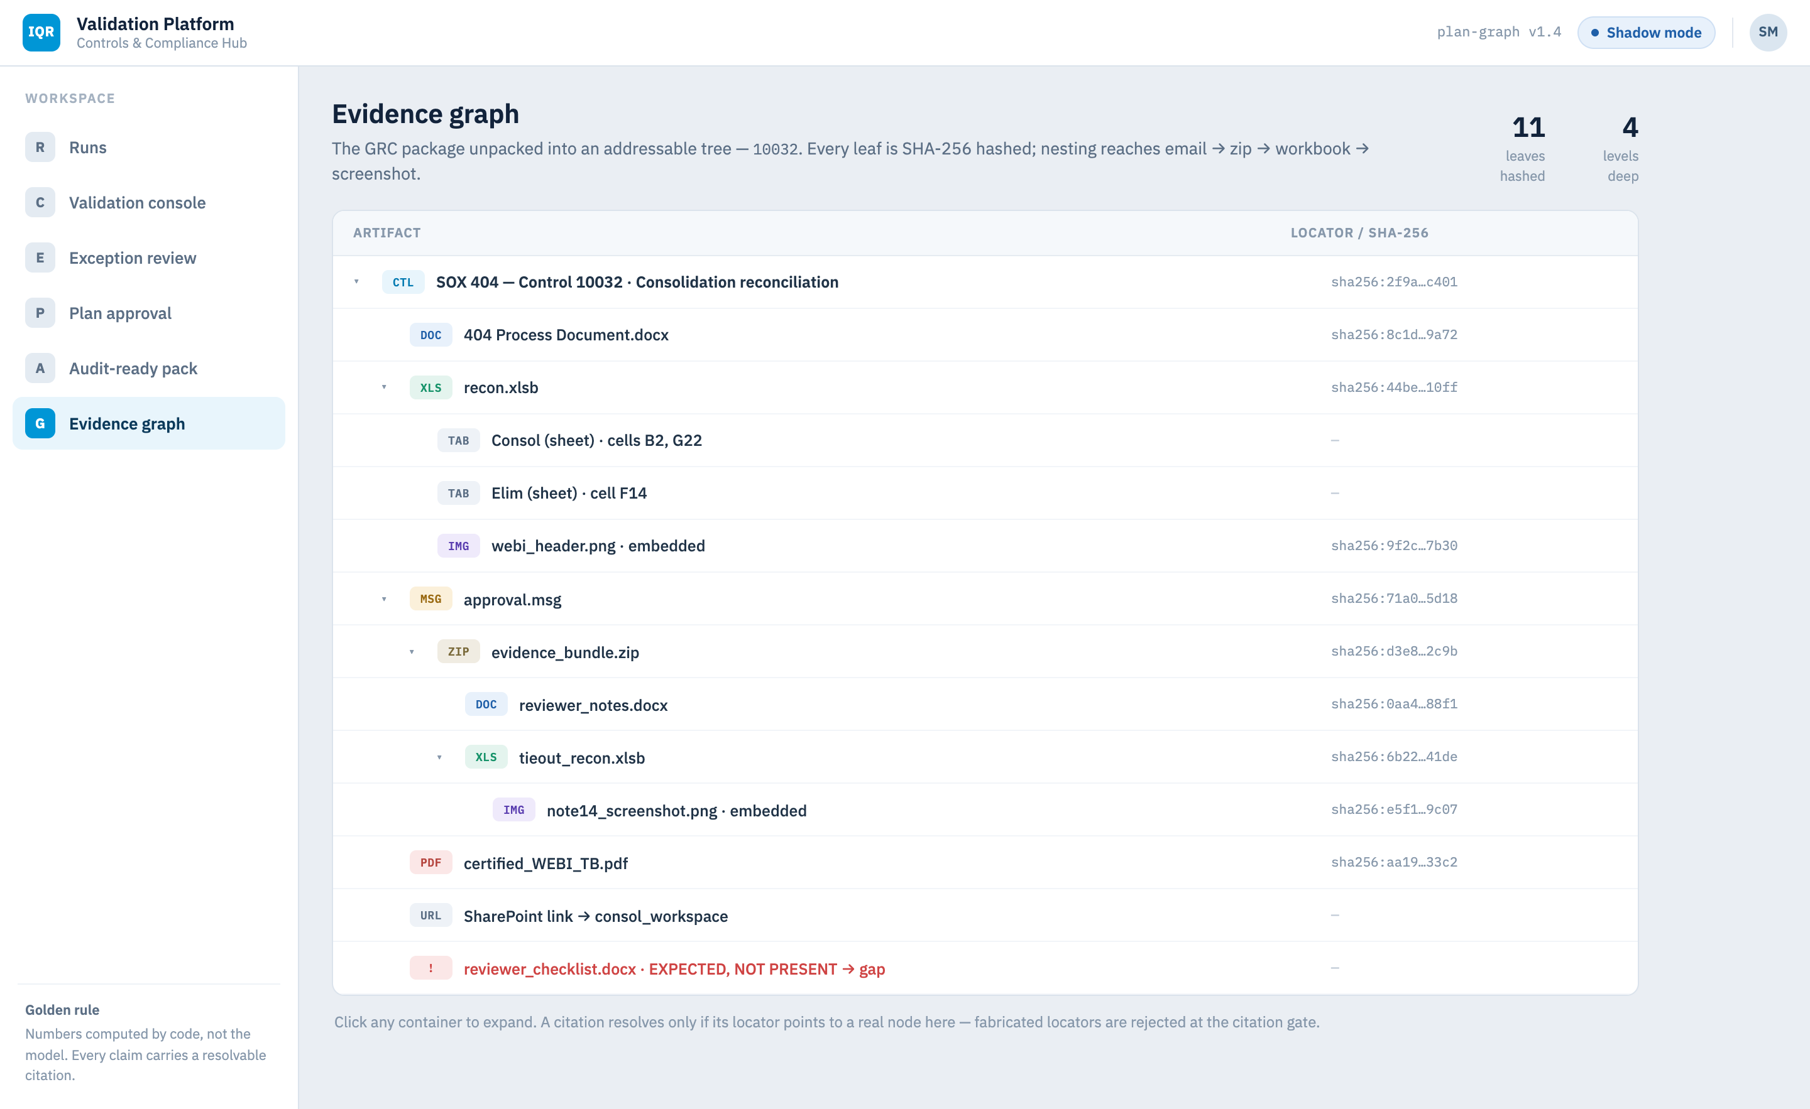
IQR
SCREEN 06 · EVIDENCE GRAPH
VALIDATION PLATFORM
The GRC package, unpacked and addressable
A SHA-256-hashed tree reaching email → zip → workbook → screenshot, four levels deep.
Notes:
The GRC package unpacked into an addressable tree. Every leaf is SHA-256 hashed; nesting reaches email to zip to workbook to embedded screenshot, four levels deep. A citation resolves only if its locator points to a real node here.

