Slide 1
JAVASCRIPT
CHINMAY

Slide 2
JS History
Beginnings at Netscape (Mocha>LiveScript>JavaScript)
“Java is to JavaScript what Car is to Carpet.”
Since mid 2000 server-side implementation introduced( Node.js in 2009.)
Adoption by Microsoft (Browser War)
Standardization
Latest Versions
ECMA Script 2016 (Commonly used)
ECMA Script 2017

Slide 3
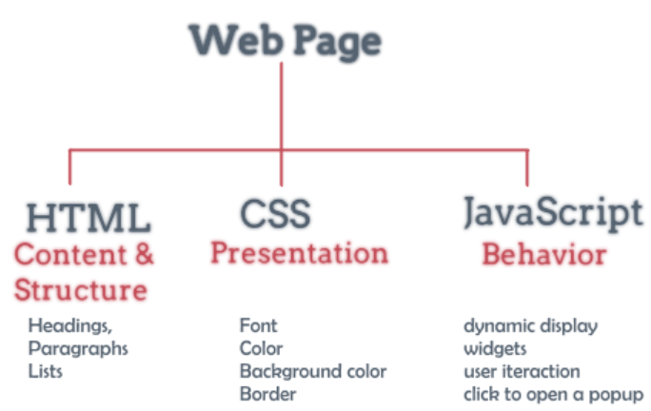
HTML CSS & JS
HTML, or HyperText Markup Language, is used to create the basic structure and content of a webpage.
CSS, or Cascading Style Sheets, is used for the design of a webpage – where everything is placed and how it looks
JavaScript is used to define the interactive elements of a webpage that help to engage users

Slide 4
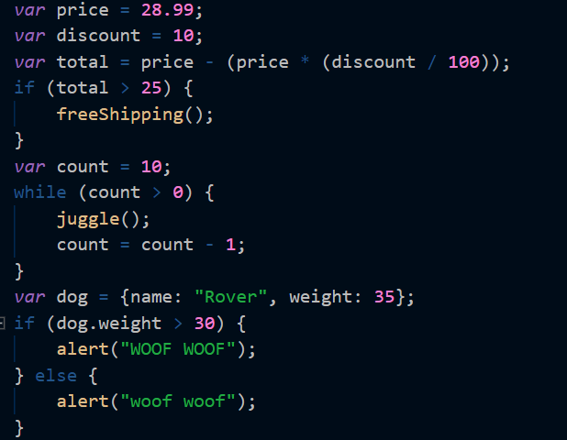
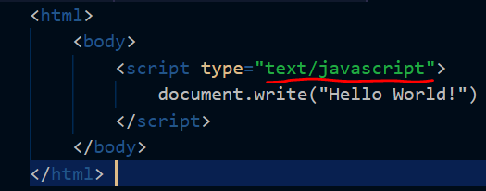
JS Style
How JS Looks ?
How JS embedded in HTML ?

Slide 5
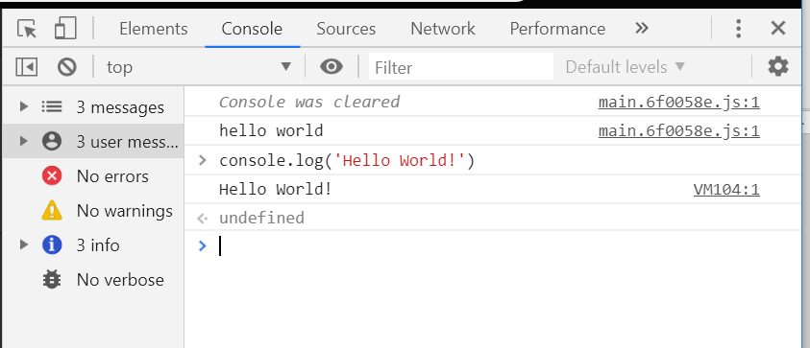
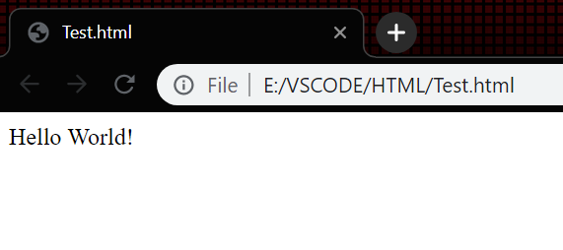
Hello World
Console(Your Browser is a JS Console)
Settings>More Tools>Developer Tools
With HTML Page

Slide 6
JS Data Types
JS supports total SEVEN data types
FOUR primitive data types
Numbers :- 10,123.45 (No Integer & Float)
Strings :- “Hello JS”
Boolean :- true, false
symbol
TWO trivial data types
Null : Points to an non existent object
Undefined : Returns NAN for any arithmetic operation
ONE composite data type
Object

Slide 7
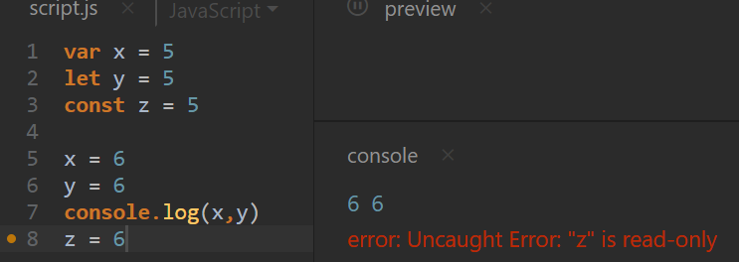
Variable Selection
In JS there three types of variable : var , let & const
var & let allows to change the value later in script
In var & let you can initialise later
‘let’ is scoped

Slide 8
operators
JavaScript supports the following types of operators.
Arithmetic Operators
Comparison Operators (== and ===)
Logical (or Relational) Operators ( && > AND , ||> OR, !>NOT )
Assignment Operators
Conditional (or ternary) Operators

Slide 9
Comparison operator
=== and !== are called strict comparison operator
Two strings are strictly equal when they have the same sequence of characters, same length, and same characters in corresponding positions.
Two numbers are strictly equal when they are numerically equal (have the same number value).
Two Boolean operands are strictly equal if both are true or both are false.
Two objects are strictly equal if they refer to the same Object.
Null and Undefined types are == (but not ===). [I.e. (Null==Undefined) is true but (Null===Undefined) is false]
Demo

Slide 10
Conditional Operator
Truthy & Falsy
let x=1,y;
if(x){
y=x;
}else{
y=0;
}
console.log(y) // Output 1
Short-Circuits Evaluation
let x =1;
let y = x||1;
console.log(y)

Slide 11
Ternary operators
The ternary operator shortens the if/else statement into a single statement
condition ? exprIfTrue : exprIfFalse
let x =1,y;
x ? (y=x,console.log(y)):(y=0,console.log(y));
When using a ternary operator — or any abbreviation — consider who will be reading your code. If less-experienced developers may need to understand your program logic, perhaps the use of the ternary operator should be avoided.

Slide 12
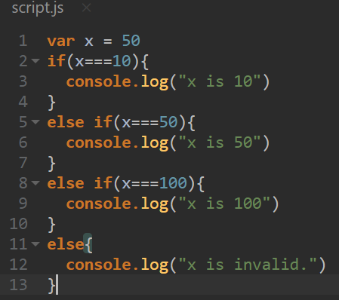
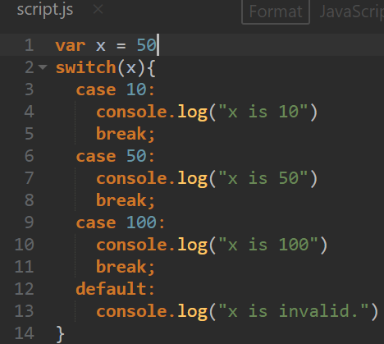
SWITCH Keyword switch case is an alternate method of if-else statement
switch
If-else if- else
The flow will stop when it correct value of x matched otherwise will go till last else statement.
If we don’t put the break then code will run till default.
Notes:
The difference between if and switch is
It can take multiple conditions using or/and operator but switch cant
Nested If is possible although switch can do nesting bt no one use it and more complicated.
3) If usually used for range type operation ex:- if(a>10) && (a<20) but switch used in for specific checks

Slide 13
Function
In JavaScript you can declare a function in FOUR ways
Normal Function function <function name>(){ body}
Function Expression const <name> = function(){ body }
Arrow Function const <name> = () => { body }
Concise Arrow Function const <name> = single parameter => single line body
Basically arrow function method is the advanced version of Function expression and Concise Arrow is the special condition of arrow function where you have a single parameter and one line return statement/function body.

Slide 14
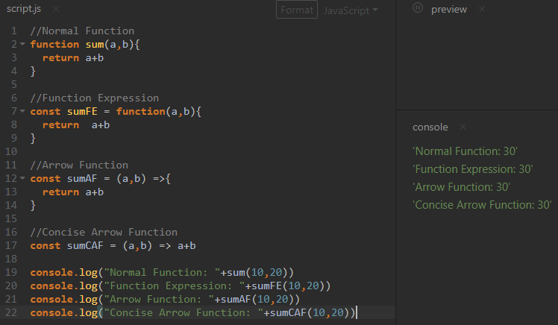

Slide 15
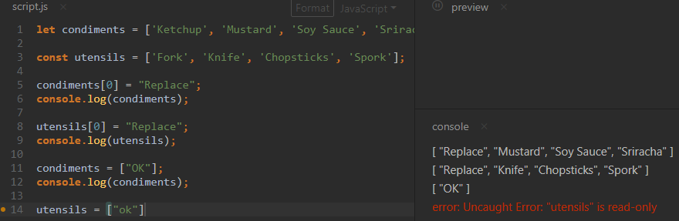
Arrays
Arrays are the JS ways of creating list.
Arrays can store any datatype .
You can declare an array using either const or let but therein const although you can replace the elements of array you can’t create a new array with same name.
Notes:
-No difference between [] and new Array() .Both are array objects.
-The above two do exactly the same. There is no need to use new Array().For simplicity, readability and execution speed, use the first one (the array literal method).

Slide 16
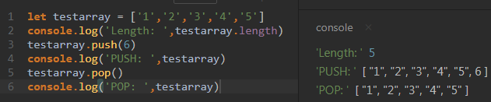
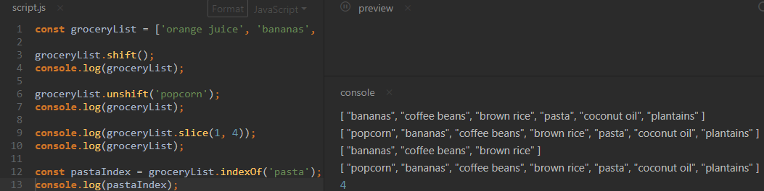
Methods on Array
Arraylength = <arrayname>.length
push = <arrayname>.push()
pop = <arrayname>.pop()
Array Slicing = <arrayname>.slice(begin, end)
Notes:
Basically shift and unshift do changes to virtual array.

Slide 17
Iterators
Iterators are built in JavaScript array methods that helps in iterating over the array element.
forEach() : Returns undefined
Map() : Returns a new array
filter() : Returns a new array
All above methods always takes a callback function as an argument.
P.S :- callback function is a function which is passed as an argument to another function.

Slide 18
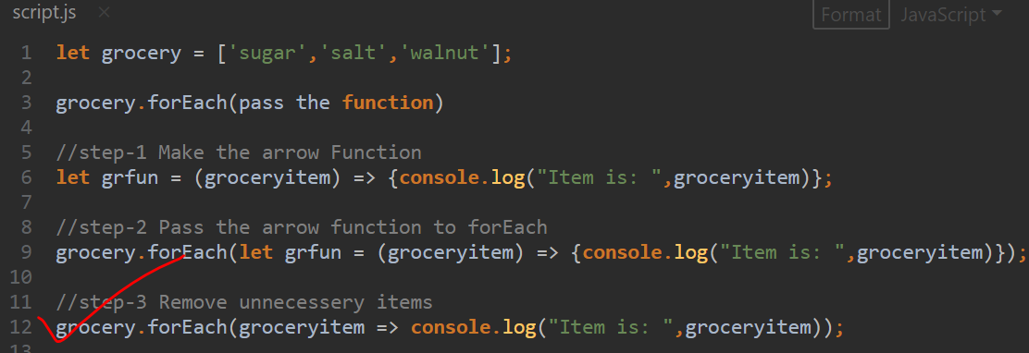
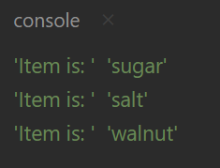
forEach

Slide 19
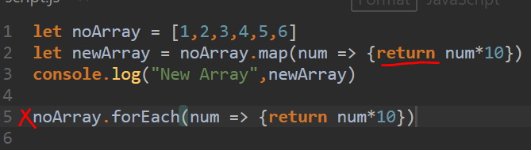
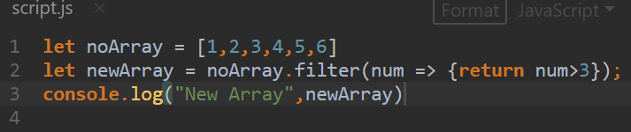


.map & .filter
Map always use return statement
Returns a new array only if given condition met for each element.
Notes:
Replace “filter” with “map” and see the difference in return array content

Slide 20
Objects
There are 7 fundamental data types in JS and Object is one type.
JavaScript objects are containers storing related data and functionality, but that deceptively simple task is extremely powerful in practice.
Object Literal:-
let <objectname> = { };
ex:- let spaceship = { color : ”Silver”, “fuel type” : “diesel”};
Its holds key-pair. If any key does not hold any special character we can declare them without any quotation mark like color we did in above.

Slide 21

Object Properties
There are two ways to access an object properties
Dot( . ) operator :- spaceship.color
Bracket( [ ] ) operator :- spaceship[“color”]
Changing/Assigning Object Property
Only accept . Operator for
Notes:
The special character keys cant be accessed via dot operator(x.”item-3”) will throw error

Slide 22
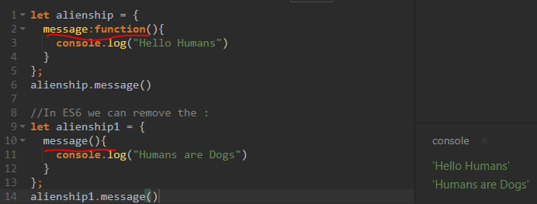
Object Method
In object we can insert the functions like any other data. These functions called the methods of the object.

Slide 23
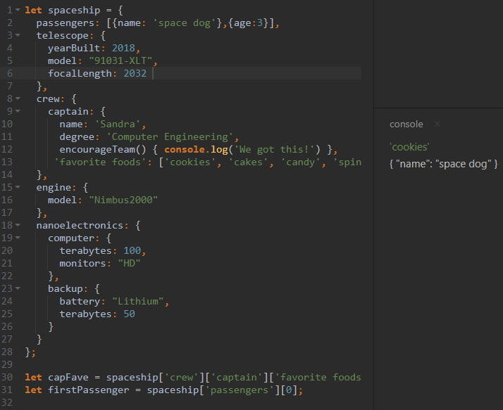
Nested Object
In real world applications you will find many objects are holding another objects as there element. Those are called nested objects. Its basically a JSON data.

Slide 24
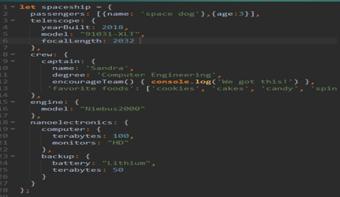
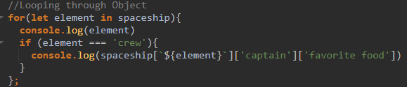
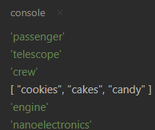
Looping through Objects
In array we loop through the elements using indexes but in case of Object we will use for loop
Object key-value pairs are accessed in random order unlike Array.

Slide 25
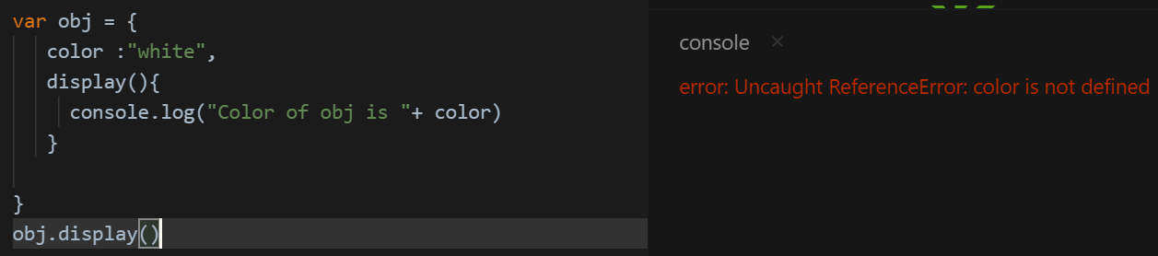
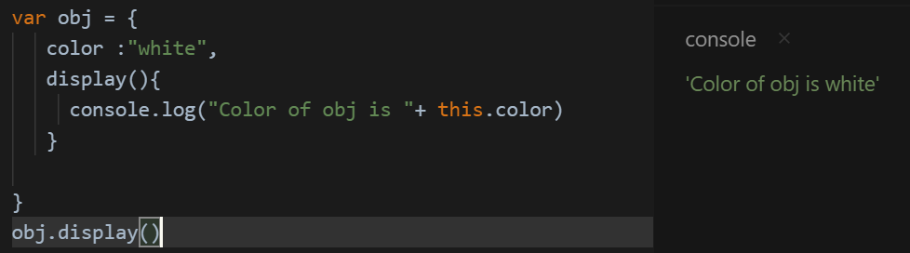
Advance Object
The this keyword :- Always points to calling object
Notes:
--“this” always points to the current object.
--Never use this keyword while using the arrow function. It will throw error because global error because arrow function already have an inbuilt “this” which points to some global space object and our this points to colour ,when we use this arrow it tries to search colour in global object which doesn’t have the colour properties, hence it will throw error.

Slide 26
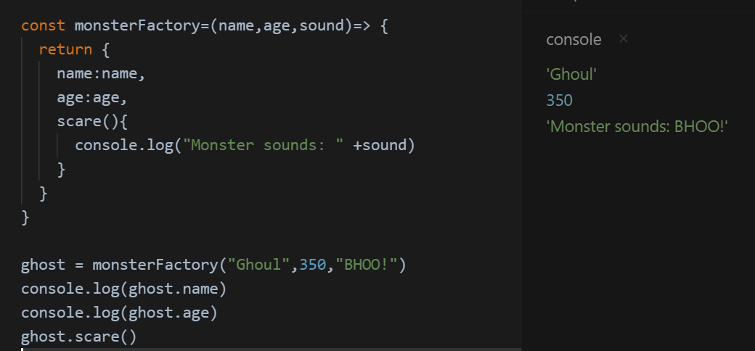
Factory Function
Factory Function provides a template to create multiple objects .

Slide 27
DOM (Document Object Model)
What is DOM ?
“The W3C Document Object Model (DOM) is a platform and language-neutral interface that allows programs and scripts to dynamically access and update the content, structure, and style of a document."
W3C DOM standards separated into 3 parts
Core DOM: - Standard model for all document type
XML DOM: - Standard model for XML document type
HTML DOM: - Standard model for HTML document type
Notes:
DOM is a World Wide Web Consortium standard for accessing documents.
When a webpage is loaded, the browser creates a DOM of that page

Slide 28
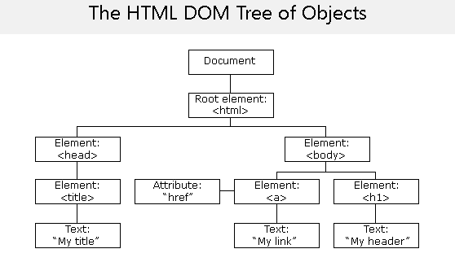
JavaScript HTML DOM
The HTML DOM is a standard for how to get, change, add, or delete HTML elements.
The HTML DOM model is constructed as a tree of Objects
using this DOM, JavaScript gets all the power it needs to create the dynamic webpage.
Notes:
By using this DOM, JavaScript gets all the power it needs to create the dynamic webpage.
JavaScript can change all the HTML elements in the page
JavaScript can change all the HTML attributes in the page
JavaScript can change all the CSS styles in the page
JavaScript can remove existing HTML elements and attributes
JavaScript can add new HTML elements and attributes
JavaScript can react to all existing HTML events in the page
JavaScript can create new HTML events in the page

Slide 29
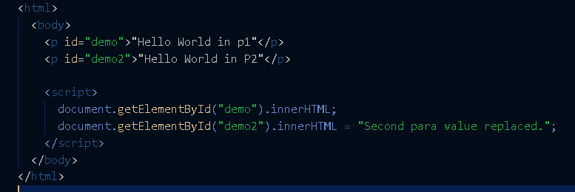

HTML DOM Methods & Properties
Methods: - Actions performed on HTML element
Properties: - Values you can set or get from HTML element
Most common HTML DOM method & Property you will come across is getElementById() and innerHTML

Slide 30
Node.JS
It’s a server side platform to run JS code.
Its designed on top of the Chrome browser’s JS engine V8.
It was developed by Ryan Dahl in 2009 & its latest version is 10.16.3
The platform written in C,C++ and JavaScript
Node.js uses an event driven non-blocking I/O model
It’s light weight and efficient .Perfect for the data intensive real time applications like chatroom.

Slide 31
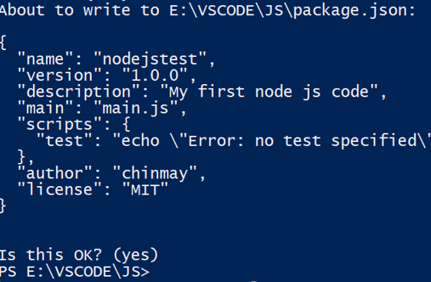
Install & Setup
Node is an open source platform hence we can download and install it free.
Download link:- https://nodejs.org/en/
Node run with npm (Node Package Manager)
npm is bundled with Node.js installation file so no need to install it separately.
You have to initialize it from command/terminal for using the Node
Command : npm init

Slide 32
Module & Exports
Usually developers segregate the functionality of the application in separate JS files called events and node look them as modules.
We call those events from the main.js file which is called entry/master file.
We call them custom modules but node also have a lot of inbuilt modules like http, path,fs..etc

Slide 33
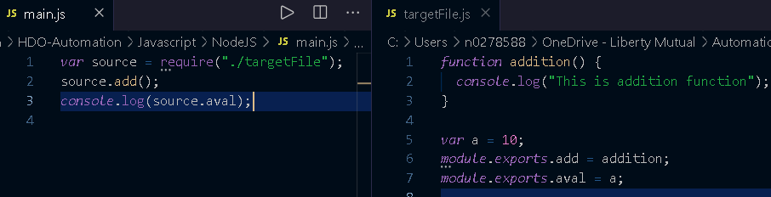
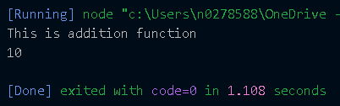
Use of require, module & Exports

Slide 34
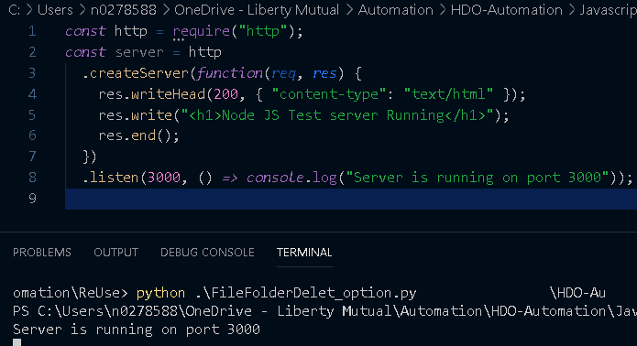
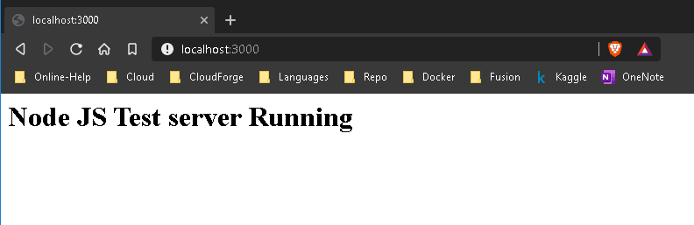
Creating a Server

Slide 35
JS Library & Frameworks
Vanilla JS :- JS in its pure form called vanilla JS.
jQuery :- jQuery is a JavaScript library designed to simplify HTML DOM tree traversal and manipulation.
React :- React is a JavaScript library for building user interfaces.
Angular JS :- AngularJS is a JavaScript-based open-source front-end web framework.
Vue JS :- Vue.js is an open-source JavaScript framework for building user interfaces and single-page applications.
Bootstarp :- Bootstrap is a open-source CSS framework directed at responsive, mobile-first front-end web development. It contains CSS- and (optionally) JavaScript-based design templates.

Slide 36
Popular Node.JS Apps
Twitter Lite :- Designed for slow Internet connection
GoDaddy :- 4x performance improvement after change in node based micro service architecture.
Netflix :- Node application in JS payload & server/client rendering reduced load time 70% .
Uber :- Node.js and Python are main software stack of Uber. Company’s dispatch system and API interface designed in node.
Linkedln :- Node.js is the principal technology used to support the mobile app backend .20x increase in performance.

Slide 37
First do it, Then do it right, Then do it better. THANK YOU

