Slide 1
GEMMA 4 GOOD HACKATHON
SignalPack
AI emergency alerts and Crisis Packets powered by Gemma 4.
TRUSTED ALERTS
STRUCTURED ACTION
HUMAN REVIEW
pixek.xyz/signalpack
SignalPack / Gemma 4 Good Hackathon / 01

Slide 2
THE PROBLEM
The first report is usually messy.
"Water entered the ground floor. Two elderly people are inside. Exit may be blocked."
Emergency reporting assumes calm users, complete forms, and stable conditions. Real moments are partial, rushed, and high-pressure.
FRAGMENTS
People send short, emotional pieces of context.
Raw signal, not a report.
MISSING DETAILS
Risk, location, hazards, and uncertainty are often incomplete.
SHARE PRESSURE
Contacts need a concise report they can act on quickly.
SignalPack / Gemma 4 Good Hackathon / 02

Slide 3
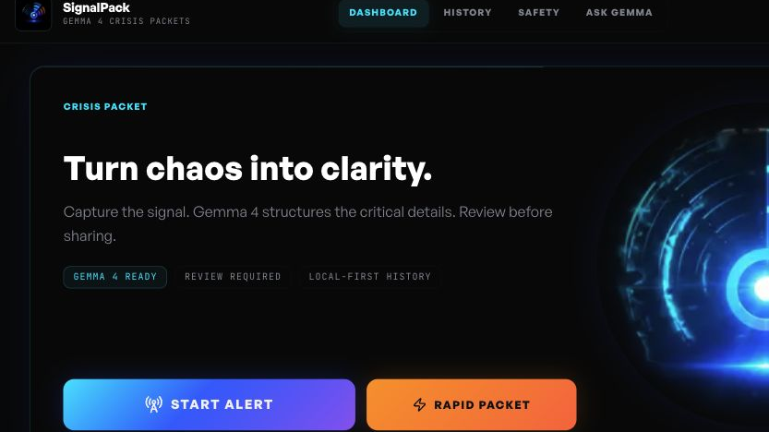
THE PRODUCT
Capture what you can. Gemma 4 structures the rest.
Quick Capture
Gemma 4 Analysis
Critical Details
Crisis Packet
Share / Save
A working path from signal to action, not a static checklist.
SignalPack / Gemma 4 Good Hackathon / 03

Slide 4
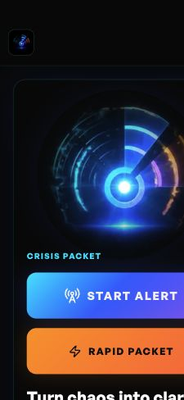

MOBILE-FIRST DEMO
Designed for one-handed capture.
In stress, the UI has to get out of the way.
Start Alert, Rapid Packet, photo, audio, message, and local context are all reachable from the first screen.
SignalPack / Gemma 4 Good Hackathon / 04

Slide 5
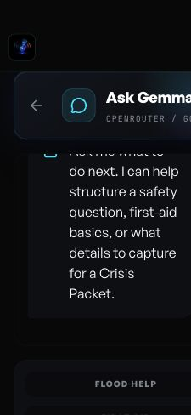
GEMMA 4 LAYER
Gemma 4 turns incomplete signals into structured reasoning.
Incident type
Risk extraction
Detect likely emergency category
People, hazards, uncertainty
Clarification
Traceability
Ask only critical missing details
Provider, model, fallback state
Fallback is marked. It is never presented as model output.
SignalPack / Gemma 4 Good Hackathon / 05

Slide 6
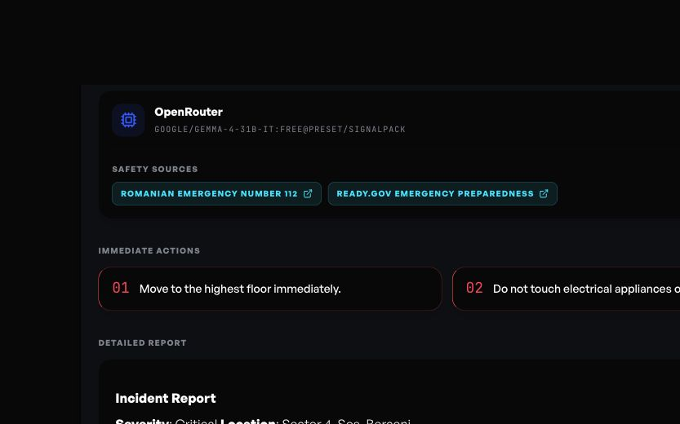
CRISIS PACKET
The output is a usable object, not just an answer.
Severity + overview
Safety sources
Immediate actions
Structured report
WhatsApp / email / native share
PDF / Markdown / JSON export
Review before sharing.
SignalPack / Gemma 4 Good Hackathon / 06

Slide 7
TECHNICAL ARCHITECTURE
API-first demo. Local-first data.
React PWA
Capture Layer
Gemma 4 Provider
Crisis Packet
->
->
->
Mobile-first dashboard and installable browser app
Text, photo, audio, and GPS context
OpenRouter + @preset/signalpack
Schema, AI trace, sources, fallback flag
Share / Export
WhatsApp · email · PDF · Markdown · JSON
Public repo ships without secrets. Hosted demo can inject a restricted key. Users can bring their own OpenRouter key.
SignalPack / Gemma 4 Good Hackathon / 07

Slide 8
IMPACT
Global resilience needs clear, trusted alerts.
SignalPack helps ordinary people communicate clearly during emergencies while keeping review, uncertainty, and safety boundaries visible.
GLOBAL RESILIENCE
SAFETY & TRUST
GEMMA 4
Trusted alerts. Structured action. Powered by Gemma 4.
Demo: pixek.xyz/signalpack · GitHub: github.com/git-clowie/signalpack
SignalPack / Gemma 4 Good Hackathon / 08

