Slide 1
GTLLMZoo
Yunxiang Yan

Slide 2
Why GTLLMZoo
One of the most popular leaderboard, open-llm-leaderboard has been archived by maintainers because of benchmark saturation and contamination problems along with high maintenance costs
Researchers and industry needs a place to faithfully evaluate SOTA LLM models and relying on single source of information might cause bias
GTLLMZoo aims to incorporate those most trusted leaderboards and merge their performance data to provide up-to-date, reliable data for SOTA LLMs by scraping and visualizing tools

Slide 3
Basic Information of GTLLMZoo
Data sources
LiveBench [1]
LMSYS Chatbot Arena [2]
Backend Framework
Scrappers
Selenium
BeautifulSoup
Data Processing
Panda
OpenAI GPT-4o API
Frontend Framework: Gradio

Slide 4
Architecture of GTLLMZoo

Slide 5
GTLLMZoo Resources
Live app available at HuggingFace: https://huggingface.co/spaces/RaccoonOnion/gt-llm-zoo
Source code
Frontend: https://github.com/git-disl/GTLLMZoo
Backend: https://github.com/RaccoonOnion/scrape-llm-leaderboards
Demo Video
https://www.youtube.com/watch?v=bCO5Sl74g1Y

Slide 6
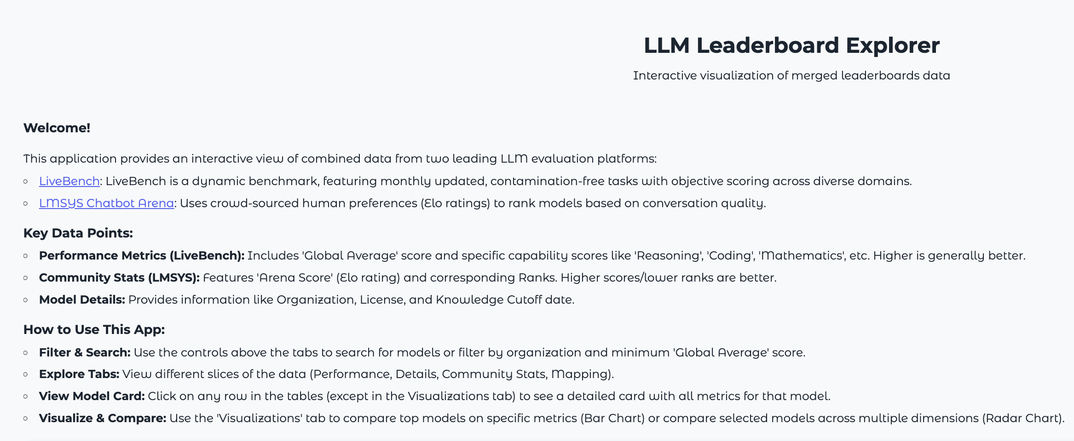
GTLLMZoo Funtionality WalkThrough - 0
Intro Page

Slide 7
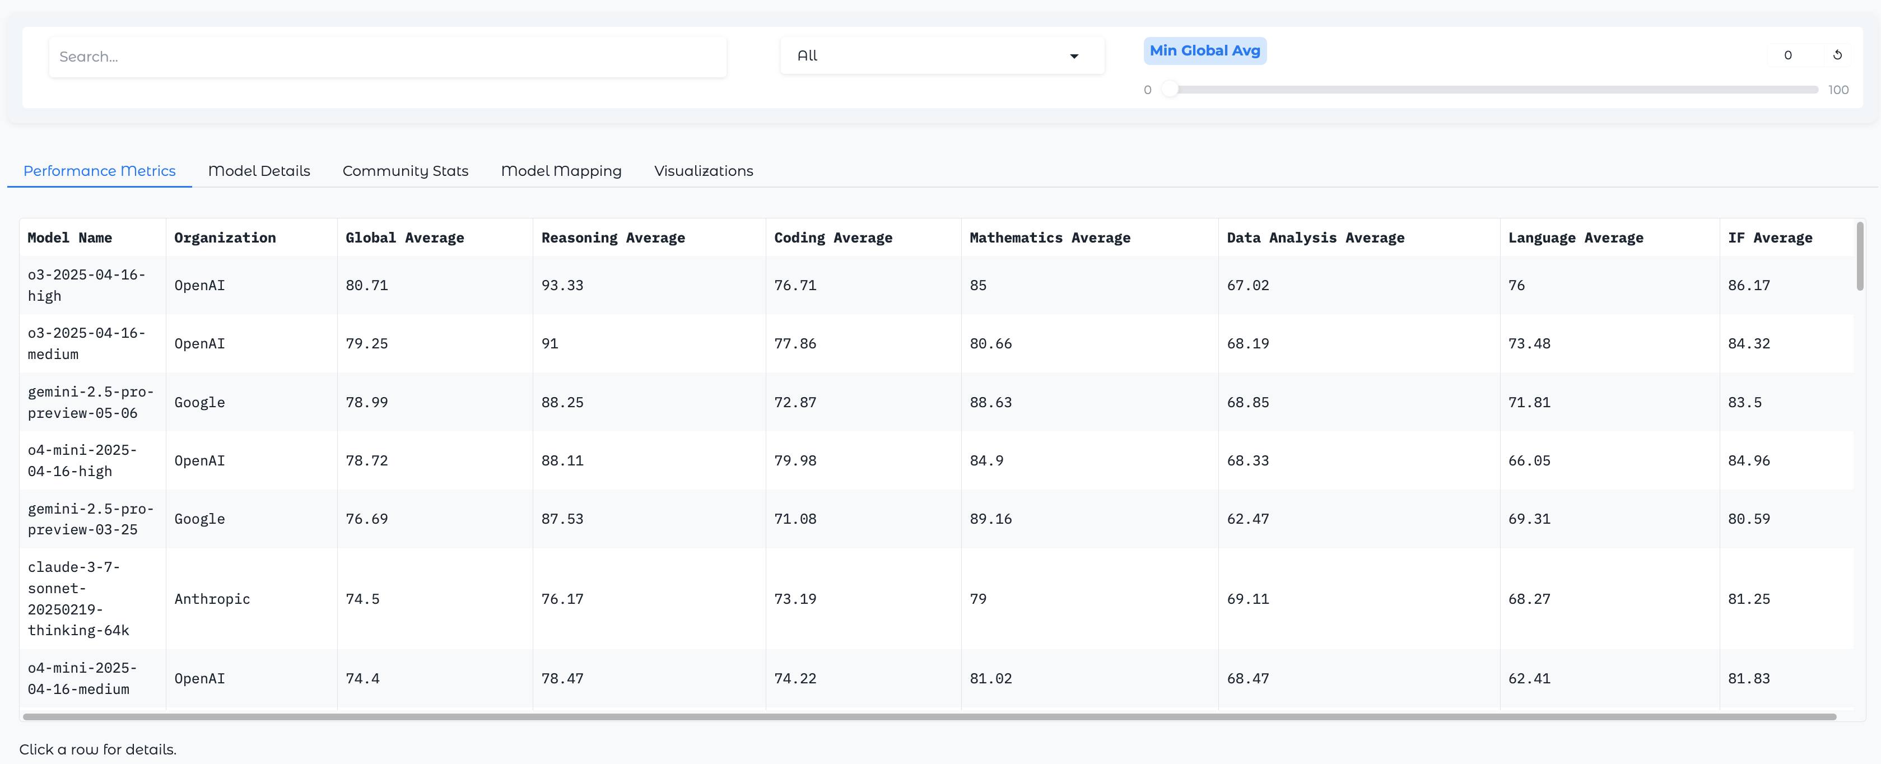
GTLLMZoo Funtionality WalkThrough - 1
Performance Metrics (data from LiveBench)
Filters and search could be applied

Slide 8
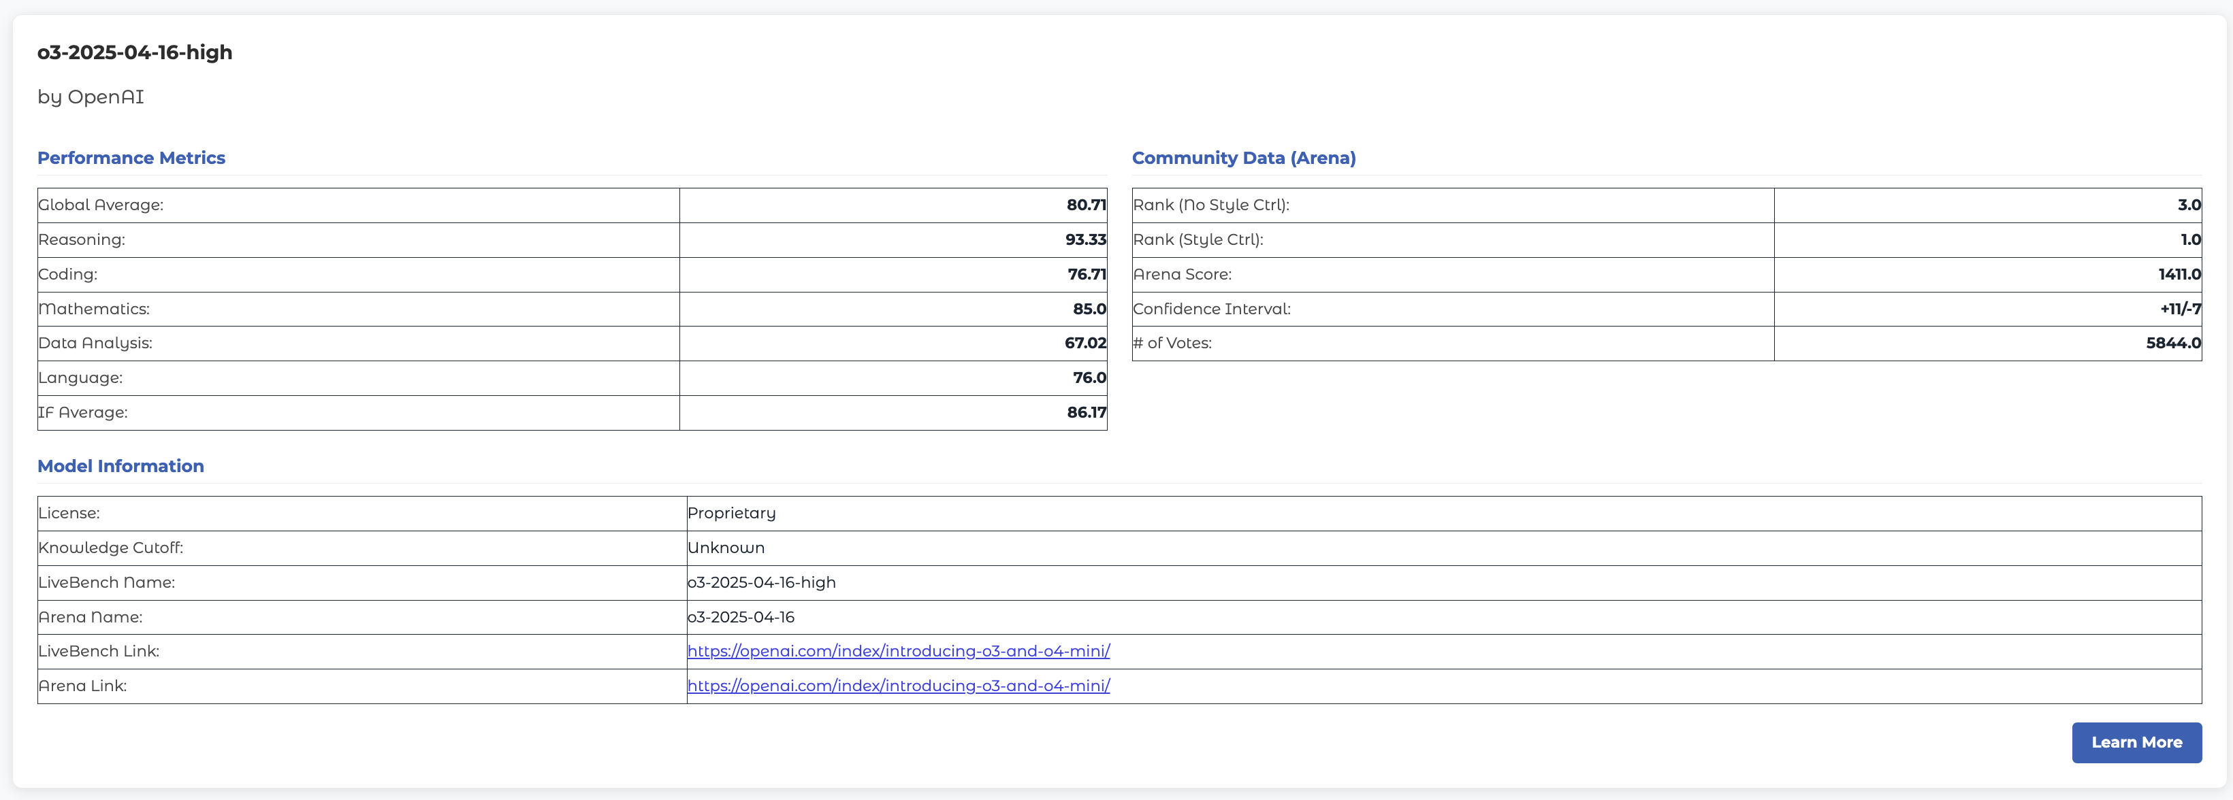
GTLLMZoo Funtionality WalkThrough – 1.1
Click the row will show detailed info of the model in model card

Slide 9
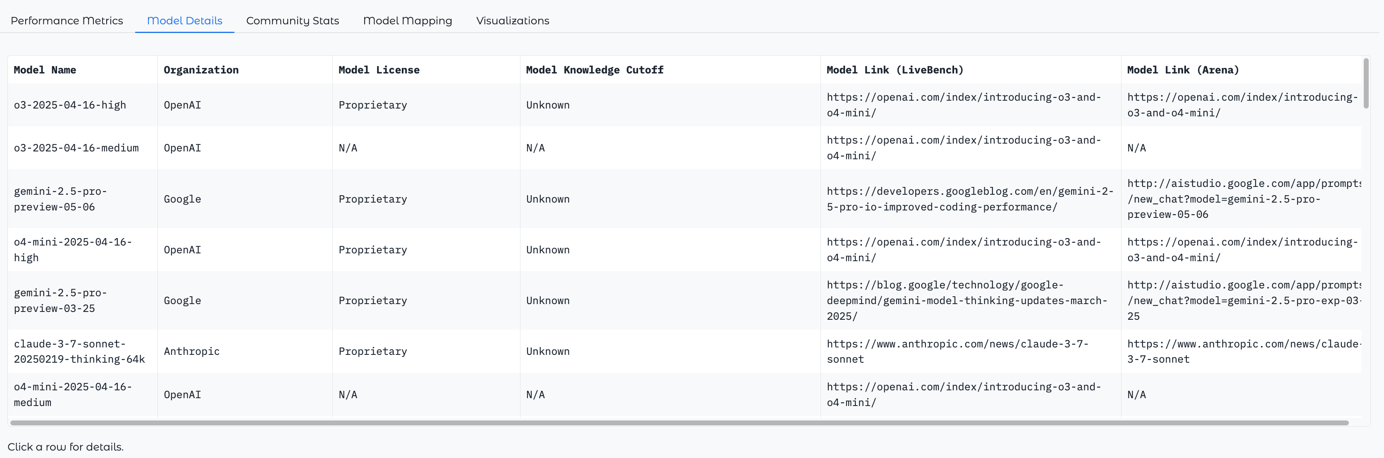
GTLLMZoo Funtionality WalkThrough – 2
Model details tab (Data from LMSYS) contains crucial info such as knowledge cutoff

Slide 10
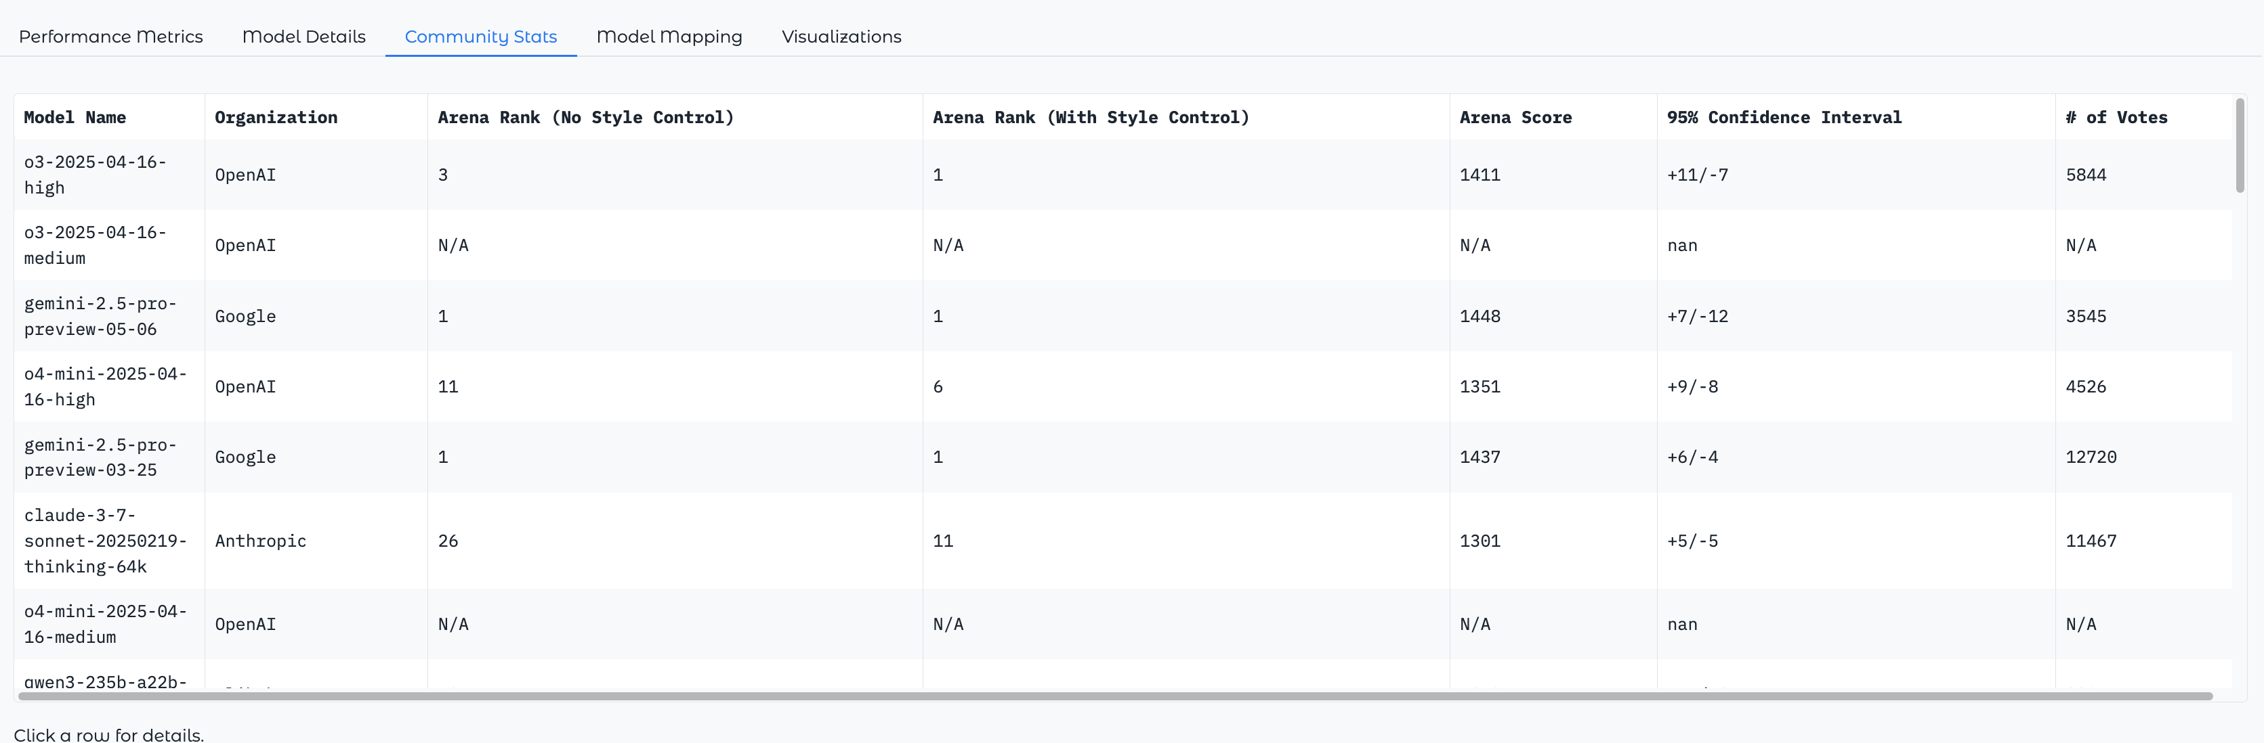
GTLLMZoo Funtionality WalkThrough – 3
Community Stats tab (data from Chatbot Arena)

Slide 11
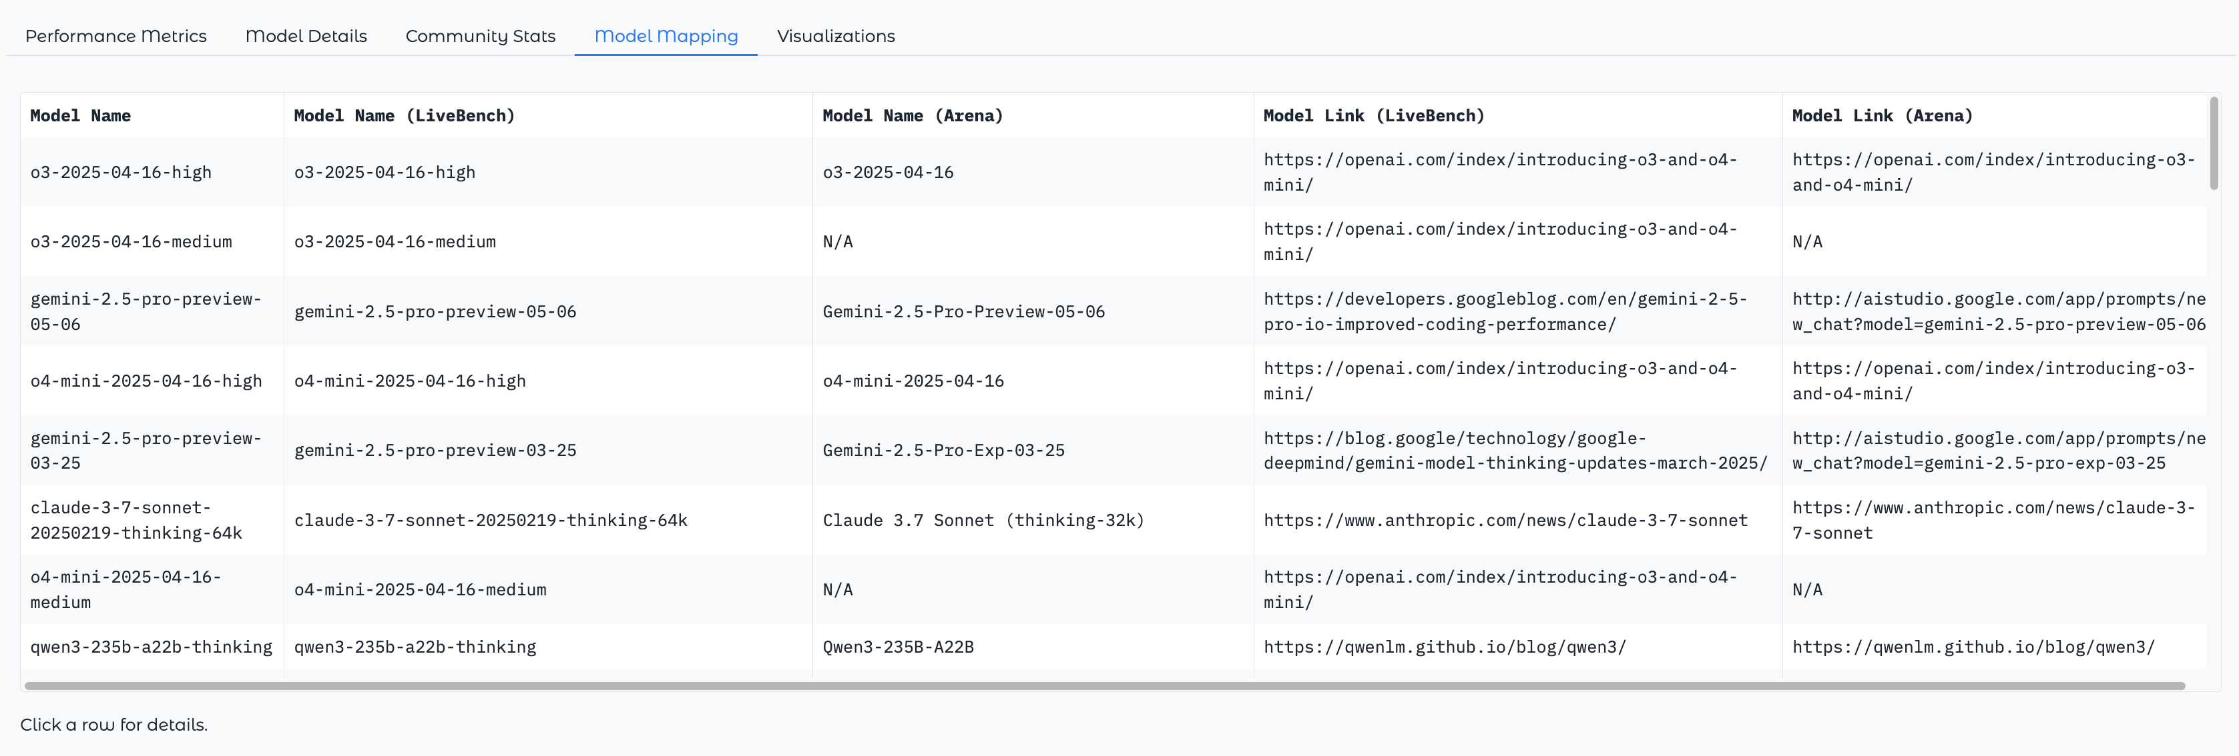
GTLLMZoo Funtionality WalkThrough – 4
Model Mapping tab (for fact check) User can check the model names that get merged by merger

Slide 12
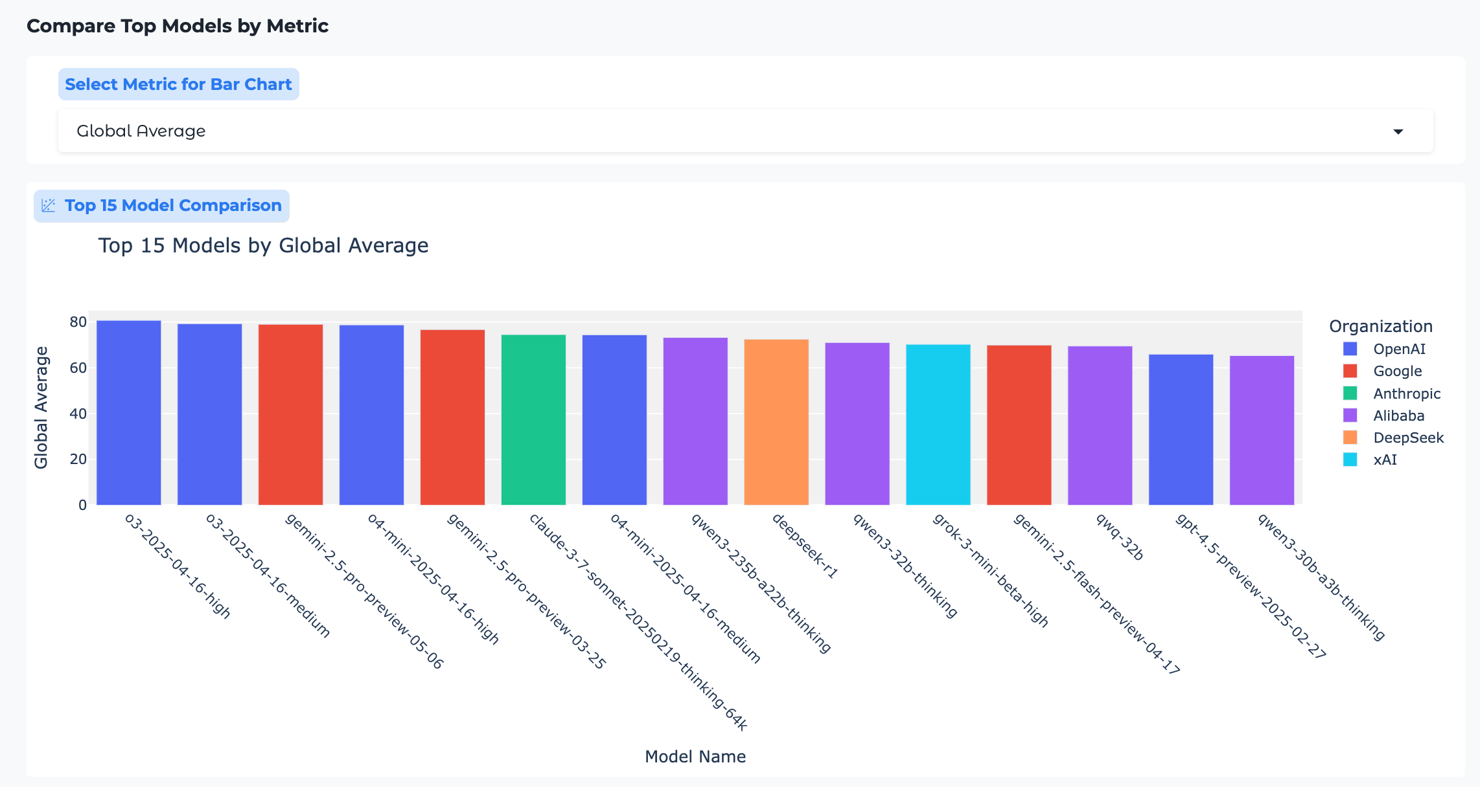
GTLLMZoo Funtionality WalkThrough – 5.1
Visualization Tab (advanced visualization on merged data for deeper insights)
Ranking by any metric and colored by model organization

Slide 13
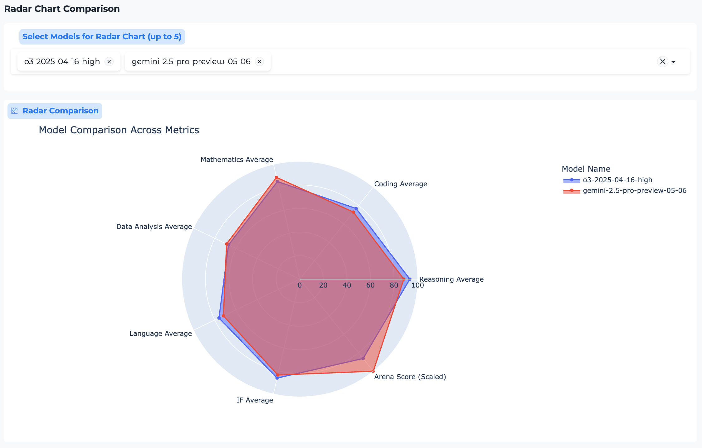
GTLLMZoo Funtionality WalkThrough – 5.2
Radar plot: visualizing model capabilities across 7 dimensions
Support up to 5 models for comparison
Helpful to pick the model that best suits downstream task

Slide 14
More to come
CI/CD deployment
Scrape, merge, publish new leaderboards automatically everyday
Community Building
Right now, two leaderboards are hand-picked from domain experience. A community-based voting for leaderboard changes could be implemented to ensure high quality of the results
More visualizations

Slide 15
References
[1] White, Colin, et al. "Livebench: A challenging, contamination-free llm benchmark." arXiv preprint arXiv:2406.19314 (2024)
[2] Chiang, Wei-Lin, et al. "Chatbot arena: An open platform for evaluating llms by human preference." Forty-first International Conference on Machine Learning. 2024

