Slide 1
IISc – Customer Intelligent Chatbot using LLM+RAG, RASA

Slide 2
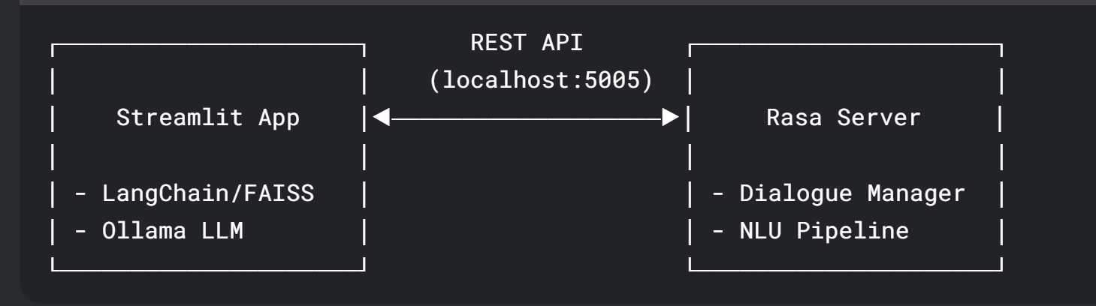
Architecture Overview – Windows GPU Laptop
This architecture provides a clean separation of concerns. It can be enhanced further for production-scale B2C deployment.
Limitations for Scale:
Single-point failures (no redundancy)
Localhost-bound communication
No load balancing
State management limitations
Streamlit's web server isn't optimized for high concurrency
Strengths:
Clear separation between conversational AI (Rasa) and LLM capabilities (Ollama)
Streamlit provides rapid UI prototyping
Isolated environments prevent dependency conflicts

Slide 3
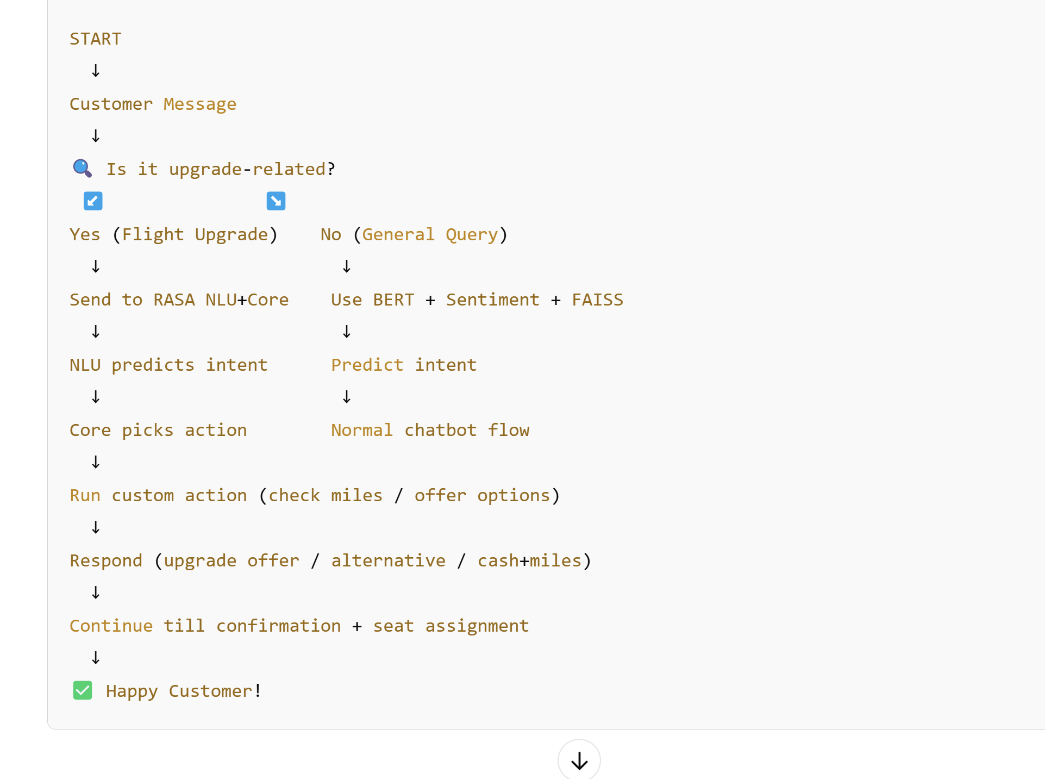
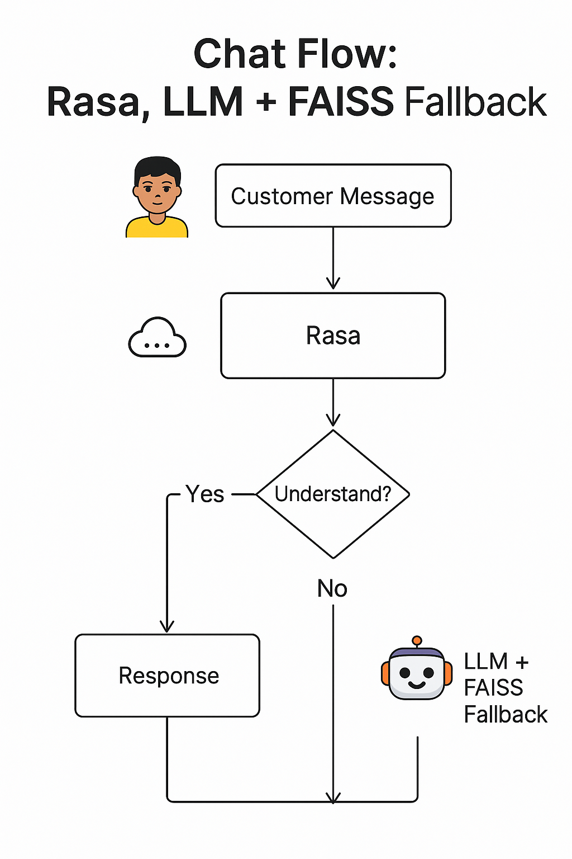
Hybrid Bot –> RASA + LLM/FAISS

Slide 4
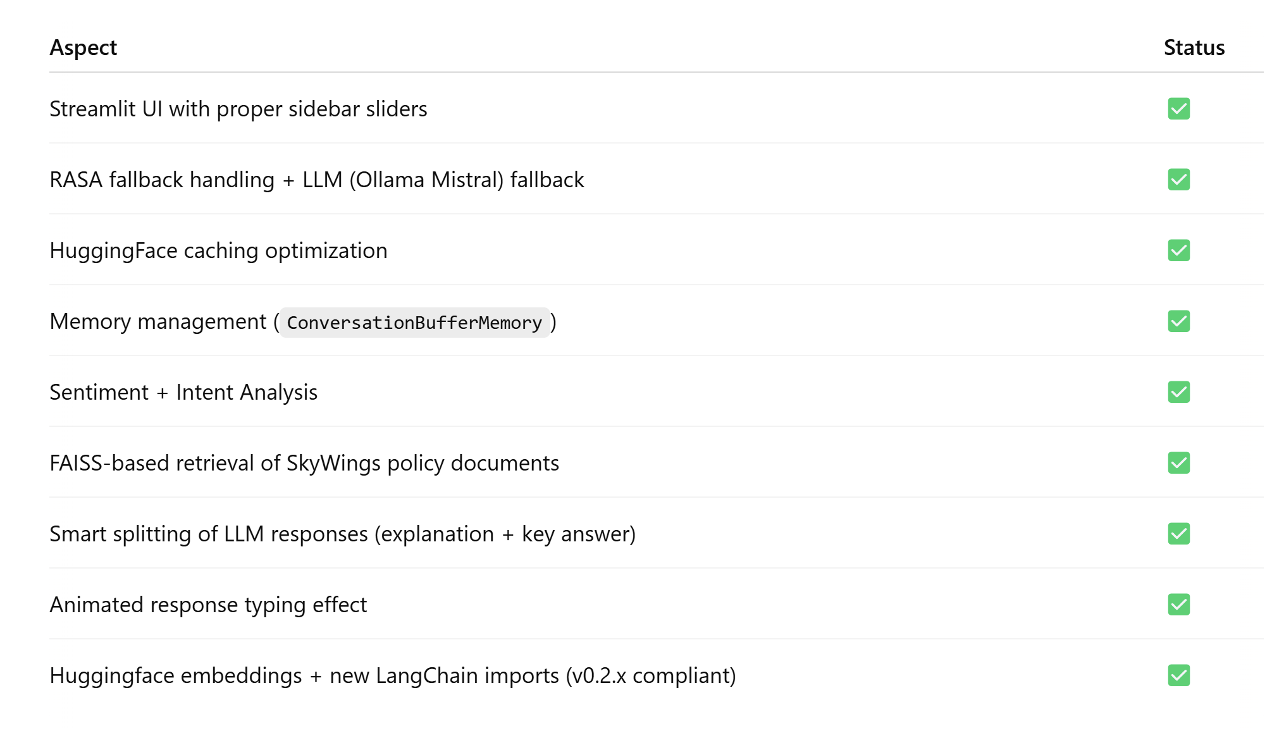
Functionality Supported by Streamlit Bot

Slide 5
Next Enhancements
No. | Chatbot Functionality | Status
1 | 1 Use Case (multi-turn) using RASA NLU and RASA Core | WIP
2 | Integrate with RDBMS for Transactional data | WIP
3 | Save Chat transcript in RDBMS for downstream analytics | Open
4 | Configurable LLM calls – Gemm2, Llama2, Mistral, Gpt 3.5 | Open

Slide 6
Appendix

Slide 7
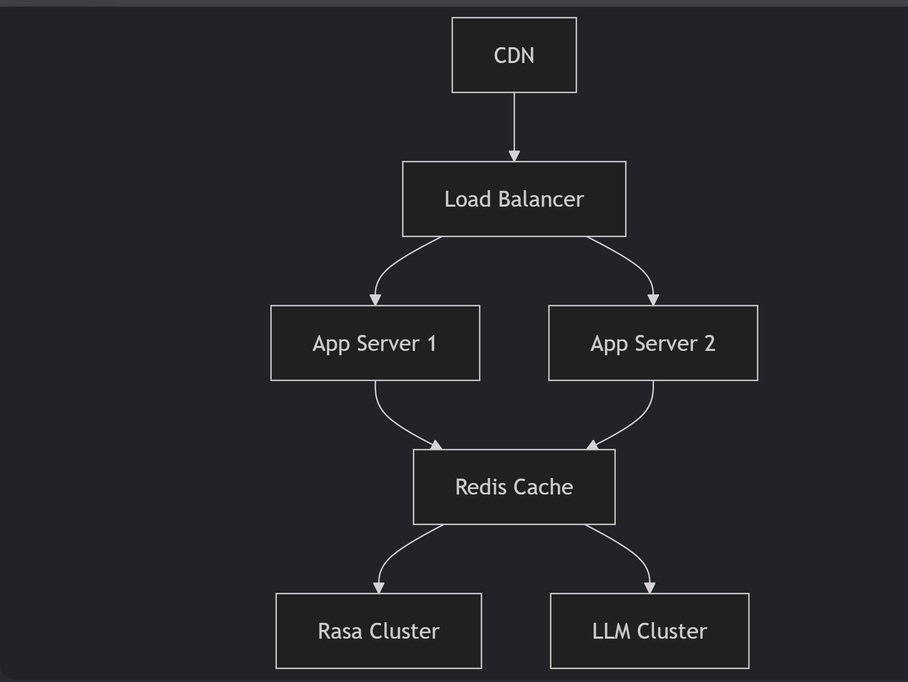
Production Scale Architecture – CLOUD based
This architecture can scale to handle 100,000+ concurrent users with proper implementation while maintaining <1s response times for common queries.
Migration Path
Immediate:
Containerize both services
Move from localhost to cloud deployment
Medium-term:
Implement Redis for session storage
Add monitoring (Prometheus + Grafana)
Long-term:
Regional deployment
AI load balancer that routes based on:

Slide 8
