Slide 1
The Vector Space Model
…and applications in Information Retrieval

Slide 2
Part 1
Introduction to the Vector Space Model

Slide 3
Overview
The Vector Space Model (VSM) is a way of representing documents through the words that they contain
It is a standard technique in Information Retrieval
The VSM allows decisions to be made about which documents are similar to each other and to keyword queries

Slide 4
How it works: Overview
Each document is broken down into a word frequency table
The tables are called vectors and can be stored as arrays
A vocabulary is built from all the words in all documents in the system
Each document is represented as a vector based against the vocabulary

Slide 5
Example
Document A
  “A dog and a cat.”
Document B
  “A frog.”
a | dog | and | cat
2 | 1 | 1 | 1
a | frog
1 | 1

Slide 6
Example, continued
The vocabulary contains all words used
  a, dog, and, cat, frog
The vocabulary needs to be sorted
  a, and, cat, dog, frog

Slide 7
Example, continued
Document A: “A dog and a cat.”
  Vector: (2,1,1,1,0)
Document B: “A frog.”
  Vector: (1,0,0,0,1)
a | and | cat | dog | frog
2 | 1 | 1 | 1 | 0
a | and | cat | dog | frog
1 | 0 | 0 | 0 | 1

Slide 8
Queries
Queries can be represented as vectors in the same way as documents:
  Dog = (0,0,0,1,0)
  Frog = ( )
  Dog and frog = ( )

Slide 9
Similarity measures
There are many different ways to measure how similar two documents are, or how similar a document is to a query
The cosine measure is a very common similarity measure
Using a similarity measure, a set of documents can be compared to a query and the most similar document returned

Slide 10
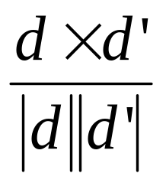
The cosine measure
For two vectors d and d’ the cosine similarity between d and d’ is given by:
Here d X d’ is the vector product of d and d’, calculated by multiplying corresponding frequencies together
The cosine measure calculates the angle between the vectors in a high-dimensional virtual space

Slide 11
Example
Let d = (2,1,1,1,0) and d’ = (0,0,0,1,0)
  dXd’ = 2X0 + 1X0 + 1X0 + 1X1 + 0X0=1
  |d| = √(2²+1²+1²+1²+0²) = √7=2.646
  |d’| = √(0²+0²+0²+1²+0²) = √1=1
  Similarity = 1/(1 X 2.646) = 0.378
Let d = (1,0,0,0,1) and d’ = (0,0,0,1,0)
  Similarity =

Slide 12
Ranking documents
A user enters a query
The query is compared to all documents using a similarity measure
The user is shown the documents in decreasing order of similarity to the query term

Slide 13
VSM variations

Slide 14
Vocabulary
Stopword lists
  Commonly occurring words are unlikely to give useful information and may be removed from the vocabulary to speed processing
  Stopword lists contain frequent words to be excluded
  Stopword lists need to be used carefully
    E.g. “to be or not to be”

Slide 15
Term weighting
Not all words are equally useful
A word is most likely to be highly relevant to document A if it is:
  Infrequent in other documents
  Frequent in document A
The cosine measure needs to be modified to reflect this

Slide 16
Normalised term frequency (tf)
A normalised measure of the importance of a word to a document is its frequency, divided by the maximum frequency of any term in the document
This is known as the tf factor.
Document A: raw frequency vector: (2,1,1,1,0), tf vector: ( )
This stops large documents from scoring higher

Slide 17
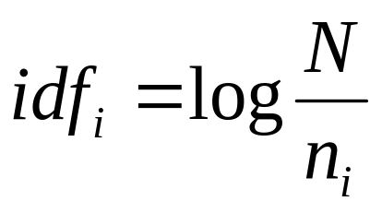
Inverse document frequency (idf)
A calculation designed to make rare words more important than common words
The idf of word i is given by
Where N is the number of documents and n_{i} is the number that contain word i

Slide 18
tf-idf
The tf-idf weighting scheme is to multiply each word in each document by its tf factor and idf factor
Different schemes are usually used for query vectors
Different variants of tf-idf are also used

