Slide 1

Physical Activity Recognition by USING Smartphone Sensor Signals

Slide 2
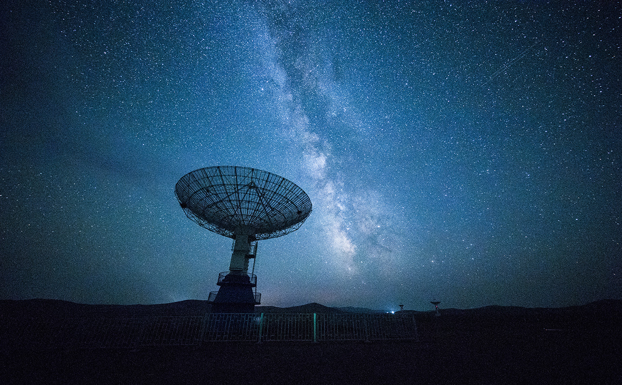
Activity Recognition
Medical diagnosis
Human to human interactions
Sport analysis

Slide 3

OBJECTIVE
Classification of 6 different activities:
walking normal
walking fast
walking with a bag
going downstairs
going upstairs
sitting
Ranking of the time-domain and frequency-domain features that contribute the most into identifying motion activity types;
Model evaluation
Problems of prior studies:
Too much focus on performances
Low attention to the interpretability
Limited number of partecipants and samples
Activity signals could vary over time

Slide 4
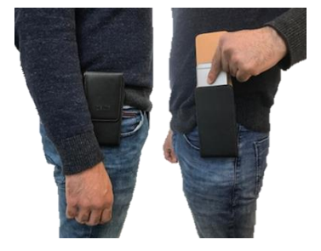



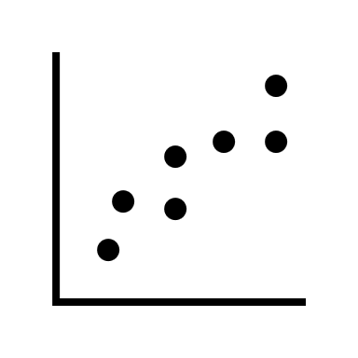


Methodology
Smartphone sensors: accelerometer and gyroscope (Samsung Galaxy S6)
Smartphone device located inside a pouch
Fixed time-length windows of 10 seconds, no overlapping
30-32 Hz rate
35 male
25 female
Age between 18 and 56 years old
60 participants

Slide 5
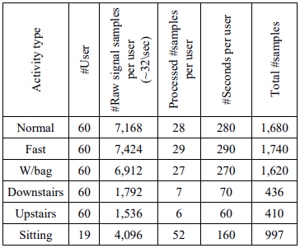
METHODOLOGY
Each individual was asked to perform the activities
Flat corridor, three levels stairs
3 minutes time for each activity
Realistic scenarios (stop to open a door…)
15/20 seconds for rest between activities
10 sessions collected
5 from one day, 5 from a week later

Slide 6
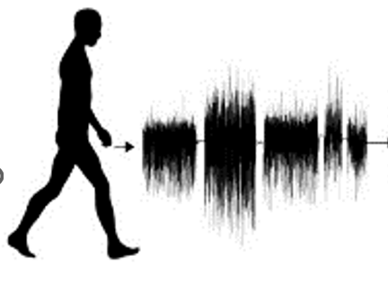
METHODOLOGY
Raw data (Gyroscope and Accelerometer signals)
Segmentation (10 secs windows)
Feature extraction (time and frequency)
Pre-processing
Feature selection
Classification task
Walking normal
Walking fast
Walking with a bag
Going upstairs
Going downstairs
Sitting

Slide 7
Features extraction
Feature domain | Feature type (count)
Time and frequency | Mean (3), standard deviation (3), median (3), variance (3), covariance (3), zero crossing rate minimum, interquartile range, average absolute, difference (3), root mean square (3), skewness (3), kurtosis (3), percentile 25 (3), percentile 50 (3), percentile 75 (3), maximum (3), minimum (3), correlation coefficients (3), average resultant acceleration (1)
Time only | Difference (3), maximum value (4), minimum value (4), binned distribution (3), maximum peaks (3), minimum peaks (3), peak occurrence (3), time between peaks (3), interquartile range (3)
Frequency only | Entropy (3), energy (3)
304 unique features generated

Slide 8
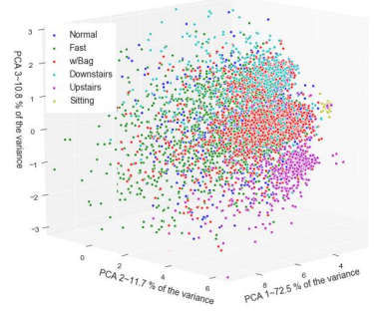
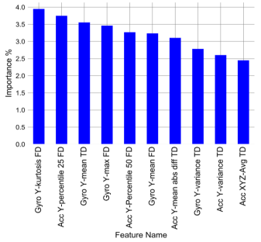
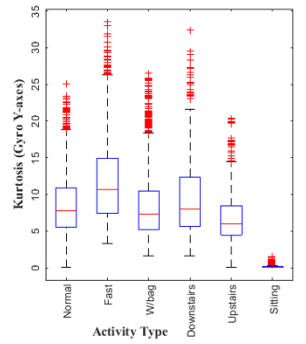
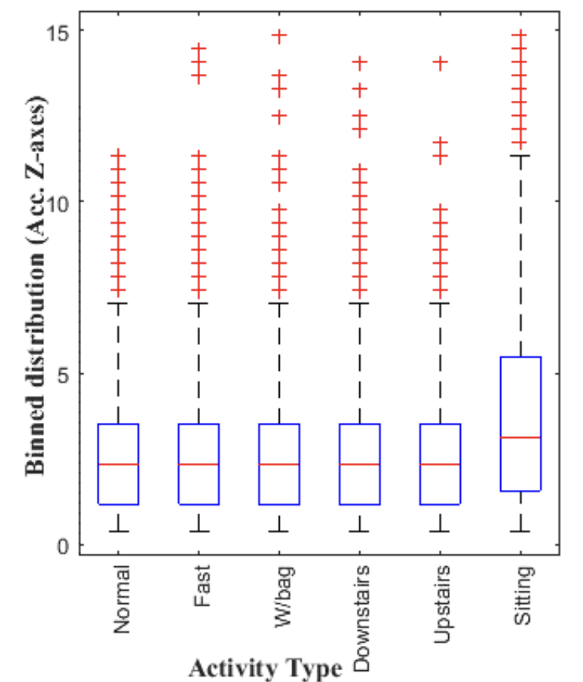
Feature selection
Using PCA for dimensionality reduction, the first, second and third component explain respectively 72.5%, 11.7% and 10.8% of the total variance
Random forest feature selection reduced the feature vector from 304 to 195 features
Top 10 ranked features are based on the y-axis of the gyroscope and accelerometer sensors. This could be due to the location of the device.
Top ranked feature
Lowest ranked feature
Similar distribution of walking normal and with a bag;

Slide 9
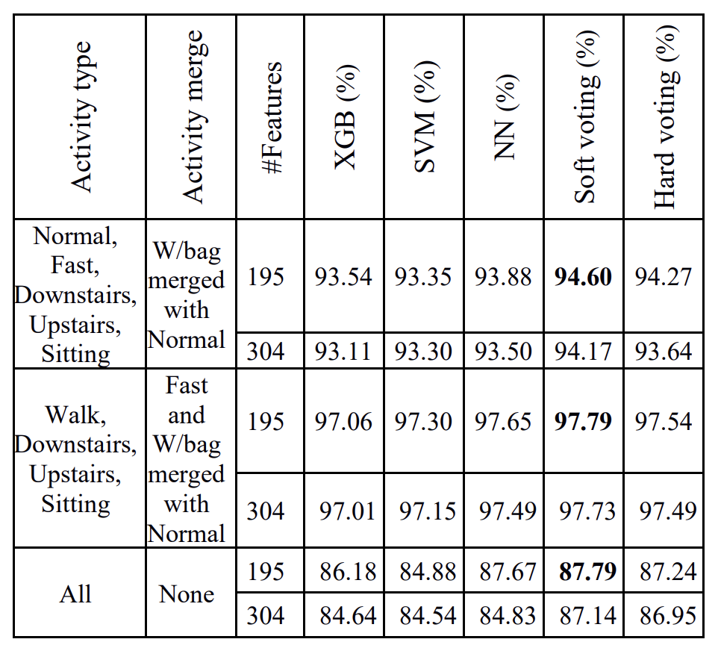
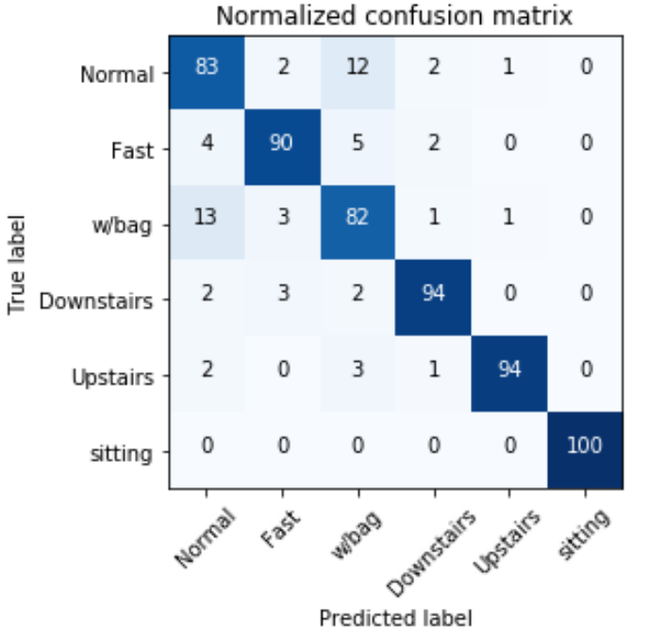
Classification task
3 classification algorithms:
Feedforward neural network (NN)
Support Vector Machine (SVM)
eXtreme Gradient Boosting (XGB)
The best model is Soft Majority Voting, using all the classification algorithms cited
Accuracy’s results change if similar activities are merged:
Everything separated: 87.9%
Bag with normal: 94.60%
Fast and bag with normal: 97.79%

Slide 10

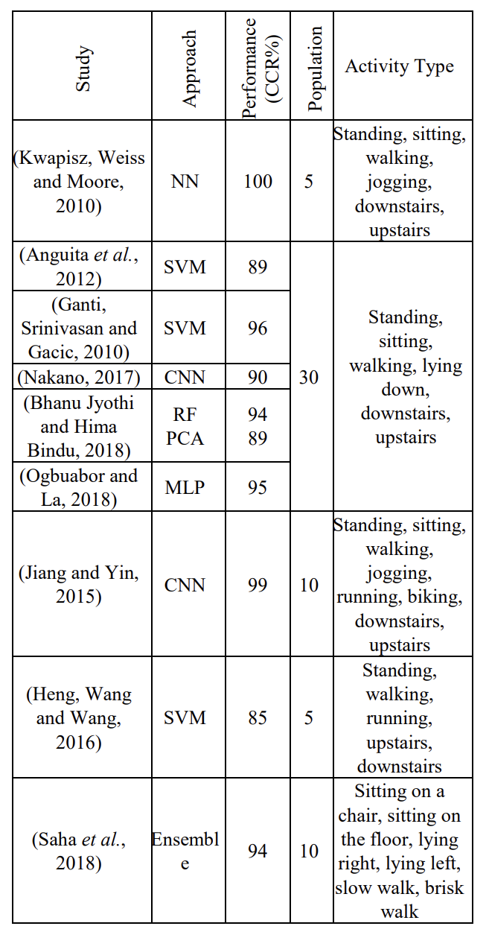
Conclusions AND OBSERVATIONS
Accuracy of nearly 98%
Different phone’s sensors?
Minimum number of seconds required to obtain a user-dependent model?
Study conducted offline. What about computational overheads?

Slide 11
Thank You!
Marco Pardini

