Slide 1
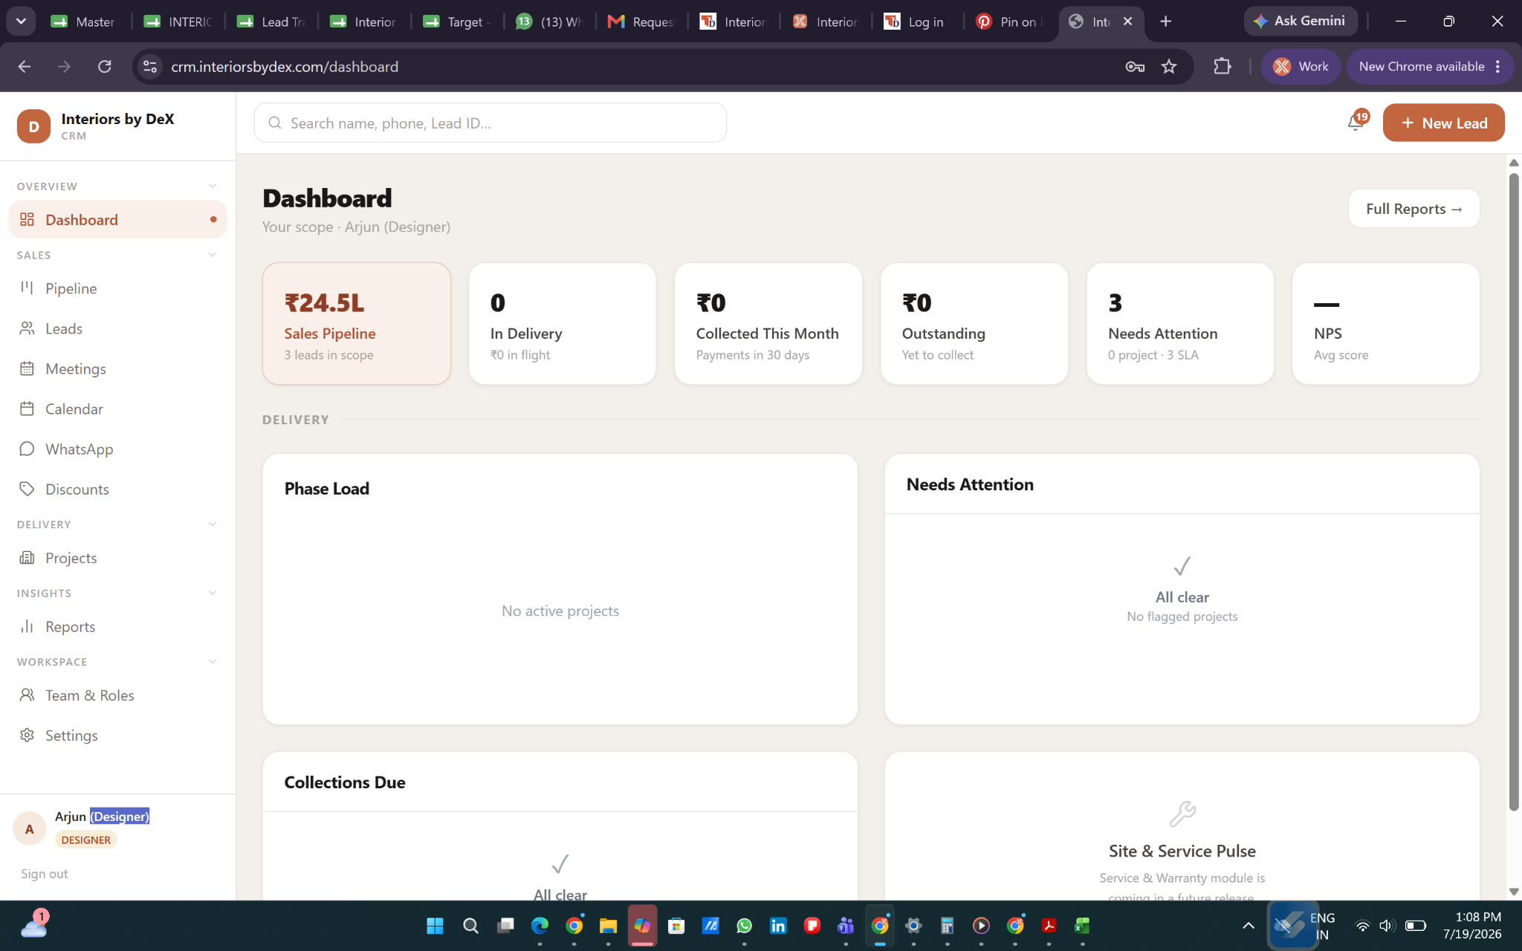
Remove 3 leads in scope
Remove 3 leads in scope
Remove the bracket - role

Slide 2
Designer Dashboard - Generally should show the current month status
Calendar filter
Sales
Over all
High Intent
Current month Target - Value
Achieved
Pending
Cash collected
Total active and onhold project no + project value
Total No of active project +value
Over all
High Intent
Current month Target - Value
Achieved
Pending
Cash collection Target - Value (calculation to be taken from the quote with Generated sign off quote signoff value 30%)
PO
Total active and onhold project no + project value
Total No of active project (with sign off timeline falls on this month cycle) +value
Pending
Achieved
Over all
High Intent
DF done -Num of project
DF pending - Num of project
Cash collection - Value (calculation to be taken from the quote with Generated DF quote DF value 30%)
DF
Total active and onhold project no + project value
Total No of active project (with DF timeline falls on this month cycle) +value
Pending
Achieved

Slide 3
Designer Dashboard
Effort metrics - Sales
SLA - Breach
To be shown in graph
Leads (When you touch each bar in the graph it should show the count +Value)
- Total Leads
- MQL
- DQL
- PR
- pp
- OB
Project (When you touch each bar in the graph it should show the count +Value)
- Total project
- OB
- Site documentation
- LF
- DD
- DF
-Masking
- SO
- Execution
-Completed
PID - Cx name - Stage - how many days breached
(For all the stages given in sales and design - Admin portal has to be notified with notification )
Effort metrics - Design
NPS - VALUE ( Overall average )
Over Achieved
Sales - Value (Average)
DF - Value (Average)
SO - Value (Average)
Target
Achieved
Effort metrics should show the expected out come like less transparent graph and as they finish the task it should fill if over achieved it should be highlighted as well

Slide 4
Designer Dashboard
Incentive
Lead to pitch - Credit gained
Lead to Booking - Credit gained
Booking to PO = Credit gained
Total Number of Pitch
Escalation
Furniture incentive - Rs.
Portfolio incentive - no of project - Value
Potential earnings - Rs
Total credit - Value
Core credit earned- value
Booster credit earned - value
Designer (name)wallet - Rs.
Incentive calculation method is given as pdf - its interlinked with the NPS system - only after getting the nps - credit and wallet reflection is shown in the dashboard

Slide 5
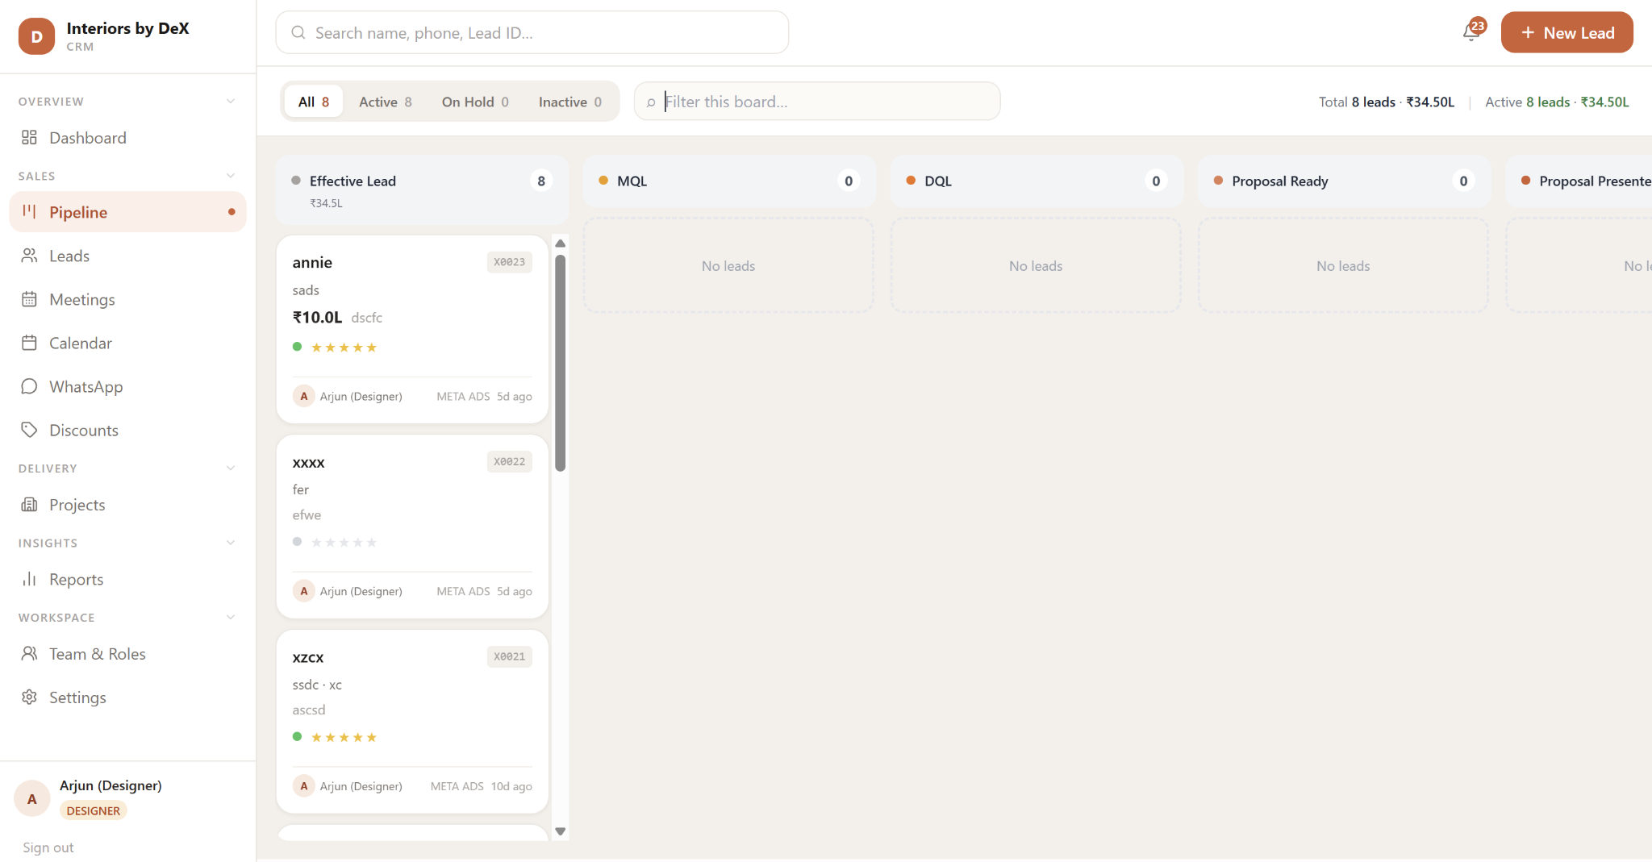
Remove Effective lead from designer dashboard
Designer Pipeline
Filter
Sales
Add Filter option
Filter criteria
Lead origin date - ( from - to Calendar )
Lead origin month - 16 to 15 th cycle
Budget - Value
Possession - date in calender
Intent - star
Projected OB ( from - to Calendar )
Rename to search
Rename it to “Sales Pipeline”
Add Separate “Design Pipeline” tab below that
Filter criteria - Pipeline Design
Stages with dates as per the timeline given in the road map
Total active dates - calendar
Handover dates (Possession)
Add Projects below the lead

Slide 6
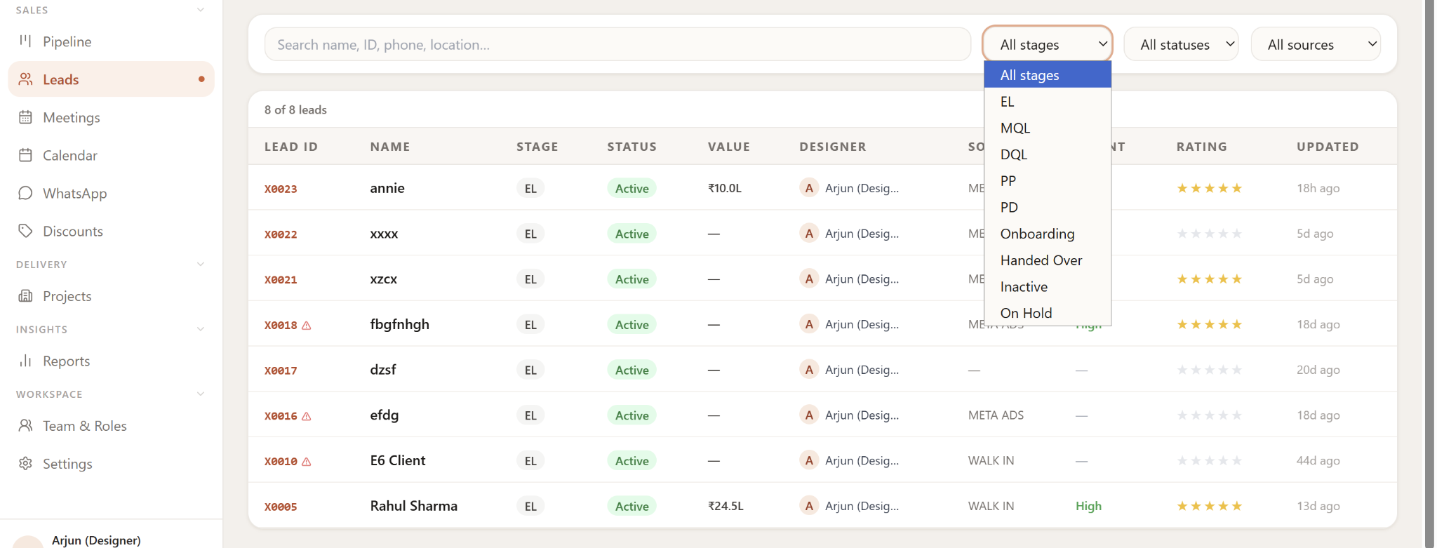
Each time new leads are received it should show the number unless the leads are open
Designer Lead
Remove
Unopened leads to be highlighted in different clr - like mails

Slide 7
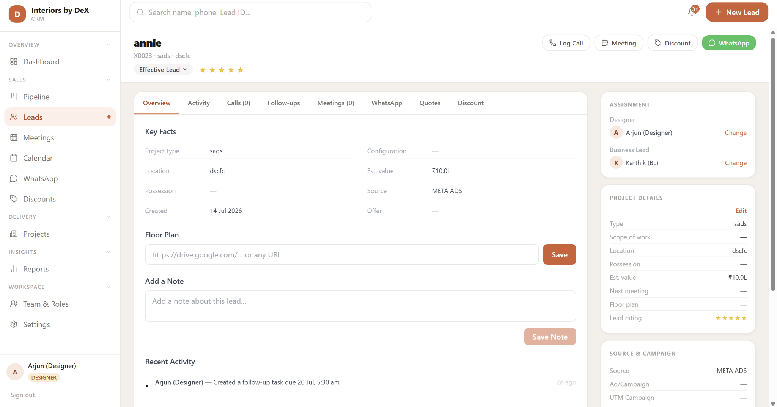
Add - project status
Active (Green clr) , on hold (Yellow clr), inactive(Red clr) - ( What ever is the current project status has to been shown
Designer Lead
NPS
If Project is on hold - Reopen date should be asked automatically in calendar format to select the date with on hold reason tab - along with the reason and date mail has to be shared with client and internal team - Mandatory both date and reason or project will not be onhold
If the project is inactivated - Reason tab for inactivation to be mandatory - mail will be shared with client and internal team.
Active
Nps mail to be triggered after these stages to client ( designers)
OB
Design freeze
Sign off
Nps displayed near the client name will have the average nps of these 3 stages for designer portal - Admin portal should have the nps tracker fin the system - once the client rate them designer will get the notification in the activity tab.

Slide 8
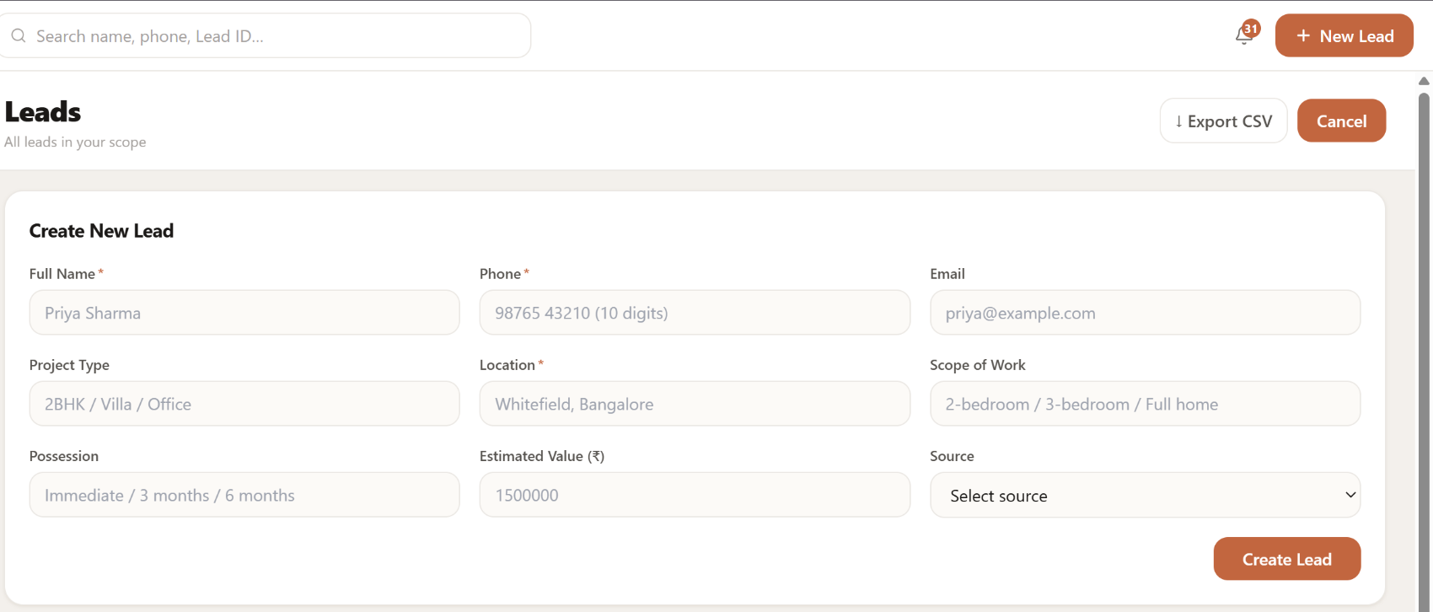
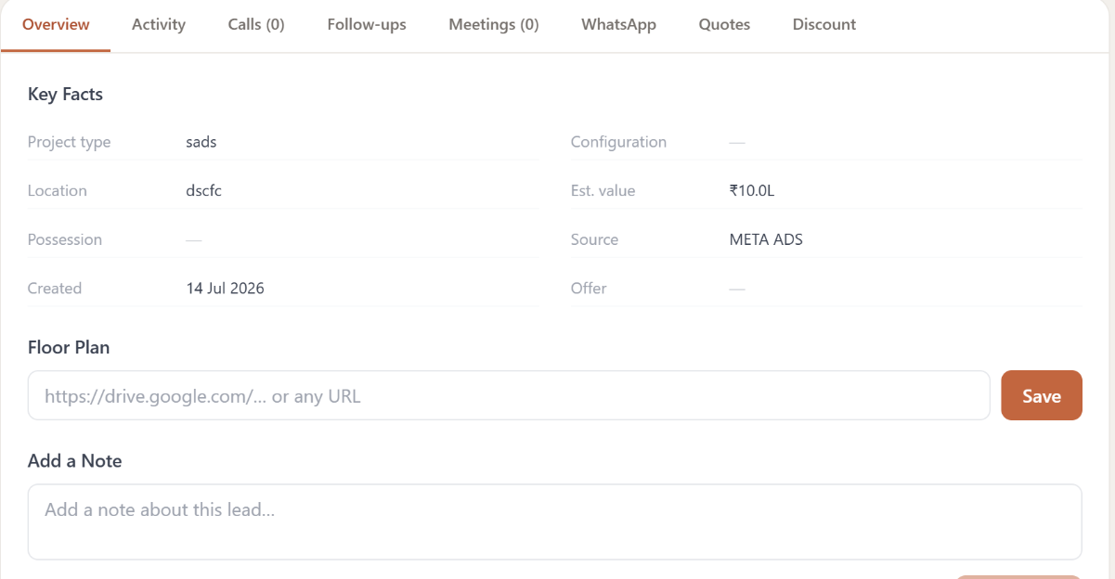
Open calender
Designer Lead - overview
Floor plan should be in attachment format not drive link
Interchange - project type and location position (first client detail then project details that's the flow)
To be Added
Builder
Offer
Notes
Floor plan
Expected move in - open calendar to select the date
Change est value to Client budget
Everything is mandatory except for floor plan and email id
Email and ph num are accepted in any format - should only accept the valid format.
To be added
Email id
Builder
Scope of work
Configuration - change to project type
Change est value to Client budget
Expected move in - open calendar to select the date
Offer 1
Offer 2
Offer 3
N/A
EL - Intent rating criteria
EC visit - 5 star
Site visit - 4 star
Virtual - 3 star
Call back - 2 star
No action planned - 1 star - in 1 star project can't be moved to next stage
All Key facts except for offer and floor plan are mandatory to move to the next stage from EL to MQL.
System has to auto detect the star in all the stages

Slide 9
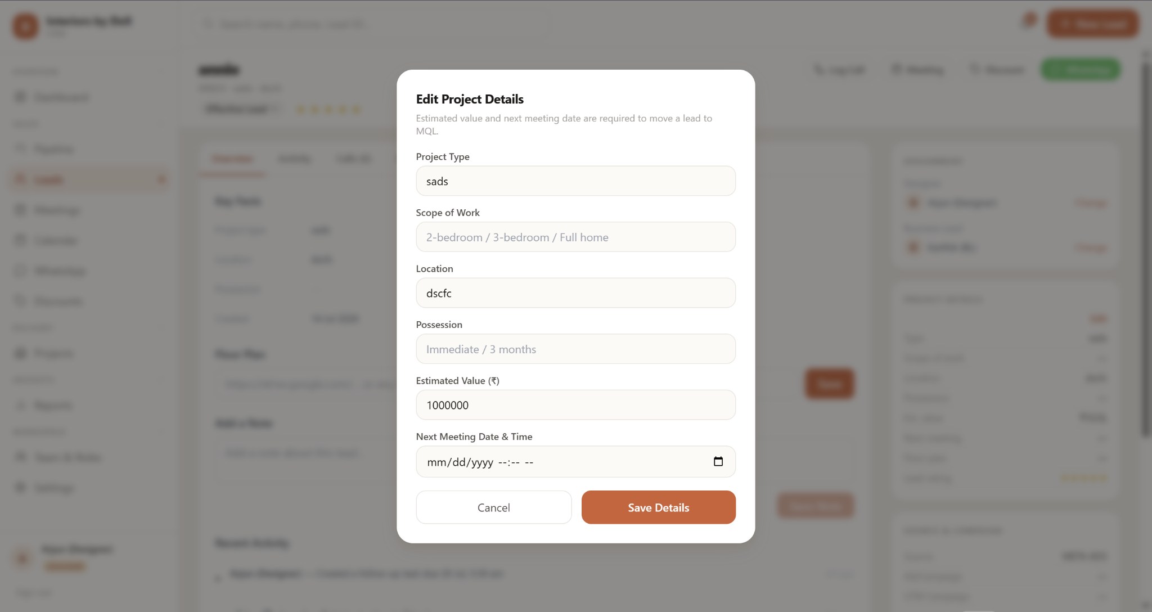
Open calender
Designer Lead - overview
Project edit should have all the data from the key facts - in current format offer is missing
To be removed.

Slide 10
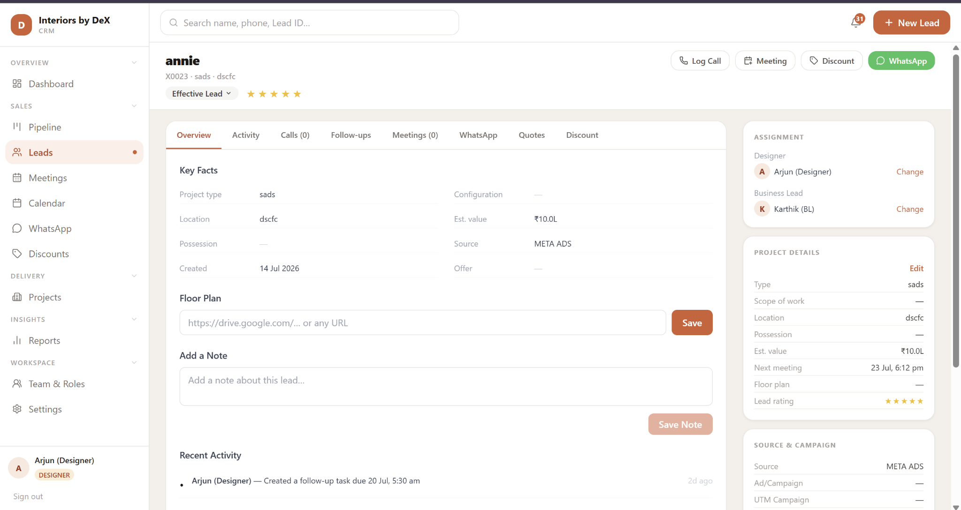
Designer Lead
To Add
client details
Contact number
Alternate number
Mail id
Alternate mail id
PAN details
GST Details.

Slide 11
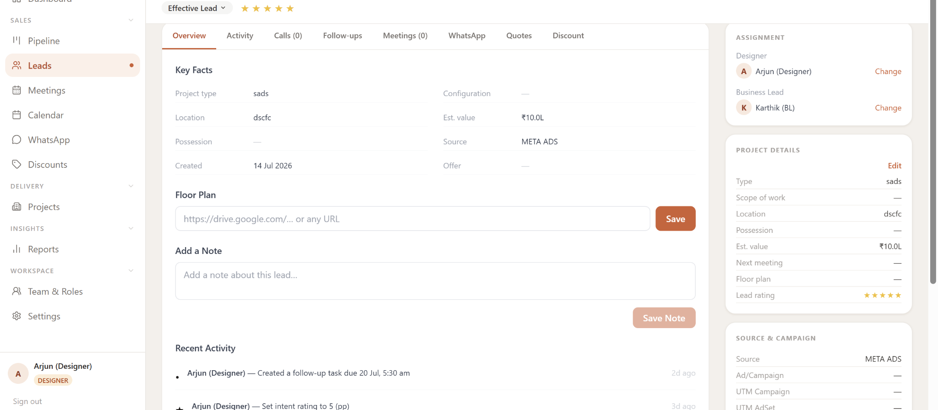
Designer Lead - over view
Remove
Recent activity to be removed from the overview.

Slide 12
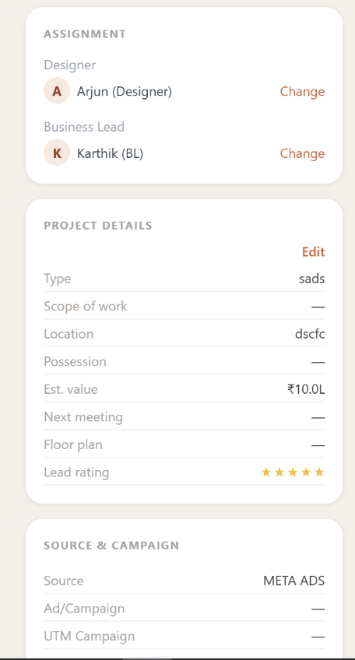
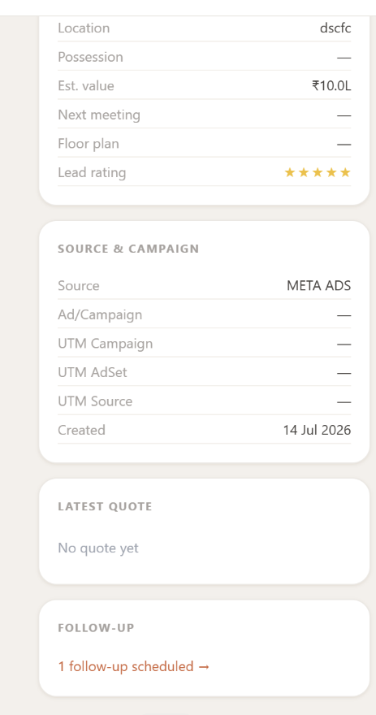
Designer Lead - overview
Order to be followed
Stage road map ( to be added) (total num of days projects was active , lead allocation date )
MQL (date of stage movement) ( i)
| TAT
DQL (date of stage movement)
| TAT
PR (date of stage movement)
| TAT
PP (date of stage movement)
| TAT
OB (date of stage movement)
Highlight the stage the project is in and
Follow up ( it should show details like - upcoming follow up - date - time - task name (green clr) , pending follow up - date - time - task name (red clr) rescheduled follow up - - date - time - task name yellow clr )
Latest quote - attachment or link to open the attachment
Project details
Source
When you click i stage movement req to be displace
When clicked on the stage - tab to be opened and ask for update stage - like the one on top left corner.
If tat is deviated - mark in red
On time green
Early - purple

Slide 13
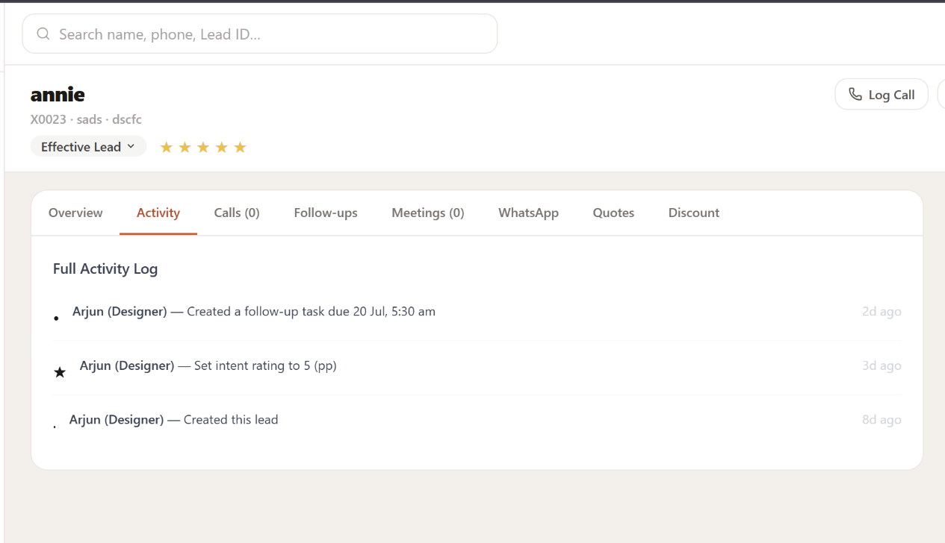
Designer Lead - Activity
Order to be followed
Calls - Phn symbol
Meeting calendar symbol
Stage movement - if moved forward
If moved backward -
Intent rating - star
Meeting completion - calendar green tick mark
Meeting rescheduled - calendar yellow tick mark
Meeting no show/ cancelled - calendar X red
Arjun - Date +Time
Stage movement - Stage moved from MQL to DQL in (TAT ) If moved
Arjun - Date +Time
Stage movement - Stage moved from MQL to EL in (TAT ) When stage is moved backward mark in red and send notification via mail and in crm to reporting manager and concern person. Note - stage can only be reversed from MQL to EL no other stages can be reversed.
Arjun - Date +Time
Auto intent rating - stars ( when stage is moved ) - Note let the stars be in icon rather than 5stars
Arjun - Date +Time
Intent rating - stars
Reason -
Arjun - Date +Time (Once the designer set intent rating is reversed then mark in red and send mail and crm notification to reporting manager and the designer , if the designer set intent rating is increased like from 3 to 5 then mark in green and send notification to the reporting manager and designer.
Intent rating - stars
Reason -
Arjun - Date +Time
Icon - outgoing call - Answered or not answered - Duration ( 3s or 21min. )
Notes or Mom
Next plan of action - Follow Up task
Arjun - Date +Time
Meeting Scheduled - DQL Meeting on date and time
Arjun - Date +Time
Meeting completed - DQL on date and time
MOM
Next plan of action - date and time - Meeting agenda
Arjun - Date +Time
Meeting Rescheduled - DQL on date and time
Arjun - Date +Time
Meeting No show When meeting is no show and haven't replanned mark in red and send notification to the reporting manager in crm and via mail

Slide 14
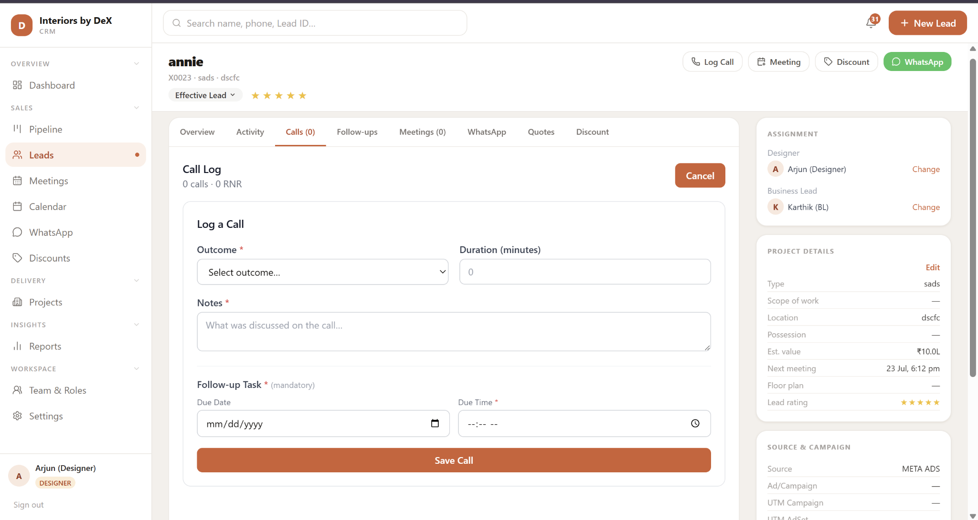
Designer Lead - Call logs
If call made through the system auto time stamp the date +time+ duration
Remove duration - Replace it with date and time
Rename follow up task to Next plan of action
Unable to edit
Add Drop down ( call or meeting ) - if its a call then let the data sit in follow up - if its a meeting then schedule meeting tab be opened or reflected here.
Once the call is done auto pop open the call log tab
Once the call log is saved auto mail trigger with notes and follow up task to Client Ccing the team ( designer + BL +Management)
Add Agenda (Manuel type - DQL meeting ) +Internal or external drop down.
If its internal - team gets the notification in crm and mail - if its external - client gets a auto mail trigger

Slide 15
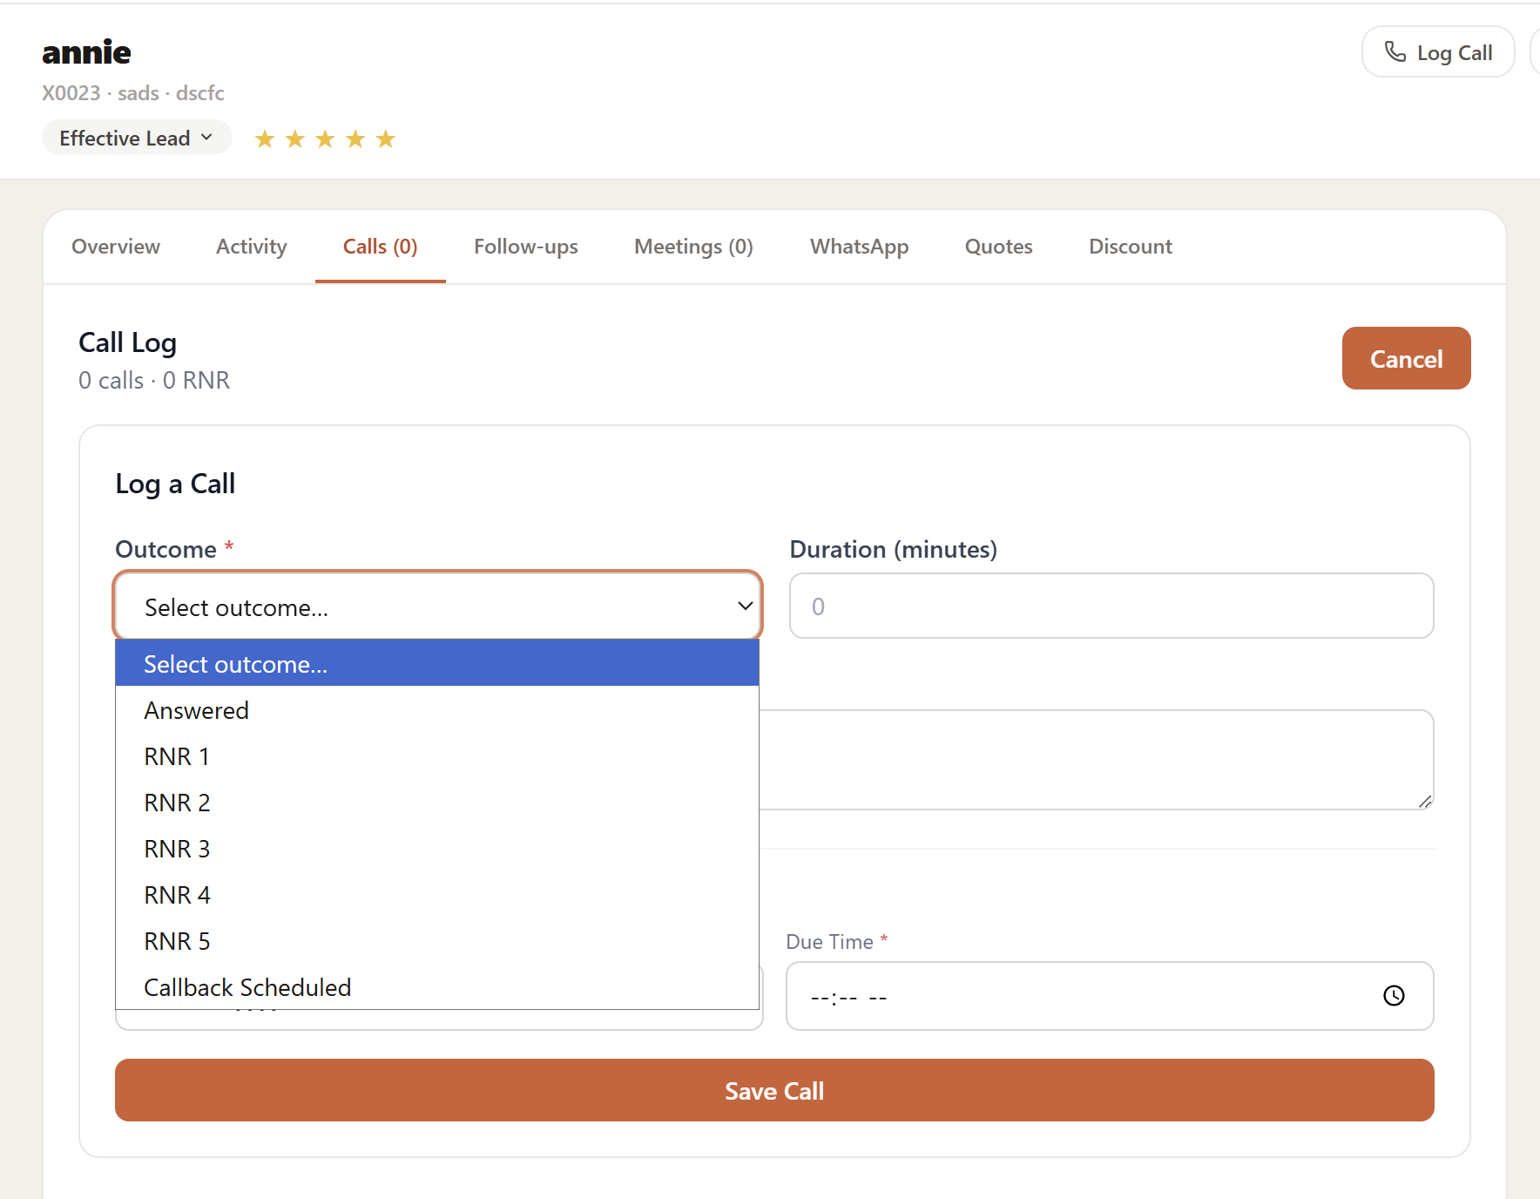
Designer Lead - Call logs
For all the call out come client and internal team gets the notification mail + watsapp - msg template will be given.
Add RNR 6 & beyond
Meeting scheduled
If its a call back scheduled the current follow up tab to be reflected , if its a meeting scheduled then - meeting scheduled tab to be reflected in next plan of action.

Slide 16
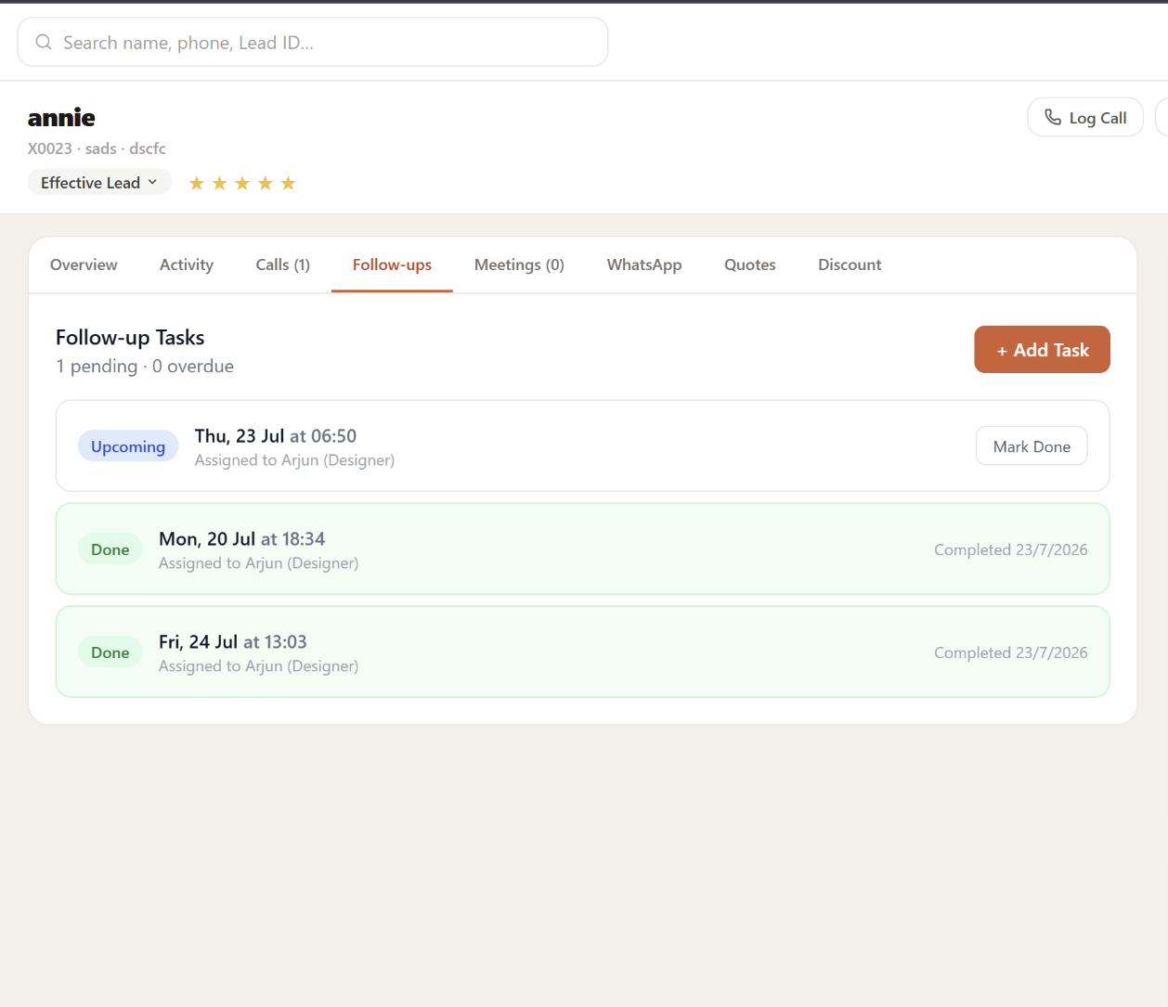
Designer Lead - Call logs
Show the number of active follow ups
When there is one active follow up - next follow up cant be created - if its getting created system to ask to update the task.
If the task is not done in the scheduled time - auto crm notification pending follow up - and change task clr to red.
If the follow up is a call then without call been recorded task cant be marked completed
Mark done - option should also have a drop down - Mark not done - mark replanned.
If its marked not done then the entire box to be in red clr
If its replanned then the entire box to be in yellow

Slide 17
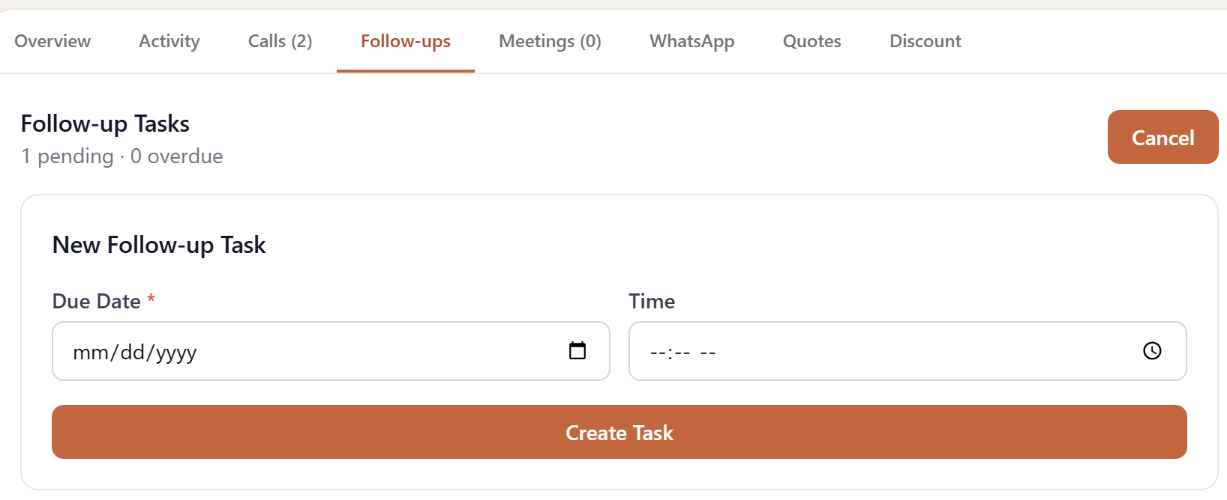
Designer Lead - Call logs
Agenda
Internal /External
Add Agenda (Manuel type - DQL meeting ) +Internal or external drop down.
If its internal - team gets the notification in crm and mail - if its external - client gets a auto mail trigger

Slide 18
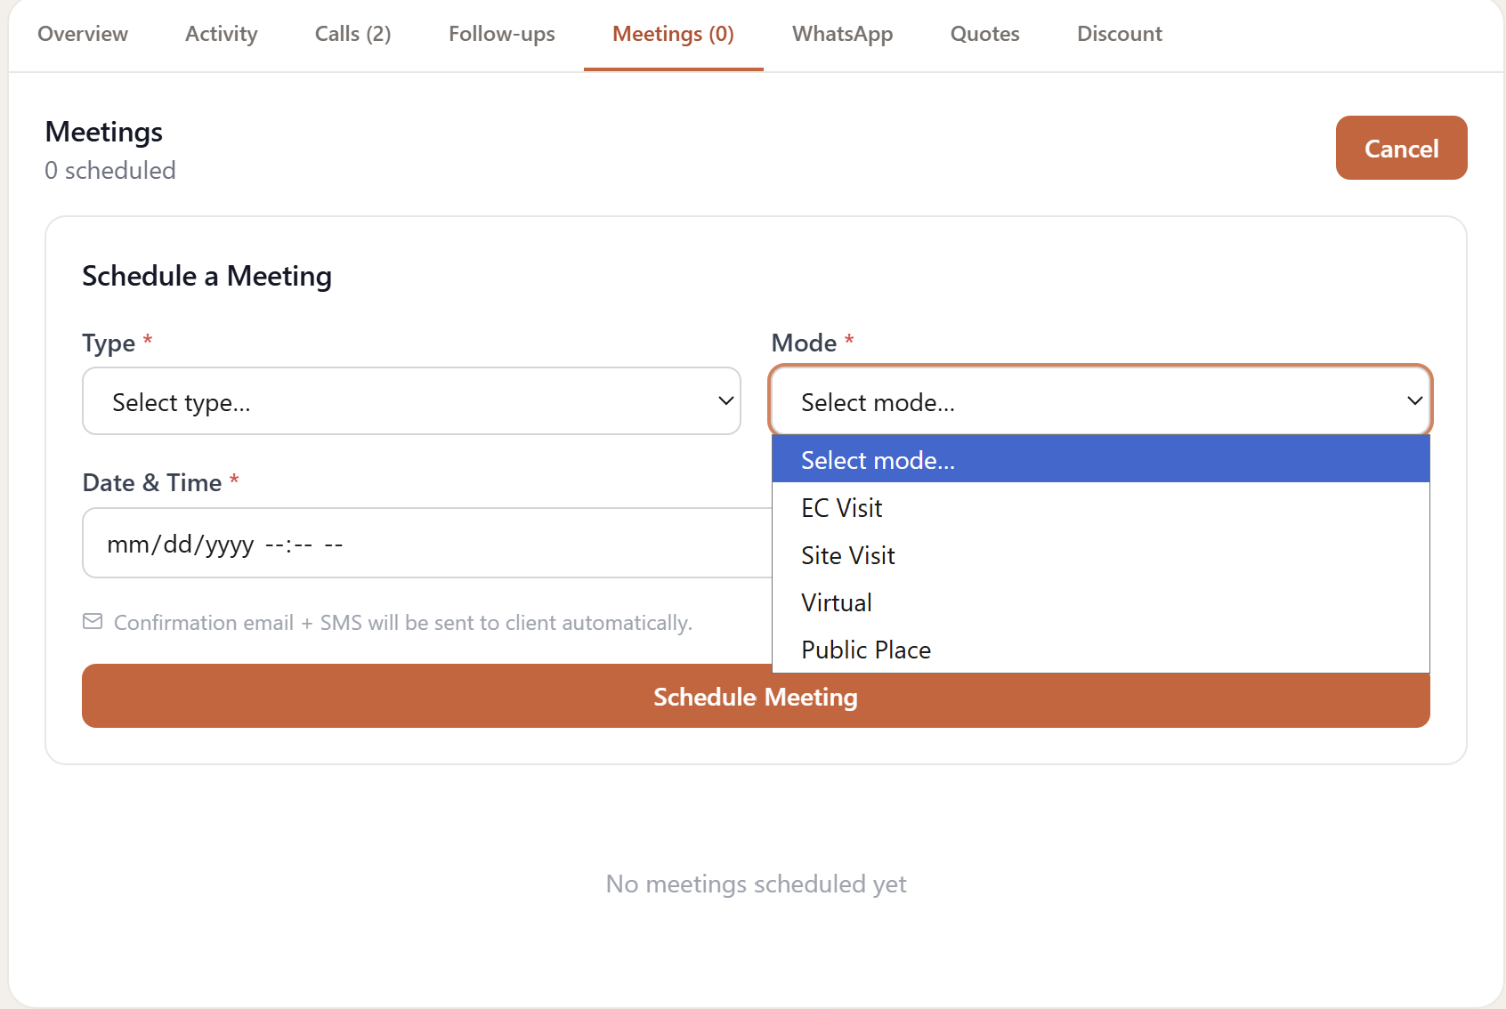
Designer Lead - Call logs
Add client place

Slide 19
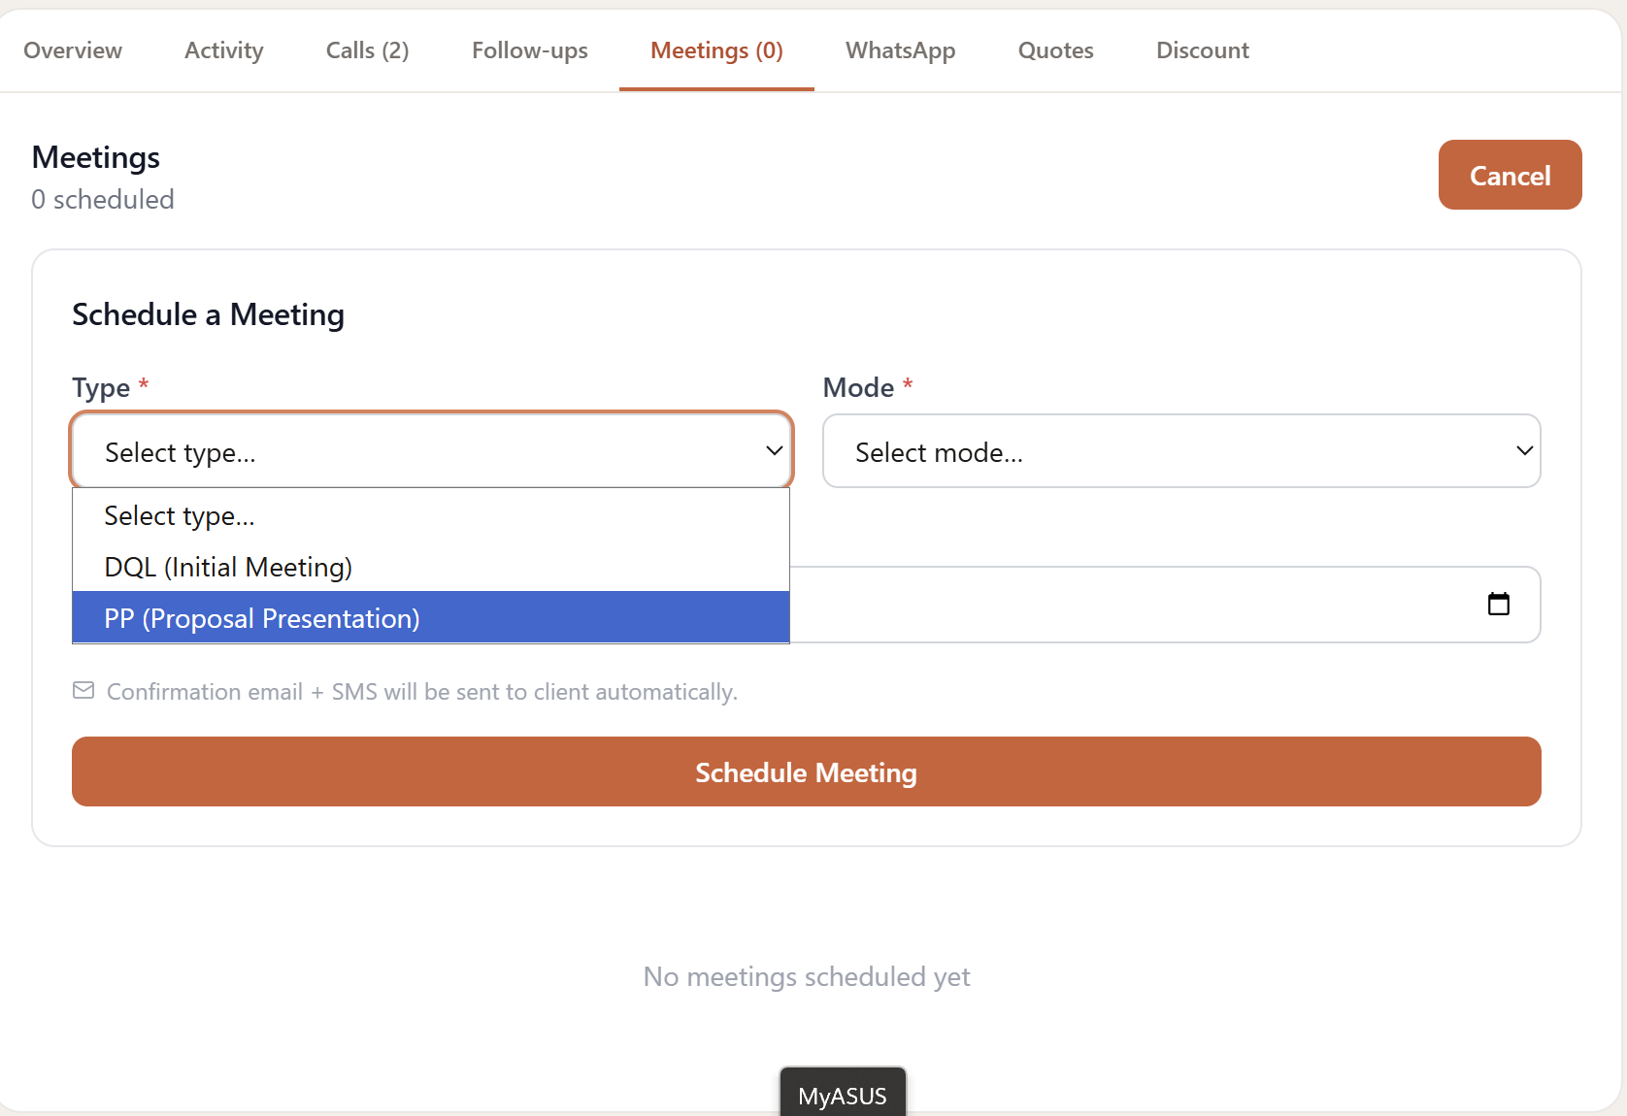
Designer Lead - Call logs
Add - OB meeting

Slide 20
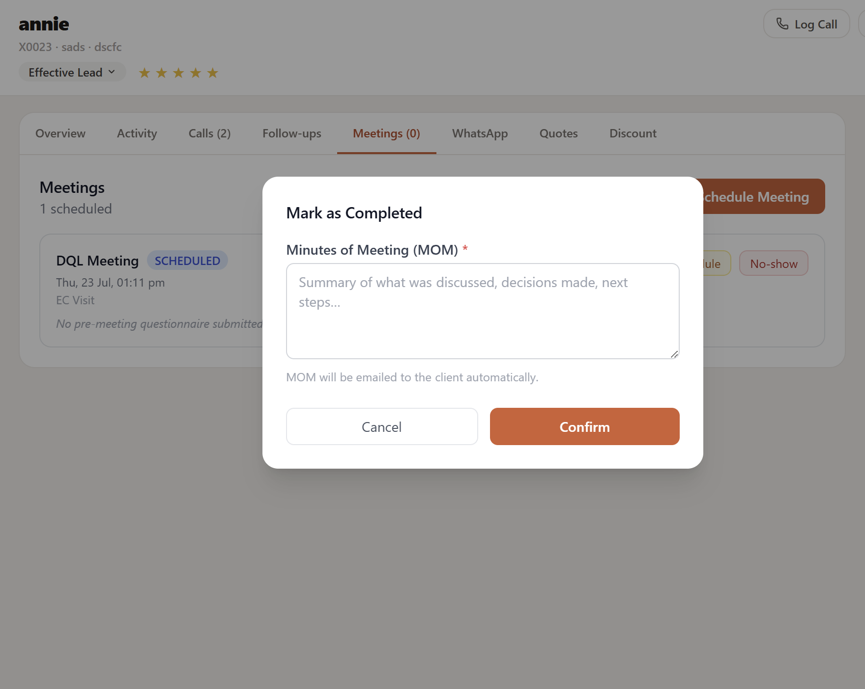
Designer Lead - Call logs
Add - Attachment type ( Lifestyle capture, Proposal, Pitch presentation - can be multiple select ) + Attachment
Add next plan of action tab
Meetings ( DQL , PP, OB ) - mode - date time
Call - agenda - date time

Slide 21
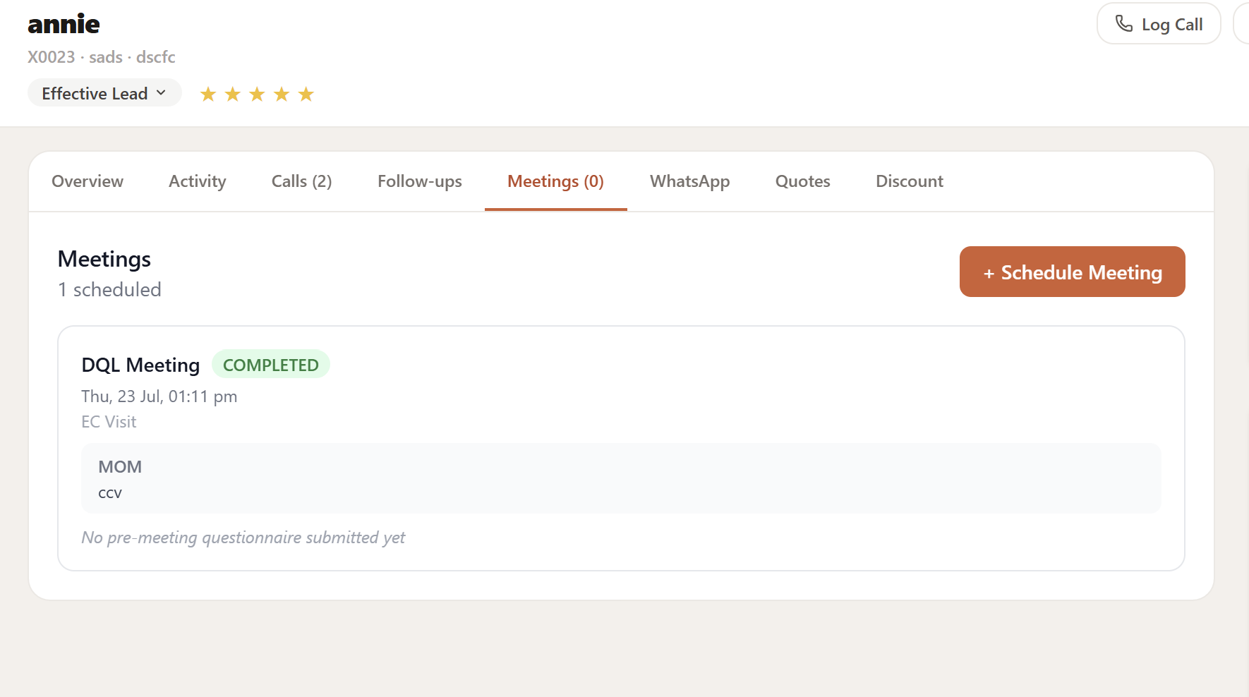
Designer Lead - Call logs
To be removed.

Slide 22
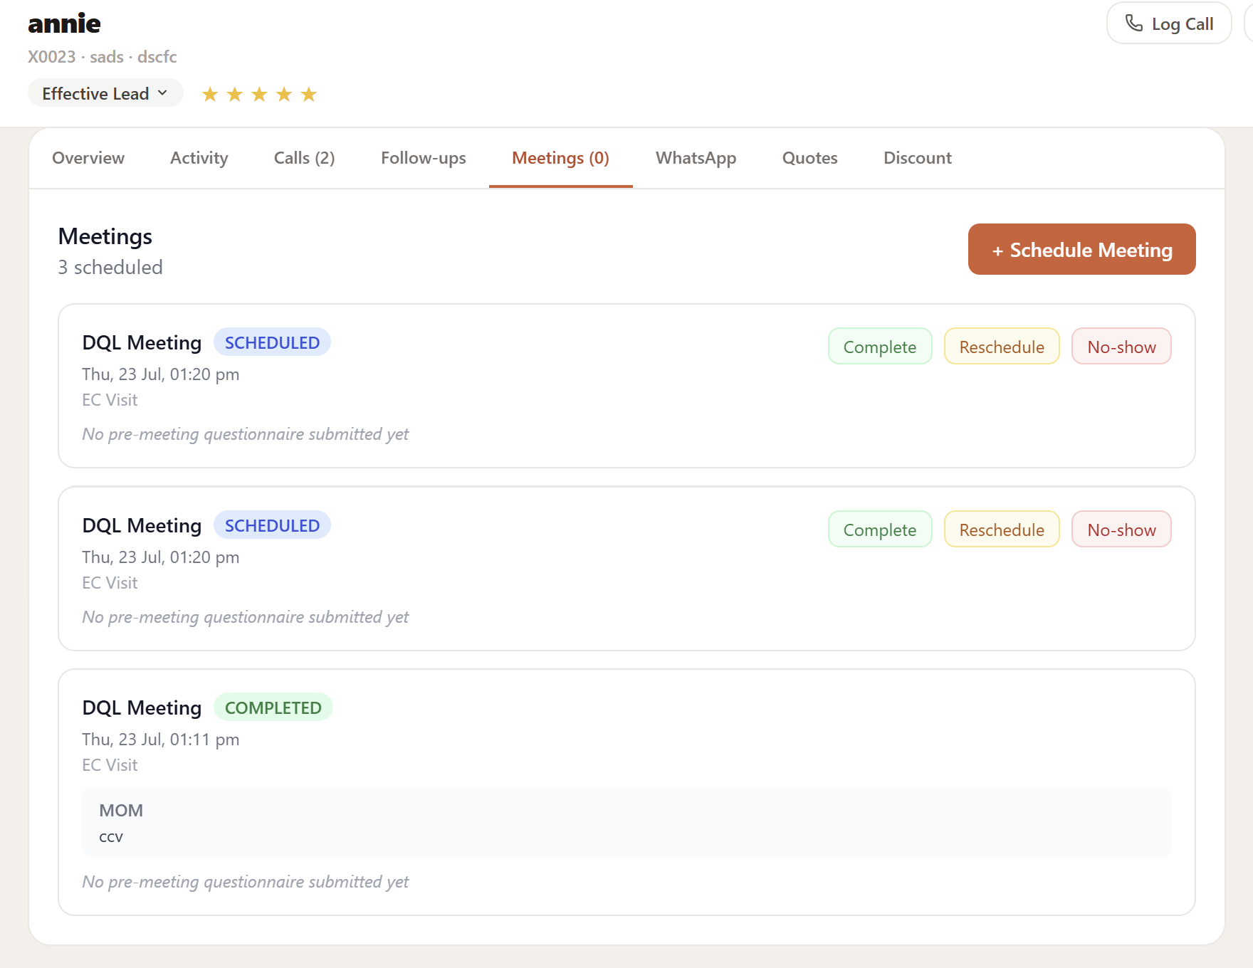
Designer Lead - Call logs
When there is one active meeting is scheduled next meeting cant be created unless its rescheduled or no show

Slide 23
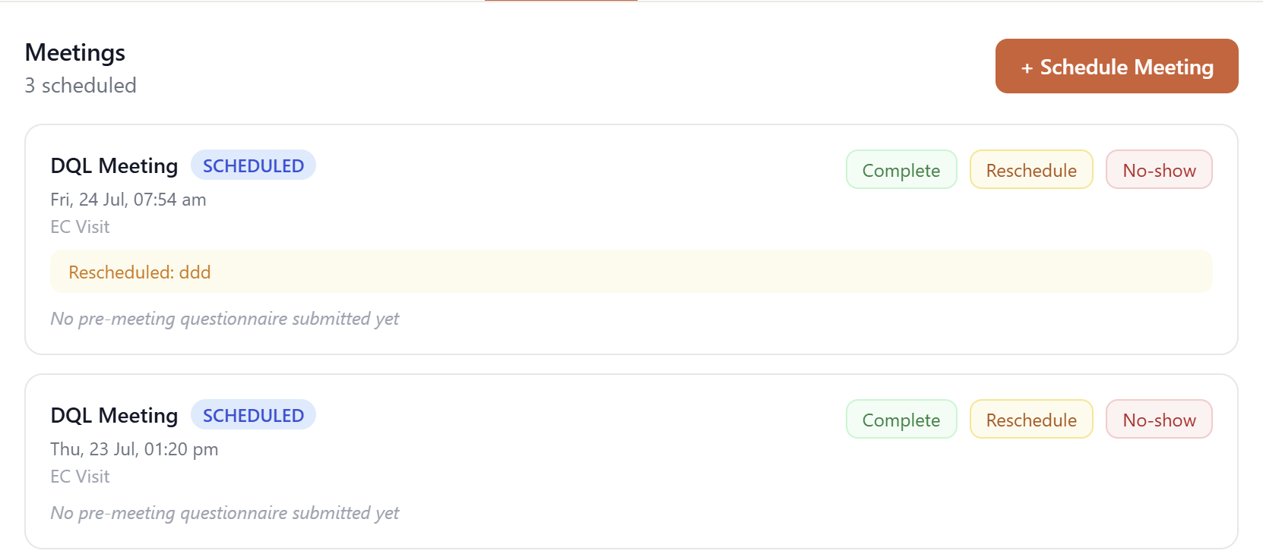
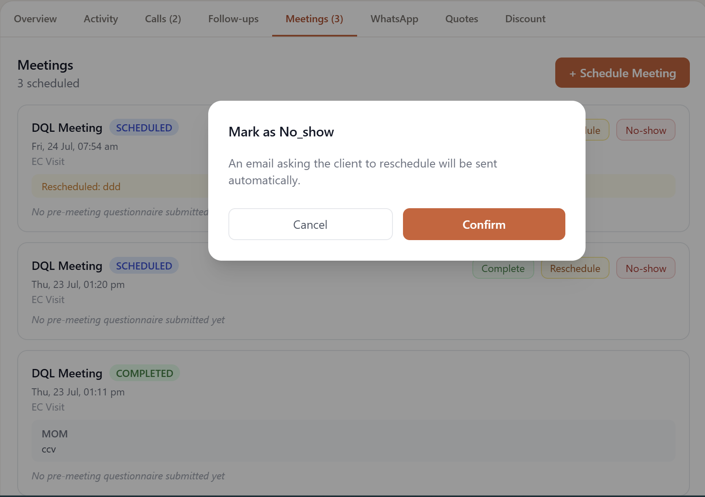
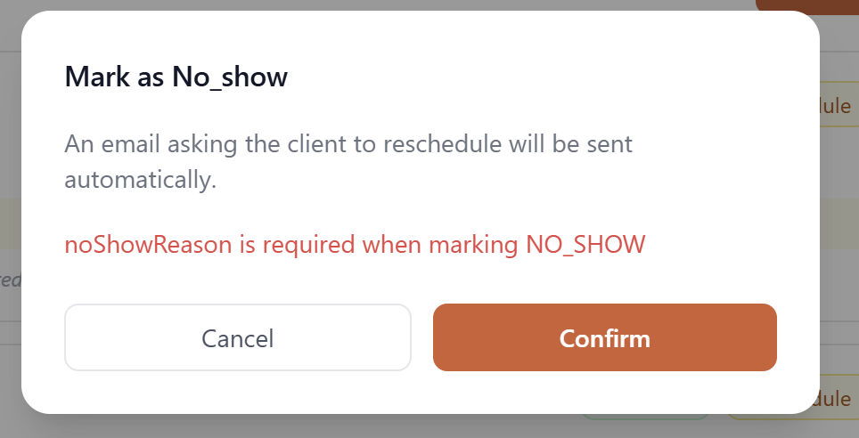
Designer Lead - Call logs
When rescheduled mark it as reschedule and create a new schedule meeting
When meeting is rescheduled - rescheduled date and time is not reflected just the reason is reflected - when the meeting is rescheduled multiple times that is also not reflected only last reschedule is reflected.
Couldnt mark no show cause reason tab is not present to fill

Slide 24
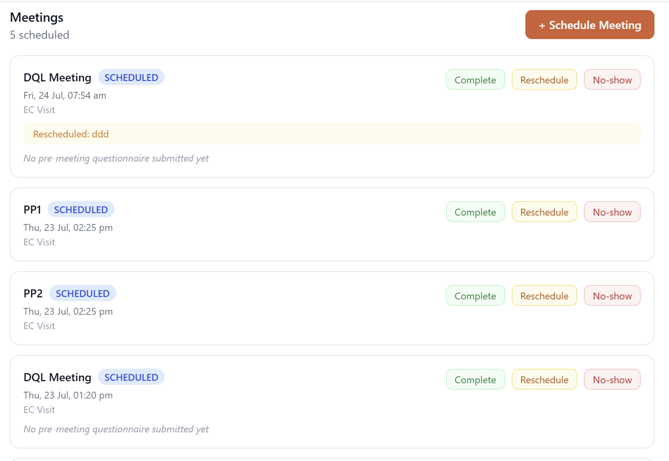
Similarly like how pp1 , pp2 is represented - dql 1 , dql 2 can also be reflected or ob 1 , ob 2 etc. .
Once the meeting is marked completed and files are uploaded and any other stage criteria is done auto pop up tab for stage moval approval - this is for any stage
Can move lead directly from dql to pp
Floor plan is mandatory to move to dql stage

Slide 25
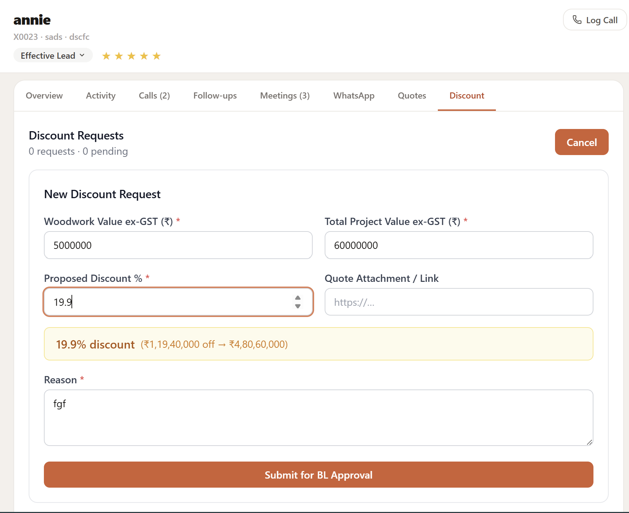
Designer Lead - Call logs
Post discount if the woodwork value comes below 5L - then its not applicable as special case request directed to Branch head
File attachment not link
With in 10 % self approval
15% - BL approval
20 % Business head approval
Above 20% - special approval from Branch head

Slide 26
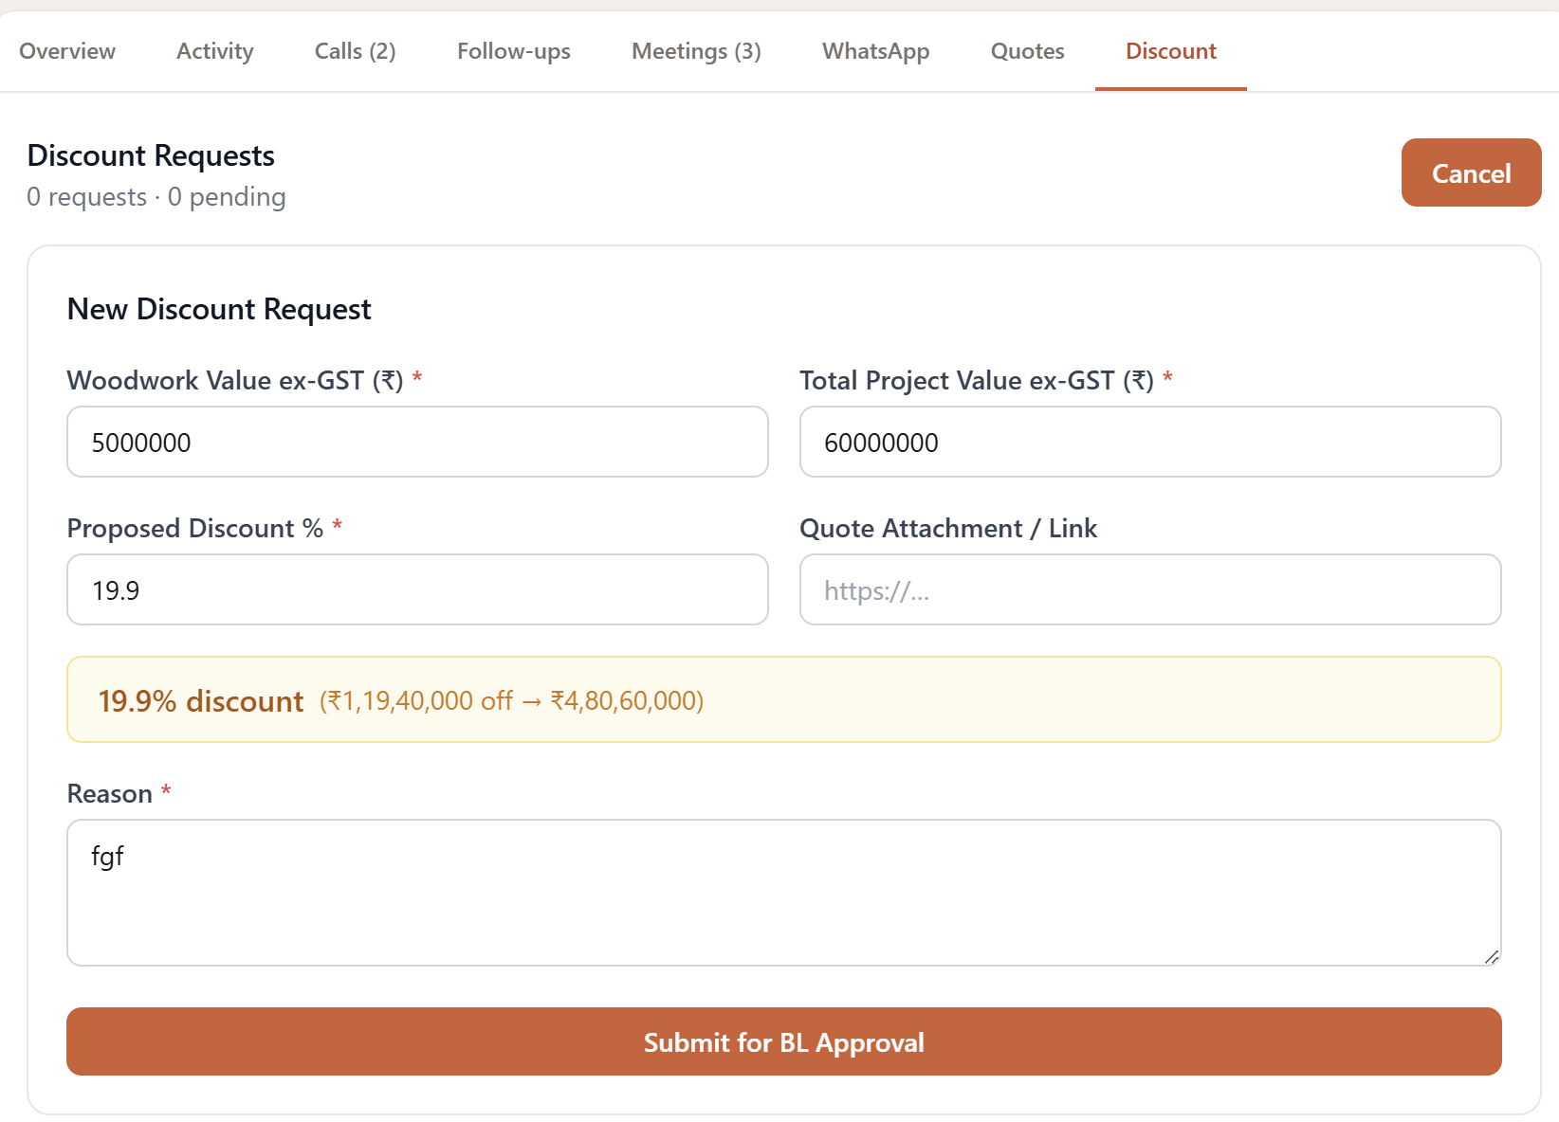
Designer Lead - Call logs
Files
File attached in each stage to be added under that stage folder.
Stage cant be moved if following files are not attached
EL and MQL - Either one should have a floor plan
DQL - life style capture sheet
PR - pitch presentation
Pp - quotation
Ob - generated quote
EL
MQL
DQL
PR
PP
OB

Slide 27
Any stage movement auto popup intend rating.
If the meetings are calls tried to be completed before the scheduled date and time reopen the time and date capture tab and ask them to record the proper time and date.
For each stage moval client and internal team will get a notification via mail crm and whatsapp
Intent rating CRE - EL stage
Ec visit - 5 star
Site visit - 4 star
Virtual - 3 star
Call back - 2 star
No action planned -1 star - if one star stage cant be moved.
Intent rating designer - DQL stage
Ec visit - 5 star
Site visit - 4 star
Virtual - 3 star
Call back - 2 star
No action planned -1 star - if one star stage cant be moved.
Intent rating designer - PR stage
Auto detect Intent is not applicable - only manual rating
Intent rating designer - pp stage
Ec visit - 5 star
Site visit - 4 star
Virtual - 3 star
Call back - 2 star
No response -1 star - if one star stage cant be moved.
Intent rating designer - pp stage - same as pp
Once MQL is marked completed - key facts tab to be opened - to be edited - handover date ,, est value - rest is all cant be edited.
Once PP is marked completed - key facts tab to be opened - mandatory to fill - expected cx budget - dex proposed budget - expected move in date - proposed move in date .

Slide 28
Admin portal track
Offers given or rolled out. Which we can add anytime . We should be able to activate or inactivate or onhold the offers. Offers that are not active should show in the drop down but should not be able to select.
Offer 1
Offer 2
Offer 3
N/A
Lead source - need a separate admin space where we can add the campaign details anytime
And we should also be able to activate or deactivate the campaign - but when we deactivate it data with that campaign shouldn't be lost.
Target tab for each role to be added in admin tab - month on month target changes so based on thet internal credits points for incentive to be auto calculated
Nps portal of each team member ( designer + project manager) to be shown
Cohort 1 - Manager (Average Nps) - team member (Average Nps) - each client (Average Nps) - stage nps rating.
Team member portal
TAT report for all the stages and when stage is moved backward
Number of meetings / calls taken per stage for each project
TAT for each stage is to be given - where to see total number of days projects was in and number of active days and onhold days - tat has to be calculated from project active days.

