Slide 1

Understanding and Implementing UDP Protocol in Computer Networks
BS Software Engineering - Computer Networks CCP Project

Slide 2
Introduction
The User Datagram Protocol (UDP) stands as a foundational component within the transport layer of computer networks. Unlike its more robust counterpart, TCP, UDP is designed for speed and efficiency, offering a minimalist approach to data transmission.
Core Transport Layer Protocol
Fast & Connectionless
UDP facilitates rapid, connectionless communication, making it indispensable for certain types of network interactions.
It excels in scenarios where low latency and high throughput are prioritized over guaranteed delivery, transmitting data over IP without establishing a dedicated session.
Real-time Applications
Project Focus
Its characteristics make it a go-to choice for real-time and time-sensitive applications where a slight data loss is acceptable if it means maintaining continuity and speed.
This project delves into a comprehensive understanding of UDP's mechanics and explores its practical implementation within various network contexts.

Slide 3


Objectives
Our exploration of the UDP protocol aims to clarify its role and functionality within the intricate landscape of computer networks. Through this project, we will cover several key objectives to provide a holistic understanding of UDP.
Define UDP
Clearly articulate the fundamental principles and operational characteristics of the User Datagram Protocol.
Compare with TCP
Highlight the crucial distinctions between UDP and TCP, elucidating why each protocol is suited for different networking requirements.
Discuss Pros & Cons
Analyze the inherent advantages and disadvantages of employing UDP in various networking scenarios.
Overview Implementation & Applications
Provide insights into how UDP is implemented in software and explore its diverse range of common applications in modern computing.

Slide 4
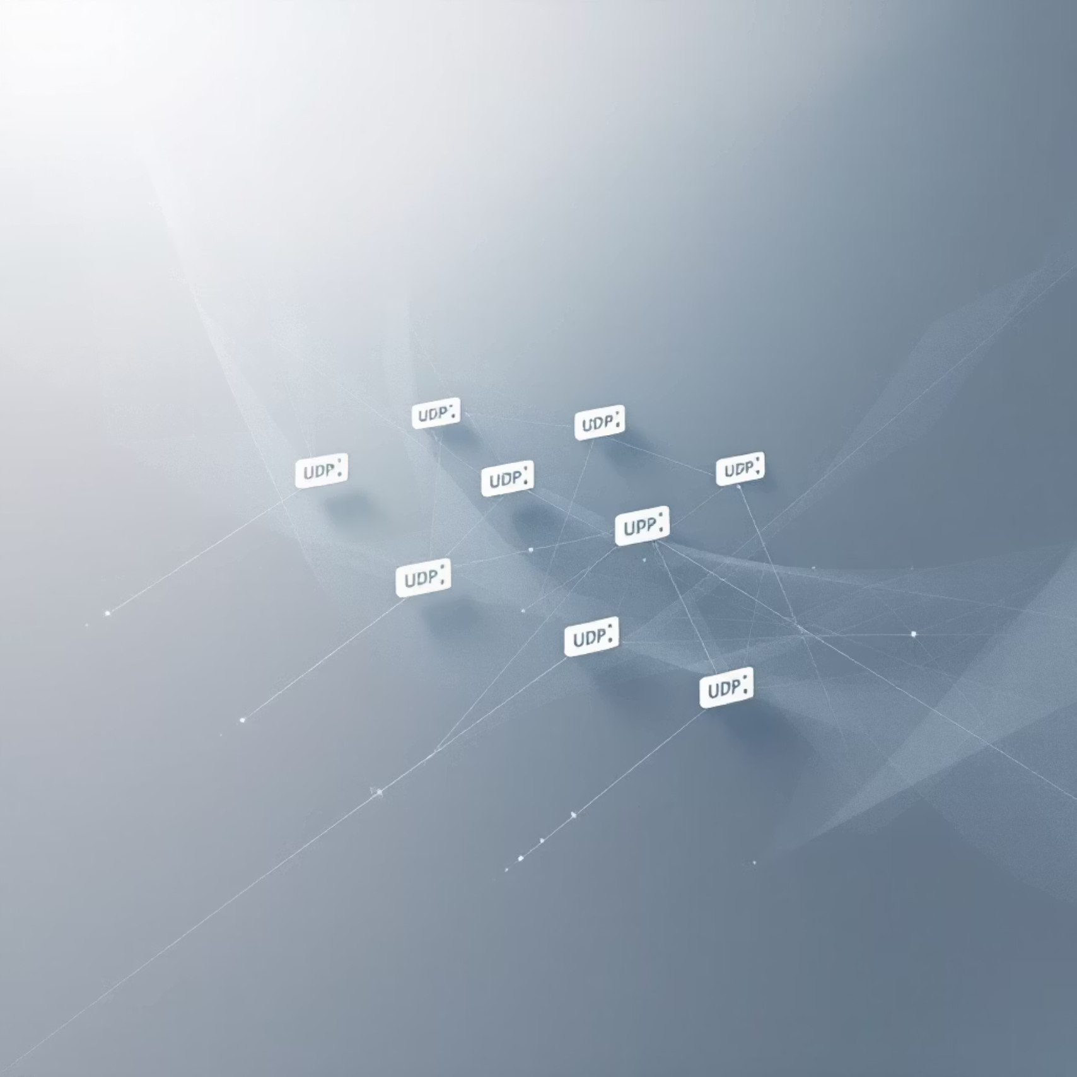
What is UDP?
The User Datagram Protocol (UDP) is a simple, lightweight, and connectionless transport layer protocol defined by RFC 768. It operates directly over the Internet Protocol (IP), providing a mechanism for sending individual units of data, known as datagrams, without prior connection establishment.
User Datagram Protocol: A minimal message-oriented transport layer protocol that provides a best-effort delivery service.
Lightweight & Connectionless: Unlike TCP, UDP does not require a handshake to establish a connection, making it faster but less reliable. This simplicity reduces overhead and latency.
Datagram Transmission: Data is sent in independent packets called datagrams. Each datagram is treated separately, without any guarantee of delivery, order, or duplication prevention.
Minimal Error Checking: UDP offers an optional checksum for basic error detection. If an error is detected, the datagram is usually discarded, but no retransmission is attempted by UDP itself.
No Guarantees: Critically, UDP does not guarantee that packets will arrive at their destination, arrive in the correct order, or arrive only once. Applications using UDP must handle these aspects if reliability is needed.

Slide 5
UDP vs TCP Comparison
Understanding the fundamental differences between UDP and TCP is crucial for designing efficient and effective network applications. While both are transport layer protocols, their operational philosophies cater to distinct communication needs.
Connection
Connectionless (no handshake)
Connection-oriented (three-way handshake)
Reliability
No guaranteed delivery or error recovery
Guaranteed delivery, error checking, retransmission
Ordering
Packets may arrive out of order
Maintains packet order
Speed
Faster due to minimal overhead and no retransmissions
Slower due to handshake, acknowledgments, and retransmissions
Congestion Control
None (can overwhelm networks)
Includes congestion control mechanisms
Use Cases
VoIP, streaming, gaming, DNS
Web browsing, email, file transfer
This comparison underscores that the choice between UDP and TCP depends entirely on the application's specific requirements regarding reliability, speed, and data integrity.

Slide 6
Advantages and Disadvantages of UDP
UDP's design, favoring speed over reliability, presents a unique set of benefits and drawbacks. Understanding these helps in determining its appropriate use.
Advantages
Disadvantages
Low Latency & Overhead
No Delivery or Order Guarantee
Its connectionless nature means no time is spent establishing or tearing down connections, resulting in very low communication latency and minimal protocol overhead. The header is only 8 bytes long.
Packets might be lost, duplicated, or arrive out of sequence, requiring the application layer to manage these issues if reliability is critical.
Lack of Congestion & Flow Control
Simple & Fast Processing
UDP transmits data without regard for network congestion, which can potentially flood the network and worsen performance for all users.
With fewer features to manage (like retransmissions or flow control), UDP packets can be processed very quickly by network devices.
Application-level Error Recovery
Multicast & Broadcast Support
Any necessary error detection and recovery mechanisms must be implemented at the application layer, adding complexity to software development.
UDP inherently supports sending data to multiple destinations simultaneously (multicast) or to all devices on a network (broadcast), which is not natively supported by TCP.
Vulnerability to DDoS Attacks
Ideal for Real-time Applications
UDP's stateless nature can be exploited in UDP flood Distributed Denial of Service (DDoS) attacks, where attackers send a large volume of UDP packets to overwhelm a target server.
Applications like Voice over IP (VoIP), video streaming, and online gaming can tolerate some packet loss for the sake of maintaining continuous, real-time flow.

Slide 7
UDP Implementation Overview and Applications
Implementing UDP involves creating sockets and sending/receiving datagrams, leveraging its simplicity for specific use cases. The protocol's minimal header ensures efficiency.
UDP Header Structure
Port Numbers for Demultiplexing
The UDP header is notably simple, comprising four fields, each 16 bits long (2 bytes):
Port numbers are crucial for directing incoming UDP datagrams to the correct application process running on a host, enabling multiple applications to share a single IP address.
Source Port: Identifies the sender's port number.
Destination Port: Identifies the receiver's port number, directing data to the correct application.
Length: Specifies the length of the UDP header and data in bytes.
Checksum: An optional field used for error detection over the header and data.
Common Applications
Socket Programming
UDP's characteristics make it ideal for various applications:
Developers implement UDP communication using datagram sockets, where data is sent and received as discrete packets without an established connection.
DNS Queries: Its speed makes it perfect for quick, single-request/response transactions like Domain Name System lookups.
VoIP and Video Streaming: These applications prioritize real-time flow; occasional packet loss is less disruptive than delays caused by retransmissions.
DHCP (Dynamic Host Configuration Protocol): Used for assigning IP addresses, relying on UDP for its stateless and quick request/reply nature.
Online Gaming: Low latency is paramount for responsive gameplay, where a lost packet is often less detrimental than a delayed one.

Slide 8
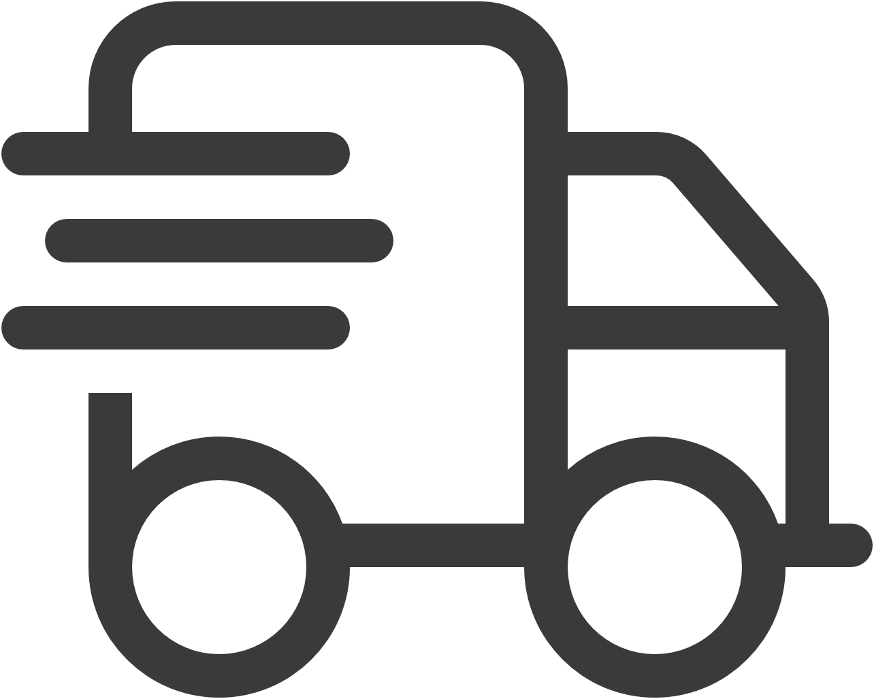

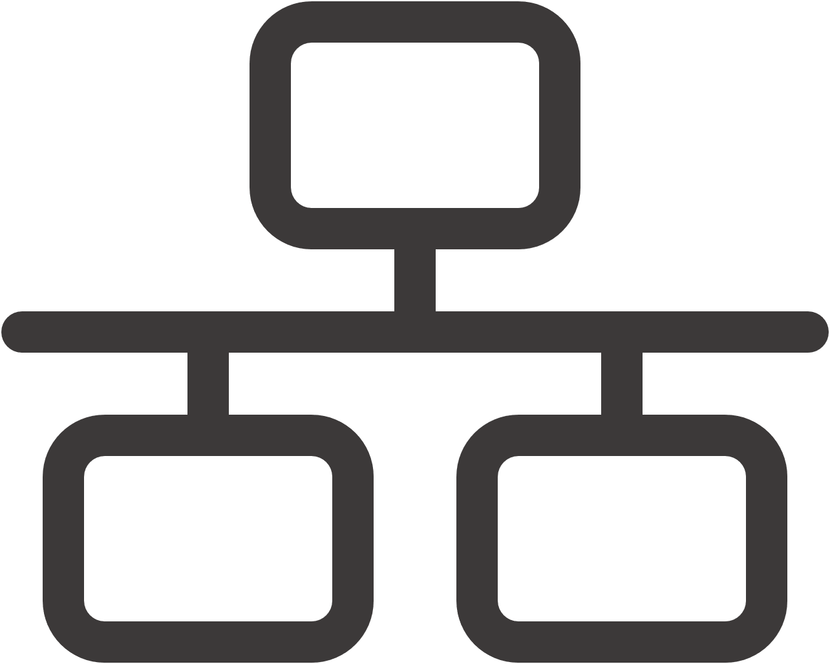


Conclusion
In summary, the User Datagram Protocol (UDP) offers a distinct and valuable approach to data transmission within computer networks. Its design prioritizes speed and efficiency, making it an indispensable choice for applications where the timely delivery of data outweighs the absolute guarantee of its arrival.
Simple & Fast
UDP is a minimalist transport protocol, delivering high speed due to its connectionless nature and minimal overhead.
Speed-Reliability Tradeoff
Its core utility lies in scenarios where a slight data loss is acceptable for maintaining real-time performance and low latency.
Designing Efficient Apps
A deep understanding of UDP is critical for architects building network applications that require specific performance characteristics.
Handling Data Loss
Developers must account for potential data loss and out-of-order delivery at the application layer when implementing UDP.
Essential for Modern Networks
UDP remains a vital component of network infrastructure, fulfilling specific communication needs that TCP cannot efficiently address.

