Slide 1
Angular

Slide 2
Ahead-of-Time(AOT) Compiler
An Angular application consists mainly of components and their HTML templates.
Because the components and templates provided by Angular cannot be understood by the browser directly, Angular applications require a compilation process before they can run in a browser.
The Angular ahead-of-time (AOT) compiler converts your Angular HTML and TypeScript code into efficient JavaScript code during the build phase before the browser downloads and runs that code.
Compiling your application during the build process provides a faster rendering in the browser.

Slide 3
Two ways to compile
Just-in-Time (JIT), which compiles your app in the browser at runtime. This was the default until Angular 8.
Ahead-of-Time (AOT), which compiles your app and libraries at build time. This is the default since Angular 9.
When you run the ng build (build only) or ng serve (build and serve locally) CLI commands, the type of compilation (JIT or AOT) depends on the value of the aot property in your build configuration specified in angular.json. By default, aot is set to true for new CLI apps.

Slide 4
Component Lifecycle
A component in Angular has a lifecycle, and Angular 8 offers us Hooks.
Hooks allow us to trigger actions by getting into the lifecycle of the components.
Angular creates it, renders it, creates and renders its children, checks it when its data-bound properties change and destroy it before removing it from the DOM.
There are eight different lifecycle hooks that a developer can tap into in any component or directive. To do so, a developer just needs to add one of the eight function calls that correspond to the lifecycle event. Add the hooks you need and leave out the ones you don’t.

Slide 5
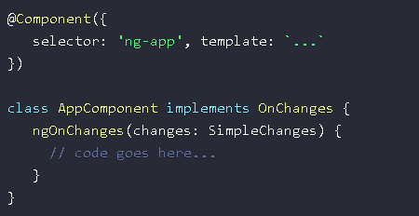
Component Lifecycle
Angular 8/9 Component Lifecycle Hooks Examples:
ngOnChanges: This lifecycle hook is called when any data-bound property of an angular directive changes. This method returns the SimpleChanges object, which holds the current and previous data properties. Make sure you limit the processing amount because it keeps on triggering all the time.

Slide 6
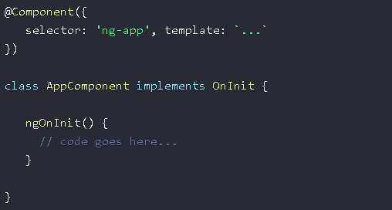
Component Lifecycle
Angular 8/9 Component Lifecycle Hooks Examples:
ngOnInit: This Angular 8/9 lifecycle hook is called at once at the time of component initialization.

Slide 7
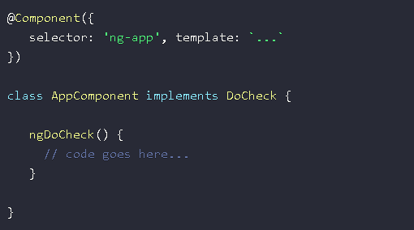
Component Lifecycle
Angular 8/9 Component Lifecycle Hooks Examples:
ngDoCheck: This lifecycle hook is used instead of a ngOnChanges hook, especially when Angular fails to recognize the changes.

Slide 8
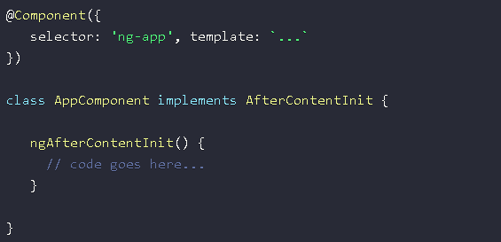
Component Lifecycle
Angular 8/9 Component Lifecycle Hooks Examples:
ngAfterContentInit: An Angular’s callback function, it is initialized right after the Angular finishes the initialization of all content in a directive. And it is called once only when the directive is called.

Slide 9
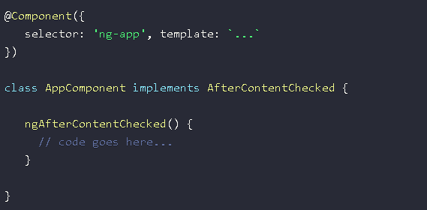
Component Lifecycle
Angular 8/9 Component Lifecycle Hooks Examples:
ngAfterContentChecked: This lifecycle method is called right after the directive content is checked.

Slide 10
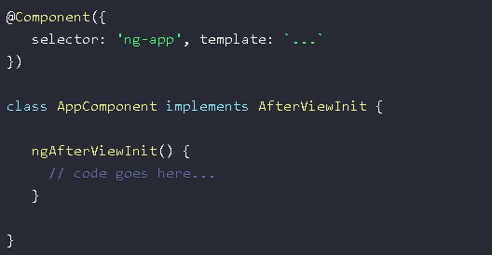
Component Lifecycle
Angular 8/9 Component Lifecycle Hooks Examples:
ngAfterViewInit: This lifecycle method is triggered right after the component’s view is instantiated.

Slide 11
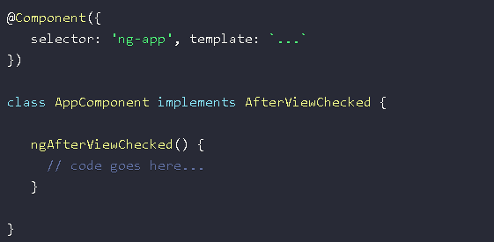
Component Lifecycle
Angular 8/9 Component Lifecycle Hooks Examples:
ngAfterViewChecked: This lifecycle method is called right after the component’s content is checked.

Slide 12
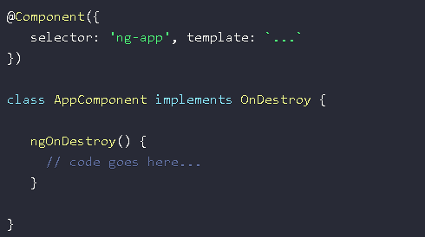
Component Lifecycle
Angular 8/9 Component Lifecycle Hooks Examples:
ngOnDestroy: A significant lifecycle hook, it protects memory leak in Angular. It triggers when the component is destroyed.

