Slide 1
Angular Interceptors

Slide 2
Interceptors
The Angular Interceptor helps us to modify the HTTP Request by intercepting it before the Request is sent to the back end.
It can also modify the incoming Response from the back end.
The Interceptor globally catches every outgoing and in coming request at a single place.
Apps often use an interceptor to set default headers on outgoing requests.

Slide 3
HTTP - Intercept requests and responses
With interception, you declare interceptors that inspect and transform HTTP requests from your application to a server.
The same interceptors can also inspect and transform a server's responses on their way back to the application.
Multiple interceptors form a forward-and-backward chain of request/response handlers.
To implement an interceptor, declare a class that implements the intercept() method of the HttpInterceptor interface.

Slide 4
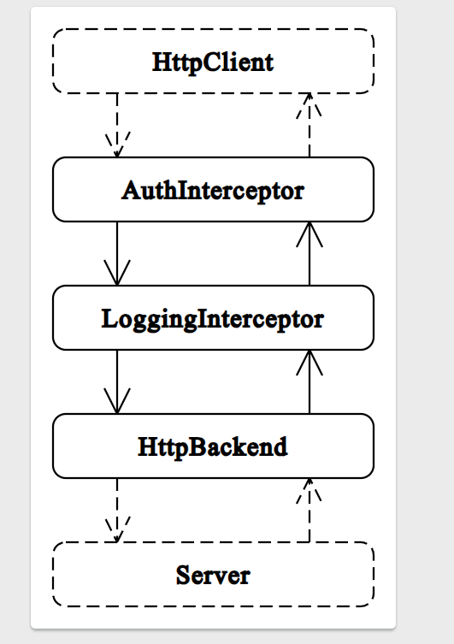
Interceptor order
Angular applies interceptors in the order that you provide them.

Slide 5
Use interceptors to request multiple values
The HttpClient.get() method normally returns an observable that emits a single value, either the data or an error.
An interceptor can change this to an observable that emits multiple values.

Slide 6
AuthGuard Authentication
Auth guard is an angular route guard that is used to stop unauthenticated or unauthorized users from accessing the protected routes.
It is implemented using the “CanActivate” interface, which allows the guard to decide if a way can be activated with the “CanActivate()” method.
We will implement the CanActivate Interface from @angular/router which will decide if a route can be activated. To fulfill our requirements we will need two types of guards:
AuthenticationGuard -> check if the user is authenticated and allow him to access Home
RoleGuard -> check if the user has permission to access User or Admin Dashboard.

Slide 7
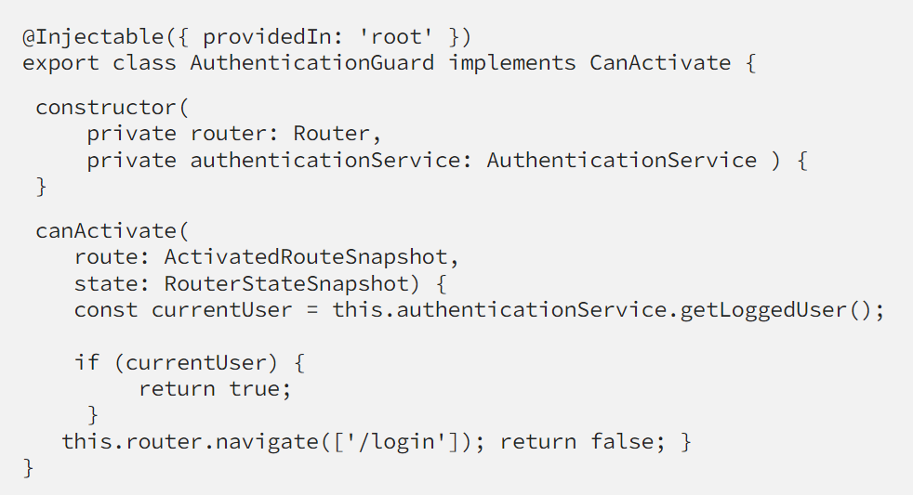
Authentication Guard
This Guard will do a simple check if the user is authenticated which means we have locally stored a token for this user. The implementation is as below.

Slide 8
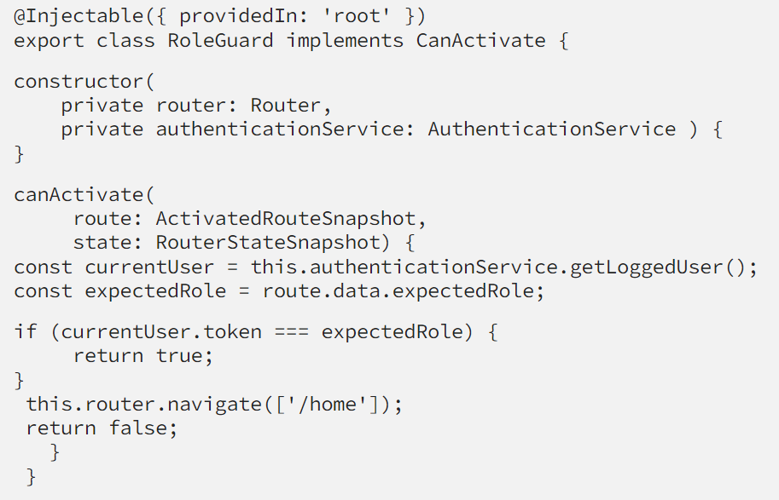
Role Guard
The back end saves the role in the token. Which means the value of our token will be either user or admin.This will be the implementation of our RoleGuard.

Slide 9
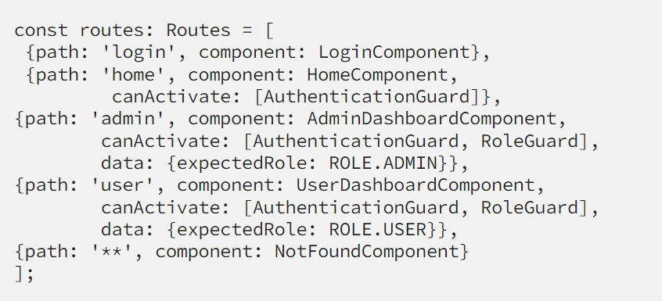
After implementing the permission guard in order to make this work we need to set up routes for the component and specify the guards that will protect them in app-routing.module:

