Slide 1
JS Closures

Slide 2
Closures in JavaScript allow us to access outer function scope from inner function even after the outer function has executed and returned. This means that the inner function will always have access to the outer function variable.
JavaScript variables can belong to the local or global scope.
Global variables can be made local (private) with closures.

Slide 3
Scoping with let and const
Traditionally (before ES6), JavaScript only had two kinds of scopes:
function scope and global scope.
Variables declared with var are either function-scoped or global-scoped, depending on whether they are declared within a function or outside a function.
This can be tricky, because blocks with curly braces do not create scopes:

Slide 4
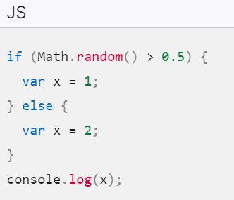
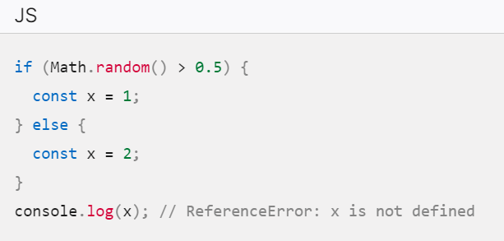
For people from other languages (e.g. C, Java) where blocks create scopes, the above code should throw an error on the console.log line, because we are outside the scope of x in either block.
However, because blocks don't create scopes for var, the var statements here actually create a global variable.
In ES6, JavaScript introduced the let and const declarations, which, allow you to create block-scoped variables.
Blocks are finally treated as scopes in ES6, but only if you declare variables with let or const

Slide 5
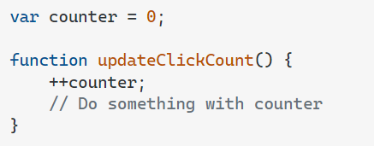
Count the number of times user clicked a button
1. You could use a global variable, and a function to increase the counter:
But, the pitfall is that any script on the page can change the counter, without calling updateClickCount().

Slide 6
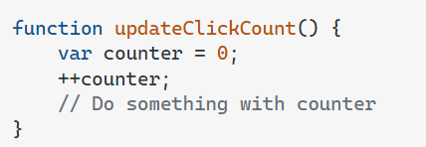
Count the number of times user clicked a button
2. Declaring the variable inside the function:
But, every time updateClickCount() function is called, the counter is set to 1 again.

Slide 7
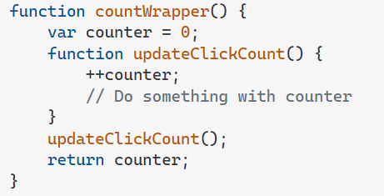
Count the number of times user clicked a button
3. Nested functions have access to the scope "above" them.
This could have solved the counter dilemma, if you could reach the updateClickCount() function from the outside and you also need to find a way to execute counter = 0 only once not everytime.

Slide 8
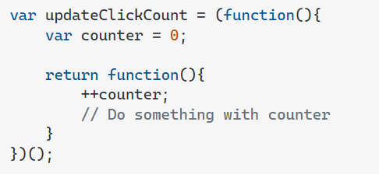
Count the number of times user clicked a button
3. Closure to the rescue! (self-invoking function):.
The self-invoking function only runs once. It sets the counter to zero (0), and returns a function expression.

